Slide 1
Netflix Dashboard

Slide 2
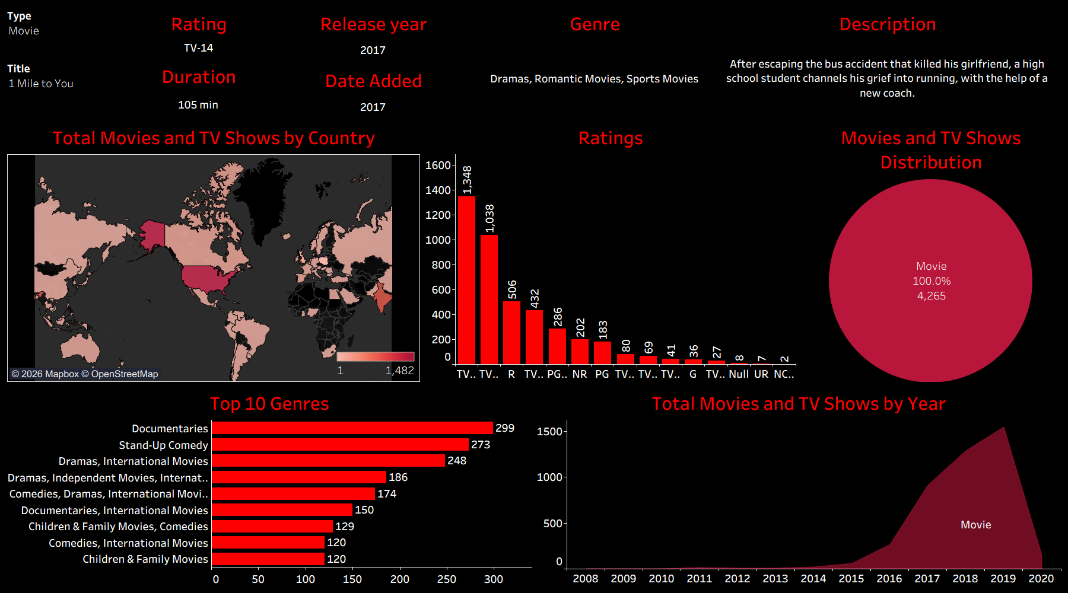

Slide 3
