Slide 1


GoChat
WEB APPLICATION BY:
Arpit Barjati
Dilpreet Kaur
Harleen Kaur
Harsimran Singh
Price Goyal

Slide 2

WHAT ARE WE BUILDING?
Before we get started, let's take a quick look at what we are building today.
This is a simple and powerful chat application that anyone can use to communicate via text messages. It's like a Discord server or a single-channel Slack room.
To join a chat and interact with other users, users must log in with their Google account.

Slide 3
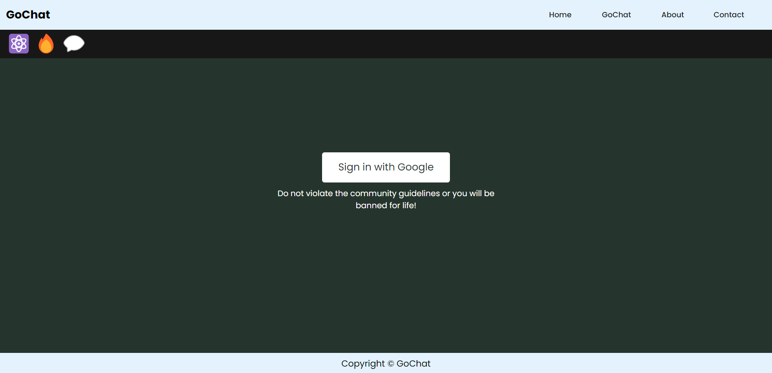

Once logged in, the user can read the previous messages from the chat and start chatting by sending messages.

Slide 4


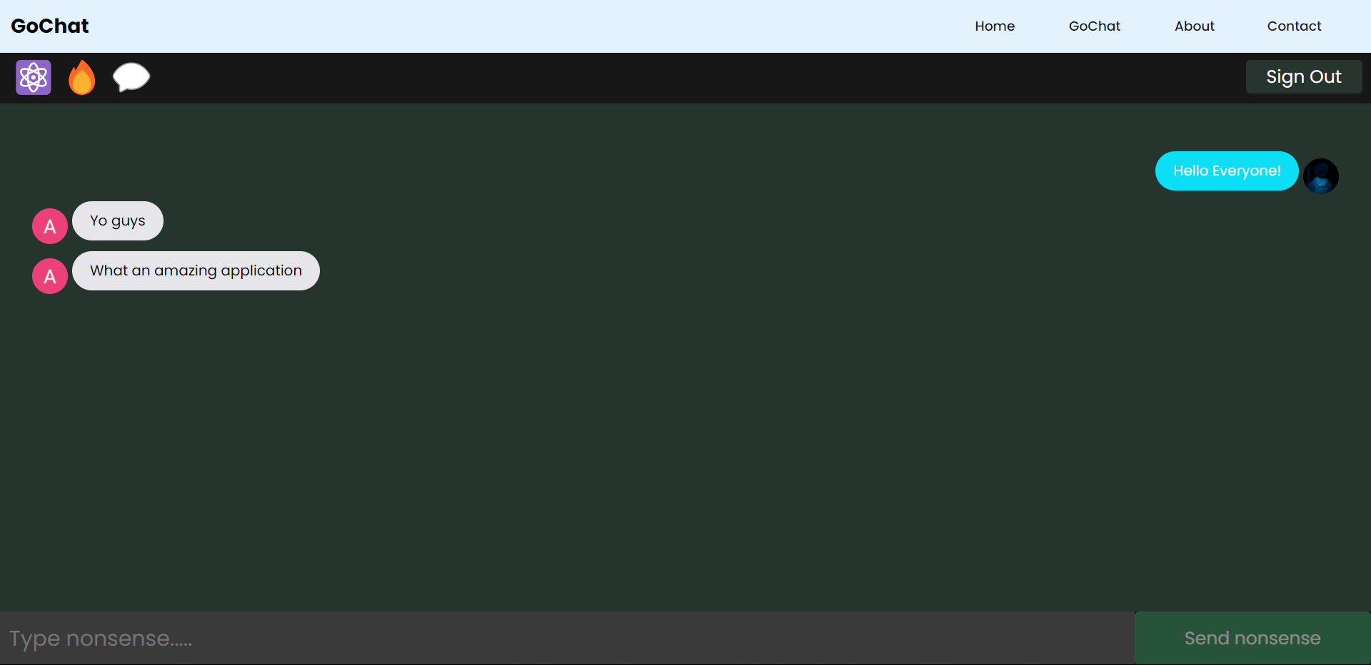
All messages are stored in a Firestore database and are sync in real-time with our React application.

Slide 5

CREATE A FIREBASE PROJECT
First of all, we'll need to create a new React application. For that, we are going to use the create-react-app tool to set up our application with just one command line.
Once it's done, we can install the dependency to work with Firebase, which is the Firebase JS SDK.
Then we create component GoChat, import the Firebase SDK along with Firestore for our database and firebase auth for user authentication.

Slide 6
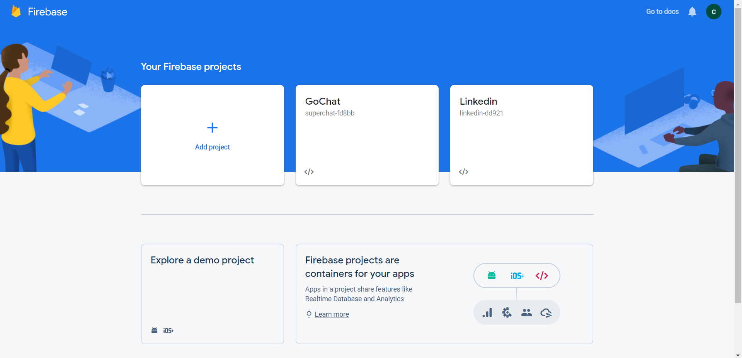
Create a Firebase project

Slide 7
CREATE A FIREBASE PROJECT
To allow users to sign in using their Google account, we need to enable the Google sign-in method from the authentication page for our project.
And to use Firestore as our database for storing messages, we need to enable it from the Cloud Firestore page.
Finally, the last thing we need to do is to add a new web app to our Firebase project. Once you are done, you should get a JavaScript object representing the configuration of the Firebase project application you just created.

Slide 8
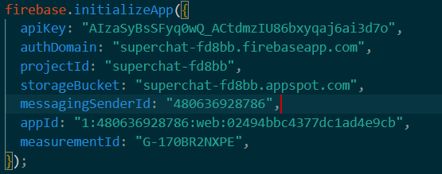
CREATE A FIREBASE PROJECT
So go ahead and copy this configuration object and paste it into the initializeApp in your source code.
Alright! Now we should have everything we need to build our chat application. We created the React application, the Firebase project, and linked the two together.
So, let's build the views of our application.

Slide 9
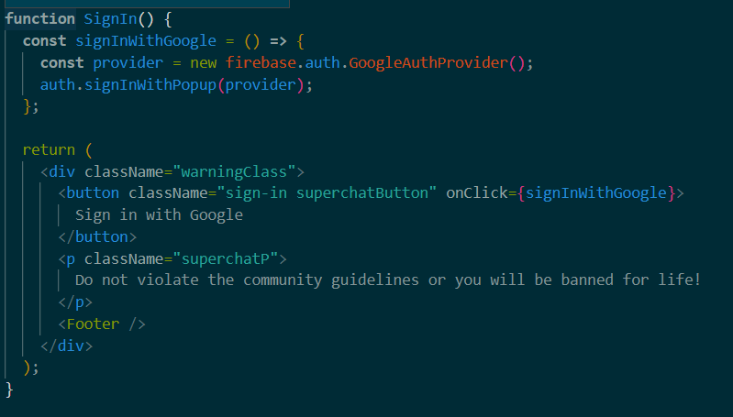
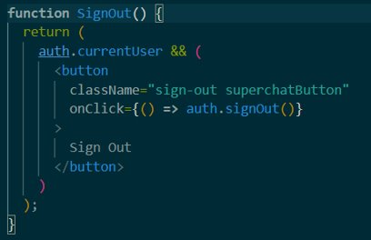
SIGNING IN AND OUT OF THE APP The shown functions allow a user to Sign in with Google and Sign out.

Slide 10
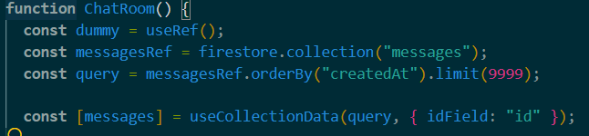
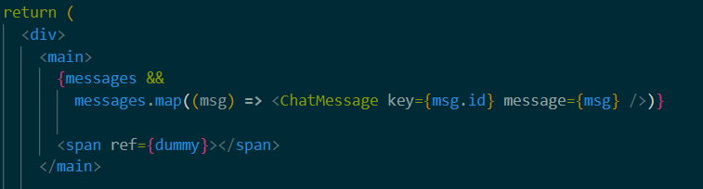
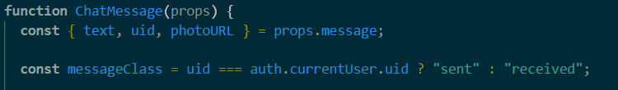
READ CHAT MESSAGES Make a query to the database, then listen to the data in realtime with the useCollectionData hook.

Slide 11
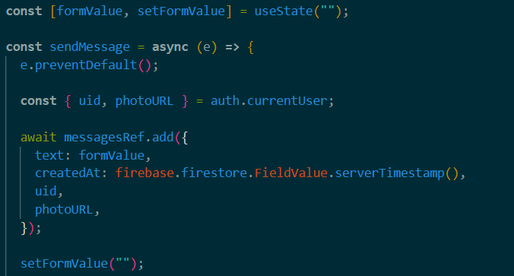
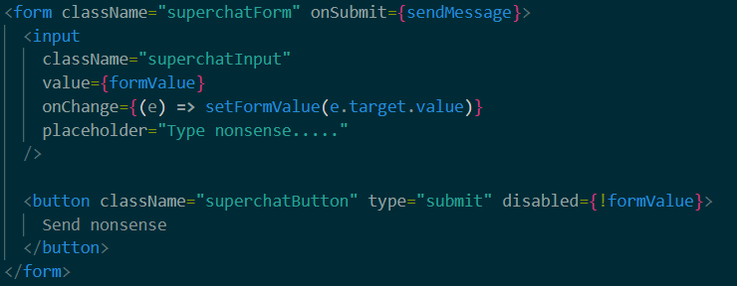

CREATE MESSAGES
Use a form to collect the user’s message, then submit it to firestore to perform a write to the database.

Slide 12

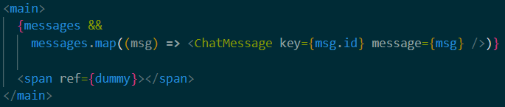
AUTO SCROLL In order to see the latest messages, the messages feed should auto-scroll to the bottom of the chat feed on each message. This can be handled when the user sends a message.

Slide 13
SECURITY When creating a message, the following security rules ensure that a user :-
Is Signed in
Is creating a document with a UID that matches their own.
Is using less than 255 text characters.
Is not trying to modify the timestamp.

Slide 14

CONCLUSION
From that all we achieved, we managed to make a web chat application, in which we used react as frontend and firebase as backend.
Thank you for your patience, we hope that you like our idea.
We welcome areas of improvements.

