Slide 1

Team Details
Team name: B3
Team leader name: Arsh Chand
Problem statement: Providing Farmers with Expert Help on Demand

Slide 2
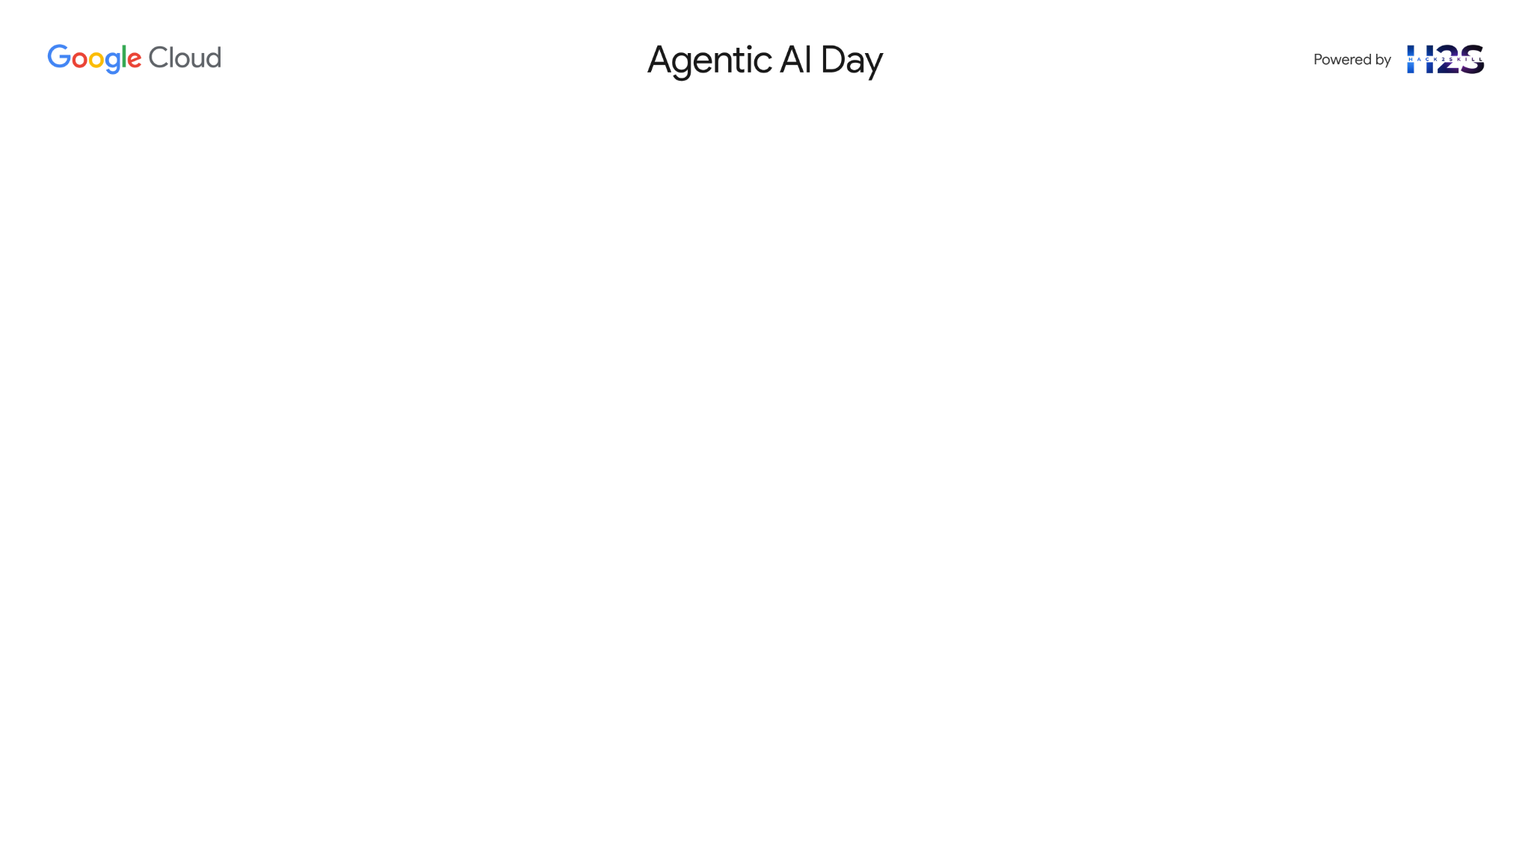
Project Kisan : Brief about the idea
Small-scale farmers in Karnataka face many challenges every day, from crop diseases and changing weather to unfair market prices. Project Kisan is an easy-to-use AI assistant on a mobile phone that helps them solve these problems. The most important part is how the farmer interacts with it. They don't need to type or read complex screens; they can simply talk to the assistant. We have put a special focus on providing a perfect Kannada experience to make it the most helpful tool for farmers in Karnataka. At the same time, the assistant is also built to understand both Hindi and English, making the platform powerful and ready to help farmers in other regions as well. The assistant provides four critical services with equal importance.
First, if a farmer sees a problem on a plant, they can just take a picture. The voice assistant then uses AI to analyze the photo, immediately tells them the exact name of the disease or pest, and clearly explains what affordable, local medicines they can use to save their crop.
Second, before selling their produce, they can ask the assistant, "What is the price of tomatoes today?" It will instantly reply with the live buying rates from their nearest mandi, also mentioning if the price is higher or lower than last week, so they have the power to negotiate and sell at the most profitable time.
Third, the assistant acts as a 24/7 lookout, constantly monitoring local weather forecasts. It will send proactive pop-up alerts directly to the farmer's phone for specific risks like hailstorms, heatwaves, or sudden heavy rains, giving them crucial hours to take protective measures and prevent devastating losses.
Finally, the assistant helps them navigate the often-confusing world of government support. A farmer can simply ask about getting a government subsidy for buying seeds or installing a new pump, and the assistant will explain the relevant schemes, what documents are needed, and how to apply, unlocking financial support they are entitled to.
By bringing all these capabilities together through a simple voice conversation, Project Kisan gives the farmer more control, helps them save their crops, earn more money, and take full advantage of available government programs.

Slide 3
Opportunities
How different is it from any of the other existing ideas?
How will it be able to solve the problem?
USP of the proposed solution

Slide 4
List of features offered by the solution

Slide 5
Process flow diagram or use-case diagram

Slide 6
Technologies to be used in the solution

Slide 7
Architecture diagram of the proposed solution

Slide 8
Wireframes/Mock diagrams of the proposed solution (optional)

Slide 10


