Slide 1

Pramaan
Tamper-proof prescription verifier
Pramaan (प्रमाण) means proof. A doctor signs; a pharmacist checks; the log cannot be quietly rewritten.
AI 331 Information Security and Cryptography · SVNIT Surat · October 2026
Notes:
Opening. Pramaan means proof. One sentence of the project: a prescription that carries proof of who issued it and that it was never altered.

Slide 2




Paper prescriptions are easy to abuse
Edited
A dose or a quantity is changed with a pen or an image editor.
The pharmacist cannot tell, and has seconds to decide.
Forged
A fake prescription with a real doctor’s name and registration number.
Stolen
A photo of a genuine prescription is redeemed by someone else.
Pramaan gives them a verdict and the evidence behind it.
Reused
One prescription is filled again and again at different pharmacies.
Notes:
Four ways paper prescriptions fail: edited, forged, stolen, reused. The pharmacist has seconds and no way to check.

Slide 3



Three layers for three adversaries
What you see is what the doctor signed. Everything else follows from that.
The forger
The abuser
The unusual user
Changes what is printed
Replays, over-prescribes
Odd behaviour, valid login
Signature over the exact content, plus a field-by-field comparison of the page with the signed record
One-time dispensing, patient PIN, rate limits, alerts, tamper-evident log
Drug and dose rules plus an anomaly model of each doctor’s habits
Notes:
Three adversaries, three layers. A fourth, the insider with database access, is covered by encryption, signatures and the chained log.

Slide 4
One process, no extra services
FastAPI
Browser
SQLite
Security headers · CSP · rate limits · role checks
React app
Doctor · Patient
Pharmacist · Admin
Auditor
Camera, upload
users, keys, encrypted records, audit log
Services
AI module
accounts · keys
prescriptions
verification
drug rules · anomaly
render-and-diff · OCR
storage/
encrypted PDFs and audit anchors
Crypto core
Secrets
ECDSA P-256 · AES-256-GCM · canonical JSON · PIN · HMAC-chained audit log
.env, signing key, signed model file
Verification path: QR or upload → decrypt → hash → signature → record cross-check → page comparison → state → risk
Notes:
Single FastAPI process serving the React app on one origin: simpler cookies, CSRF and CSP. State is SQLite plus an encrypted storage folder.

Slide 5



Cryptography: sign what is printed
Sign the exact content
Encrypt at rest
Protect the keys
Canonical JSON, then SHA-256, then ECDSA P-256
The PDF is drawn from the same signed data
QR carries id, key, hash and 64-byte signature
One AES-256-GCM key per prescription
Wrapped by a master key; rotation re-wraps, files stay put
Payload and PDF cannot be swapped between prescriptions
Doctor’s private key sealed by their own password
Lockout after 5 wrong passwords
Revoking a key stops its unused prescriptions
Notes:
WYSIWYS: what you see is what you sign. Domain-separated signatures, strict base64url, no floats in canonical JSON. Envelope encryption so master key rotation never rewrites files.

Slide 6






Security around the cryptography
Roles from the database
Activation, not signup
Role checked on every request; a test fails if a route is unclassified
Doctors exist only through an admin and a one-time code
Replay protection
Patient PIN
One atomic update, plus a unique (prescription, fill) constraint
A six-digit code in the patient’s account; three wrong tries lock it
Rate limits and alerts
Tamper-evident log
Per IP, account and user; eight alert rules, shown to admins
HMAC chain, signed checkpoints and anchors outside the database
Notes:
Authorization: object-level 404, role matrix. Replay: atomic dispense. Consent: PIN. Accountability: audit chain with checkpoints anchored externally.

Slide 7
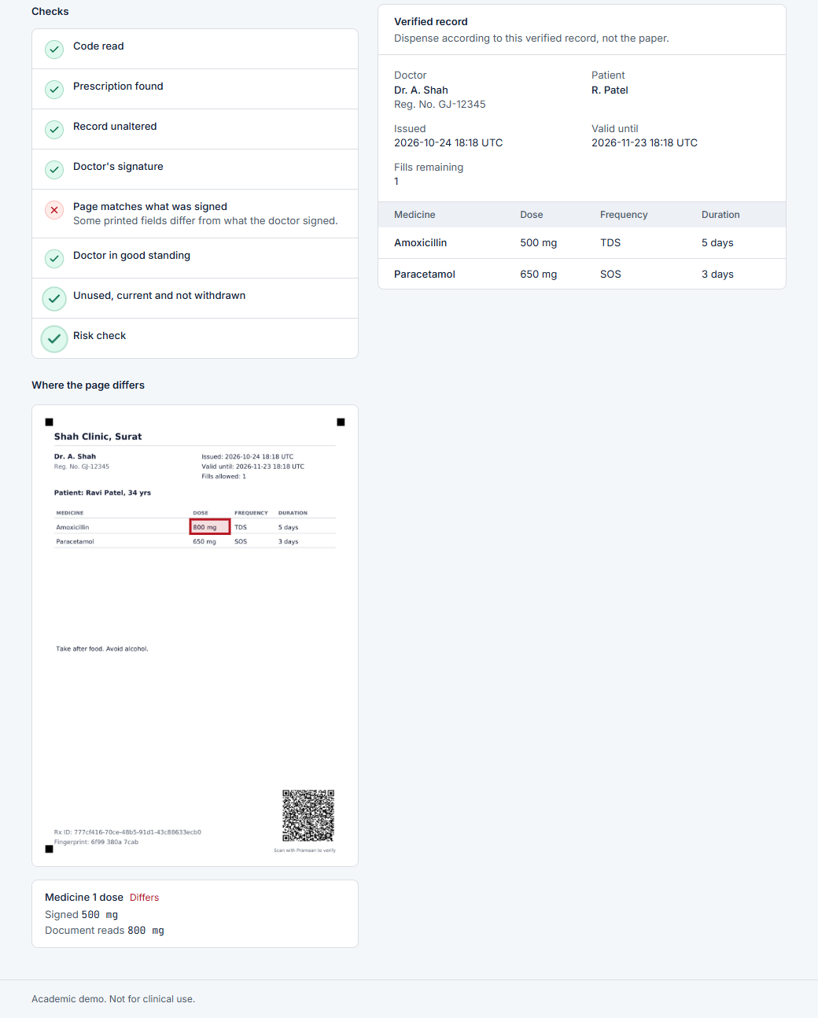
AI I: find exactly which field was edited
Redraw the page that should exist from the signed data.
Straighten the photo onto it (QR plus three corner marks).
Compare field by field; read any difference with OCR.
Blank rows must stay blank; a PDF’s hidden text must match.
Cannot tell? Say “review”, never accuse.
29 of 29
8 of 8
0 of 87
edited digital files caught
edited photos caught
genuine photos wrongly accused
Photographs are simulated. Real photos will give more “review” results.
Notes:
Screenshot is the real UI: the dose cell is outlined and the callout reads Signed 500 mg / Document reads 800 mg. Numbers from docs/evaluation.md: 58 generated files plus a 75-photo stress run (12 + 75 = 87 genuine photos, none accused). Photos are simulated, not real captures.

Slide 8
AI II: rules and learned habits
Drug and dose rules catch the obvious: a fake drug, an absurd dose.
Isolation Forest scores how unusual a prescription is for that doctor.
ROC-AUC 0.88 on unseen types; 10% false alarms in the review band.
All data is synthetic. This shows the method, not real accuracy.
First three: tuning set. Last three: never seen during tuning.
Notes:
Be upfront: a one-class SVM and LOF score about 0.03 AUC higher than the forest on this data; the forest was kept for the spec and for its explanations. The model never blocks issuing: the doctor can override with a reason. Review band means risk of 40 or more; the review threshold is 60.

Slide 9
One decision flow, in a fixed order
1
2
3
4
5
6
7
Read the QR
Find the record
Check hash and signature
Cross-check the record
Compare the page
State and expiry
Risk
Verdict, strongest first
TAMPERED
Any integrity check fails
SUSPICIOUS
Authentic, but unusual
REVOKED
Doctor, key or prescription withdrawn
REVIEW REQUIRED
Authentic, page not readable
ALREADY USED
Every fill has been dispensed
VERIFIED
All checks pass
EXPIRED
Past the doctor’s validity date
Verifying never uses up a fill. Only dispensing does, with the patient’s PIN.
Notes:
Precedence: tampered over revoked over already used over expired over suspicious over review required over valid. Uploads add step 5; QR-only checks skip it.

Slide 10
16 attacks, 16 stopped
# | Attack | Stopped by
1 | Flip a bit of the stored payload | AES-GCM tag, hash
2 | Extend expiry in the database | Cross-check with signed data
3 | Change one dose digit in an image | Render-and-diff, OCR
4 | White-box overlay on a PDF | Text layer vs page
5 | Add an extra medicine line | Blank rows stay blank
6 | Forge one QR signature character | ECDSA verification
7 | Paste another prescription’s QR | Page vs its own record
8 | Replay at a second pharmacy | Atomic dispense, alert
# | Attack | Stopped by
9 | Double dispense, 20 threads | Conditional update, unique key
10 | Redeem a photo without the PIN | PIN with three-try lock
11 | Brute-force a login | Rate limit, lockout
12 | Brute-force the signing password | Key lockout, alert
13 | Reuse a token after logout | Token version, DB role
14 | Pharmacist calls doctor APIs | Role matrix
15 | Edit, recompute, truncate the log | HMAC chain, checkpoints
16 | Swap the anomaly model file | Signature before load
Run any time: python scripts/attack_suite.py. Each attack is also an automated test.
Notes:
Results are in docs/attack_suite.md. STRIDE table is in docs/threat_model.md. The suite attacks a freshly seeded instance with throwaway accounts so the demo data is untouched.

Slide 11
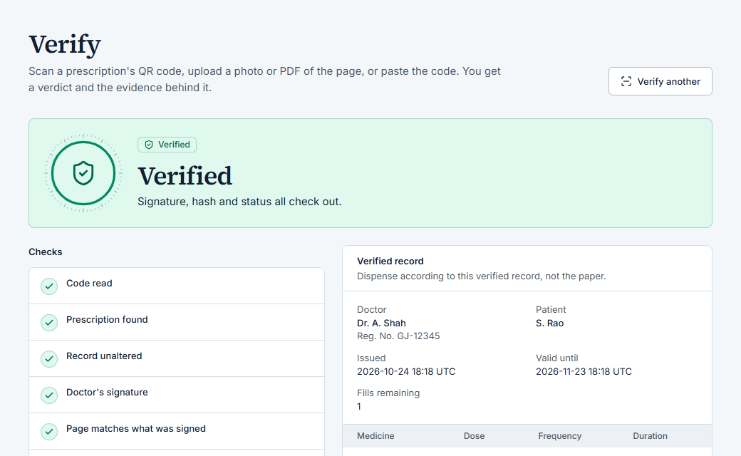
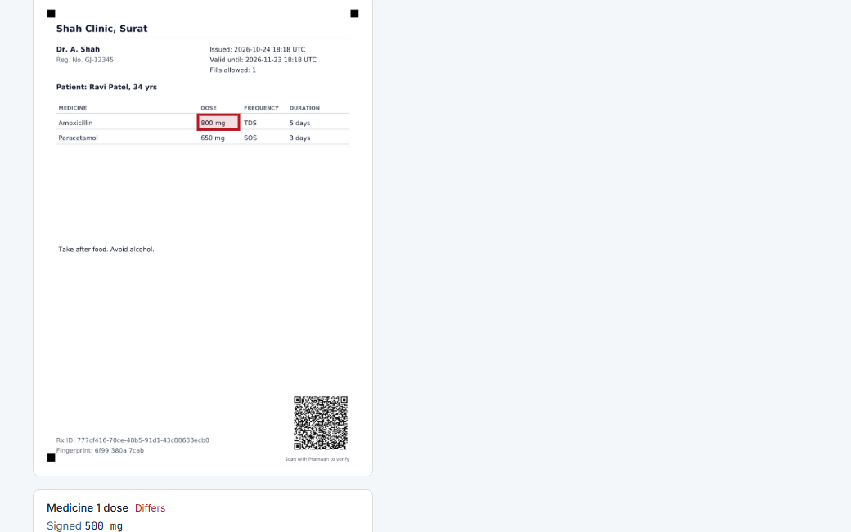
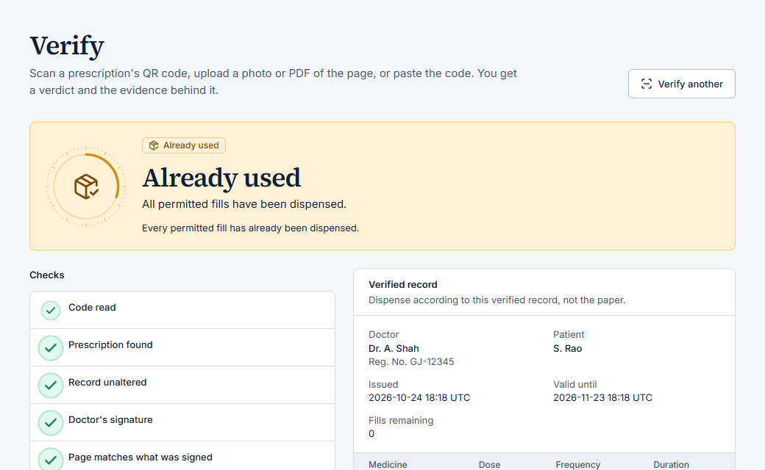
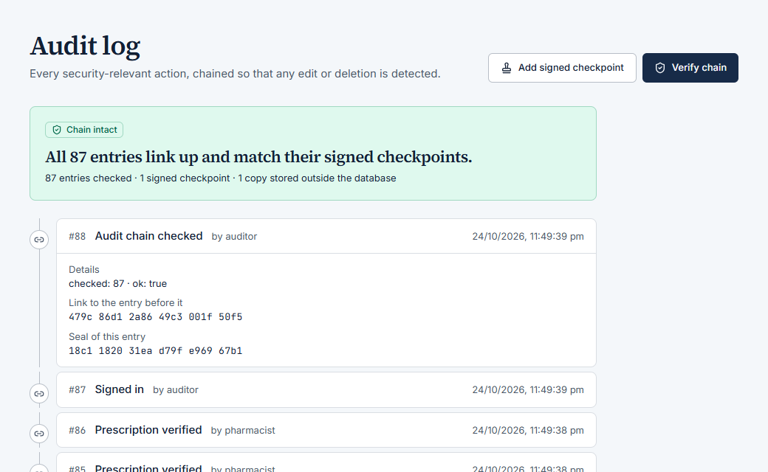
Live demo
1 Genuine: verified, then dispensed with the PIN
2 Edited image: the changed field is outlined
3 Replay at a second pharmacy: already used
4 Auditor verifies the audit chain
Notes:
Run the demo from the README: seed, start, then the eight steps. Backup video covers the same path.

Slide 12
What this does not do
Custodial signing
The server unseals a doctor’s key while signing. A compromised server plus a phished password could forge.
Photos depend on photos
Poor photos give “review”, not a verdict. Our test photos are simulated.
Synthetic AI data
No real prescribing data exists here. The anomaly numbers show the method only.
Demo infrastructure
No TLS, no hardware security module, single SQLite writer, in-memory rate limits.
Not clinical
Drug and dose tables are small demo sets. Regulations cited are illustrative.
Next: client-side signing, an HSM, TLS, real photo trials, a multi-worker rate-limit store
Notes:
Stated honestly in docs/threat_model.md and docs/assumptions.md.

Slide 13
Questions we expect
Why not a blockchain?
There is no multi-party trust problem. A keyed hash chain with signed, externally stored checkpoints gives the same tamper evidence with far less machinery.
Why ECDSA P-256?
Short 64-byte signatures keep the QR scannable; it is a widely supported standard and fast.
Why sign on the server?
Doctors need no hardware or key management. It is custodial, so we say so, protect keys with the doctor’s password and list client-side signing as future work.
Team: crypto · backend and security · AI · frontend and integration
Code, tests, results and the live demo: github.com/Arshad-13/Pramaan
Notes:
Add each member’s name next to the area they owned: crypto, backend and security, AI, frontend and integration.

