Slide 1
Vizcraft hackathon
Team rookies:
1.Roshan (rxr210122). 2.Afsaruddin (axm210415).
3.Sucharitha (sxb210138). 4Gopika (kxg210060)

Slide 2
Agenda
Our Problem Statement.
Trends in Data.
Envisioning the problem as a Predictive Model.
Evaluation of Models.
Enhancing Insights.

Slide 3
Our Problem Statement
We are trying to predict the success of a call using the available features .
The features being :
* DAY OF WEEK: string
* MEMBER_AGE: integer
* MEMBER_GENDER: string
* LOB: string
* MEMBER_LANGUAGE: string
* Time_Category: string
* STATE SOLD: string

Slide 4
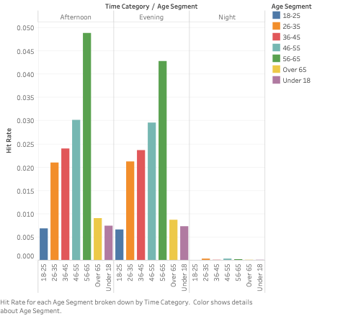
Trends in Data. DATVIZ1
Analysis Based on Age and Time Segments:
Nighttime Hit Rate: Hit rate is low at night, recommending avoidance of calls during nighttime hours.
Optimal Calling Time: Afternoon identified as the best time to call.
Age Group Responsiveness: Age group 56-65 most responsive during the afternoon, making it the most effective time segment for outreach.

Slide 5
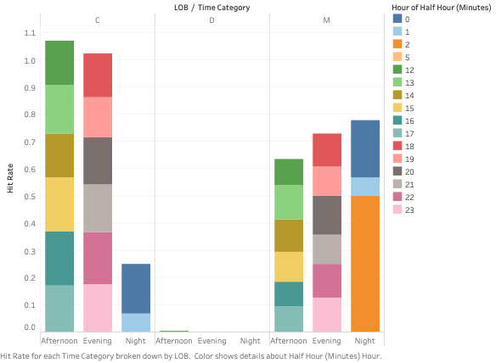
Trends in Data. DATVIZ2
Optimal Calling Time by Line of Business (LOB):
LOB C:Best time: Afternoon
LOB M:Best time: Night
LOB D: Low hit rate

Slide 6
Envisioning the problem as a Predictive Model.
After cleaning up the data, we tried to identify the KPI from the log data which can tell if it is a successful call or an unsuccessful call.
After identifying those KPI’s we posed it as a classification problem , where we try to predict the output class based on the features selected.

Slide 7
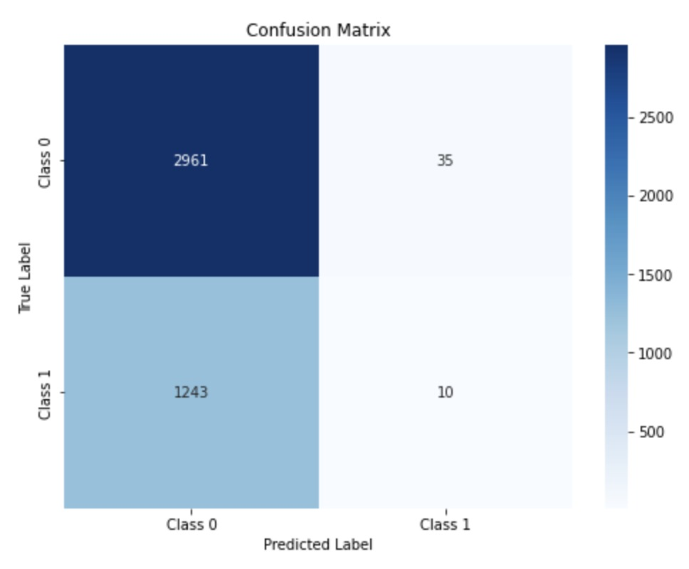
Evaluation of Models.
Classifiers employed:
Logistic Regression Classifier
Random Forest Classifier
GBT classifier
Decision Tree Classifier.
GBT classifier turned out to be the best performing model (metric used = F1 score). Therefore we re-trained the model and performed some predictions.
Confusion Matrix:
Challenge: Due to high imbalance of class, we got a very few class 1 values correct .
Solution: Sub Sampling , to get class balance

Slide 8
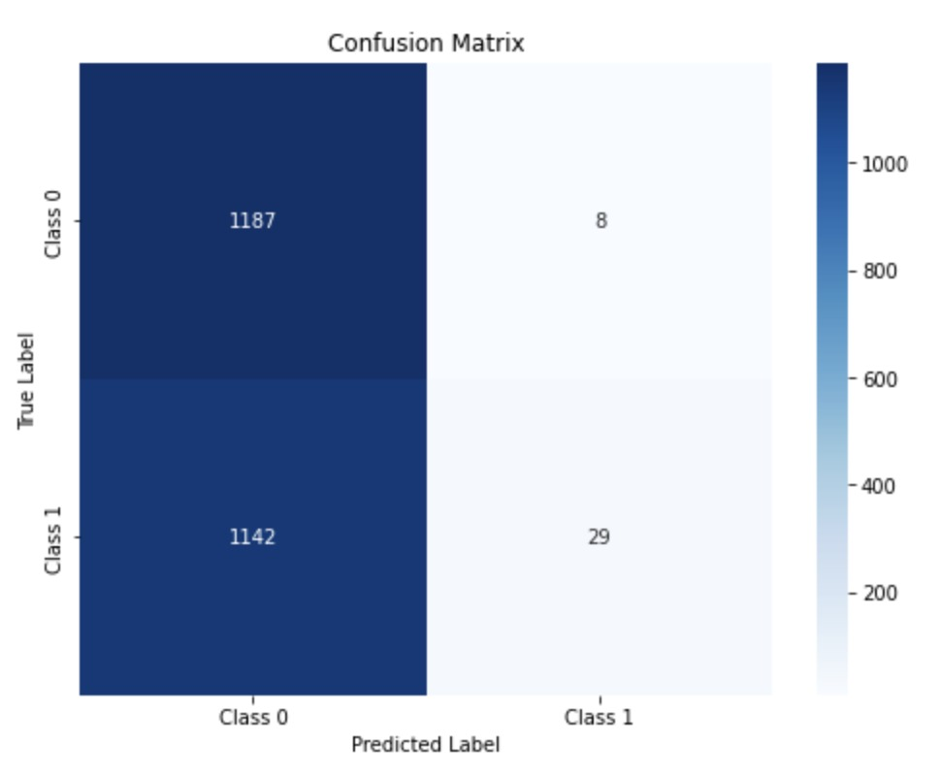
Evaluation of Models.
After sub sampling we have got better results
Achieved accuracy = 70.5 %
Achieved F1 score = 0.364

Slide 9
Enhancing Insights
We believe that incorporating a predictive model in the workflow of automating calls could improve the success rate of calls.
For example, populate the examples based on client data and time of day that you want to initiate a call. Based on the predictive model we could a get a success rate of the call for the given duration of the day.
Therefore, take an action accordingly

Slide 10
Thank you

