Slide 1

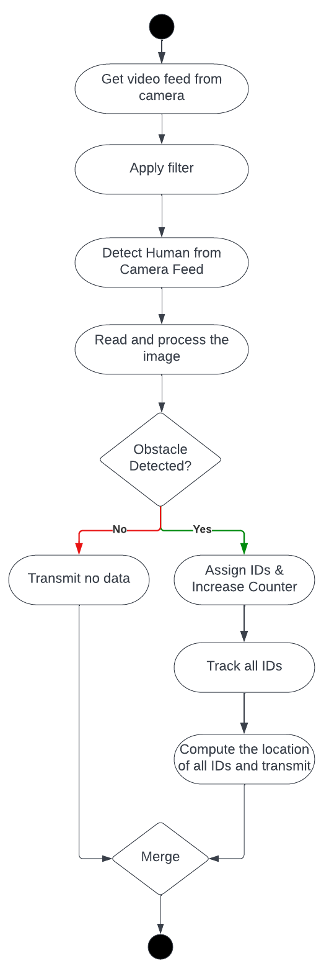
Acme’s Perception Robotic Module
Dhinesh R, Arshad S, Acme Robotics
Objective
Develop a software module for perception task of detecting a human (N>=1) and tracking them.
The software module, upon detection of human obstacle, shall be able to compute its location in reference to robotic frame and send the data to other robotic modules.
Design Constraints:
Image occlusion is not considered
Only monocular camera will be used
Fig: Preliminary Design Chart
Approach
Key Milestones
Develop the software module by the following steps:
Get and process the image from monocular video camera
Run human form obstacle detection algorithm. If obstacle detected, run the tracker algorithm by assigning IDs
Compute the location of each of the obstacle with respect to the robot’s frame
Transmit the location data to other modules of the robot.
Potential Risk: Noise data in the Camera image
Mitigation Mechanism: Suitable filtering method
Requirements, architecture, design by AIP 10/12
Preliminary Design Review 10/15
Implement software using Test-Driven Development
(TDD) 10/19
Critical Design Review 10/21
Validation and Approval 10/26
Partners: Dhinesh Rajasekaran, Arshad Shaik, Acme Robotics
10/12

