Slide 1



DEFI REGULATION: GLOBAL RESPONSES COMPARED
  United States | European Union (MiCA) | India | Singapore
  Regulatory Arbitrage
Course : DeFi (HBCC801)
Continuous Assessment – 1
Academic Year : 2025 - 26
By Arshad Shaikh
D16ADB / 49

Slide 2

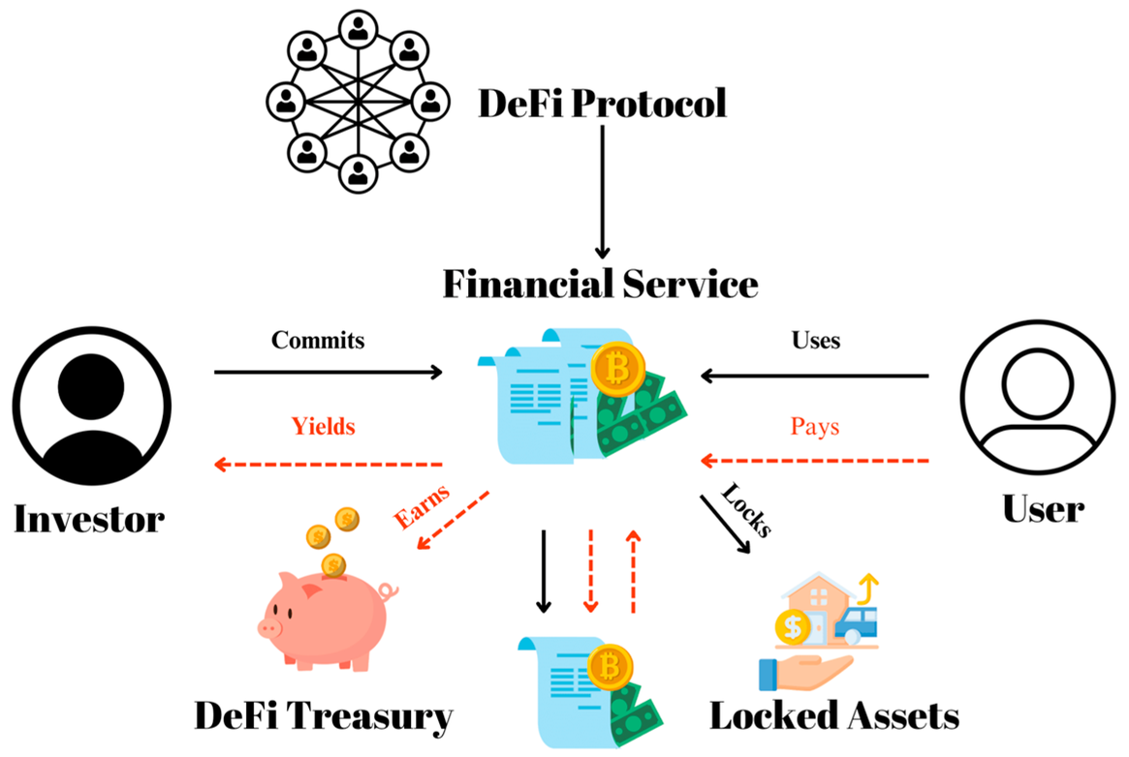
WHAT IS DEFI?
  Decentralized Finance (DeFi) refers to blockchain-based financial systems operating without traditional intermediaries.
  Examples: Decentralized exchanges, lending platforms, stablecoins, governance tokens.

Slide 3

WHY GOVERNMENTS ARE CONCERNED ABOUT DEFI
  Money laundering and terrorism financing risks
  Consumer and investor protection
  Financial stability concerns
  Tax evasion and regulatory gaps
  Lack of identifiable legal entity

Slide 4


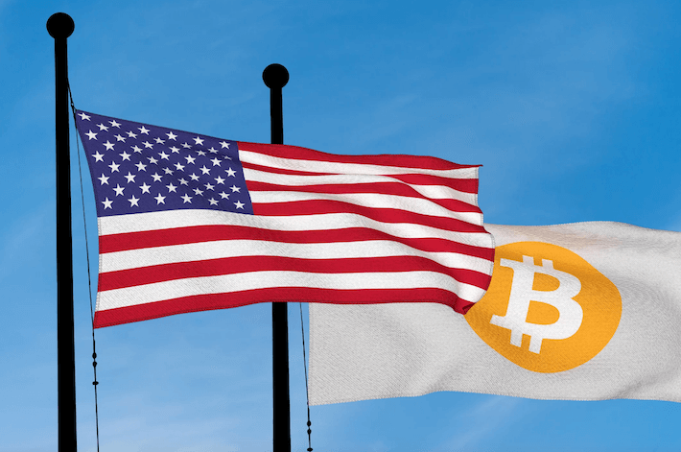
UNITED STATES APPROACH
  Enforcement-led regulation through SEC, CFTC, FinCEN
  Focus on securities law and AML
  Targeting centralized actors interacting with DeFi
  Legal focus on 'control' and 'administration' of protocols
U.S. Securities and Exchange Commission, Commodity Futures Trading Commission, Financial Crimes Enforcement Network

Slide 5
EUROPEAN UNION – MICA FRAMEWORK
  First comprehensive crypto regulation (Markets in Crypto-Assets Regulation(MiCA))
  Covers Crypto Asset Service Providers (CASPs) and stablecoins
  DeFi not fully covered yet
  EU Commission mandated to study DeFi and NFTs for future regulation

Slide 6
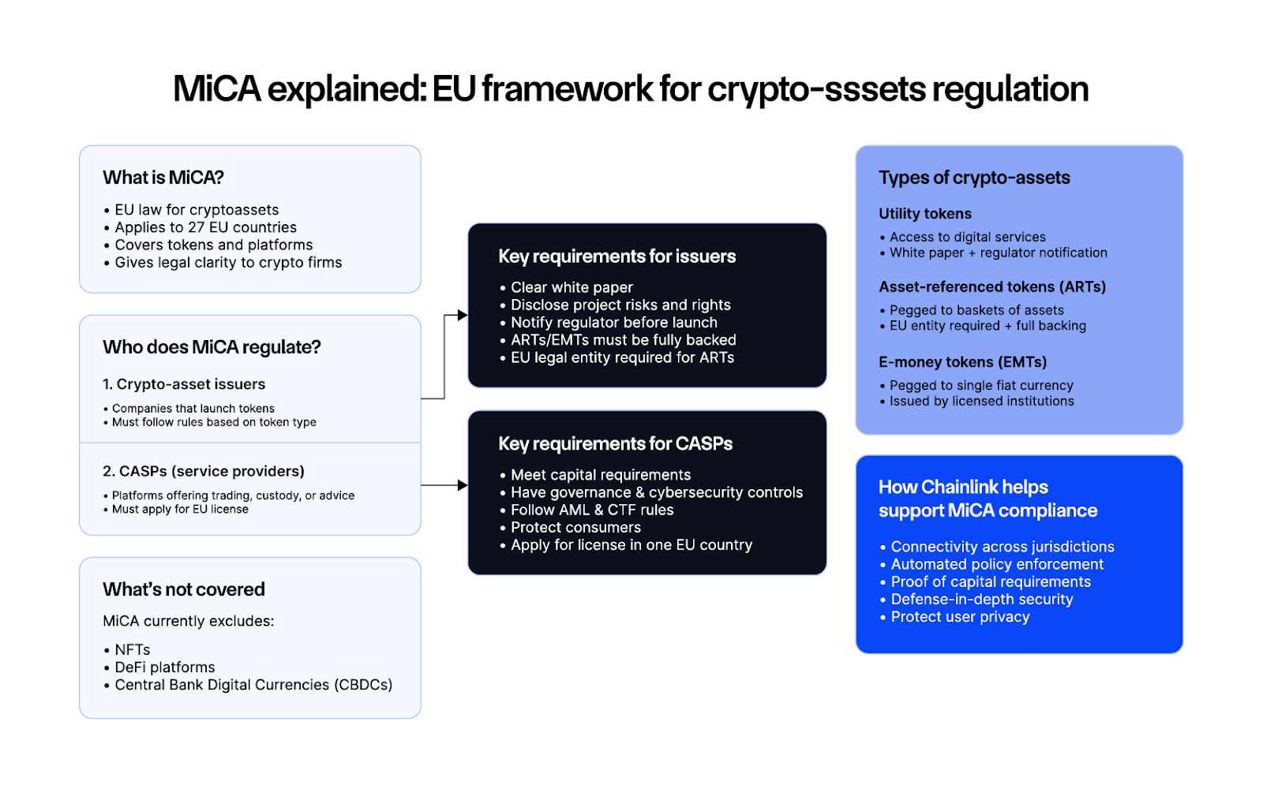
EUROPEAN UNION – MICA FRAMEWORK

Slide 7
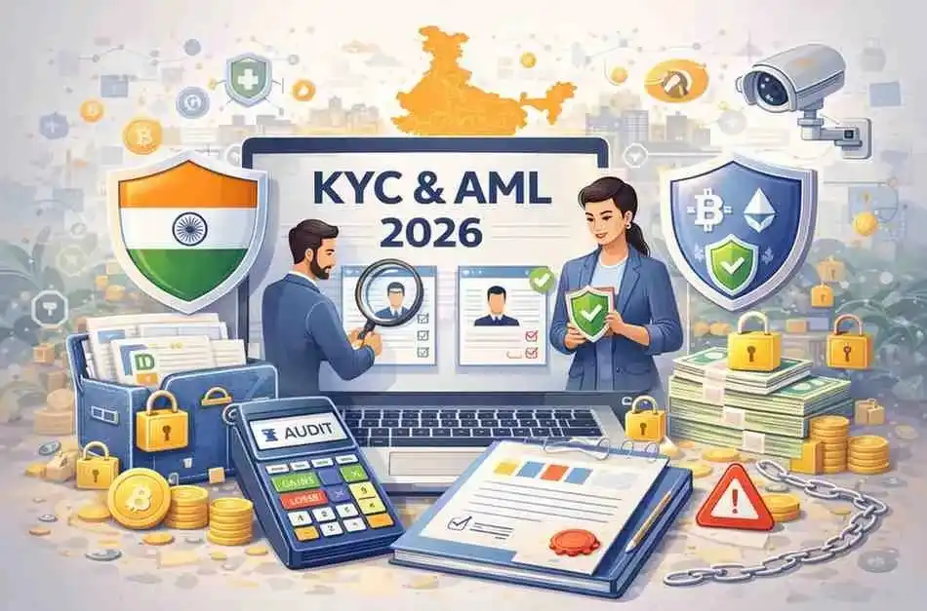
INDIA’S REGULATORY POSITION
  High taxation on crypto transactions
  Strong AML and KYC focus
  RBI skeptical of private cryptocurrencies
  Preference for Central Bank Digital Currency (CBDC)
  DeFi remains in legal grey area

Slide 8
SINGAPORE’S STRATEGY
  Risk-based and innovation-friendly approach
  Licensing for Virtual Asset Service Providers
  Strict AML/CFT compliance
  Focus on fiat on/off ramps and custodial services

Slide 9
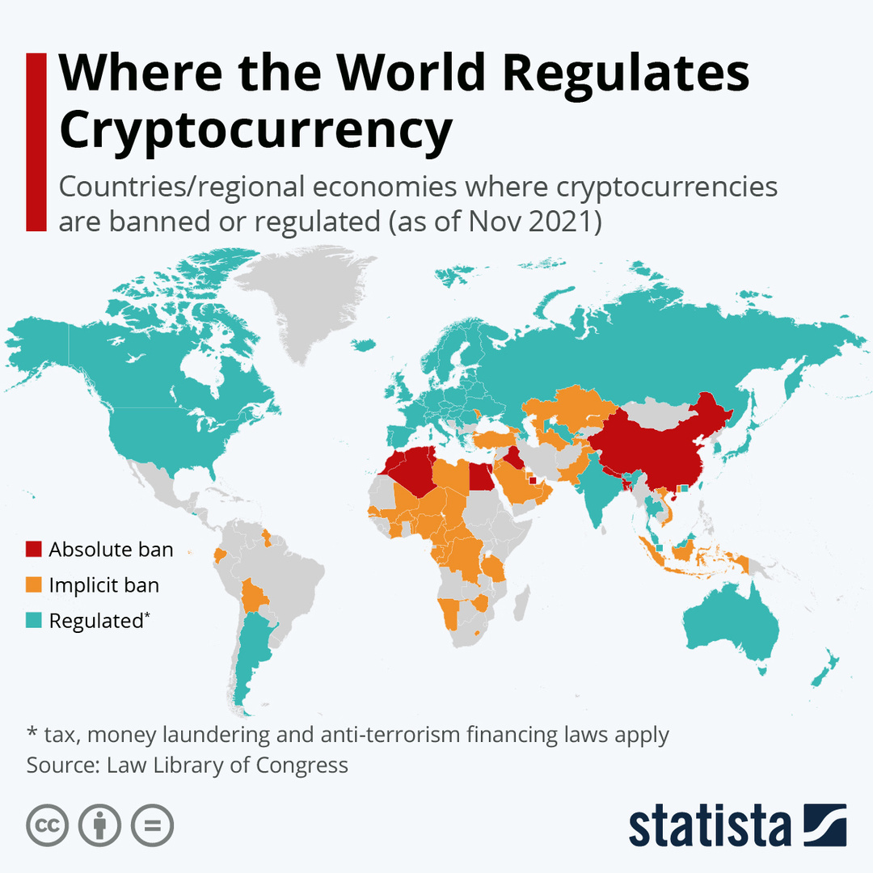
COMPARATIVE SNAPSHOT
  US: Enforcement and securities focus
  EU: Structured regulation (MiCA) with future DeFi review
  India: Restrictive, tax-heavy, AML focused
  Singapore: Balanced, risk-based supervision

Slide 10
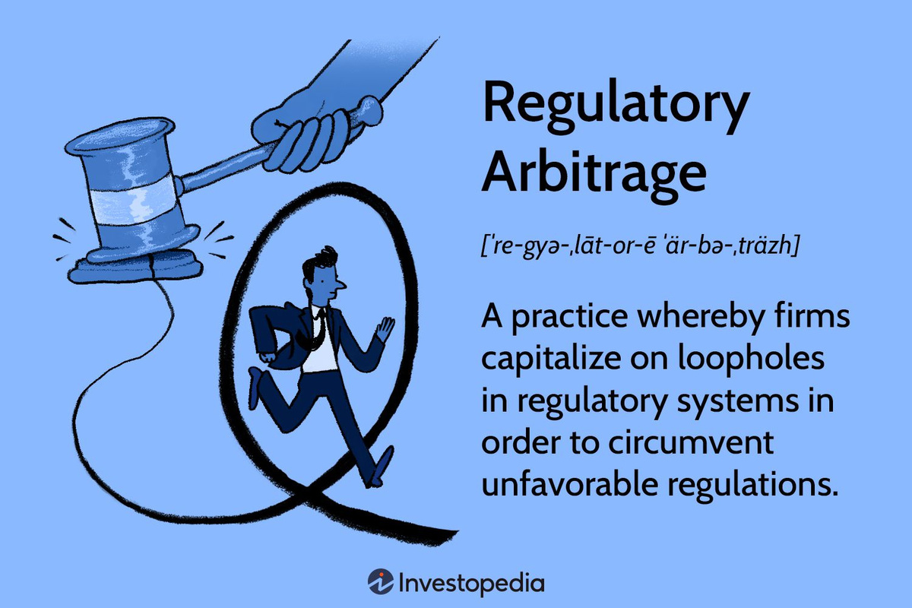
REGULATORY ARBITRAGE?
  Practice of exploiting differences in national regulations to avoid strict compliance.
  Common in DeFi due to borderless nature of blockchain.

Slide 11
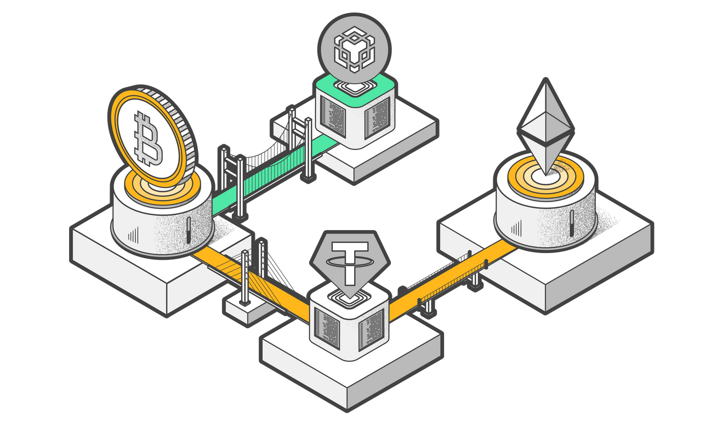
HOW REGULATORY ARBITRAGE HAPPENS IN DEFI
  Setting up entities in permissive jurisdictions
  Using offshore exchanges and wallets
  Claiming full decentralization to avoid liability
  Routing users through different platforms
  Use of privacy tools and cross-chain bridges

Slide 12

IMPLICATIONS FOR DEFI PROJECTS AND INVESTORS
  Need for compliance at on/off ramps
  Transparency in governance and treasury control
  Legal risks based on jurisdiction
  Importance of decentralization roadmap

Slide 13
FUTURE OF DEFI REGULATION
  EU likely to expand MiCA to DeFi
  US moving towards clearer rulemaking
  India may tighten AML and taxation rules
  Singapore to refine supervisory expectations

Slide 14
CONCLUSION
  DeFi challenges traditional regulation due to decentralization.
  Jurisdictions are focusing on gatekeepers and legal control points.
  Reducing regulatory arbitrage requires global cooperation.

Slide 15
THANK YOU

