Slide 1
Transportation Management System
(TMS)
Presented By: Arshad Ahmad Amiri, Akram Mal, M.Rafi Tahiri

Slide 2
CONTENTS
01
02
03
04
Introduction
Entity
Attribute
ERD

Slide 3
1
Introduction
This Project is for Transportation Management System we will Create an ERD(Entity Relationship Diagram) for a Bus transportation management system
PART ONE

Slide 4
Entities
2
We have these below entities in our database:
User Login | Bus
Company/Central Agency | Ticket
Agency | Customer
Staff | Goods
Drivers
PART TWO

Slide 5
Attributes
3
And all attributes of Entities are below:
User Login
user name
password
User type
Company/Central Agency
name
Address
Description
PART THREE

Slide 6
Attributes
3
Agency
name
address
Description
personnel/staff
Name
NIC
Phone no
Job
Salary
PART THREE

Slide 7
Attributes
3
Drivers
name
License-number
Address
Phone NO
NIC
Bus
Bus-type
regestretion no
Bus-brand
model
total number
Bus-rotation
owner
PART THREE

Slide 8
Attributes
3
Ticket
Passenger name
number of persons
ID
Bus-NO
type
price
seat NO
date
from
to
Passenger
ID
name
Numbers of tickets
mobile number
PART THREE

Slide 9
Attributes
3
Goods
ID
Description
weight
rent
PART THREE

Slide 10
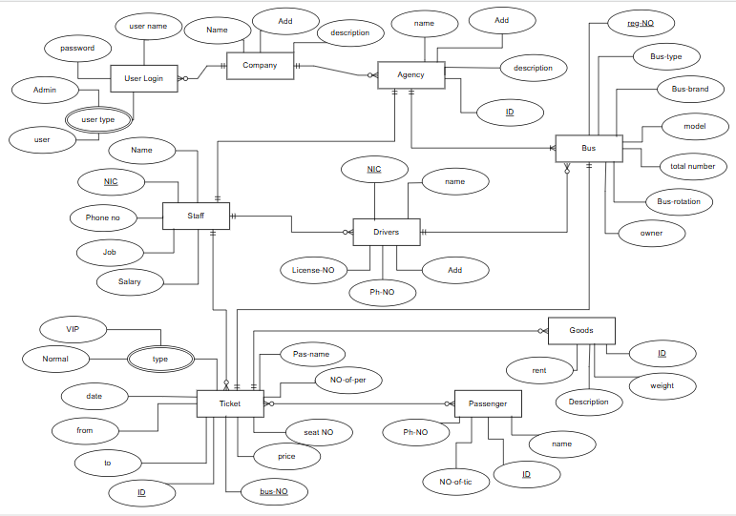
ERD

Slide 11
Thanks For your attention
any question?

