Slide 1
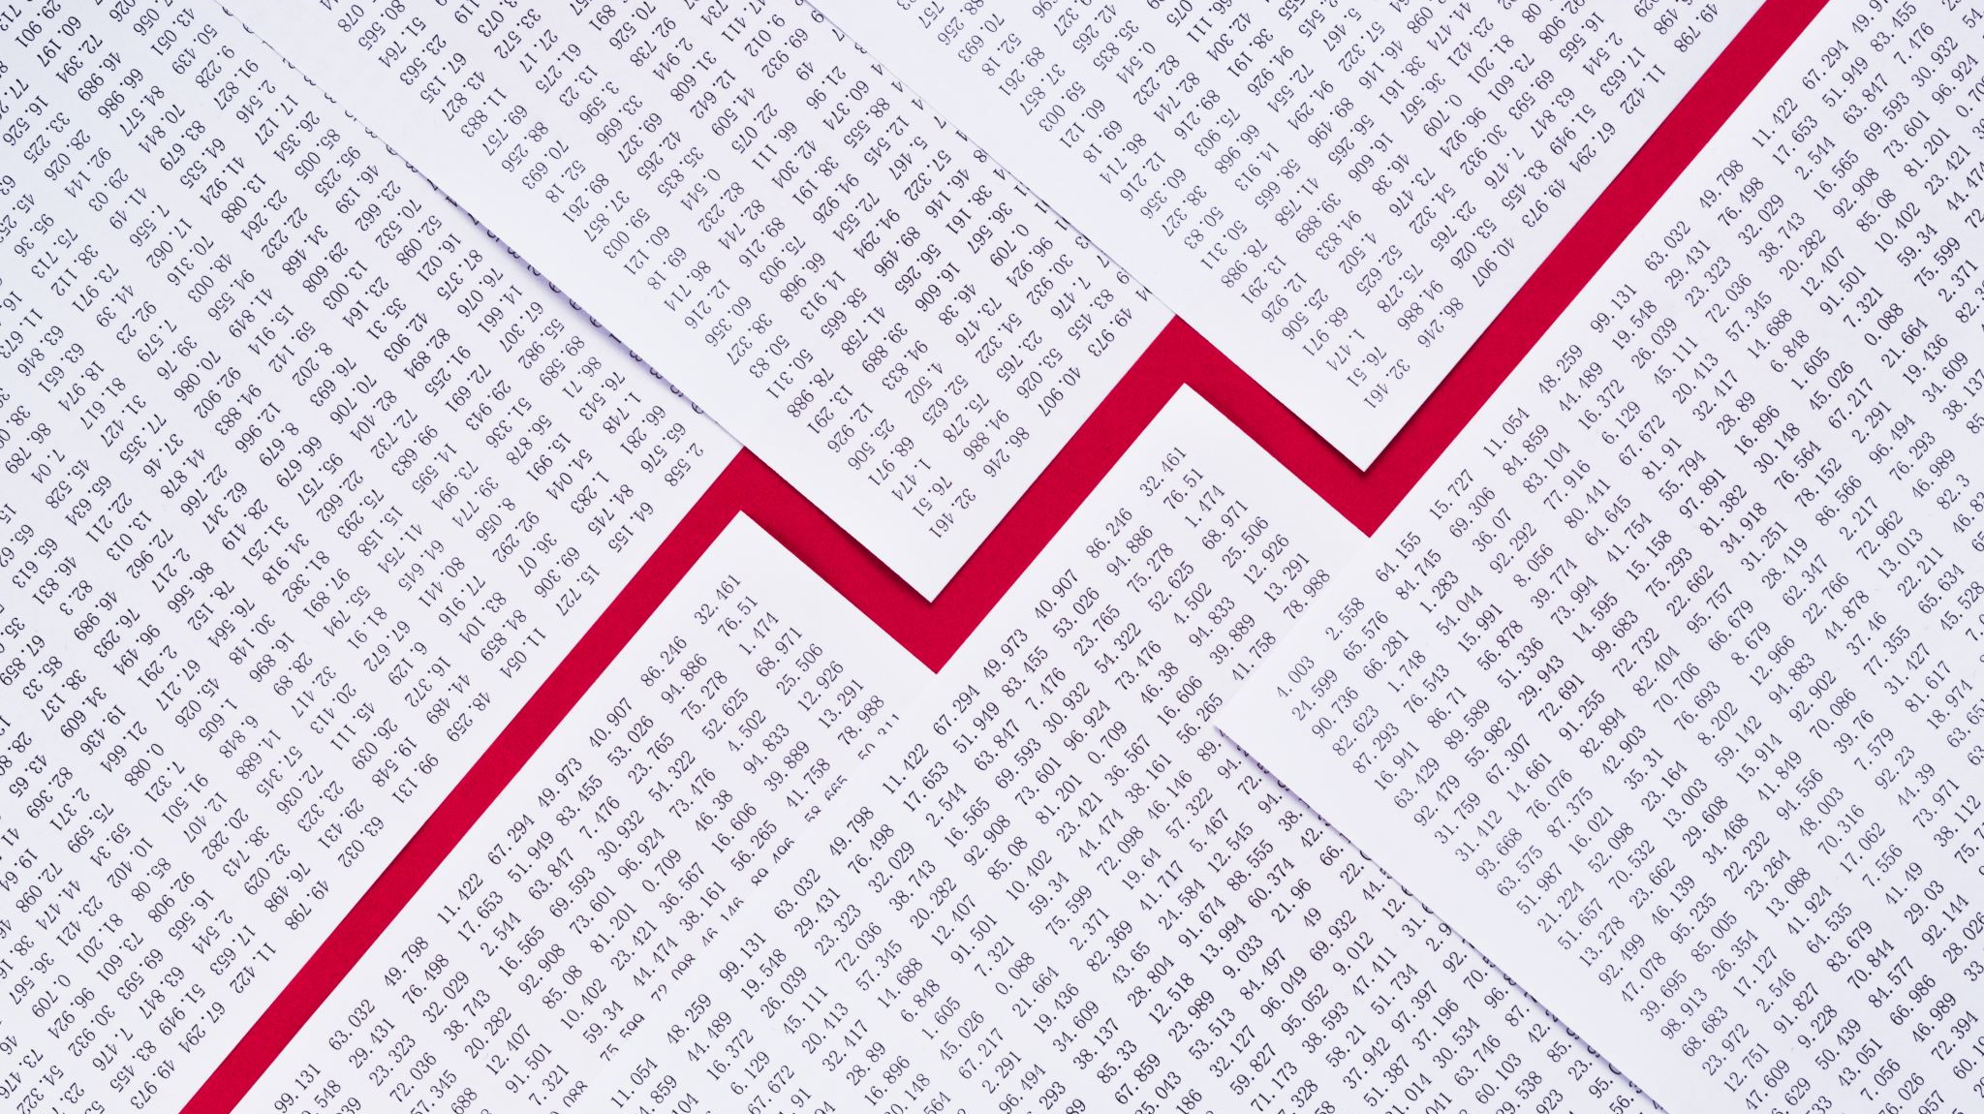
Year-Over-Year Difference Sales Prediction

Slide 2
Sindhura Alla
Arshad Abdullah Mohammad
TEAM
Ameer Basha Mittigar
Manikanta Varaprasad Inakollu

Slide 3
What is Year-Over-Year?
Year-over-year (YOY)—sometimes referred to as year-on-year—is a frequently used financial comparison for looking at two or more measurable events on an annualized basis. Observing YOY performance allows for gauging if a company’s financial performance is improving, static, or worsening. For example, you may read in financial reports that a particular business reported its revenues increased for the third quarter, on a YOY basis, for the last three years.
Year-over-year growth compares a company's recent financial performance with its numbers for the same month one year earlier. This is considered more informative than a month-to-month comparison, which often reflects seasonal trends..
Common YOY comparisons include annual and quarterly as well as monthly performance.
Understanding
Year-Over-Year Growth

Slide 4
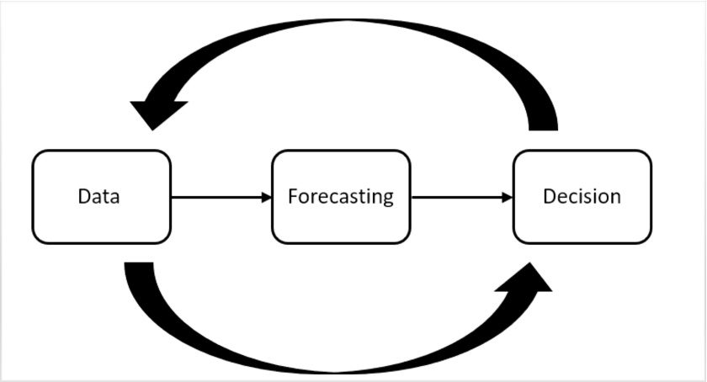
Problem statement
Year-over-year difference sales prediction involves predicting the percentage change in sales revenue between two consecutive years for a given business. Given historical sales data for the past few years, the goal is to develop a machine learning model that can accurately predict the percentage change in sales revenue for the upcoming year.
This problem is important for businesses to forecast their future sales and plan their resources accordingly. It can be framed as a regression problem, where the input features could include factors such as seasonality, economic indicators, marketing campaigns, and other relevant data points.
By analyzing the data and identifying key factors driving sales, we aim to provide insights and recommendations that will help the company achieve its sales targets and grow its business.

Slide 5
Real-World Examples
In a 2019 NASDAQ report, Kellogg Company released mixed results for the fourth quarter of 2018, revealing that its YOY earnings continued to decline, even when sales increased following corporate acquisitions. Kellogg predicted that adjusted earnings would drop by a further 5% to 7% in 2019 as it continued to invest in alternate channels and pack formats.
The company also revealed plans to reorganize its North America and Asia-Pacific segments, removing several divisions from the former and reorganizing the latter into Kellogg Asia, Middle East, and Africa. Despite decreasing YOY earnings, the company’s solid presence and responsiveness to consumer consumption trends meant that Kellogg’s overall outlook remained favorable.
In the first quarter of 2021, the Coca-Cola corporation reported a 5% increase in net revenues over the first quarter of the previous year. By comparing the same months in different years, it is possible to draw accurate comparisons despite the seasonal nature of consumer behavior.
This YOY comparison is also valuable for investment portfolios. Investors like to examine YOY performance to see how performance changes across time.

Slide 6
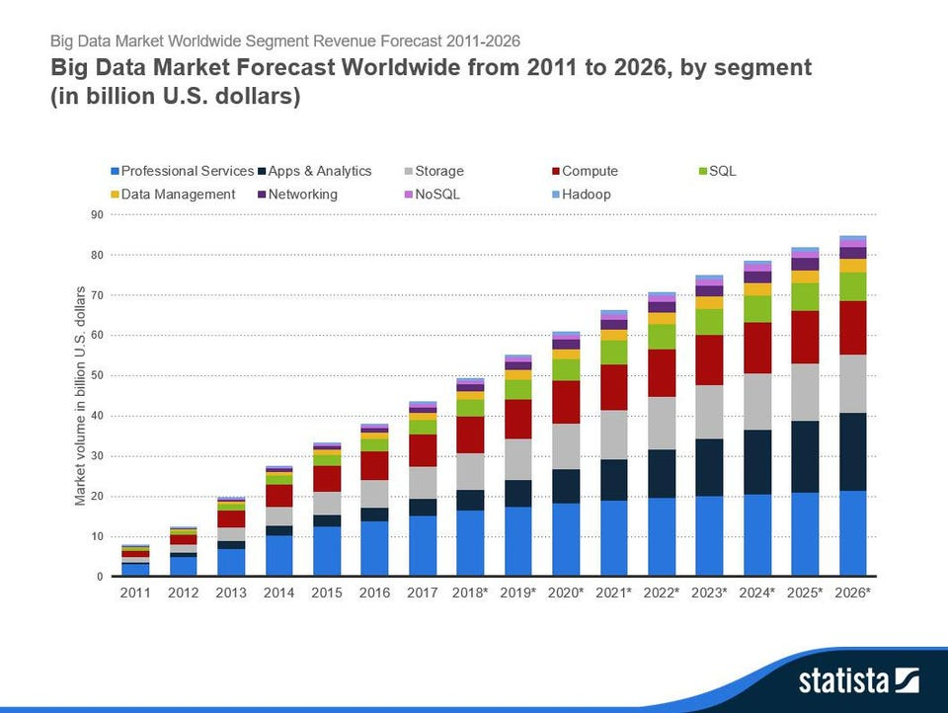

Slide 7

Target
The targeted client industry for this project is Video Gaming and the specific players are Game developers, Publishers, Console manufacturers, Gaming accessory manufacturers, Retailers and Consumers.
Aim
Utilize the available data to create a reliable and accurate sales prediction model for the coming year based on historical sales data to help the gaming industry plan for the future and make informed business decisions.

Slide 8
According to the Research
Drivers of Video Game Sales
Game releases
User engagement
Player demographics
Marketing and promotion
Reviews and ratings
Platform compatibility
Competitor behavior
In-game events and updates
User retention
Pricing strategies
Geography
Intellectual properly
Player Satisfaction

Slide 9
Data Scraping
Approximately 6500 rows with pricing data for Japan in top 5 ranks
Probability of a system being in top 5 based on release date or week number that's one thing
Another thing that we can do is filter the data which has price check if there is a relationship between the price and the system being in the top 5 ranking
Check if the game is in top5 monthly, yeraly
has valid data only until 2015 for Japan sales data
2016, 2017 data is scraped from Nintendo
Only has Japan sales data
Taiwan, South Korea data missing
2018, 2019, 2020 data from Restera
Some weeks has Japan, Taiwan and South Korea
Pricing data is missing for some weeks
2021 – 2023 data scraped from Nintendo
Has data for Japan, Taiwan and South Korea
Pricing data is available only for Japan

Slide 10
Previous Works
Project Title/Author(s) | Techniques Used | Variables/Factors Considered | Results & Conclusions
Sales Forecasting using Machine Learning Techniques: A Review by Rajdeep Kaur and Rupinder Singh | Machine learning techniques such as regression, neural networks, and decision trees | Historical sales data, seasonality, product life cycle, promotions, economic indicators, and customer behavior | The study found that machine learning techniques can improve sales forecasting accuracy by 5-20% over traditional statistical methods.
A comparative study of machine learning algorithms for sales forecasting by S. Gokul and K. S. Ramakrishnan | Machine learning algorithms such as linear regression, random forest, and neural networks | Historical sales data, seasonality, and product attributes | The study found that random forest outperformed other algorithms in sales forecasting accuracy, with an error rate of 4.17%.
Sales forecasting using multiple regression analysis: A case study on a food distribution company by Gökhan Koca and Cengiz Kahraman | Historical sales data, prices, promotions, and weather conditions | Historical sales data, prices, promotions, and weather conditions | The study used multiple regression analysis to forecast sales and found that prices and weather conditions had a significant impact on sales, with R-square values of 0.87 and 0.69, respectively.
A novel hybrid model for sales forecasting using artificial neural network and multiple regression analysis by Md. Zahidul Islam and Mohammad Nurul Huda | Artificial neural networks and multiple regression analysis | Historical sales data, seasonality, promotions, and customer behavior | The study proposed a hybrid model that combined artificial neural networks and multiple regression analysis for sales forecasting and found that the hybrid model outperformed individual models in accuracy, with a mean absolute percentage error of 7.26%.

Slide 11
Continued
Project Title/Author(s) | Techniques Used | Variables/Factors Considered | Results & Conclusions
Sales Forecasting in Fashion Industry using Time Series Analysis and Machine | Time series analysis and machine learning | Historical sales data, seasonality, and promotions | The study used time series analysis and machine learning techniques to forecast sales
Machine Learning Based Sales Forecasting for Online Retailer by Karthikeyan Shanmugam and Sumathi Annamalai | Machine learning techniques such as decision trees, random forest, and artificial neural networks | Historical sales data, customer behavior, and product attributes | The study used machine learning techniques to forecast sales for an online retailer and found that decision trees and random forest outperformed artificial neural networks in accuracy, with an error rate of 8.04% and 7.67%, respectively.
Comparative Analysis of Time Series and Machine Learning Methods for Sales Forecasting by A. R. Yarmukhamedova and V. G. Yarmukhamedov | Time series analysis and machine learning techniques such as artificial neural networks and support vector regression | Historical sales data, seasonality, and economic indicators | The study compared different time series and machine learning methods for sales forecasting and found that support vector regression performed the best in accuracy, with a mean absolute percentage error of 7.16%.
Sales Forecasting of Durable Consumer Goods: A Comparative Analysis of Statistical and Machine Learning Techniques by Tahir Khan, Farhan Hassan Khan, and Adeel Anwar | Statistical techniques such as ARIMA and machine learning techniques such as artificial neural networks and decision trees | Historical sales data, seasonality, and economic indicators | The study compared different statistical and machine learning techniques for sales.

Slide 12
Dataset
Data Source: Web-scraped from HERE
Variables:
Variable | Description
rank | Rank of the Game
last_year_rank | Last year rank of the Game
system | Name of the console for the Game
title | Title of the Game
genre | Genre of the Game
publisher | Publisher of the Game
release_date | Release Date of the Game
price | Price of the Game
year_to_date_sales | Year to Date sales of the Game
week | Week of the Year
year | Year
week_start | Start Date of the Week
week_end | End Date of the Week

Slide 13
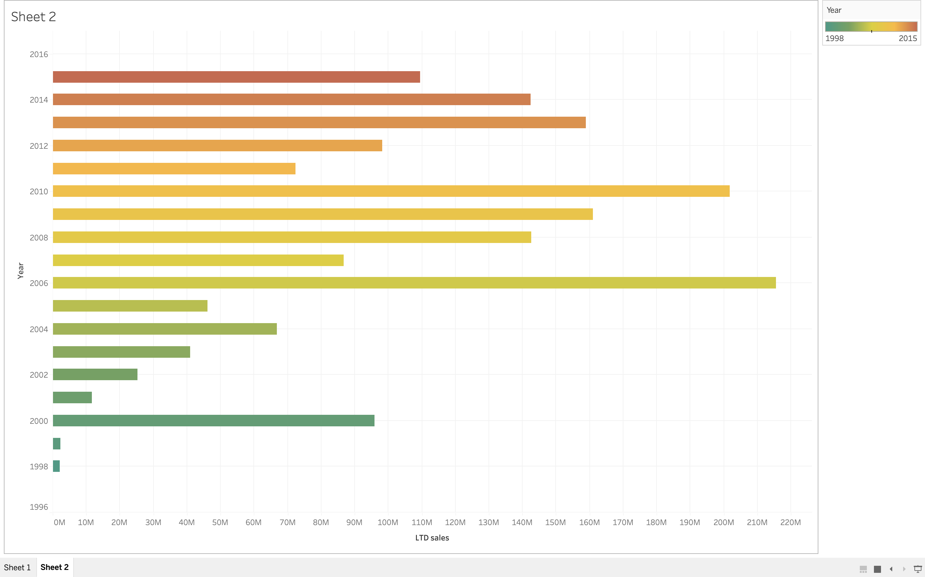
Data Visualization

Slide 14
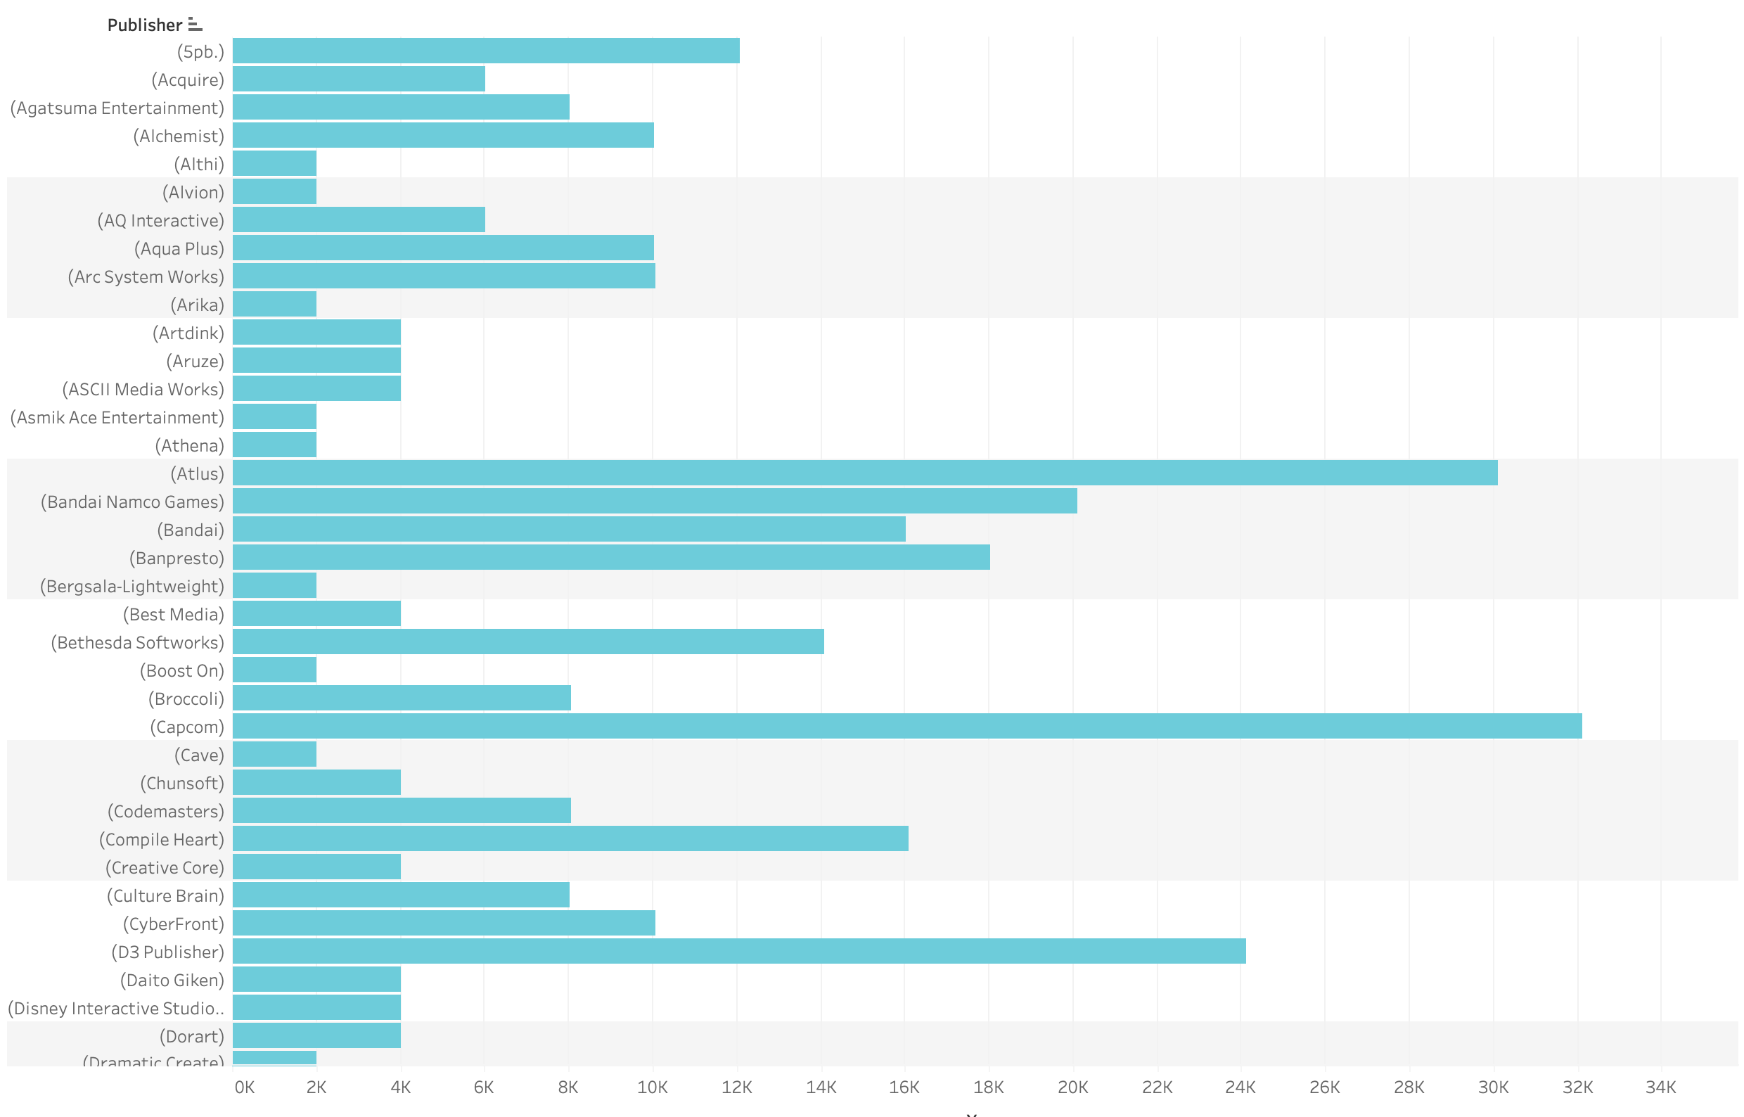
Data Visualization

Slide 15
Next Steps
Once trained and validated time series model, we will evaluate its performance on new data using metrics such as mean absolute error, mean squared error, or coefficient of determination (R-squared)
Model Evaluation
We will train the dataset and validate its performance using techniques such as cross-validation and holdout testing and try with different model parameters and data transformations to find the best combination for your data.
Model Training & Validation
Time-Series Modelling
We are looking at the potential options like ARIMA & other exponential smoothing models.
Data Cleaning
We noticed null values in the year_to_date_sales, so, we will clean the data accordingly and shape it for further processing.

Slide 16
Thank you
GO BULLS!!

