Slide 1
Sales Prediction Group ID: MCA23B007 Mentor: Dr. Taraknath paul Student Name and Code: 1.Arshad Murtaza Ahmed(BWU/MCA/23/081) 2.Subinoy Khatua(BWU/MCA/23/089) 3.Sayan Malakar(BWU/MCA/23/071) 4.Rimi Das(BWU/MCA/23/109) 5.Praveen Kumar(BWU/MCA/23/108)
it’s all about sales

Slide 2
TABLE OF CONTENTS
Introduction
Purpose
01
02
Tools
03
CONTENT
A Bref Introduction about sales prediction
What do we want to achieve?
Strategy
04
What Tools we used in this project?
What System Strategies we have used in this project?

Slide 3
INTRODUCTION
Sales prediction is the process of forecasting future sales based on historical data and trends. It helps businesses plan inventory, staffing, and marketing strategies. Common methods include analyzing past sales data, using time series forecasting , and applying machine learning models like regression.

Slide 4
Purpose
We are building a responsive website with features that enhance user interaction and convenience, and allow us to analyze, visualize, and predict product sales.

Slide 5
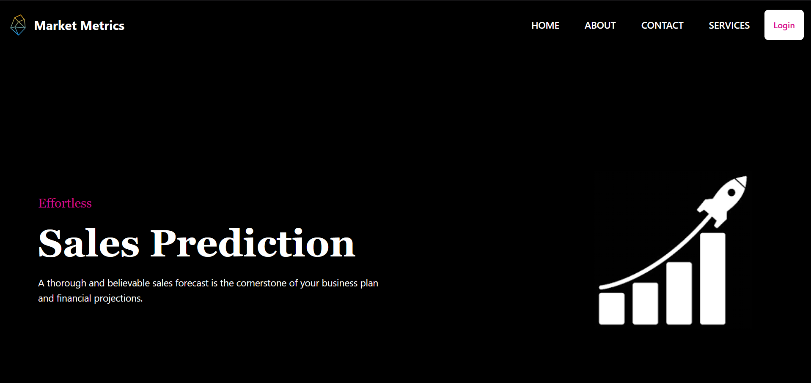
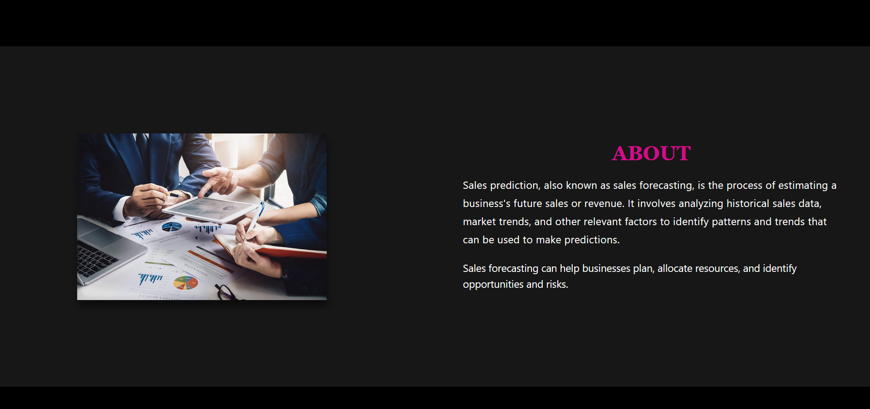
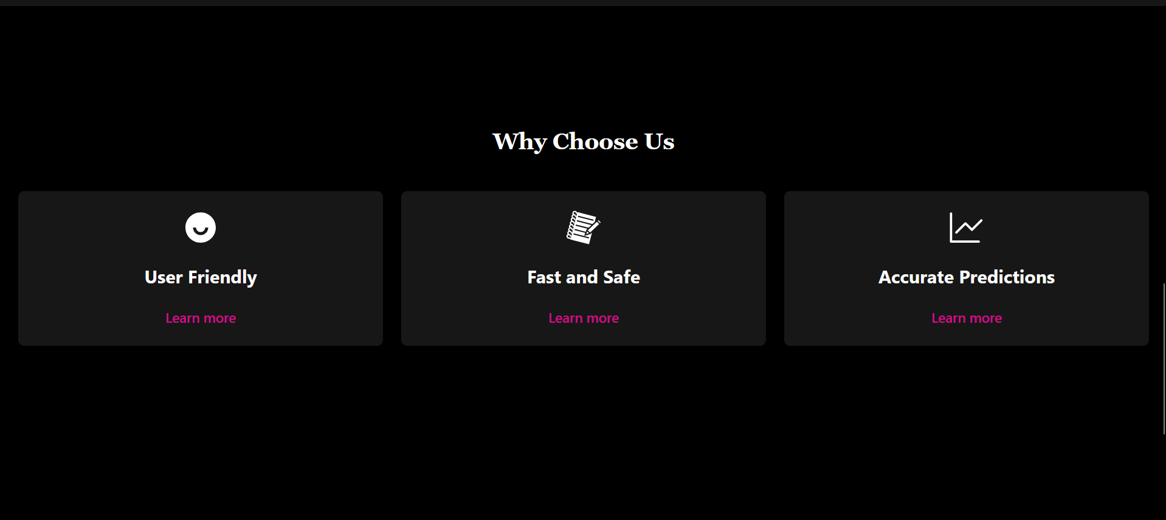
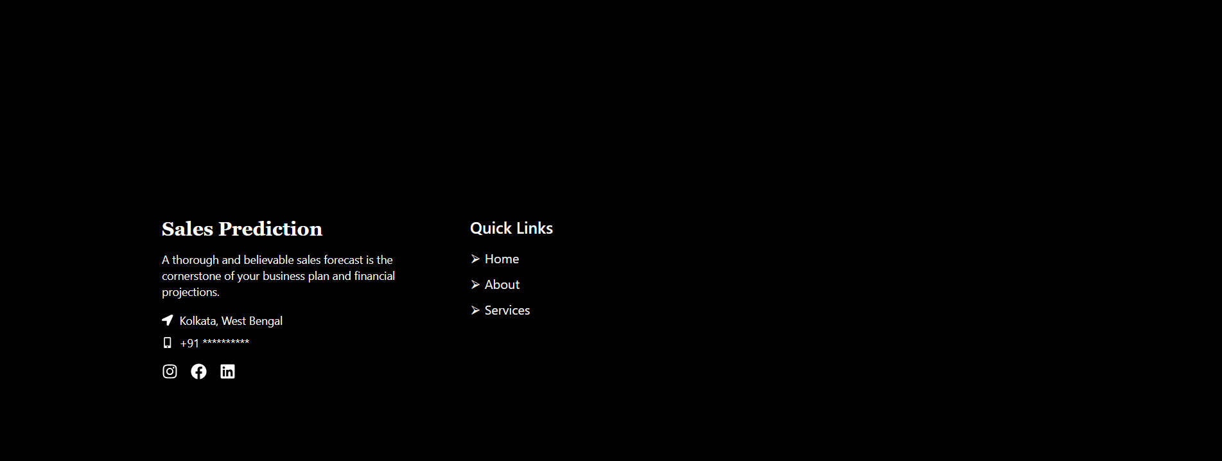

Slide 6
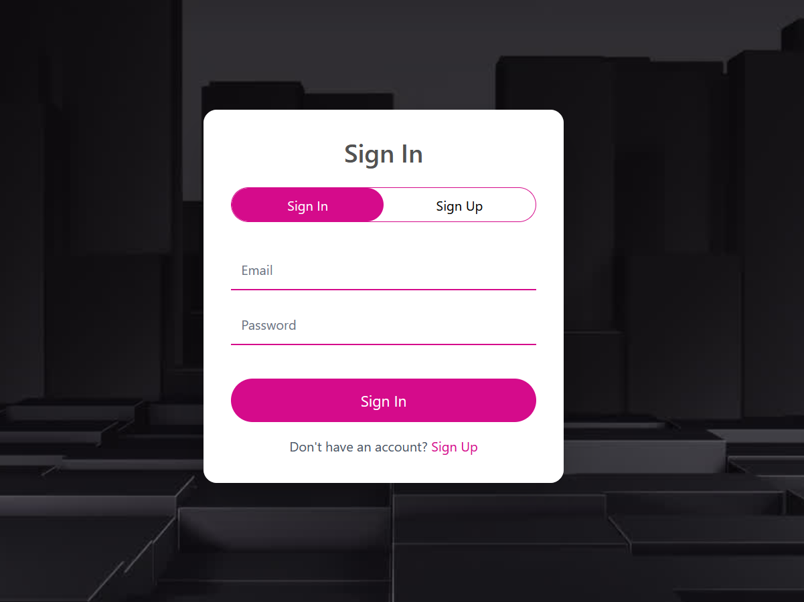
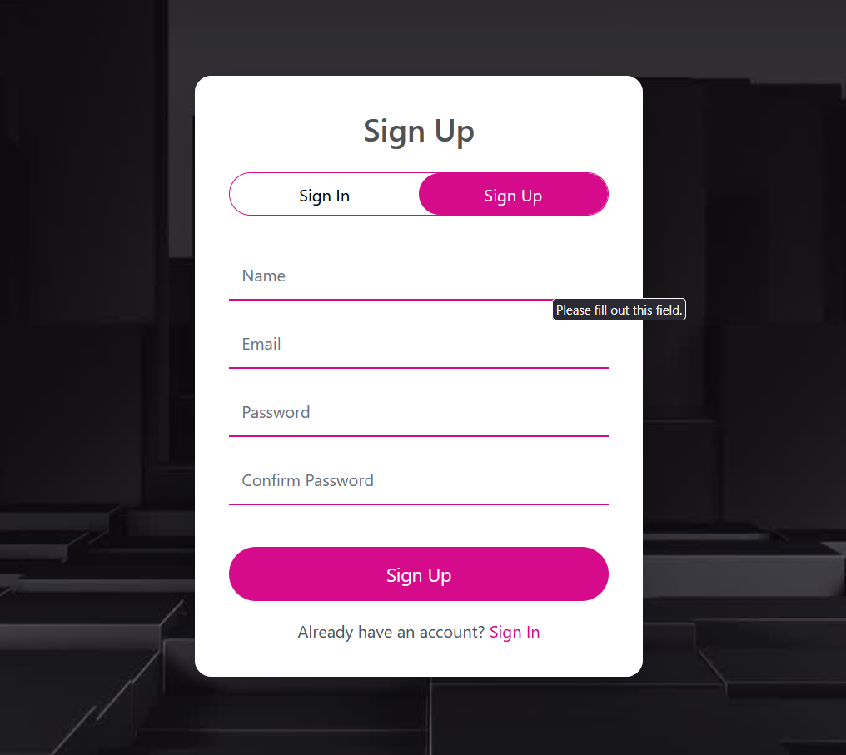

Slide 7
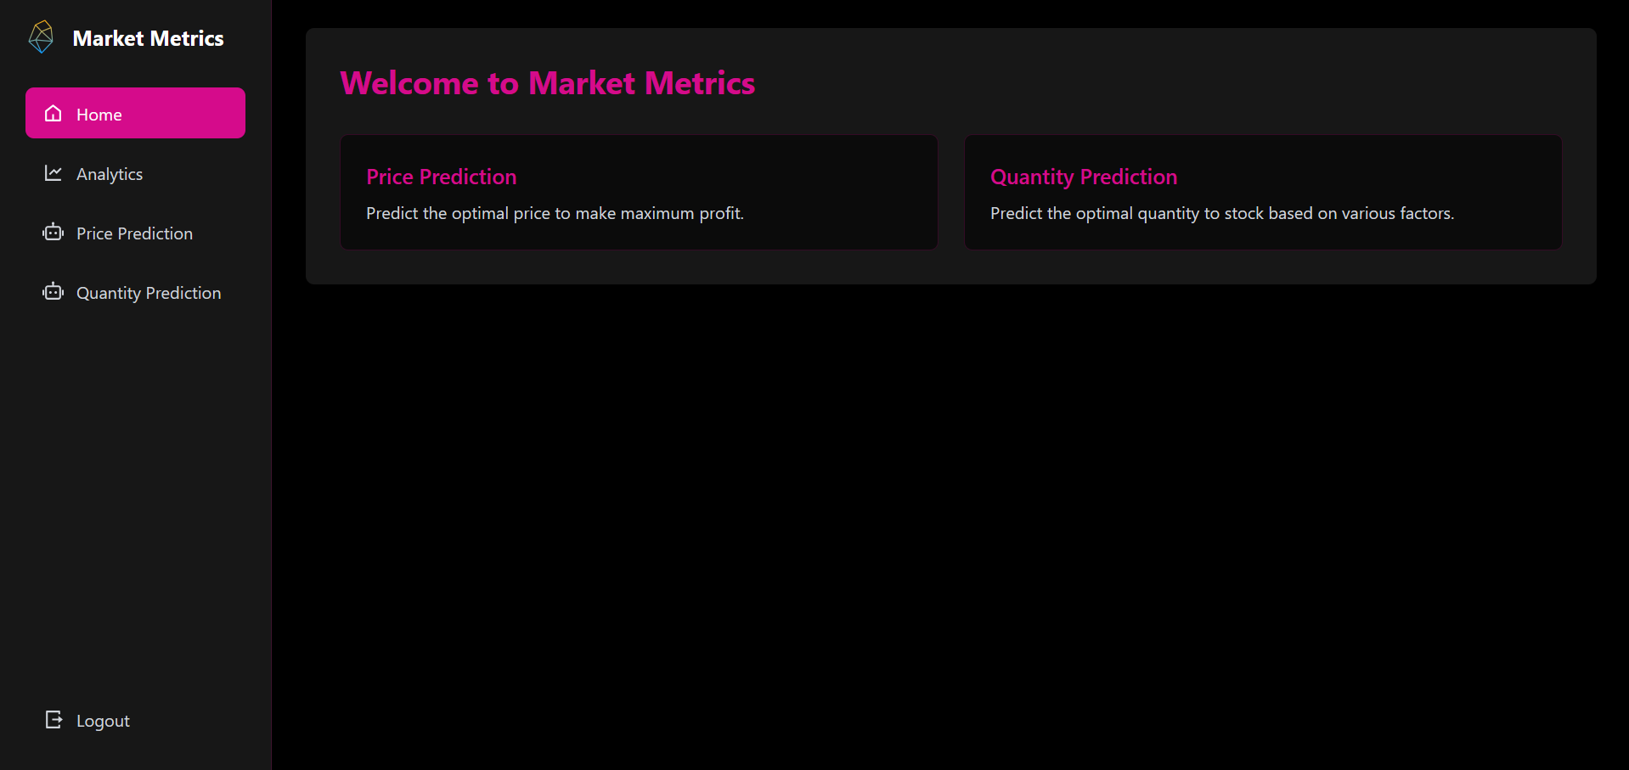
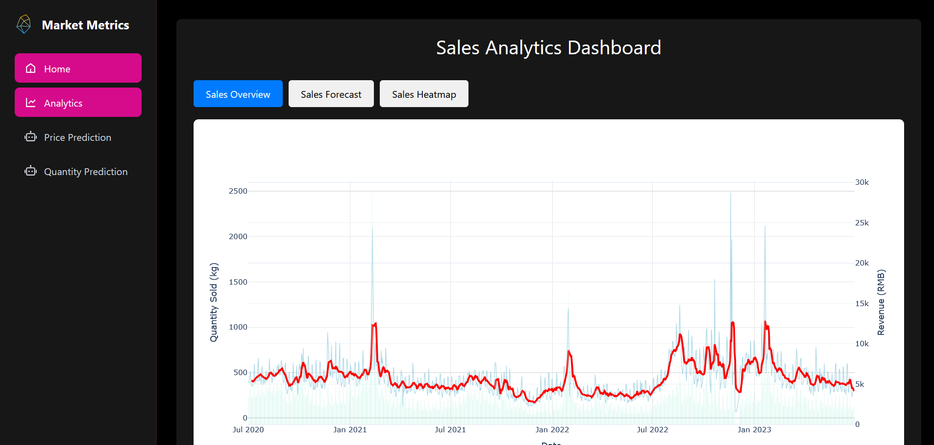
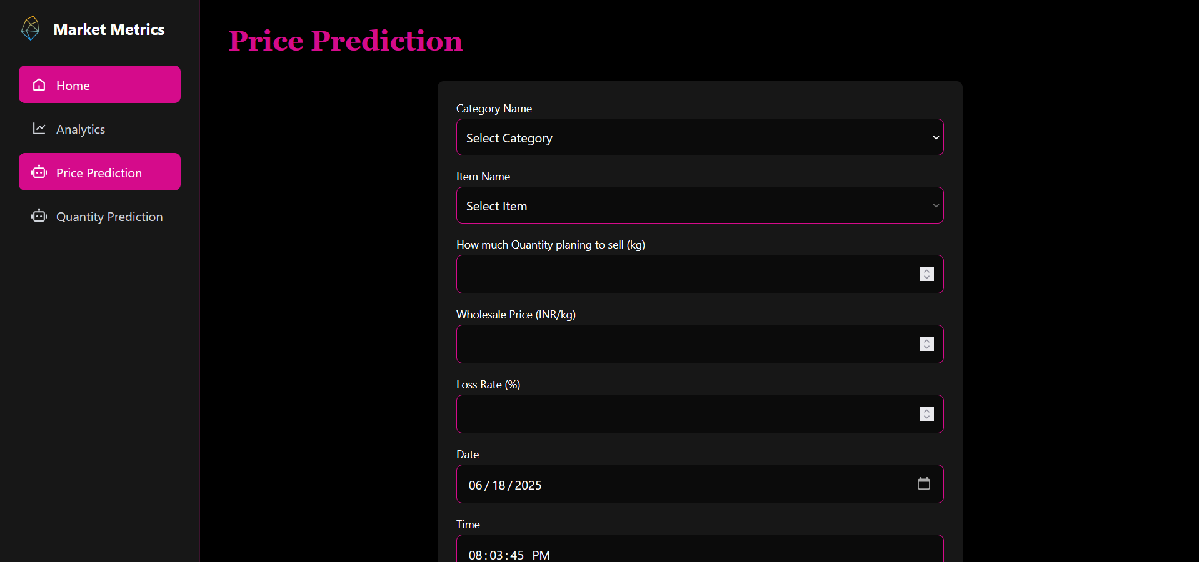
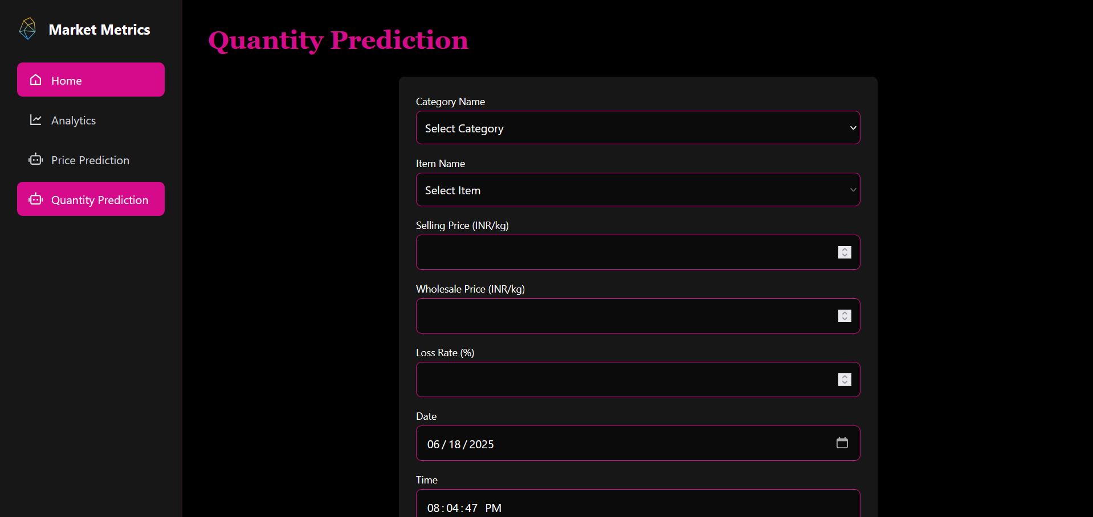

Slide 8
Tools Used
Frontend: React.js, Tailwind CSS
Backend: Python with Flask(Pandas, Matplotlib, numpy, seaborn, klib, dtale, sickit-learn, joblib, pandas-profiling)

Slide 9
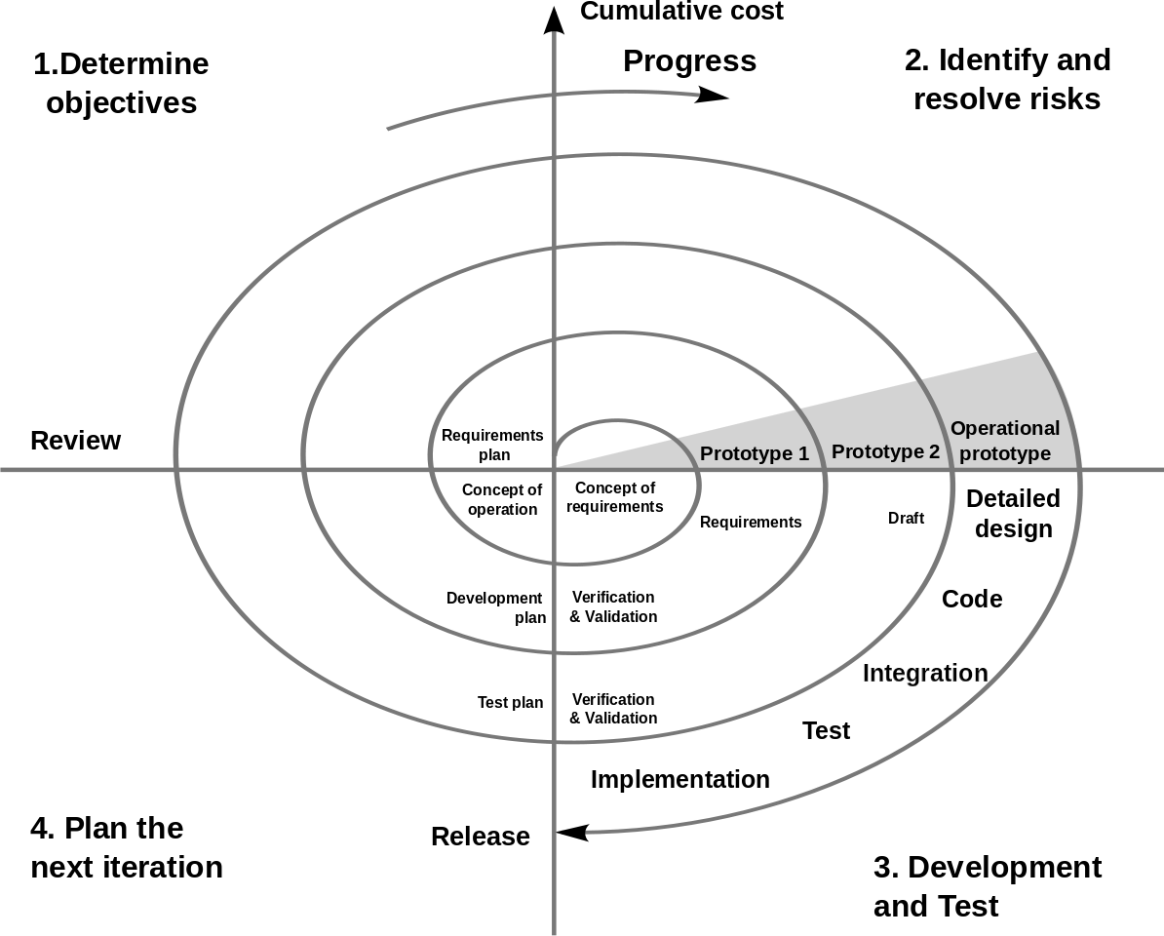
System Development Strategy
The spiral model consists of a series of cycle or loops where each cycle represents a phase of development. This phases typically include planning, risk analysis, development and evaluation. The key idea behind the spiral model is to continiously refine and improve the software through repeated iterations.

Slide 10
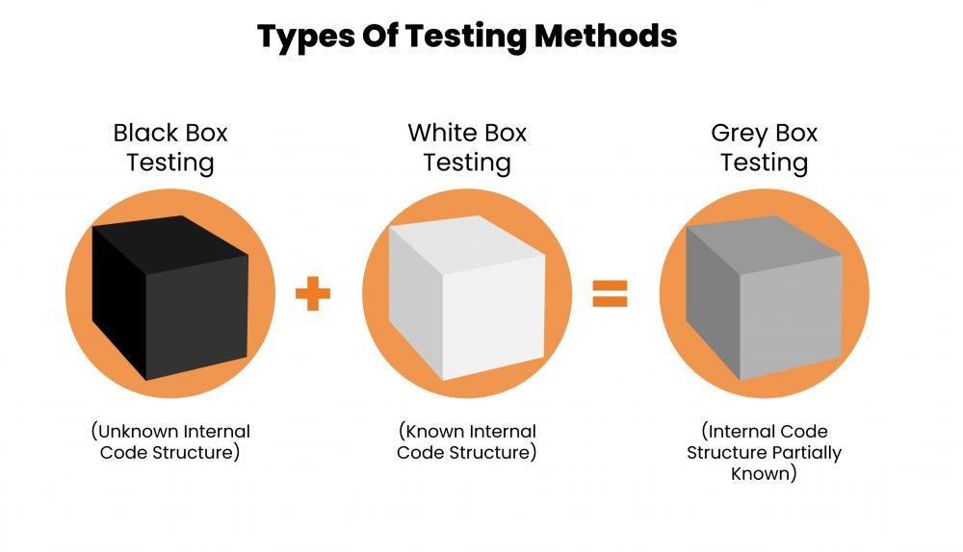
Testing

Slide 11
Limitations
Haven’t collected real world data
Difficult of prediction with high accouracy
Always need clean data
Doesn’t incorporate unexpected events that change the prediction

Slide 12

THANKS

