Slide 1
Image Captioning Using Deep Learning with Flickr8k Dataset
A Project on Vision & Language Model
Sonu Soni
Raghu V Sangala
Arshad Jafri

Slide 2
Background
Image Captioning is the task of automatically generating textual descriptions of images.
It combines Computer Vision to understand image content, and Natural Language Processing to generate coherent sentences.
Traditionally, this is tackled by using CNNs for feature extraction from images and RNNs/LSTMs for language generation.
This project focuses on applying deep learning techniques to learn from real image-caption pairs and produce descriptive captions.

Slide 3
Project Motivation
Inspired by how humans can look at an image and effortlessly describe what’s happening.
Motivated by the success of models like Show and Tell, Show, Attend and Tell.
Wanted to explore:
How well a pre-trained CNN (EfficientNet) can capture image semantics?
How effective LSTM-based decoders are in forming correct, natural captions?
Goal: To build a lightweight, yet powerful system capable of generating captions on unseen images.

Slide 4
Dataset
Flickr8k Dataset:
Contains 8,000 images from various real-world scenes.
Each image is annotated with 5 unique captions written by humans.
Preprocessing Steps:
Converted all captions to lowercase.
Removed punctuation and special characters.
Added special tokens:
<start> token at the beginning.
<end> token at the end.
Filtered out rare words (appearing less than 5 times) to reduce vocabulary size and improve model focus.

Slide 5
Method – Architecture Overview
Feature Extraction:
Used EfficientNet-B7 (pre-trained on ImageNet) to extract 2560-dimensional features from each image.
EfficientNet balances accuracy and efficiency, offering robust image representations.
Encoder:
Simple fully connected layer maps 2560-dim features to embedding size (e.g., 256).
Batch normalization is applied to stabilize training.
Decoder:
Caption tokens are passed through an Embedding layer to get dense word vectors.
A 2-layer LSTM processes these embeddings to model sequential dependencies.
Outputs are passed through a Fully Connected Layer to map to vocabulary probabilities.
Loss Function:
CrossEntropyLoss, ignoring padded tokens during training.
Optimization:
Used Adam optimizer with a learning rate of 1e-4.
Early stopping applied to avoid overfitting.

Slide 6
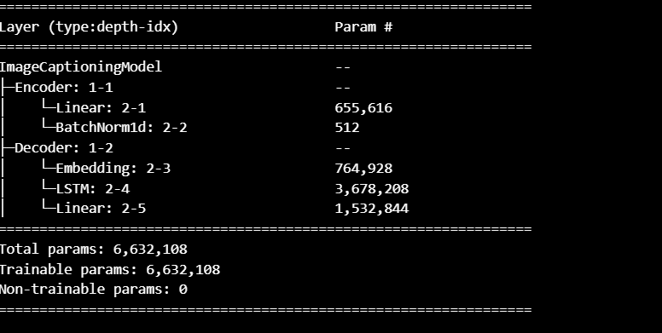
Architecture

Slide 7
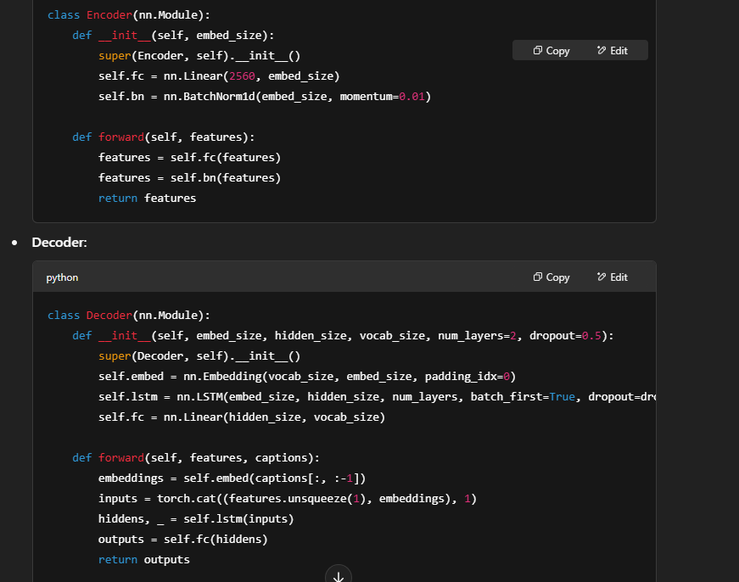
Code Snippets

Slide 8
Experiments & Results
Training Setup:
Epochs: 50
Batch size: 32
Optimizer: Adam
Early Stopping: Patience of 5 epochs without improvement.
Metrics:
Training Loss: Reduced from 4.6 initially to about 2.1.
Validation Accuracy: Improved steadily, reaching up to 30-40% token-level accuracy.
Visuals:
Loss vs Epochs graph.
Accuracy vs Epochs graph.
Sample images with generated captions.

Slide 9
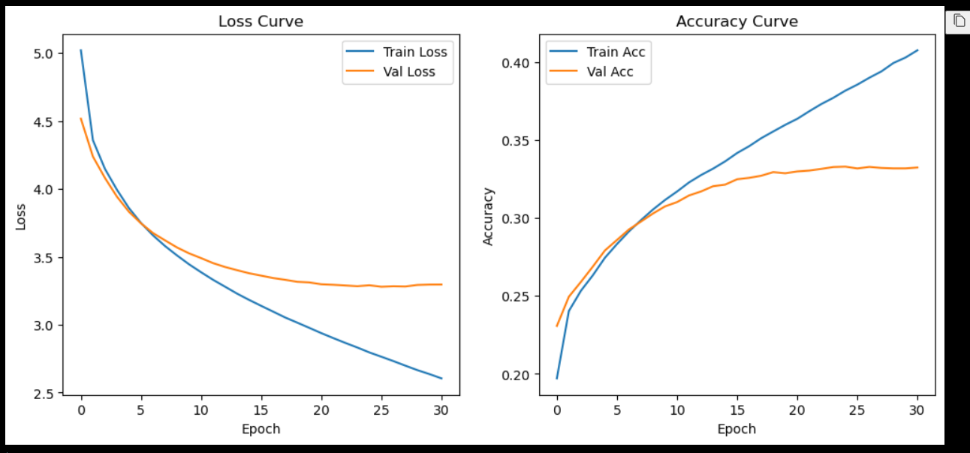
Loss Curves

Slide 10
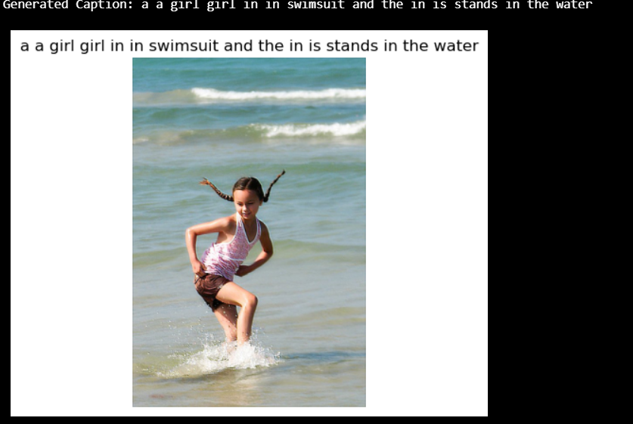
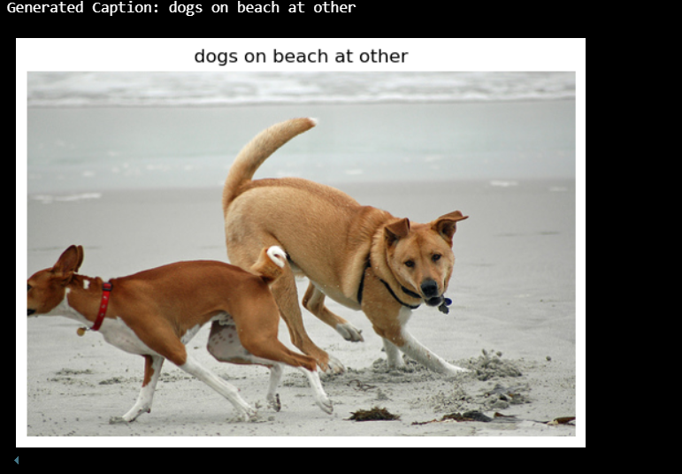
Generated captions

Slide 11
Discussion
Strengths:
EfficientNet provided strong visual features from images.
The model performed well despite small dataset size.
Generated captions were often semantically accurate.
Challenges:
Model sometimes generated repetitive phrases (e.g., "dogs dogs dogs").
The limited size of Flickr8k led to overfitting risks.
Lessons Learned:
Importance of vocabulary tuning.
Greedy decoding limits caption diversity.
Future Work:
Use larger datasets like MSCOCO.
Experiment with Transformer models or Attention mechanisms.
Implement Beam Search to improve generation quality.

