Slide 1
CSE 326: Data Structures
Lecture #2
Analysis of Algorithms
Alon Halevy
Fall Quarter 2000

Slide 2
Analysis of Algorithms
Analysis of an algorithm gives insight into how long the program runs and how much memory it uses
  time complexity
  space complexity
Why useful?
Input size is indicated by a number n
  sometimes have multiple inputs, e.g. m and n
Running time is a function of n
  n, n², n log n, 18 + 3n(log n²) + 5n³

Slide 3
Simplifying the Analysis
Eliminate low order terms
  4n + 5 ⇒ 4n
  0.5 n log n - 2n + 7 ⇒ 0.5 n log n
  2^{n} + n³ + 3n ⇒ 2^{n}
Eliminate constant coefficients
  4n ⇒ n
  0.5 n log n ⇒ n log n
  log n² = 2 log n ⇒ log n
  log₃ n = (log₃ 2) log n ⇒ log n
Notes:
We didn’t get very precise in our analysis of the UWID info finder; why?
Didn’t know the machine we’d use.
Is this always true? Do you buy that coefficients and low order terms don’t matter?
When might they matter?
(Linked list memory usage)

Slide 4
Order Notation
BIG-O T(n) = O(f(n))
  Upper bound
  Exist constants c and n₀ such that
  T(n) ≤ c f(n) for all n ≥ n₀
OMEGA T(n) = Ω (f(n))
  Lower bound
  Exist constants c and n₀ such that
  T(n) ≥ c f(n) for all n ≥ n₀
THETA T(n) = θ (f(n))
  Tight bound
  θ(n) = O(n) = Ω (n)
Notes:
We’ll use some specific terminology to describe asymptotic behavior.
There are some analogies here that you might find useful.

Slide 5
Examples
n² + 100 n = O(n²) = Ω(n²) = θ(n²)
  ( n² + 100 n ) ≤ 2 n² for n ≥ 10
  ( n² + 100 n ) ≥ 1 n² for n ≥ 0
n log n = O(n²)
n log n = θ(n log n)
n log n = Ω(n)

Slide 6
More on Order Notation
Order notation is not symmetric; write
  2n² + 4n = O(n²)
but never
  O(n²) = 2n² + 4n
      right hand side is a crudification of the left
Likewise
  O(n²) = O(n³)
  Ω(n³) = Ω(n²)

Slide 7
A Few Comparisons
Function #1
n³ + 2n²
n^{0.1}
n + 100n^{0.1}
5n⁵
n⁻¹⁵2^{n}/100
8^{2log n}
Function #2
100n² + 1000
log n
2n + 10 log n
n!
1000n¹⁵
3n⁷ + 7n

Slide 8
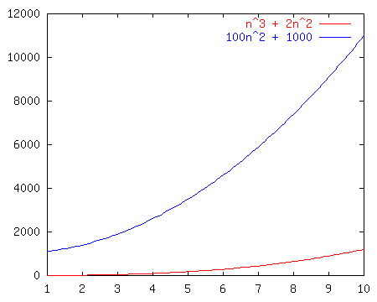
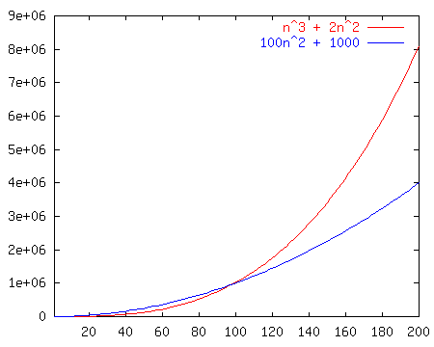
Race I
n³ + 2n²
vs.
100n² + 1000

Slide 9
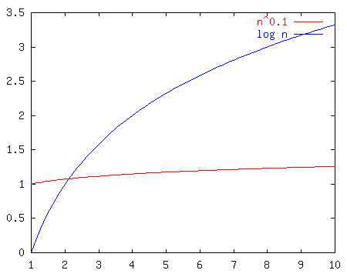
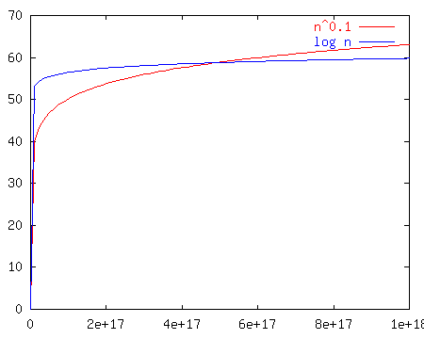
Race II
n^{0.1}
vs.
log n
Notes:
Well, log n looked good out of the starting gate and indeed kept on looking good until about n^17 at which point n^0.1 passed it up forever.
Moral of the story? N^epsilon beats log n for any eps > 0. BUT, which one of these is really better?

Slide 10
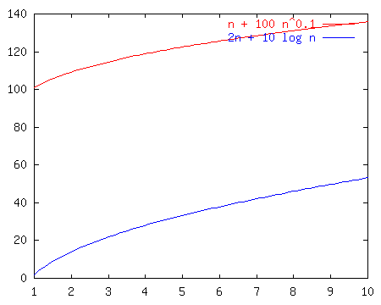
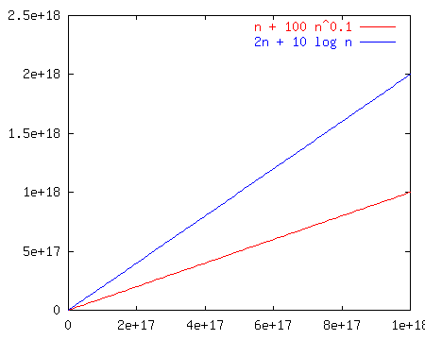
Race III
n + 100n^{0.1}
vs.
2n + 10 log n
Notes:
Notice that these just look like n and 2n once we get way out. That’s because the larger terms dominate. So, the left is less, but not asymptotically less.
It’s a TIE!

Slide 11
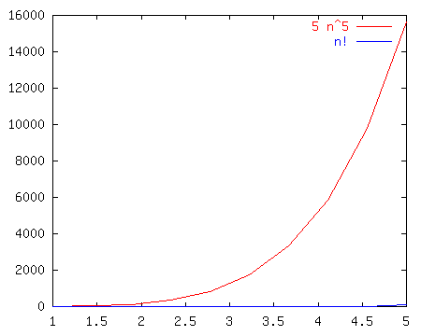
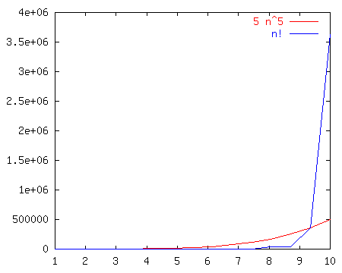
Race IV
5n⁵
vs.
n!
Notes:
N! is BIG!!!

Slide 12
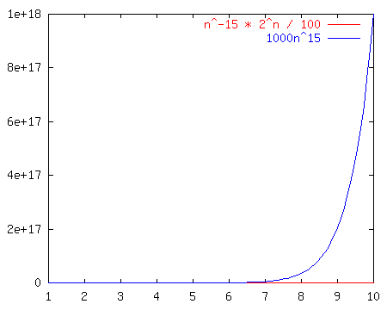
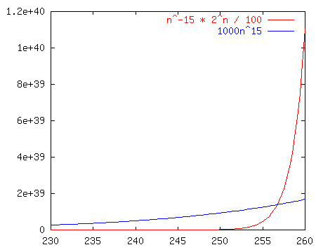
Race V
n⁻¹⁵2^{n}/100
vs.
1000n¹⁵
Notes:
No matter how you put it, any exponential beats any polynomial. It doesn’t even take that long here (~250 input size)

Slide 13
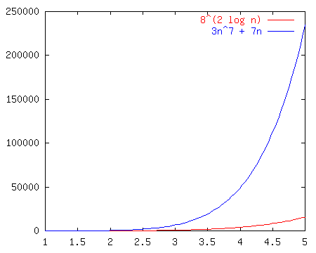
Race VI
8^{2log(n)}
vs.
3n⁷ + 7n
Notes:
We can reduce the left hand term to n^6, so they’re both polynomial and it’s an open and shut case.

Slide 14
The Losers Win
Better algorithm!
O(n²)
O(log n)
TIE O(n)
O(n⁵)
O(n¹⁵)
O(n⁶)
Function #1
n³ + 2n²
n^{0.1}
n + 100n^{0.1}
5n⁵
n⁻¹⁵2^{n}/100
8^{2log n}
Function #2
100n² + 1000
log n
2n + 10 log n
n!
1000n¹⁵
3n⁷ + 7n
Notes:
Welcome, everyone, to the Silicon Downs. I’m getting race results as we stand here.
Let’s start with the first race. I’ll have the first row bet on race #1. Raise your hand if you bet on function #1 (the jockey is n^0.1)
So on.
Show the race slides after each race.

Slide 15
Common Names
  constant: O(1)
  logarithmic: O(log n)
  linear: O(n)
  log-linear: O(n log n)
  superlinear: O(n^{1+c}) (c is a constant > 0)
  quadratic: O(n²)
  polynomial: O(n^{k}) (k is a constant)
  exponential: O(c^{n}) (c is a constant > 1)
Notes:
Well, it turns out that the old Silicon Downs is fixed. They dope up the horses to make the first few laps interesting, but we can always find out who wins.
Here’s a chart comparing some of the functions. Notice that any exponential beats any polynomial.
Any superlinear beats any poly-log-linear.
Also keep in mind (though I won’t show it) that sometimes the input has more than one parameter. Like if you take in two strings. In that case you need to be very careful about what is constant and what can be ignored.
O(log m + 2^{n}) is not necessarily O(2^{n})

Slide 16
Kinds of Analysis
Running time may depend on actual data input, not just length of input
Distinguish
  worst case
    your worst enemy is choosing input
  best case
  average case
    assumes some probabilistic distribution of inputs
  amortized
    average time over many operations
Notes:
We already discussed the bound flavor. All of these can be applied to any analysis case. For example, we’ll later prove that sorting in the worst case takes at least n log n time. That’s a lower bound on a worst case.
Average case is hard! What does “average” mean. For example, what’s the average case for searching an unordered list (as precise as possible, not asymptotic).
WRONG! It’s about n, not 1/2 n. Why? You have to search the whole thing if the elt is not there.
Note there’s two senses of tight. I’ll try to avoid the terminology “asymptotically tight” and stick with the lower def’n of tight. O(inf) is not tight!

Slide 17
Analyzing Code
C++ operations - constant time
consecutive stmts - sum of times
conditionals - sum of branches, condition
loops - sum of iterations
function calls - cost of function body
recursive functions - solve recursive equation
Above all, use your head!

Slide 18
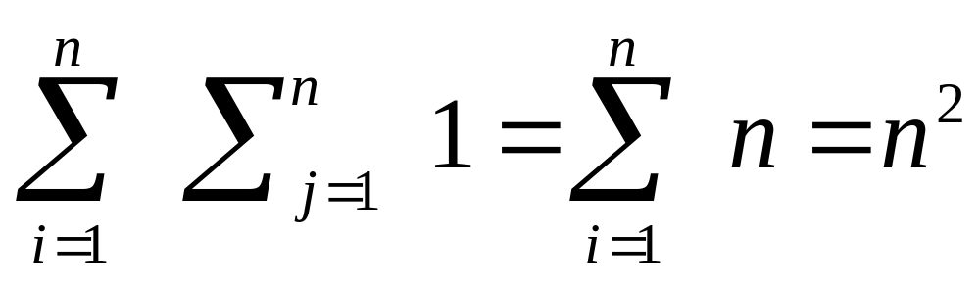
Nested Loops
for i = 1 to n do
for j = 1 to n do
sum = sum + 1
Notes:
This example is pretty straightforward. Each loop goes N times, constant amount of work on the inside.
N*N*1 = O(N^2)

Slide 19
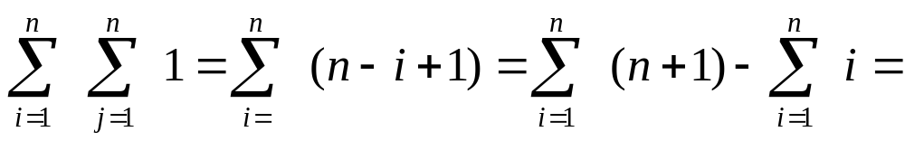
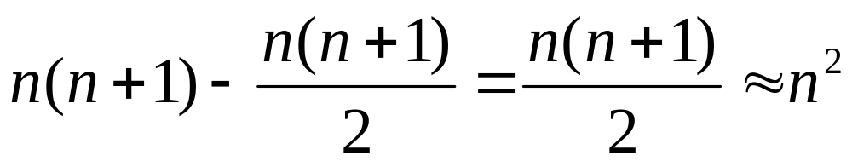
Nested Dependent Loops
for i = 1 to n do
for j = i to n do
sum = sum + 1
Notes:
There’s a little twist here. J goes from I to N, not 1 to N.
So, let’s do the sums
inside is constant.
Next loop is sum I to N of 1 which equals N - I + 1
Outer loop is sum 1 to N of N - I + 1
That’s the same as
sum N to 1 of I
or N(N+1)/2
or O(N^2)

Slide 20
Conditionals
Conditional
if C then S₁ else S₂
time ≤ time(C) + Max( time(S1), time(S2) )
Notes:
OK, so this isn’t exactly an example. Just reiterating the rule.
Time <= time of C plus max of S1 and S2
<= time of C plus S1 plus S2
time <= sum of times of iterations
often #of iterations * time of S (or worst time of S)

Slide 21
Coming Up
Thursday
  Unix tutorial
  First programming project!
Friday
  Finishing up analysis
  A little on Stacks and Lists
  Homework #1 goes out

