Slide 1
Project on
Bike Sharing Demand Prediction
By Mohd Arshad

Slide 2
Introduction Dataset Description:
Dataset has 8760 rows & 14 columns.
There are no Null values in the dataset.
There are some Duplicate values in the dataset.
The columns contained in the dataset are Date, Rented Bike count, Hour, Temperature, Humidity, Windspeed, Visibility, Dew point temperature, Solar radiation, Rainfall, Snowfall, Seasons, Holiday, Functional Day
Objective:
Develop a robust prediction model for bike rentals in Seoul City using advanced machine learning regression algorithms, integrating exploratory data analysis (EDA) to uncover hidden customer behavior patterns.
Predict bike demand accurately to make sure bikes are available when and where people need them in Seoul City. Use data to manage resources better, making bike rentals easy and convenient for everyone.

Slide 3

What manipulations have you done and what insights have you found?
Converted object data types to string data types for specified columns.
Utilized a loop to iterate through the specified columns and apply the conversion.
Changed the data type of the 'Date' column from object to datetime.
Separated the 'Day', 'Month', and 'Year' from the 'Date' column and added them as separate columns.
Dropped the 'Date' column as it was no longer needed.

Slide 4
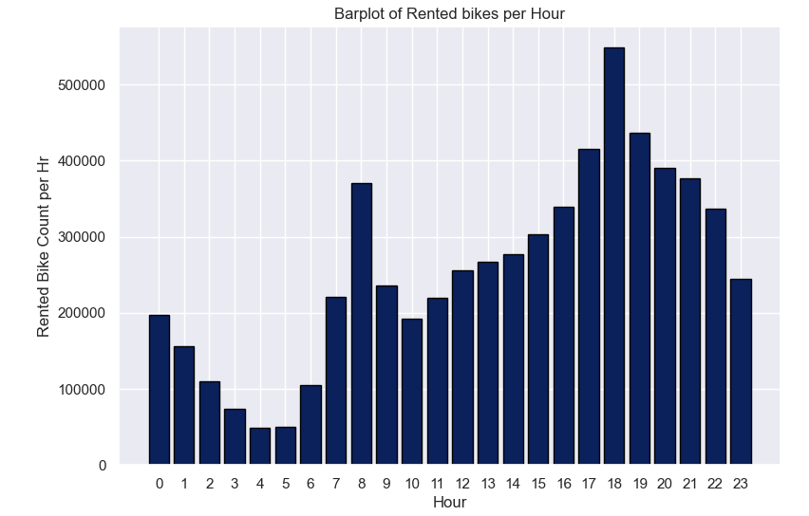
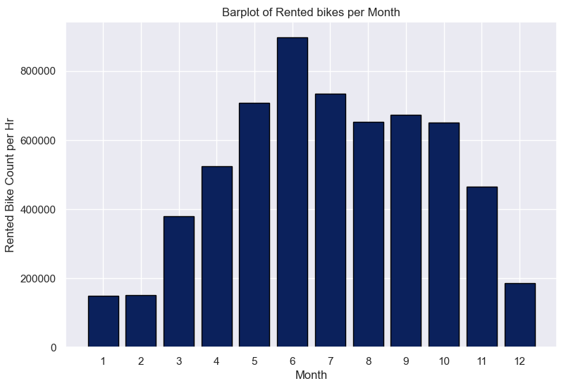
Exploratory Data Analysis
Our data indicates a bimodal distribution in bike demand, with a notable increase starting at 10:00 am and reaching its peak at 6:00 pm. This highlights an opportunity to enhance revenue by focusing on optimizing bike availability between 8:00 am and 11:00 pm, encompassing 23 hours in total.
We identify a seasonal pattern in bike demand, with the lowest utilization during winter (December-February) and peak demand from May to October, presenting a crucial opportunity to maximize ridership and revenue.

Slide 5
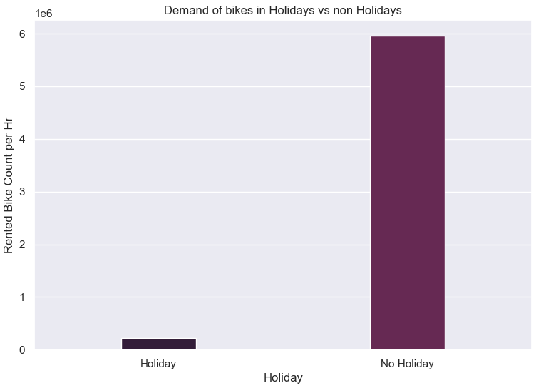
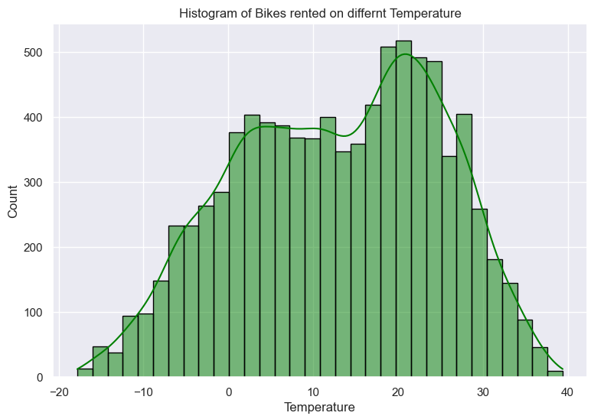
Relative to non-holiday periods, there exists a notably diminished demand for rental bikes during holiday periods.
If the temperature is below 0 degrees and more than 30 degrees folks don’t prefer renting bikes. They prefer other public services for going to workplaces.

Slide 6
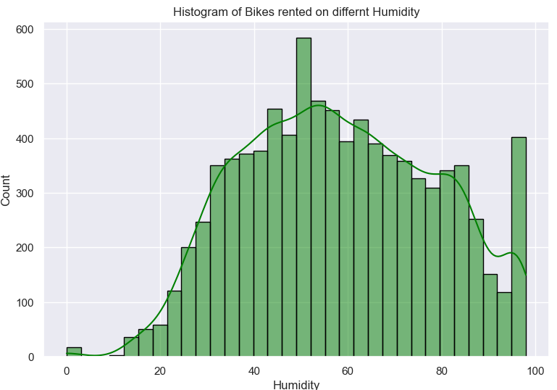
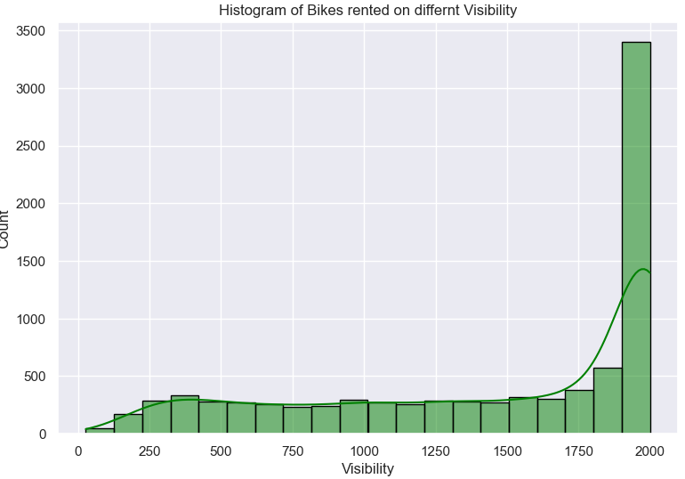
Our data shows that bike rentals increase when visibility is over 1800 meters, meaning people prefer to bike in clear weather. When visibility is below this level, bike rentals stay steady as people likely choose other transportation options.
Humidity between 25 to 85 is good concerning bike demand. anything other does not work in favor.

Slide 7
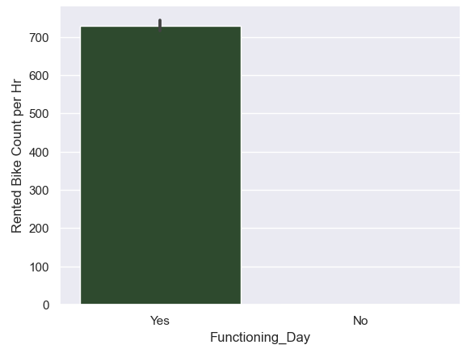
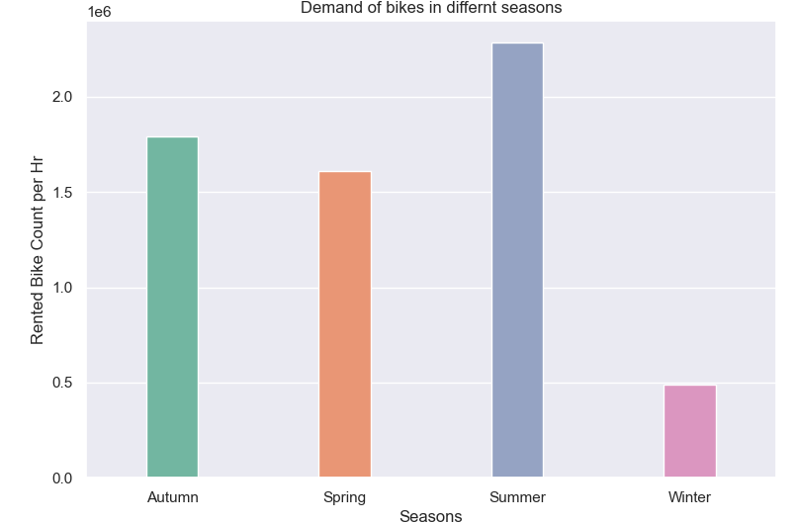
Bike demand peaks during summer, followed by autumn and spring. Winter experiences an 80% drop in demand compared to summer.
Bike demand peaks during summer, followed by autumn and spring. Winter experiences an 80% drop in demand compared to summer.

Slide 8
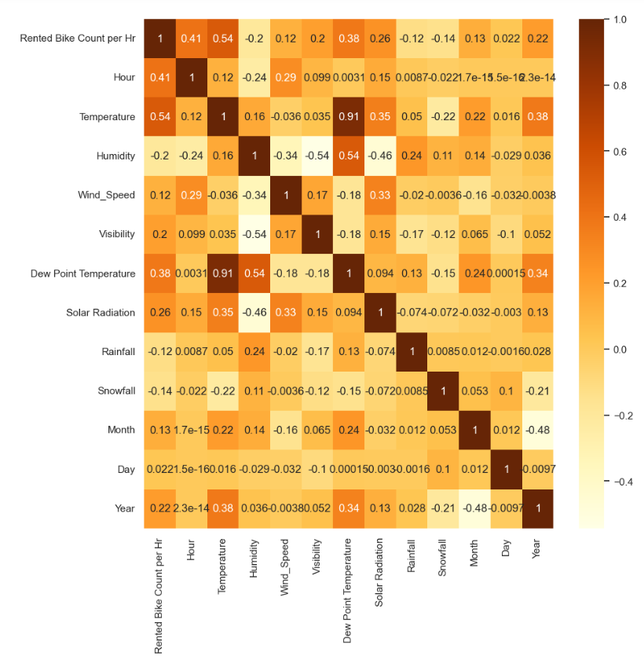
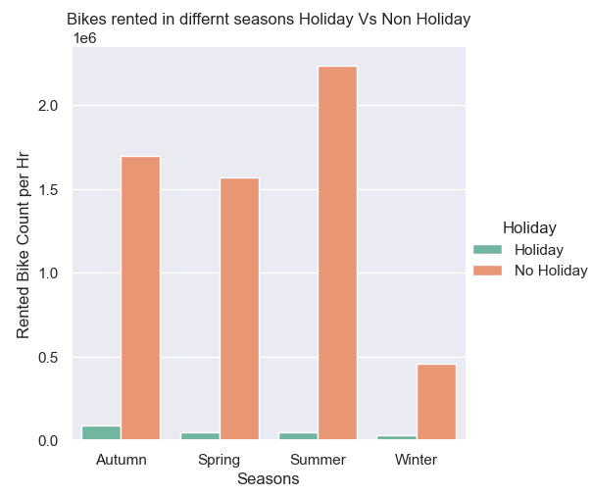
During non-holiday periods, peak bike demand is in summer, while in holiday periods, it reaches its highest point in autumn, surpassing other seasons.
Temperature and Bike Rentals:
Warmer weather = more bike rentals.
Positive correlation.
Snowfall and Bike Rentals:
Snow = fewer bike rentals.
Strong negative correlation.

Slide 9
Conclusions from EDA
Peak Demand Hours: Demand surges at 6:00 pm, prioritize availability from 8:00 am to 11:00 pm.
Weekly Patterns: Weekends show lower demand, tailor strategies accordingly.
Seasonal Variation: Lowest demand in winter, peaks from May to October.
Yearly Trends: 2018 saw a significant ridership increase over 2017.
Weekend Preferences: Bikes mainly for commuting, no demand on non-functioning days.
Diversification Strategy: Offer various bike types, and flexible rental plans, and collaborate for leisure activities.
Temperature Sensitivity: Demand is affected by temperature, avoid renting below 0 degrees.

Slide 10
Model building
Model building serves as the cornerstone of data-driven decision-making, enabling organizations to harness the power of their data for strategic insights and actionable intelligence. By leveraging machine learning algorithms, businesses can automate processes, optimize operations, and predict future outcomes precisely. This automation enhances efficiency and frees up valuable strategic initiatives and innovation resources.
Regression Algorithms Used:
XG boost
Decision Tree
Polynomial reg.
Ridge Regression
Lasso Regression
Multilinear
Elastic net regression
KNN
SVR and Dual form SVR

Slide 11
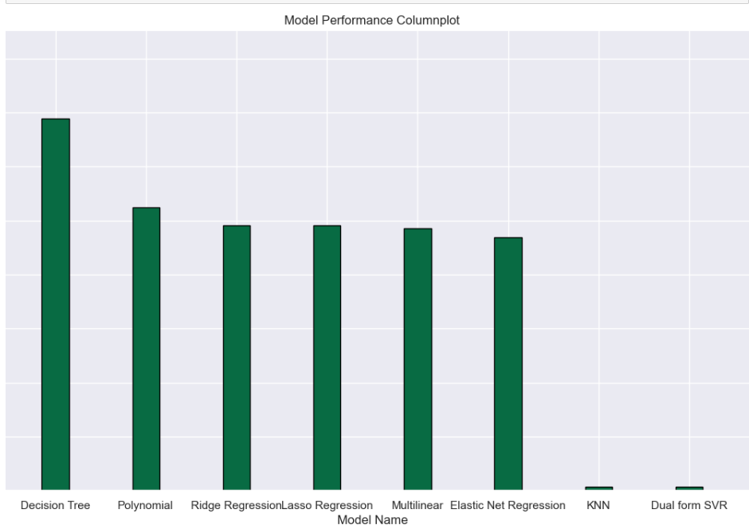
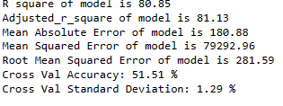
The choice of metric should be guided by discussions with domain experts. For this task, Adjusted R Square is selected as the primary evaluation metric, though other metrics can also be considered.
XGBoost Regressor emerges with the highest Adjusted R Square value among the models explored.
Therefore, the recommendation is to utilize XGBoost Regression for predicting rental bike demand.

Slide 12
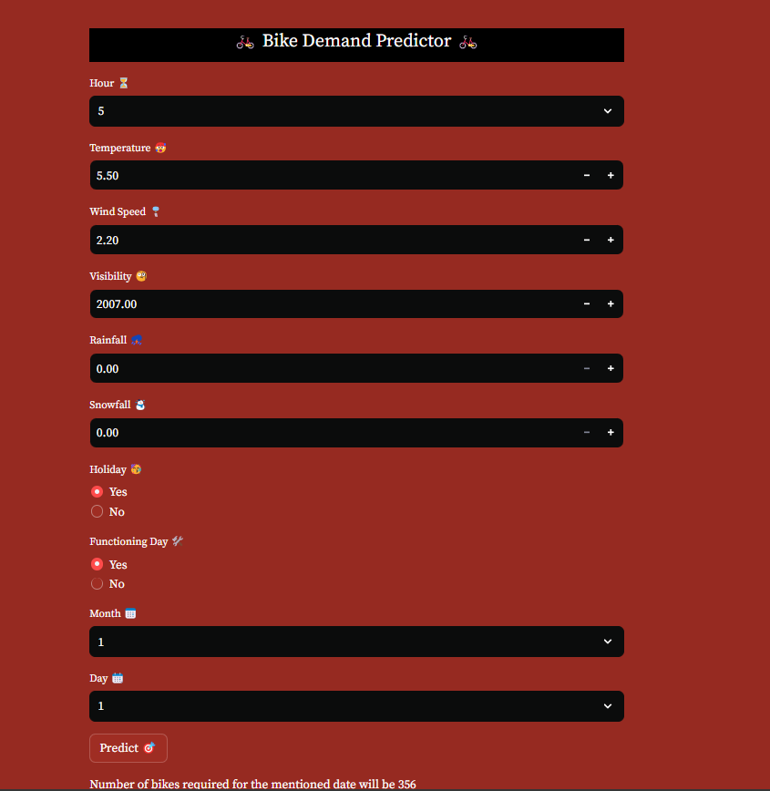
Machine Learning Model Deployment
I've implemented a machine learning project using Streamlit, which offers a user-friendly web interface for interacting with the model predictions. This deployment allows users to effortlessly engage with the predictive model, making it accessible and intuitive

Slide 13
Conclusion
Businesses need to factor in this mindset. and strategize accordingly. Consider offering diverse bike types (leisure bikes, cargo bikes) and flexible rental packages (multi-day passes, family plans) to cater to a wider range of needs. Explore collaborations with local attractions, businesses, or event organizers to promote bike rentals as part of leisure activities or errand trips.

Slide 14

THANK YOU

