Slide 1
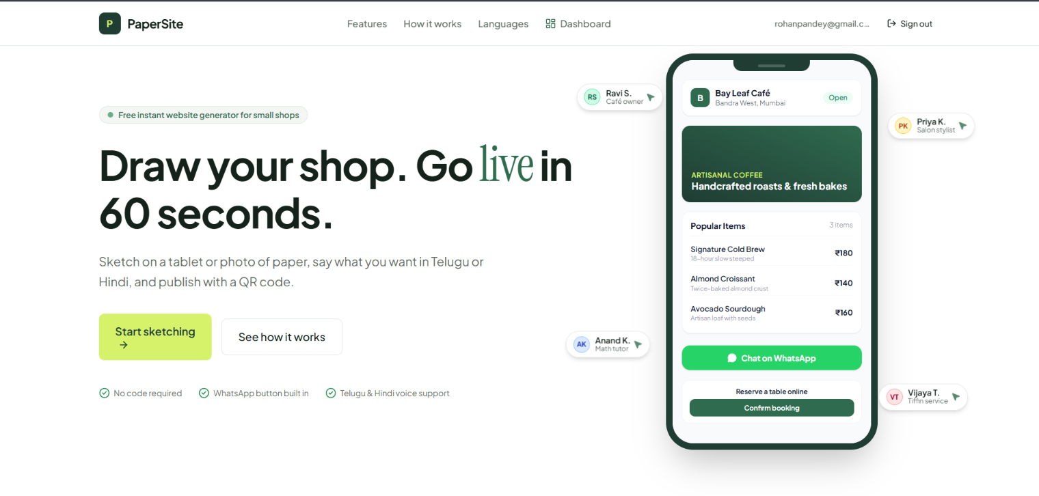
PAPERSITE
From Sketch to Website
AI-Powered Website Generation Platform
Sk Arshad Ahamad | B. Pardha Manoj Reddy
B. Giridhar | Pathan Arif
NBKRIST | Department of CSE

Slide 2
OVERVIEW
Introduction to PaperSite
“Transforming a simple hand-drawn website sketch into a functional, publishable website using AI.”
AI-powered website generation platform
Built for small businesses and people with an idea but no coding skills
Create projects, draw or upload sketches, generate, edit and publish
Receive customer bookings in realtime

Slide 3
THE PROBLEM
Problem Statement
Cost
Complexity
Professional website development can be expensive
Traditional website builders may be complicated for beginners
Technical barrier
Online presence
Turning a visual idea into a working site requires technical knowledge
Small businesses need a simpler way to get online

Slide 4
THE SOLUTION
Proposed Solution
Sketch Creation / Upload
→
AI Sketch Understanding
→
Layout Generation
→
HTML Generation
→
Live Preview
→
Website Publishing
The user starts from a drawing, not code or templates
AI interprets the sketch and produces a structured layout
The layout is turned into website HTML the user can preview and edit
One click publishes (or unpublishes) the site
Fewer steps between an idea and a first working website

Slide 5
ARCHITECTURE
System Architecture and Technology Stack
Frontend
Backend
AI Integration
React
TypeScript
Vite
Tailwind CSS
Supabase Edge Functions
TypeScript server-side processing
OpenRouter API
NVIDIA Nemotron (free model)
Structured JSON generation
Layout-to-HTML generation
→
→
↓
Deployment
Database and Storage (Supabase)
Vercel (frontend)
Supabase (backend)
PostgreSQL | Auth | Storage | Realtime | Row Level Security
Browser → Edge Functions → OpenRouter; data, auth and realtime handled by Supabase

Slide 6
CORE IMPLEMENTATION
THE FOUR HEARTS OF PAPERSITE
1
Sketch Export
2
AI JSON Generation
src/lib/exportSketch.ts
supabase/functions/_shared/openrouterJson.ts
3
Database Security
4
Realtime Bookings
supabase/migrations/0002_policies.sql
src/hooks/useLiveBookings.ts

Slide 7
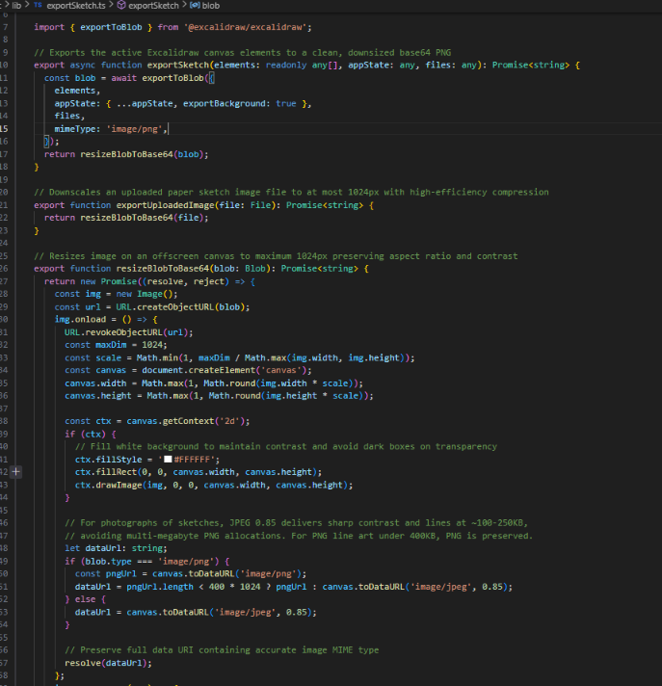
HEART 1
Heart 1: Sketch Export
Exports the Excalidraw canvas to an image
Also accepts uploaded sketch images
Resizes to max 1024 px, keeping aspect ratio
PNG or JPEG (0.85) chosen by image type and size
Returns a data URI with the correct MIME type
src/lib/exportSketch.ts
Canvas / Uploaded Image
→
Blob
→
Resize
→
Compress
→
Base64 Data URI

Slide 8
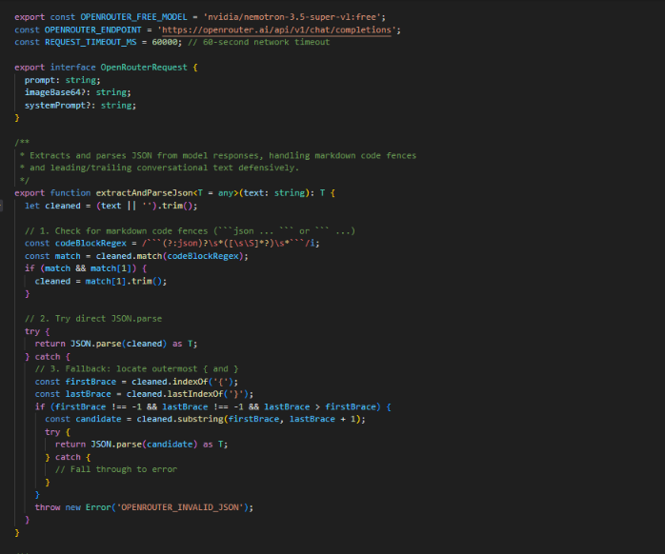
HEART 2
Heart 2: AI JSON Generation
Connects PaperSite to the OpenRouter API
Free model: nvidia/nemotron-3.5-super-vl:free
Sends the sketch image for multimodal understanding
Extracts JSON from code fences or surrounding text
Throws OPENROUTER_INVALID_JSON on bad output
supabase/functions/_shared/openrouterJson.ts
Sketch Image
→
OpenRouter API
→
NVIDIA Nemotron
→
Structured JSON
→
Validation

Slide 9
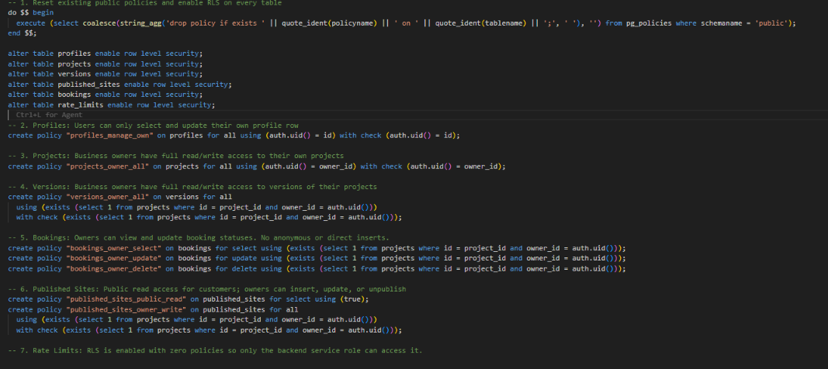
HEART 3
Heart 3: Database Security
RLS enabled on every public table
Users reach only their own profile, projects and versions
Booking access limited to the project owner; no anonymous inserts
Published sites: public read, owner write
rate_limits: no policies, backend only
supabase/migrations/0002_policies.sql
Authentication
→
RLS Policies
→
Authorized Database Access

Slide 10
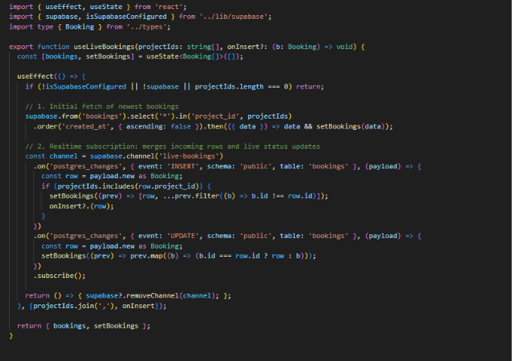
HEART 4
Heart 4: Realtime Bookings
Fetches the newest bookings for the user’s projects
Subscribes to Supabase Realtime changes on bookings
INSERT adds the booking and calls onInsert
UPDATE merges status changes live
Client filters by projectIds; channel removed on unmount
src/hooks/useLiveBookings.ts
Customer Booking
→
Database Change
→
Realtime Event
→
Dashboard Update

Slide 11
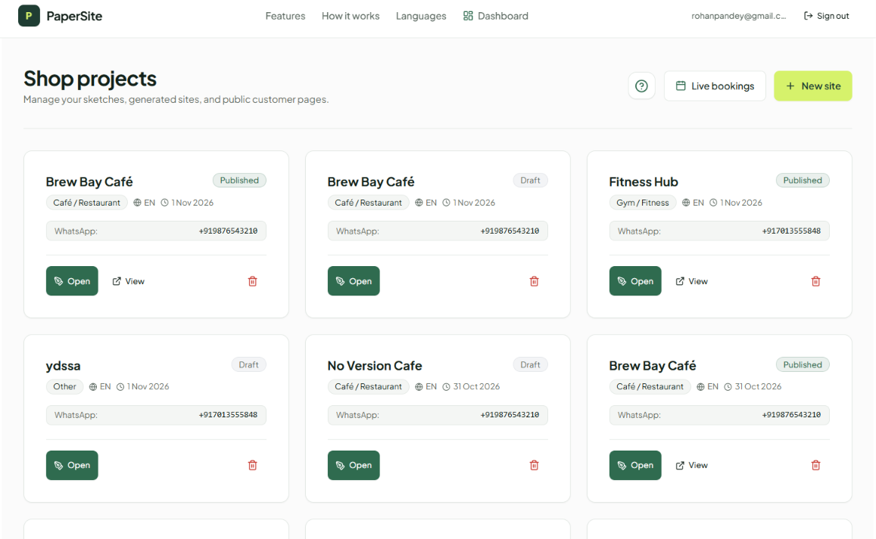
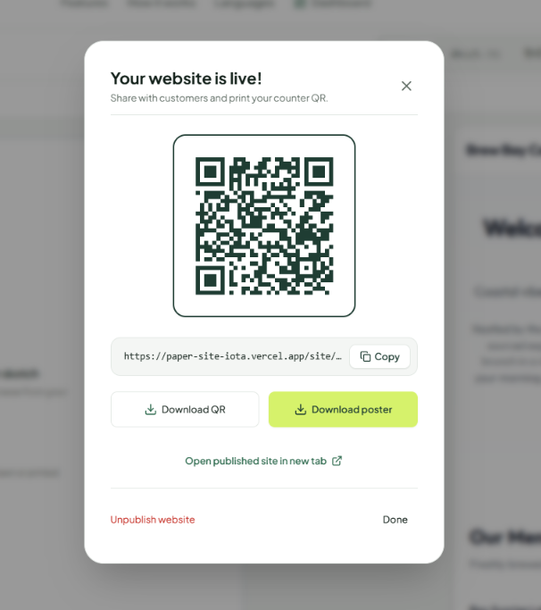
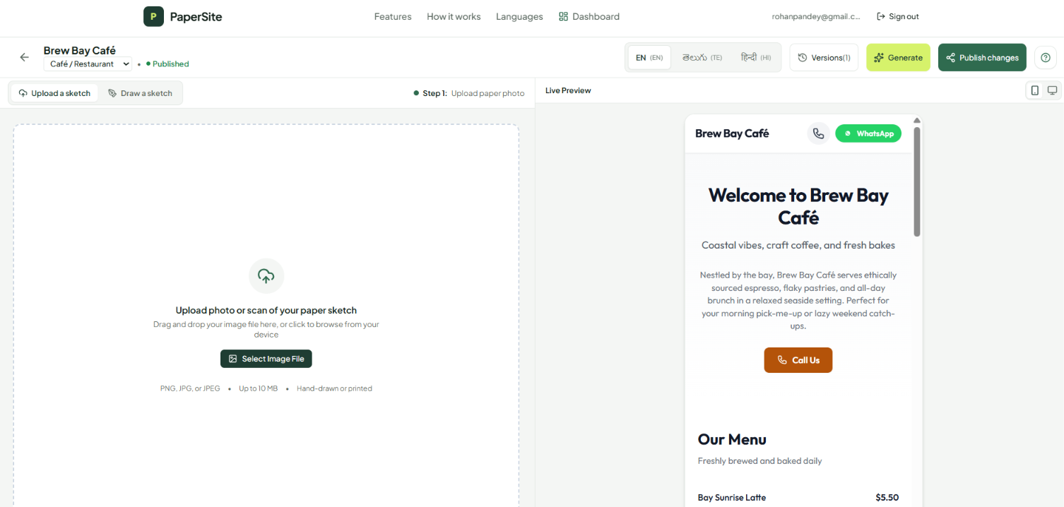
LIVE PRODUCT
Product Demonstration
Live URL and QR code
Download QR or poster
Unpublish anytime
1. Dashboard
2. Sketch upload and live preview
3. Published website

Slide 12
QUALITY
Security, Reliability and Future Scope
Implemented
Future Enhancements
Supabase authentication
Row Level Security
Server-side API key management
Input validation
HTML sanitization
Request-size limits
Meaningful API error handling
More advanced visual editing
Additional business-specific layouts
Multilingual website generation
Custom domains
Additional integrations

Slide 13
YOUR SKETCH. YOUR VISION. YOUR WEBSITE.
PaperSite connects a visual idea to a real, publishable website: sketch, generate, edit, publish and take bookings.
PAPERSITE | From Sketch to Website
https://paper-site-iota.vercel.app/
Sk Arshad Ahamad, B. Pardha Manoj Reddy, B. Giridhar, Pathan Arif
NBKRIST | Department of CSE
Thank You

