Slide 1

A P r e s e n t a t i o n o n
Optical Coherence Tomography (OCT) Images for Eye Diseases Diagnosis

Slide 2
Presented By
Arshadul Islam Sourav
ID: 22309017

Slide 3
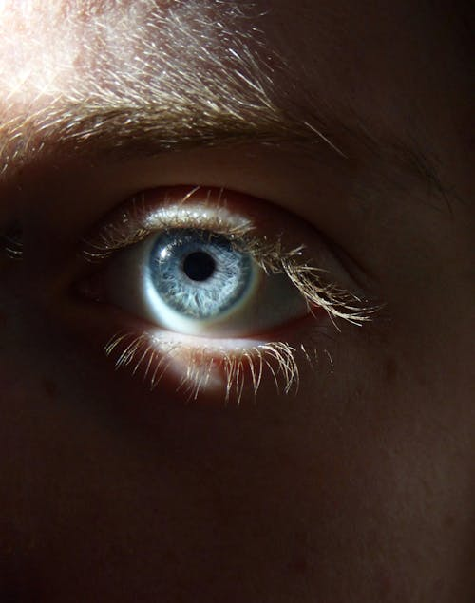
Outline
Introduction
Objectives
Literature Review
Methodology
Result Analysis and Discussion
Conclusion and Future Work
Optical Coherence Tomography

Slide 4

Introduction
Human Eye
The human eye is an organ of the body, part of the nervous system that interacts with visible light and allows us to use new information for a different of purposes, including seeing environments of our surroundings area, maintaining balance, and maintaining our circadian tone .

Slide 5
Eye Disease
Retinal damage is one of the most common eye diseases. The most common cause of retinal detachment is age, minor injury or injury. Retinal detachment can damage vital tissue. They can affect our vision and some of them can be so severe that we may blind. For retinal damages one could notice various visual effects such as –
• Blurry spots in one's central vision.
• Defects in side vision.
• Also can result in vision loss and eventual blindness.
• General distortion of images such as straight lines appearing wavy .

Slide 6
Optical Coherence Tomography
Optical Coherence Tomography (OCT) is a modern, non-invasive scanning technology used to image internal features of biological tissues. It works by monitoring optical reflections, providing cross-sectional views. In the context of eye diseases, OCT retinal images help ophthalmologists understand the condition or damage to the retina, macula, and optic nerve. It is crucial for early detection of retinal damage, which can lead to vision loss and blindness, including conditions like CNV, DRUSEN, AMD, and DME.

Slide 7
Classification Of OCT
Choroidal Neovascularisation (CNV)
Diabetic Macular Edema (DME)
DRUSEN
NORMAL

Slide 8
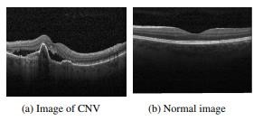
Choroidal Neovascularisation (CNV)
A frequent condition that can cause vision loss is called choroidal neovascularisation. It is caused by the formation of new blood vessels that emerge from the choroid through a rupture in the Bruch membrane and enter the sub-retinal pigment epithelium or sub-retinal space.

Slide 9
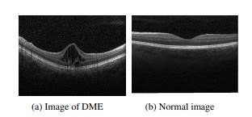
Diabetic Macular Edema (DME)
Diabetic macular edema (DME) is an eye disease that can occur in people with diabetes. It happens when high blood sugar levels damage blood vessels in the retina, causing them to leak fluid and swell, particularly in the macula, the central part of the retina responsible for sharp vision.

Slide 10
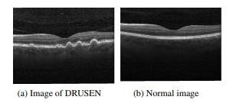
DRUSEN
Drusen are tiny, yellowish deposits that accumulate under the retina, primarily composed of proteins and fatty substances.

Slide 11
Comparison Between CNV, DME and DRUSEN
Feature | CNV | DME | DRUSEN
Nature | Abnormal new blood vessel growth | Swelling of the macula due to fluid leakage | Deposits under the retina
Primary Cause | Wet AMD, high myopia, inflammation | Complication of diabetes (diabetic retinopathy) | Aging (associated with AMD)
Mechanism | Formation of leaky blood vessels | Leaky retinal blood vessels due to high blood sugar | Accumulation of waste products
Vision Impact | Rapid, severe central vision loss due to leakage/bleeding | Blurred/distorted central vision due to swelling | Risk factor for AMD; can lead to vision loss if AMD progresses
Treatment | Anti-VEGF injections, PDT | Anti-VEGF injections, corticosteroids, laser treatment | Monitoring, sometimes anti-VEGF for AMD

Slide 12
Objectives
Patients have a better chance of recovery and visual restoration if retinal injury is identified or predicted early on. Which will help the ophthalmologists to take a clear look on the back of the eye and determine at early stages the damage caused to the retina, macula, and optic nerve.
In addition to affecting the retina and the patient's vision, eye disorders are linked to heart conditions and hypertension. This implies that early detection and diagnosis of eye diseases can help protect the patient's heart health.
Most of the diseases are microscopic, so wanted to develop a system that automatically classify diseases
The purpose of this research is to provide a new transfer learning-based categorization model.
Using retinal pictures from an optical coherence tomography (OCT) instrument, CNN architecture and a suggested model are used to automatically categories the various retinal disorders.

Slide 13
Literature Review
❏ "Automated Diagnosis of Glaucoma Using Deep Learning Methods" by Fard et al. This study proposed a deep learning-based method for automated diagnosis of glaucoma using labeled OCT images
❏ "Automated Diagnosis of Retinal Diseases Using Convolutional Neural Networks" by Liu et al. This study proposed a convolutional neural network (CNN) based method for automated diagnosis of retinal diseases using labeled OCT images
❏ "Retinal Layer Segmentation in Optical Coherence Tomography Images Using Deep Learning" by Chen et al. This study proposed a deep learning-based method for automated segmentation of retinal layers in OCT images, which can be used to aid in the diagnosis and monitoring of retinal diseases

Slide 14
Methodology
Experimentation Procedure:
Experiment Work :
Optical Coherence Tomography
Experimental Protocols:
Choroidal Neovascularisation (CNV)
Diabetic Macular Edema (DME)
Drusen
Normal
Experimental Approaches:
Transfer Learning
Sequential CNN architrcture
Proposed Model
Experimental Metric:
Loss on test
Accuracy on test
Confusion Matrix
Precision and Recall
Experimental Environment:
Windows 10
VGG-16
Python
Machine Learning
Software Environment: Colab

Slide 15
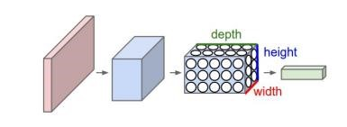
What is CNN
A particular type of multi-layer neural network called a convolutional neural network (CNN, or ConvNet) is made to identify visual patterns straight from pixel pictures with little to no preprocessing.
Figure: Convolutional neural network

Slide 16
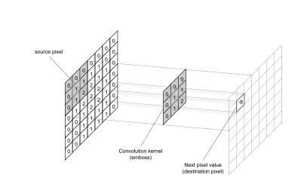
Kernel
Kernel is the parameter convolution layer used to convolve the image. Size and stride are two of the kernel's parameters. Any rectangle's dimensions can be used for the size. The number of pixels that are shifted each time is called stride.
Figure: Convolutional operation

Slide 17
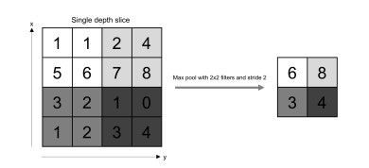
Max pooling
Convolution layers are sandwiched by pooling layers. By sampling, pooling layers minimize the picture size across layers. By choosing the highest value inside a window, the sample is carried out. Over the timeframe, average pooling averages are calculated.
Figure: Max pooling operation

Slide 18
VGG-16 Architecture
VGG16 convolution neural net (CNN) architecture won the ILSVR (Imagenet) competition. It is regarded as one of the best vision model architectures available today. The most distinctive feature of VGG16 is that, rather than having several hyper-parameters, they concentrated on having 3x3 convolution layers with stride 1 and consistently employed the same padding and maxpool layer of 2x2 stride 2 filters. Throughout the whole design, it continuously uses this configuration of convolution and max pool layers. Its final output consists of two FC (fully connected layers) and a soft max. The 16 in VGG16 stands for its 16 weighted layers. With over 138 million parameters, this network is rather vast.

Slide 19
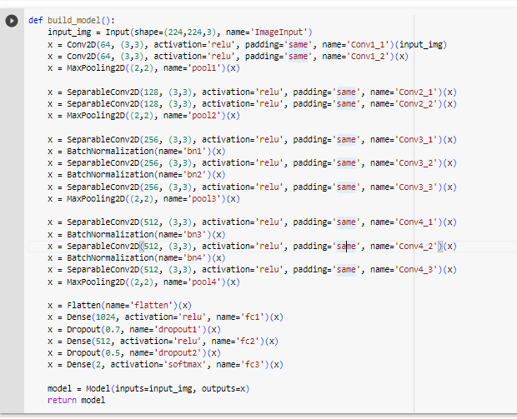
VGG-16 Architecture Layer

Slide 20
Transfer Learning
Reusing components of a previously trained model in a new machine learning model is known as transfer learning. The two models can exchange generalized information if they are designed to carry out comparable tasks. The resources and quantity of labelled data needed to train new models are decreased using this method of machine learning advancement.

Slide 21
Sequential CNN architecture
We call this traditional CNN a "sequential CNN model" since each layer only links to the layers that come before and after it. The spine photos are used to train this model from scratch. Three fully-connected and five convolutional layers make up the suggested model. The input layer receives input photos with dimensions of 227 × 227 × 3. The first convolutional layer has 96 filters, each with a size of 7 by 7 and stride of 2. To improve learning, each convolutional layer is followed by an activation of a Rectified Linear unit (ReLU) [21]. The filters in each of the other convolutional layers are 3x3 in size. A Gaussian distribution with a zero mean is used to initialize the weights.

Slide 22
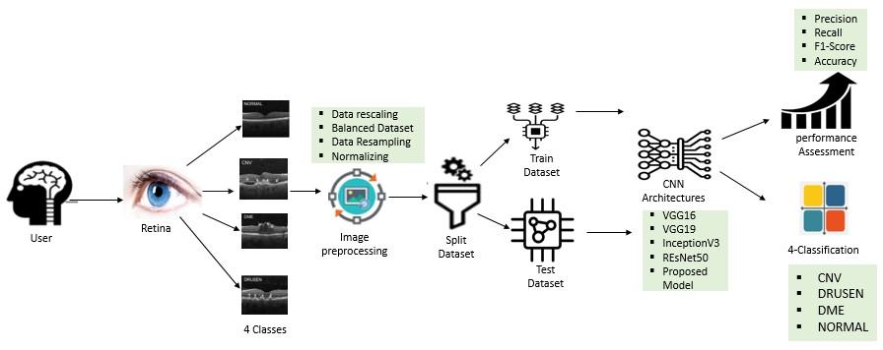
Proposed Method
Figure: Proposed Method

Slide 23
Performance Parameters
Accuracy on test:
Accuracy=TN+TP/TN+FP+FN+TP
Precision:
Precision=TPTP+FP
Recall:
Recall=TPTP+FN
F1Score=2*precision* recallprecision + recall
(TP: True Positive FP: False Positive TN: True Negative FN: False Negative)

Slide 24
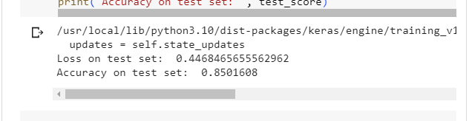
Analysis of performance
Figure: Transfer learning w/VGG-16’s Accuracy

Slide 25
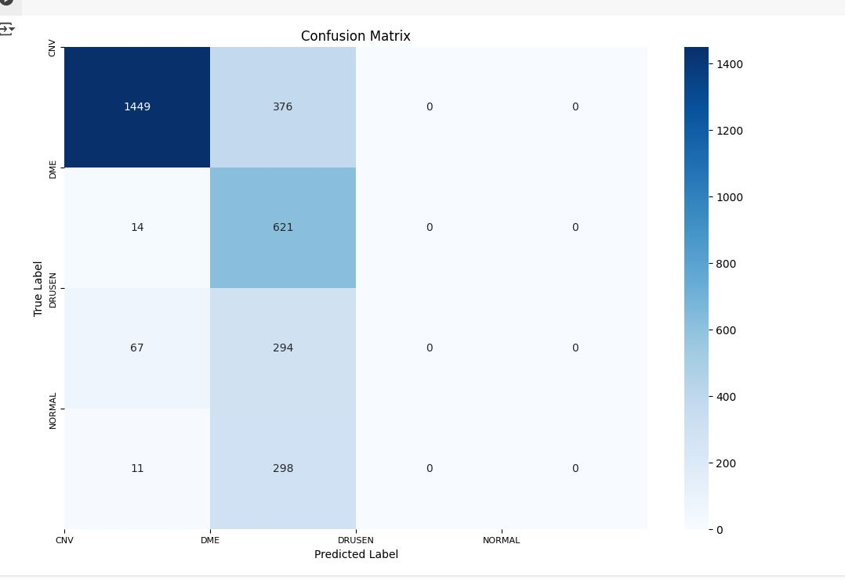
Analysis of performance
Figure: Transfer learning w/VGG-16’s Confusion matrix

Slide 26
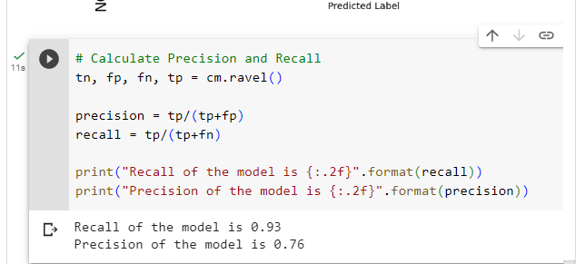
Analysis of performance
Figure: Transfer learning w/VGG-16’s Precision and Recall

Slide 27
Conclusion
In order to categories retinal pictures acquired from an OCT scanning equipment, we suggested a novel classification model based on deep neural networks. The results indicate that the application of convolutional neural networks might provide very intriguing outcomes. 85% in image classification, offers a novel, easy, and efficient way to identify CNV, DME, and DRUSEN early, and may be used to evaluate physicians in medical diagnosis. Additionally, we have shown that using sequential models and some pre-trained models can improve model efficacy and time outcomes.

Slide 28
Future Work
Other datasets can be used in this experiment. The model cannot be trained at 448 × 448 × 3 resolution due to compute resource limitations. Therefore, 448 x 44 8 × 3 resolution can be used to train the suggested techniques. Even though my suggested design improves retrieval accuracy, the ResNet50 architecture model can be used since its network architecture weights are somewhat high and slow to train. In further research, we will confirm the outcome using a wide range of datasets.

Slide 29
References
https://en.wikipedia.org/wiki/Human_eye
https://my.clevelandclinic.org/health/articles/21204-vision
https://associatedretinaconsultants.com/symptomsofdamagedretina/#:~:text=Retinal%20damage%20is%20one%20of,serious%20enough%20to%2 0cause%20blindness.
Deep learning for identifying and classifying retinal diseases
Classification of Optical Coherence Tomography using Convolutional Neural Networks
Ali, Liaqat & Khelil, Khaled & Kanwal et al. (2017). Machine learning based computer-aided diagnosis of liver tumours. 139-145. 10.1109/ICCI-CC.2017.8109742.

Slide 30
References
Hoover, A., and Goldbaum, M. (2003). Locating the optic nerve in a retinal image using the fuzzy convergence of the blood vessels. IEEE Trans. Med. Imaging 22, 951–958.
Hoover, A., Kouznetsova, V., and Goldbaum, M. (2000). Locating blood vessels in retinal images by piecewise threshold probing of a matched filter response. IEEE Trans. Med. Imaging 19, 203–210
Kaiser, P.K., Brown, D.M., Zhang, K., Hudson, H.L., Holz, F.G., Shapiro, H., Schneider, S., and Acharya, N.R. (2007). Ranibizumab for predominantly classic neovascular age-related macular degeneration: subgroup analysis of first-year ANCHOR results. Am. J. Ophthalmol. 144, 850–857
Szegedy, C., Vanhoucke, V., Ioffe, S., Shlens, J., and Wojna, Z. (2016). Rethinking the Inception Architecture for Computer Vision. In 2016 IWWW Conference on Computer Vision and Pattern Recognition, pp. 2818–2826.

Slide 31
THANKS!

