Slide 1

Clustering Genders based on Open Sex-Role Survey
By: Arsham Vosoughinia
Data From: The Bem Sex-Role Inventory
Published by: Open-Source Psychometrics Project
Link: https://openpsychometrics.org/tests/OSRI/development/

Slide 2
BACKGROUND & DEVELOPEMENT
The Bem Sex-Role Inventory is one of the most popular measures used to study gender differences in personality. It measures masculinity and femininity as two separate scales. This contrasts to most earlier tests that conceptualized masculinity as the opposite of femininity and measured on one scale ¹
The approach taken to develop the OSRI was to collect a list of questions that showed a large gender difference
Analyze them with factor analysis to see if Bem's two factor solution could be fit
An initial screening procedure looked at 2,610 self-report items, and the average gender difference for each was computed using a multitude of different samples
From the items on this list that had the highest correlation with gender, a selection of 44 was taken as a beta version of the OSRI
Using this beta version, responses were collected from 316,256 internet participants along with demographic information

Slide 3
PROJECT’S GOALS
Predicting gender (Female, Male) based on 3 data criterion evaluations:
Only the 44 test questions
The 44 test questions and 3 demographic questions (Age, Right/Left-Handed and Orientation)
The 44 questions containing only the hetero-sexual participants
Applying Reduction and Clustering methods to obtain results
Determining the reliability and accuracy of each criterion
The outcome/result of this project to be used by psychiatric and social scientists for behavioral clustering of masculinity or femineity and determining attributes effecting sex-roles in humans personal and social structure.

Slide 4
DATA DESCRIPTION
The shape of the Data Set is 318,572 rows and 57 columns
The size of the data set is 18,158,661
There are 44 main questions on the test survey
Answers are the integer range of 1 to 5 corresponding to strongly disagree to strongly agree respectively
There are 6 demographic questions:
Race: 1=Mixed race, 2=Asian, 3=Black, 4=Native American, 5=Native Australian, 6=White, 7=Other
Religion: 1=Mixed race, 2=Asian, 3=Black, 4=Native American, 5=Native Australian, 6=White, 7=Other
Age: (ages < 13 not recorded)
Sexual Orientation: 1=Heterosexual, 2=Bisexual, 3=Homosexual, 4=Asexual, 5=Other
Native of English: 1=Yes, 2=No
Gender: 1=Male, 2=Female, 3=Other
Education: 1=Less than high school, 2=High school, 3=University degree, 4=Graduate degree
Left/Right-Handed: 1=Right, 2=Left, 3=Both

Slide 5
QUESTIONS & AFFILIATION
Feminine Sex-Role | Masculine Sex-Role
I really like dancing. I give people handmade gifts. I leave nice notes for people now and then. I take lots of pictures of my activities. I bake sweets just for myself sometimes. I decorate my things (e.g., stickers on laptop). I jump up and down in excitement sometimes. I wear a blanket around the house I have kept a personal journal. I think horoscopes are fun. | I have daydreamed saving one from a burning building. I think a natural disaster would be kind of exciting. I have thrown knives, axes or other sharp things. I like guns. I have considered joining the military. I have taken apart machines just to see how they work. I have set fuels, aerosols or other chemicals on fire, for fun. I have been very interested in historical wars. I have studied how to win at gambling. I have burned things up with a magnifying glass.

Slide 6
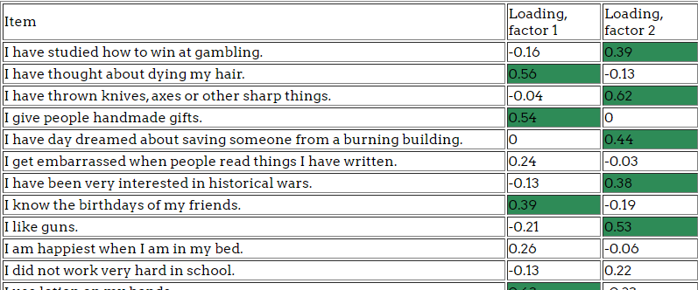
FACTOR STRUCTURE
The structure of the 44 items was investigated with factor analysis using varimax rotation. An inspection of the scree plot provides strong evidence that gender differences do not fall along a single continuum; Instead, a 2-factor solution is suggested.¹
Snapshot of factor structure table for 44 questions, factors above 0.3 are shaded¹

Slide 7
PROJECT CONDUCT DETAILS
Only participants identified as Male or Female were included, other genders were omitted
A sample of 50,000 participants from the main dataset was evaluated in this project
Only participants with native or bilingual status of English were examined
In the first criterion, all sexual orientations are included
In the third criterion, only hetero-sexual participants were accounted

Slide 8
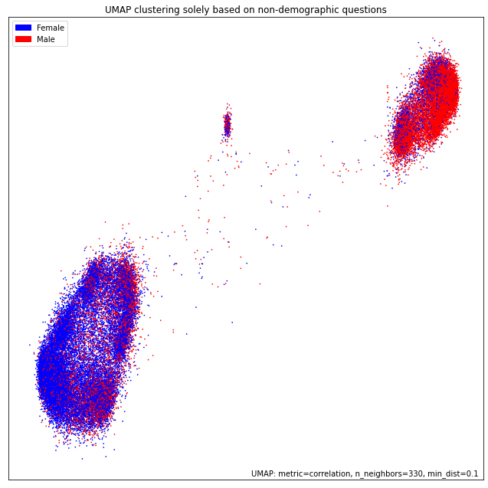
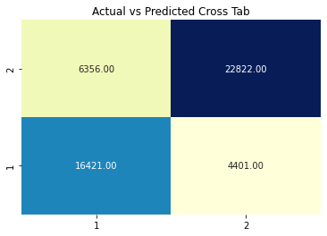
Visual Result for the first criterion (Technical questions)

Slide 9
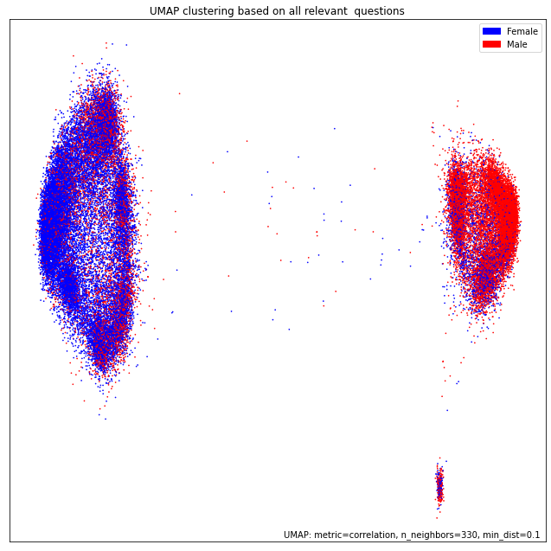
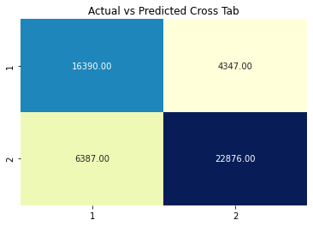
Visual Result for the second criterion (Technical & Demographic questions)

Slide 10
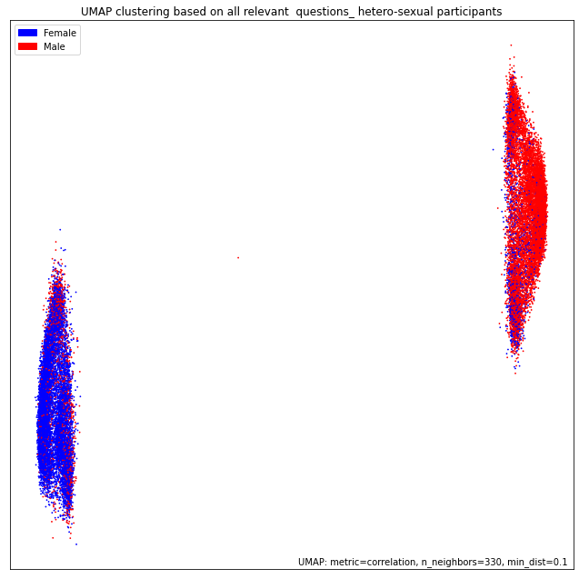
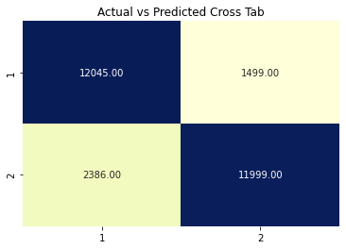
Visual Result for the last criterion (Hetero-sexual participants)

Slide 11
RESULTS SPECIFICATIONS
All three criterions revealed fairly good predicting accuracy score
UMAP and K-MEANS methods was the most effective method clustering males and females
Including participants demographic data of Orientation, Right/Left-Handed and Age did not provide meaningful result difference compared to the first criterion
The prediction accuracy is significantly higher among hetero-sexual participants

Slide 12
Thank You!

Slide 13
REFFERENCE
1. “Development of the OSPP Sex-Role Inventory.” Open-Source Psychometrics Project, 17 Apr. 2019, openpsychometrics.org/tests/OSRI/development.

