Slide 1
JavaScript in the Browser
ADACODE SOLUTIONS

Slide 2
JavaScript in the Browser
Javascript was initially created to make web pages alive.
Js can be used to makes the web page more interactive.
The browser has an embedded engine called the Javascript engine or the Javascript runtime.

Slide 3
Developer Tool
Every modern web browser includes a powerful suite of developer tools.
These tools do a range of things, from inspecting currently-loaded HTML, CSS and JavaScript to showing which assets the page has requested and how long they took to load.
What are browser developer tools? - Learn web development | MDN (mozilla.org)
We can also write js commands in the console.

Slide 4
The Script tag - <script> <script/>
The script tag is used to insert Js into html page.
It can be used to insert external or internal scripts.
Eg : <script> or <script src=“./script.js”> <script>
alert(“Hello”)
<script>

Slide 5
Console Object Method
The console object has several methods , log being one of them. Some of them are as follows:
assert () – Used to assert a condition
clear() – Cleans the console
log() – Outputs a message to the console
table() – Displays a tabular data
warn ()-used for errors
info() – Used to special information

Slide 6
Interaction : alert, prompt and confirm
alert() –Used to invoke a mini window with a message
alert(“Welcome to Luminar Technolab”)
prompt() – Used to take user input as string
input=prompt(“hi”,”no”)
confirm() – Shows a message and wait for the user to press or cancel. Returns true for ok and false for cancel.

Slide 7
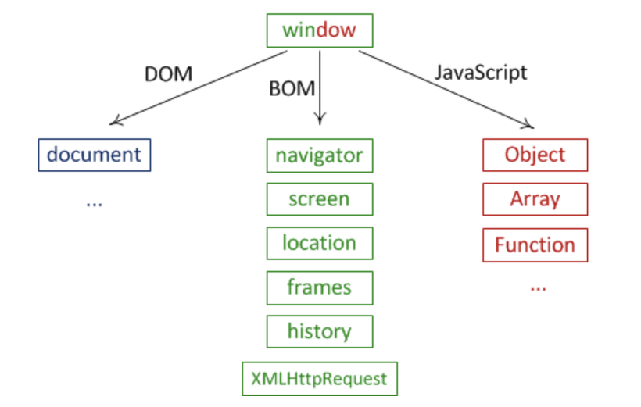
Window Object BOM & DOM

Slide 8
Window Object
All objects, functions, and variables are a part of the window object.
Both BOM and DOM are window objects.
BOM
BOM stands for Browser Object Model.
The BOM is the window object that represents a window in the browser.
We can manipulate the browser window with the window object and add various events using BOM properties
The DOM is a subset of BOM object

Slide 9
Window Object
DOM
It stands for Document Object Model.
Document Object Model in JavaScript is used to access the elements inside the document.
It maps the entire Document into a hierarchy of parent and child in tree structure along with its properties and methods.
The document object represents the whole HTML document.
When an HTML document is loaded in the browser, it becomes a document object, and you can use document object to manipulate the web page.
We can change an element's text, element's color, hide and show elements, add an event listener to the HTML elements etc.

Slide 10

DOM

Slide 11
With the object model, JavaScript gets all the power it needs to create dynamic HTML:
JavaScript can change all the HTML elements in the page
JavaScript can change all the HTML attributes in the page
JavaScript can change all the CSS styles in the page
JavaScript can remove existing HTML elements and attributes
JavaScript can add new HTML elements and attributes
JavaScript can react to all existing HTML events in the page
JavaScript can create new HTML events in the page

Slide 12
Select Elements in the Document
getElementsByTagName()- select elements by a tag name.
getElementById() - select an element by id.
getElementsByClassName() - select elements by one or more class names.
querySelector() - select only one element by one or more class names.
querySelectorAll() - select all elements by one or more class names.

Slide 13
Thank You

