Slide 1
Styling
ADACODE

Slide 2
CSS (Cascading Style Sheet)
CSS stands for Cascading Style Sheets.
It is a style sheet language which is used to describe the look and formatting of a document written in markup language.
It provides an additional feature to HTML.
It is generally used with HTML to change the style of web pages and user interfaces.

Slide 3
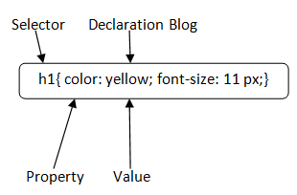
CSS Syntax
A CSS rule set contains a selector and a declaration block.
Selector: Selector indicates the HTML element you want to style. It could be any tag like <h1>, <title> etc

Slide 4
Declaration Block:
The declaration block can contain one or more declarations separated by a semicolon. For the above example, there are two declarations:
color: yellow;
font-size: 11 px;
Each declaration contains a property name and value, separated by a colon.

Slide 5
Components of CSS
Selector : A Selector is a html tag at which a style will be applied. Eg: <h1>
Property : A property is a type of attribute of html tag. Eg: color,border
Value : Values are assigned to properties. Eg: color:pink

Slide 6
CSS SELECTORS
CSS selectors are used to select the HTML elements that are to be styled by CSS. For example,
h1 {
color : Green;
}

Slide 7
TYPES OF CSS SELECTORS
There are the following different types of selectors in CSS.
Element selector
Id selector
Class selector
Universal selector
Group selector

Slide 8
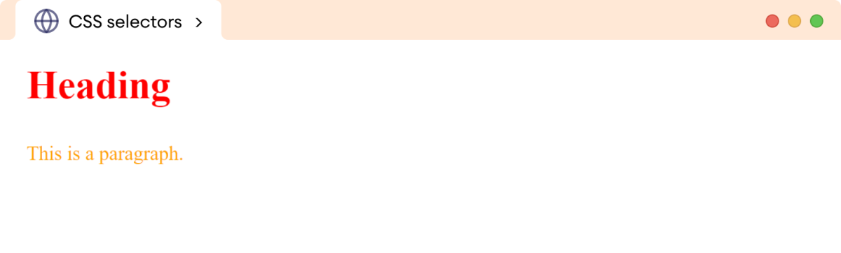
ELEMENT SELECTOR
The Element Selector selects HTML elments( h1,h3,P,..etc)
OUTPUT
h1 {
color: red;
}
p {
color: orange;
}

Slide 9
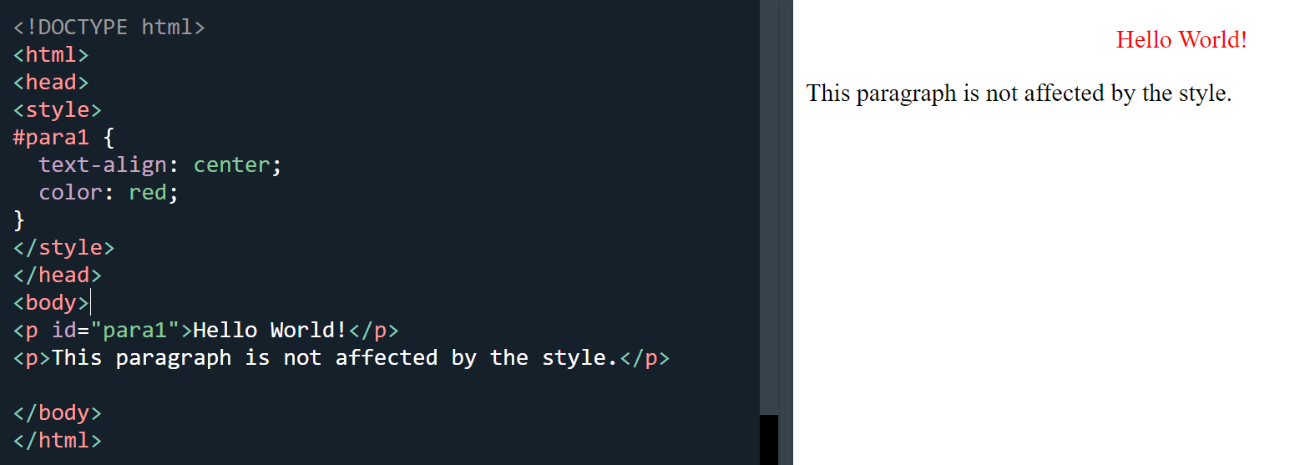
ID SELECTOR
The id of an element is unique within a page, so the id selector is used to select one unique element!
To select an element with a specific id, write a hash (#) character, followed by the id of the element.

Slide 10
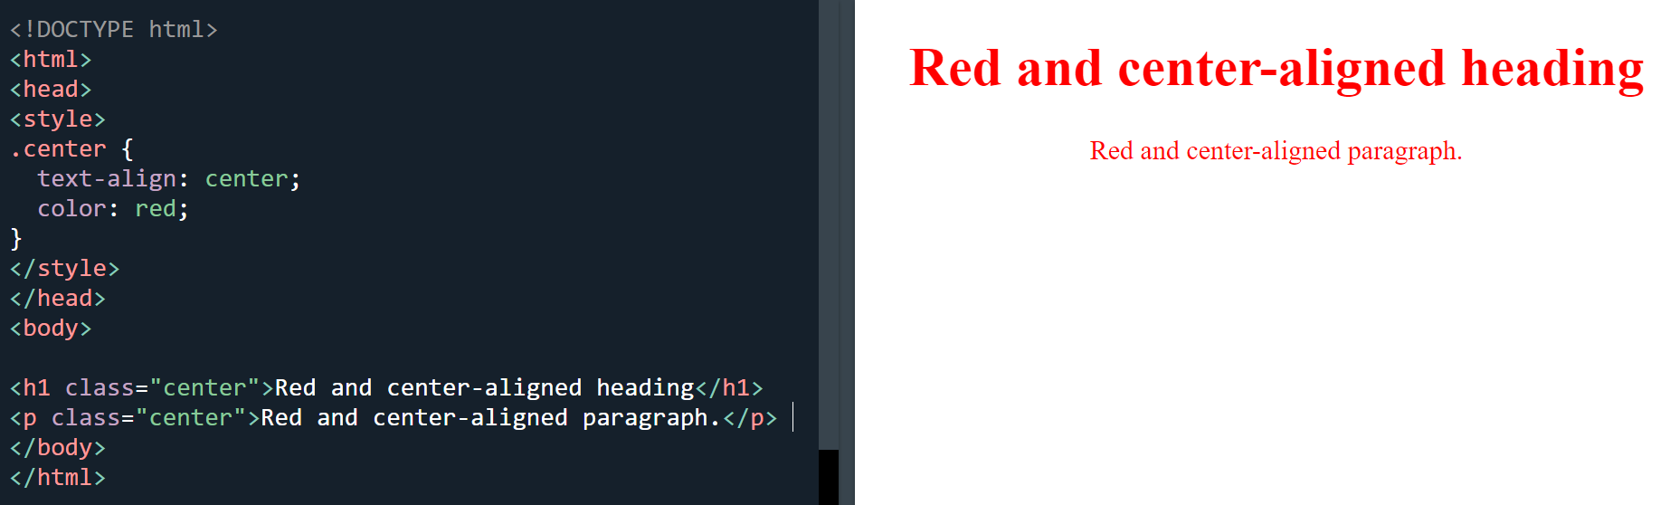
CLASS SELECTOR
The class selector selects HTML elements with a specific class attribute.
To select elements with a specific class, write a period (.) character, followed by the class name.

Slide 11
Universal Selector
The universal selector (*) selects all HTML elements on the page
Eg:* {
text-align: center;
color: blue;
}

Slide 12
Group Selector
The grouping selector selects all the HTML elements with the same style definitions.
It will be better to group the selectors, to minimize the code.
To group selectors, separate each selector with a comma.
eg :
h1, h2, p {
text-align: center; color: red;
}

Slide 13
HTML Colors
HTML colors are specified with predefined color names, or with RGB, HEX, HSL, RGBA, or HSLA values.
Color Values
In HTML, colors can also be specified using RGB values, HEX values, HSL values, RGBA values, and HSLA values.
rgb(255, 99, 71), #ff6347, hsl(9, 100%, 64%)
background color set with RGBA and HSLA values, which adds an Alpha channel to the color (here we have 50% transparency):
rgba(255, 99, 71, 0.5)hsla(9, 100%, 64%, 0.5)

Slide 14
HTML style Attribute
The style attribute specifies an inline style for an element.
The style attribute will override any style set globally, e.g. styles specified in the <style> tag or in an external style sheet.
Eg:
<h1 style="color:blue;text-align:center">This is a header</h1> <p style="color:green">This is a paragraph.</p>

Slide 15
HTML Style Tag
The html <style> tag contains the style information of the document, or it is a part of a document.
<style> tag contains the CSS which is used for styling the Web Page.
<style> ...content here </style>

Slide 16
1. Background-Color
With this CSS property we can set the background color for any HTML element like <div>, <h1> etc.
Example:
<h1 style="background-color:blue">My background is blue</h1>

Slide 17
2. Color
The font color of the text in an HTML element can be controlled by setting its color attribute to the right color name or HEX code, or RGB code.
Example
<h1 style="color:blue">My font color is blue</h1>
Output:

Slide 18
3. Border Color
We can set the border color of any HTML element if we’d like to add a border to it.
Example
<p style="border: 1px solid red">My border is red</p>
Output:

Slide 19

4. Background-Image
We can also set an image as a background by using the background-image property as follows:
Example:
<div style="background-image: url('https://www.google.com/images/branding/googlelogo/2x/googlelogo_color_272x92dp.png');height :365px">
Output:

Slide 20

5. Background-Repeat
when an image is set as background using the background-image property, it by default repeats the image both horizontally as well as vertically. However, some images may need to be repeated either vertically or horizontally.
This behavior can be controlled by setting the desired value against the property of background-repeat.
The value “repeat-x” is used to allow the image to be repeated only horizontally.
The value “repeat-y” is used to allow the image to be repeated only vertically.
The value “no-repeat” is used to stop any kind of repetition of the background image.
Eg: <div style="background-image: url('https://www.google.com/images/branding/googlelogo/2x/googlelogo_color_272x92dp.png');height :365px; background-repeat:no-repeat">
Output:

Slide 21

6. Background-Position
Example
<div style="background-image: url('https://www.google.com/images/branding/googlelogo/2x/googlelogo_color_272x92dp.png');height :365px; width:500px;background-repeat: no-repeat; background-position: left bottom;">
</div>
Output:

Slide 22
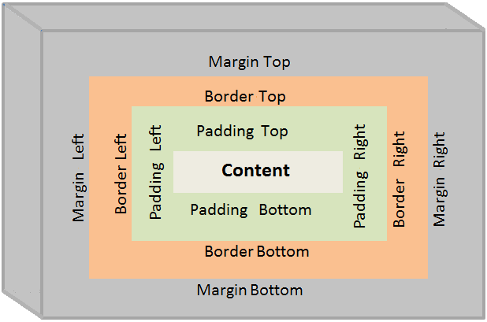
CSS BOX MODEL
The components of the box model are:
Content: actual text or image that is displayed in the element
Padding: transparent space between the content and the
border of an element
Border: line that surrounds the padding and content within the element
Margin: transparent area added outside the border
The primary purpose of the box model is to explain how
the dimensions and spacing of elements are calculated
and how they relate to each other.

Slide 23
Div Tag
The div tag is known as Division tag.
The div tag is used in HTML to make divisions of content on the web page like (text, images, header, footer, navigation bar, etc).
Div tag has both opening(<div>) and closing (</div>) tags and it is mandatory to close the tag.
Eg: <div>Welcome</div>

Slide 24
Span Tag
The HTML span element is a generic inline container for inline elements and content.
It used to group elements for styling purposes (by using the class or id attributes).
A better way to use it when no other semantic element is available.
The span tag is very similar to the div tag, but div is a block-level tag and span is an inline tag.
<span>Welcome</span>

Slide 25
Property:
A Property is a type of attribute of HTML element. It could be color, border etc.
Value: Values are assigned to CSS properties. In the above example, value "yellow" is assigned to color property.
Selector{Property1: value1; Property2: value2; ..........;}

Slide 26
Types of CSS
Inline CSS
Internal or Embedded CSS
External CSS

Slide 27
Inline CSS
Inline CSS contains the CSS property in the body section attached with element is known as inline CSS.
This kind of style is specified within an HTML tag using the style attribute.
Eg: <p style = "color:#009900; font-size:50px;
font-style:italic; text-align:center;">
Welcome
</p>

Slide 28
Internal or Embedded CSS
The internal style sheet is used to add a unique style for a single document. It is defined in <head> section of the HTML page inside the <style> tag.
Eg<head> <style>
h1 {
color: red;
margin-left: 80px; }
</style> </head>
<body> <h1>The internal style sheet is applied on this heading.</h1> </body>

Slide 29
External CSS
The external style sheet is generally used when you want to make changes on multiple pages. It is ideal for this condition because it facilitates you to change the look of the entire web site by changing just one file.
It uses the <link> tag on every pages and the <link> tag should be put inside the head section.
Eg:<head>
<link rel="stylesheet" type="text/css" href="mystyle.css">
</head>

Slide 30
External CSS
The external style sheet may be written in any text editor but must be saved with a .css extension. This file should not contain HTML elements
Let's take an example of a style sheet file named "mystyle.css".
File: mystyle.css
body {
background-color: lightblue;
}
h1 {
color: navy;
margin-left: 20px;
}

Slide 31
TASKS
Difference between div and span
What is CSS3?, Features, Advantages , Uses and Needs

