Slide 1
FUNCTIONS

Slide 2
FUNCTIONS
In JavaScript, a function allows you to define a block of code, give it a name and then execute it as many times as you want.
Simply its a block of code designed to perform a particular task.
A JavaScript function is executed when "something" invokes it (calls it).

Slide 3
Function Definition
A JavaScript function can be defined using function keyword.
A JavaScript function is defined with the function keyword, followed by a name, followed by parentheses ().
Function names can contain letters, digits, underscores, and dollar signs (same rules as variables).
The parentheses may include parameter names separated by commas: (parameter1, parameter2, ...)
The code to be executed, by the function, is placed inside curly brackets: {}

Slide 4
Function Syntax
//defining a function
function <function-name>()
{
// code to be executed
};

Slide 5
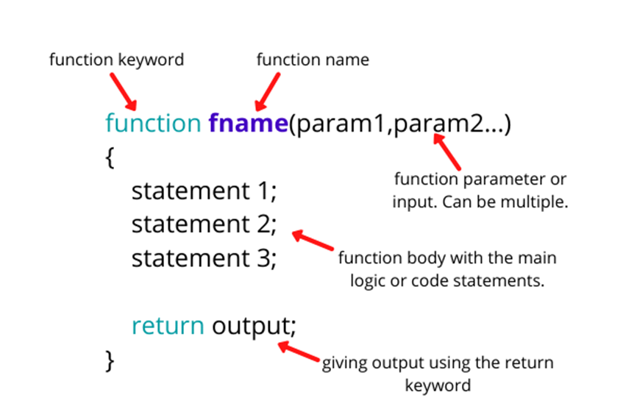

Slide 6
Function Invocation
The code inside the function will execute when "something" invokes (calls) the function:
When an event occurs (when a user clicks a button)
When it is invoked (called) from JavaScript code
Automatically (self invoked)
//calling a function
<function-name>();

Slide 7
Function Return
When JavaScript reaches a return statement, the function will stop executing.
If the function was invoked from a statement, JavaScript will "return" to execute the code after the invoking statement.
Functions often compute a return value. The return value is "returned" back to the "caller":
Eg: function add(n1,n2){
console.log( n1+n2);
}add(5,6);

Slide 8
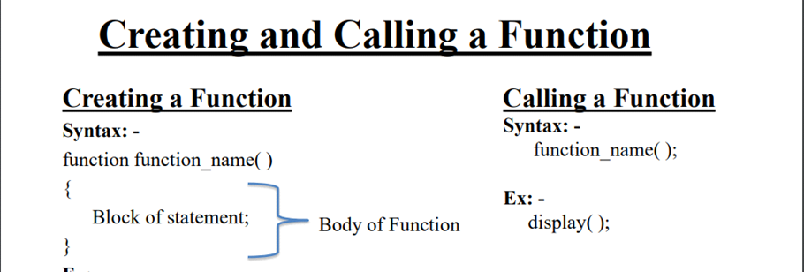

Slide 9
Arrow Functions
An arrow function expression is a compact alternative to a traditional function expression, but is limited and can't be used in all situations.
Every programming language provides certain kinds of practices to write any function. The arrow function syntax is one of the most used and efficient ones to create a function in JavaScript.
How to create arrow function: To write the arrow function, simply create any variable it can be const, let, or var but always do prefer with const to avoid unnecessary problems. And then do assign the function code to the variable that’s it. So from now, you can call that function by writing the parenthesis in front of that variable. With arrow function syntax, we consider function as an object and assign the definition to some variable.

Slide 10
Traditional function V/S Arrow function
// Traditional Function
//SUBTRACTION
function sub(n1,n2){
result=n1-n2;
return result;
}
result=sub(70,50);
console.log(result);
//Using arrow function
var sub=(n1,n2)=>{
result=n1-n2;
return result;
}
result=sub(70,50);
console.log(result);

Slide 11
Tasks
1 Write a program to find the area of a triangle using function
2 Write a JavaScript function that accepts a number as a parameter and check the number is prime or not.
3 Write a JavaScript function that checks whether a passed string is palindrome or not?

Slide 12
Thank You

