Slide 1
Strings

Slide 2
Strings
Strings are used to store and manipulate text.
Strings can be created using the following the syntax
let name = “John”;
Strings can be also created using single quotes
let name =‘John’;

Slide 3
Template literals
Template literals use backticks instead of quotes to define a string
let name=`John`
With template literals ,It is possible to use both single as well as double quotes inside a string
let sentence=`The name “is” Hari’s `
We can insert variables directly in template literals this is called String interpolation
let a= `This is ${name}` //prints This is Hari

Slide 4
Escape Sequence Characters
let text = “This is my “new" car.";
JavaScript will misunderstand this string:
The solution to avoid this problem, is to use the backslash escape character.
The backslash (\) escape character turns special characters into string characters:
let text = " This is my \" new \" car.";
let text = "The character \\ is called backslash.";

Slide 5
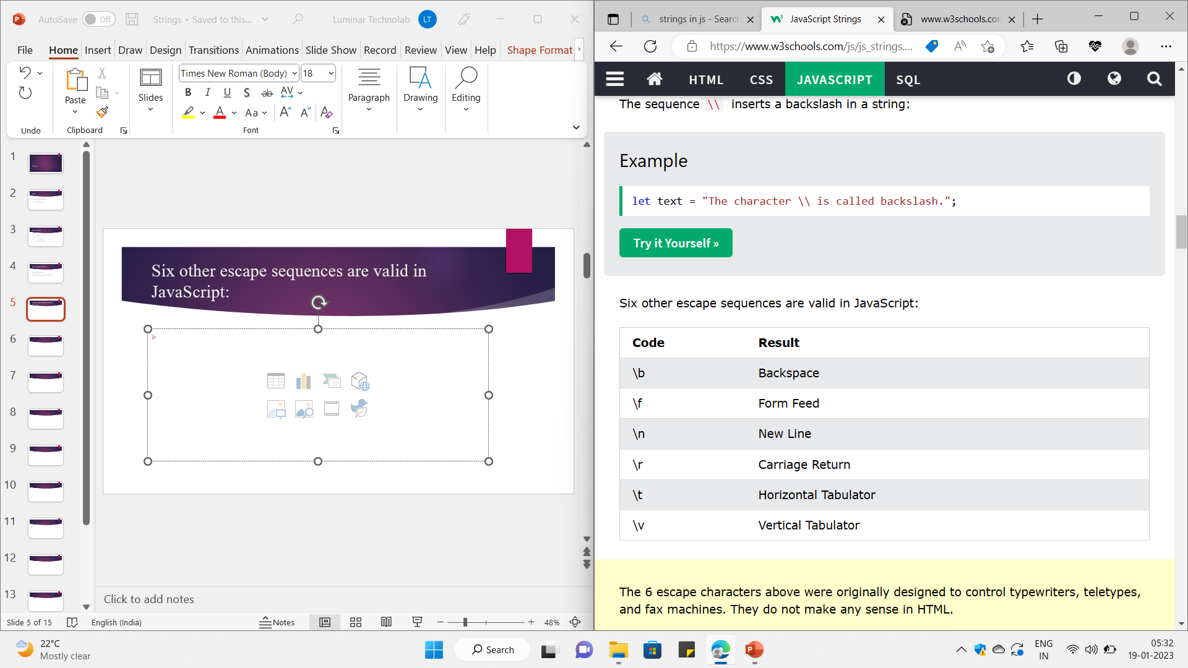
Six other escape sequences are valid in JavaScript:

Slide 6
String Properties and Methods
let sname = "Manu"
console.log(sname.length); //Prints the length of the string
console.log(sname.toUpperCase());//prints MANU
console.log(sname.toLowerCase());//prints manu
console.log(sname.slice(2,3));//prints n
// M -0, a-1, n-2, u-3
//here it starts from 2 to 3 but 3 is not included
console.log(sname.slice(2));//prints nu
//from 2 to end of string

Slide 7
String Properties and Methods
let name1 ="Ann M"
let newname = name1.replace("M","Luka")
console.log(name1); //Ann M
console.log(newname);//Ann Luka
let s_name ="Sagar"
let m_name="Alias"
let l_name="Jacky"
let full_name=s_name.concat(m_name+l_name)
console.log(full_name);//SagarAliasJacky

Slide 8
Access String Characters
You can access the characters in a string in two ways.
1. One way is to treat strings as an array. For example,
const a = 'hello’;
console.log(a[1]); // "e“
2. Another way is to use the method charAt(). For example,
const a = 'hello’;
console.log(a.charAt(1)); // "e"

Slide 9
Tasks
1 What will be output the following print statement in js
console.log("har\"".length)
2 Explore the includes, startswith and endswith function of a string
3 Write a program to convert a given string to lowercase
4 Extract the amount out of the string
"Please give Rs 10000"
5 Try to Change 4th character of a given string
"Where you able to do it?"
6 Note on All string methods with programs

Slide 10
Thank You

