Slide 1
Blinkit Sales & Delivery
Performance Analysis
Excel-based Business Intelligence Presentation
3,000 Orders • Jan–Dec 2025 • 8 Cities

Slide 2
Problem Statement
2
Why the analysis is needed
Blinkit operates in a highly competitive quick-commerce market where sales growth, profitability, customer satisfaction, and timely delivery are essential for business success.
However, analyzing large volumes of order data manually makes it difficult to identify sales trends, understand customer purchasing behavior, evaluate product and city performance, and detect delivery inefficiencies.
The objective of this project is to develop an interactive Power BI dashboard using Blinkit order data to analyze sales performance, profitability, customer behavior, and delivery efficiency.
The dashboard will use key performance indicators (KPIs), visualizations, and interactive filters to identify business trends, highlight operational issues, and support data-driven decision-making.
Blinkit Sales & Delivery Performance Analysis

Slide 3
Business Questions & Chart Types
3
Questions used to guide the analysis
1. How do sales change month by month? — Line Chart
2. Which city generates the highest sales? — Bar Chart
3. Which product category contributes the most to sales? — Column Chart
4. What is the order cancellation rate? — Donut Chart
5. Which product category generates the highest estimated profit? — Bar Chart
6. Which cities have the highest late delivery rates? — Bar Chart
7. Which delivery partners have the longest average delivery times? — Bar Chart
8. How does delivery delay affect customer ratings? — Scatter/relationship analysis
9. Which payment mode is used most by customers? — Donut Chart
Blinkit Sales & Delivery Performance Analysis

Slide 4
KPI Dashboard
4
Overall performance snapshot from the Excel analysis
₹22.12L
3,000
₹4.46L
₹737.29
Total Sales
Total Orders
Total Profit
Average Order Value
19.07%
37.15%
28.24 min
4.07
Cancellation Rate
Late Delivery Rate
Avg Delivery Time
Avg Customer Rating
Blinkit Sales & Delivery Performance Analysis

Slide 5
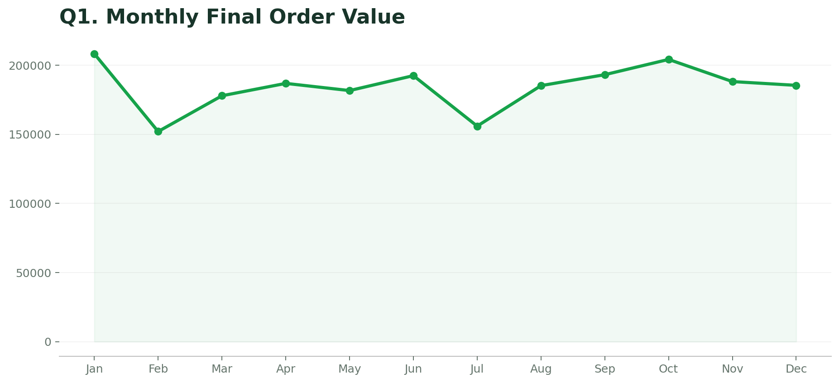
Q1. Monthly Final Order Value
5
Monthly sales trend
Key insight
January is the strongest month; February and July are weaker, with a strong October rebound.
Excel pivot analysis
Blinkit Sales & Delivery Performance Analysis

Slide 6
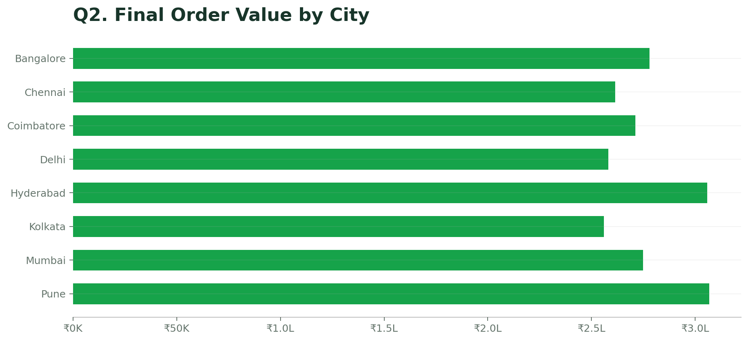
Q2. Final Order Value by City
6
City-wise sales
Key insight
Pune leads city sales at about ₹3.07L, closely followed by Hyderabad at about ₹3.06L.
Excel pivot analysis
Blinkit Sales & Delivery Performance Analysis

Slide 7
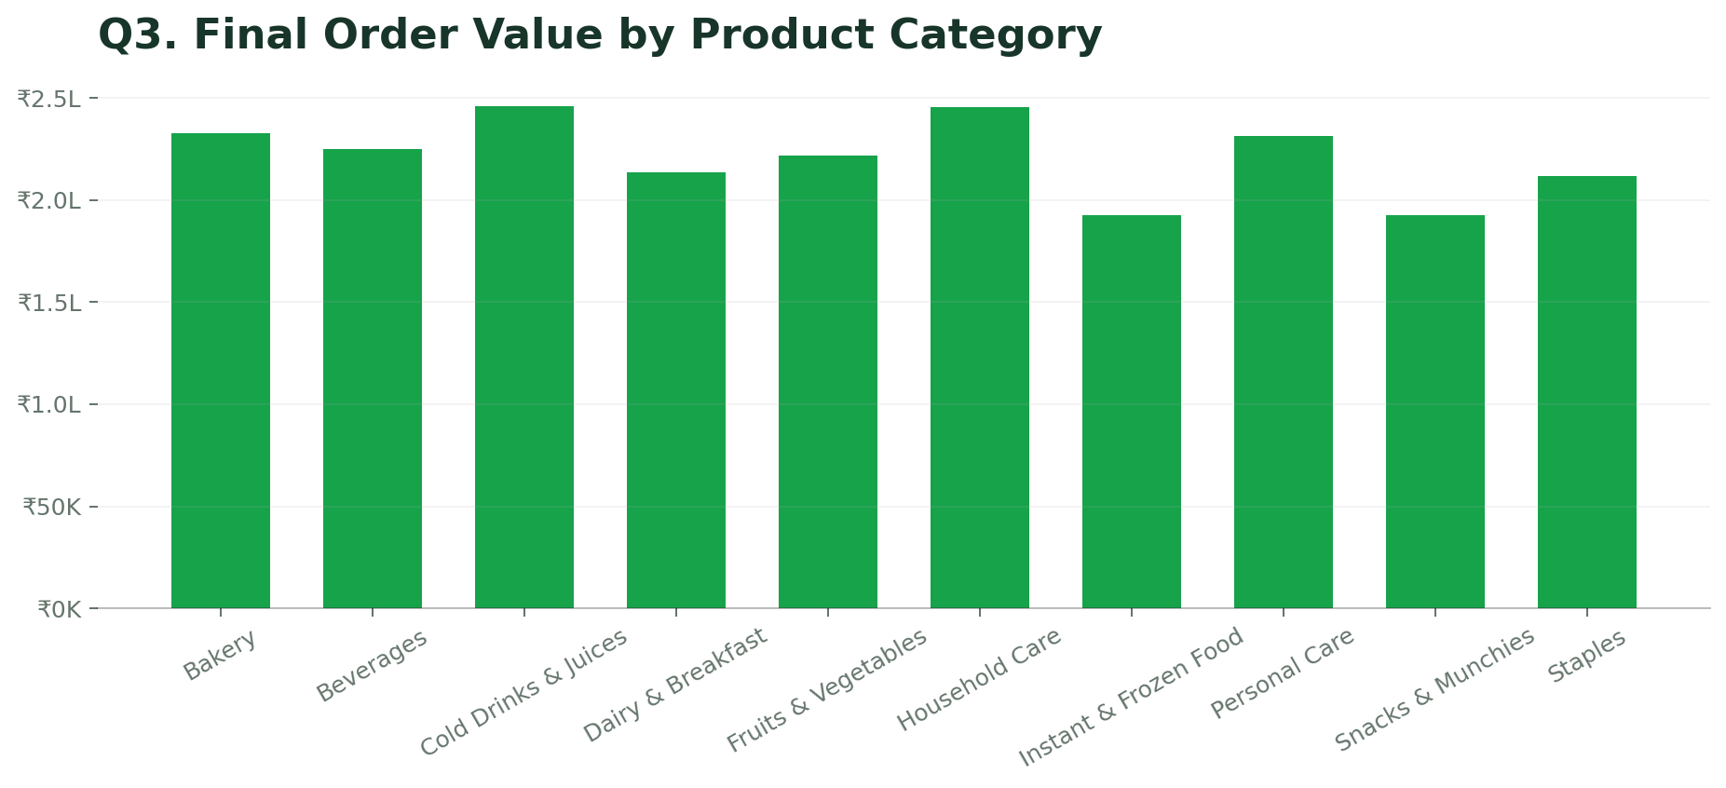
Q3. Final Order Value by Product Category
7
Category-wise sales
Key insight
Cold Drinks & Juices and Household Care are the top sales categories.
Excel pivot analysis
Blinkit Sales & Delivery Performance Analysis

Slide 8
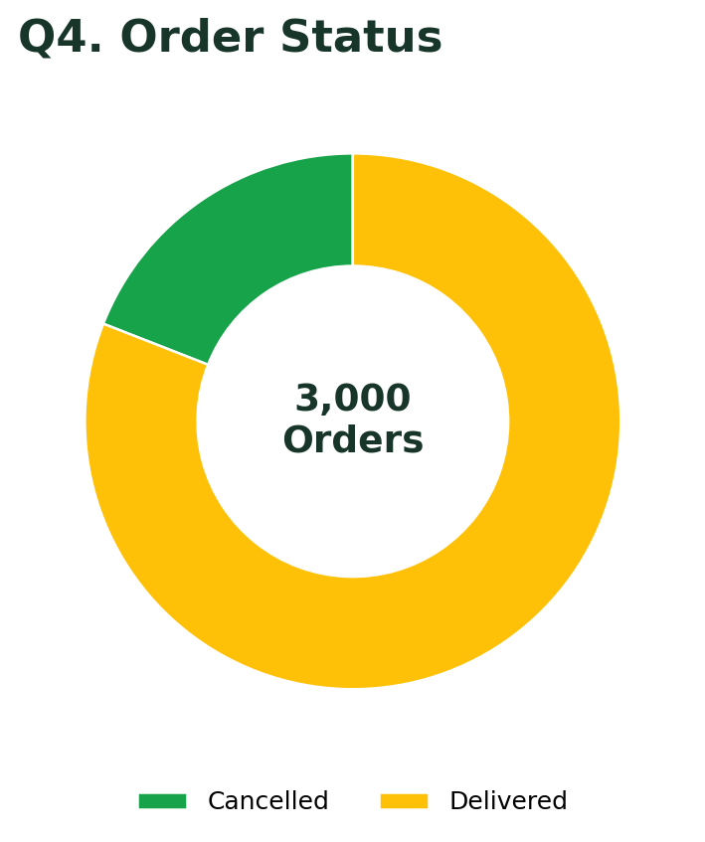
Q4. Order Status
8
Delivered vs cancelled
Key insight
2,428 orders were delivered and 572 were cancelled, giving a 19.07% cancellation rate.
Excel pivot analysis
Blinkit Sales & Delivery Performance Analysis

Slide 9
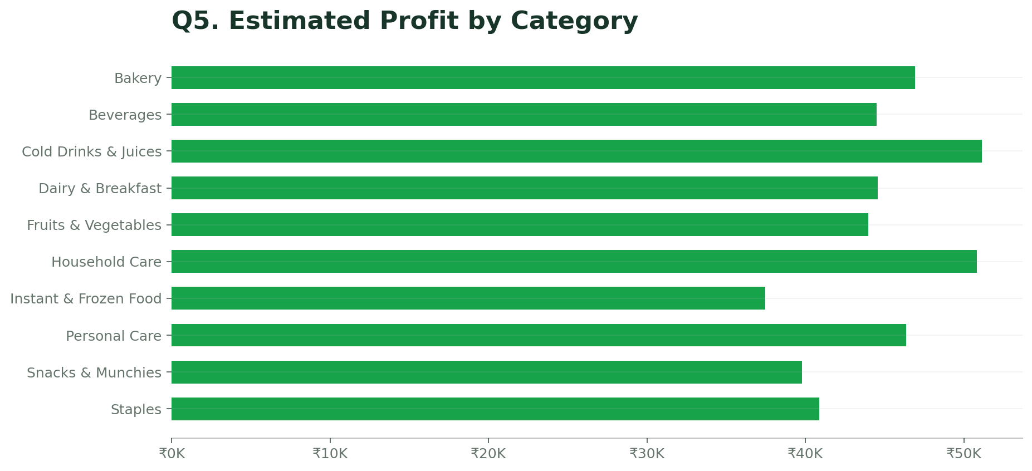
Q5. Estimated Profit by Category
9
Category-wise estimated profit
Key insight
Cold Drinks & Juices has the highest estimated profit at about ₹51.15K.
Excel pivot analysis
Blinkit Sales & Delivery Performance Analysis

Slide 10
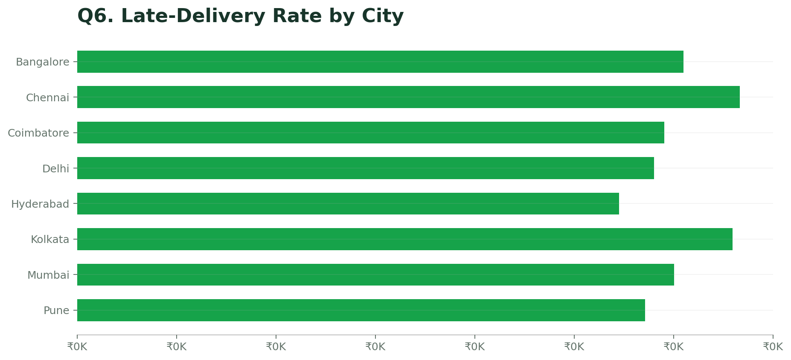
Q6. Late-Delivery Rate by City
10
Late delivery by city
Key insight
Chennai has the highest late-delivery rate at about 33.3%; Hyderabad is lowest at about 27.3%.
Excel pivot analysis
Blinkit Sales & Delivery Performance Analysis

Slide 11
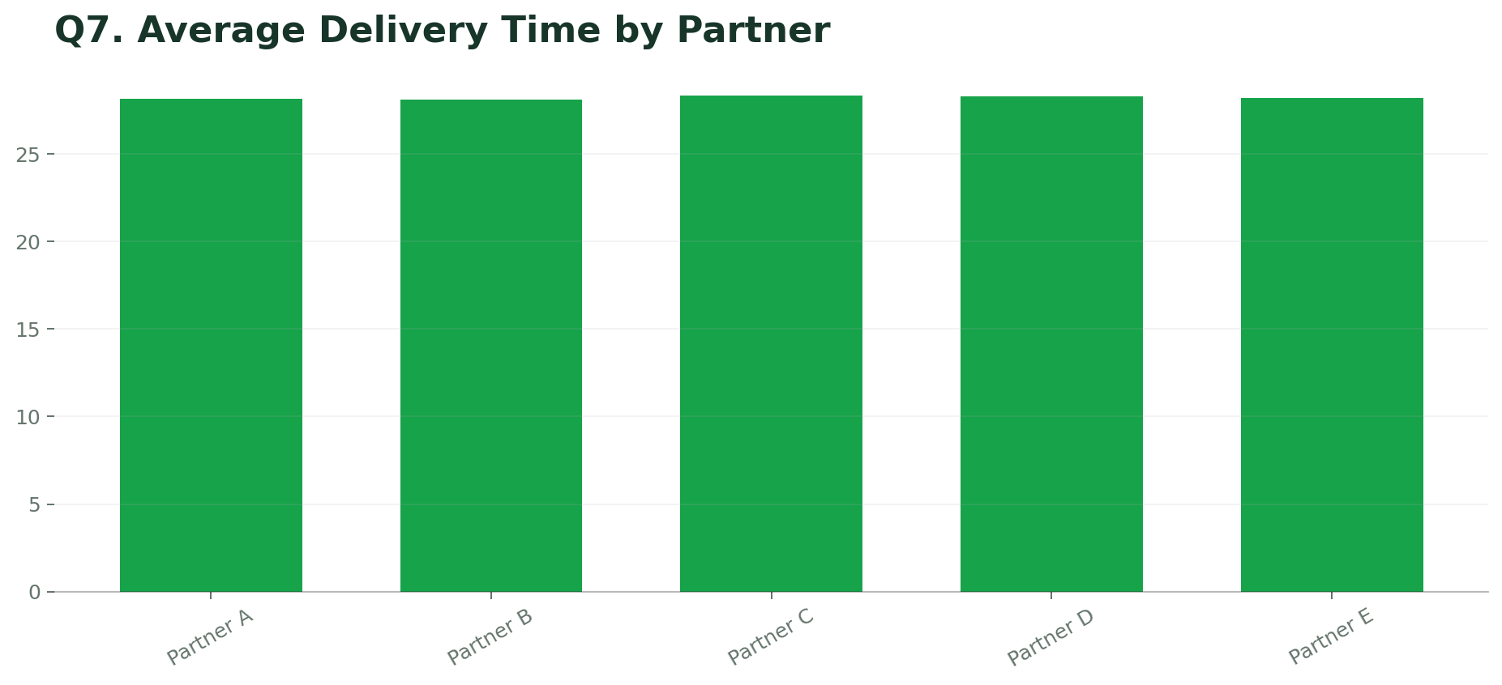
Q7. Average Delivery Time by Partner
11
Average delivery time
Key insight
Partner B is fastest at about 28.14 minutes; partner differences are small.
Excel pivot analysis
Blinkit Sales & Delivery Performance Analysis

Slide 12
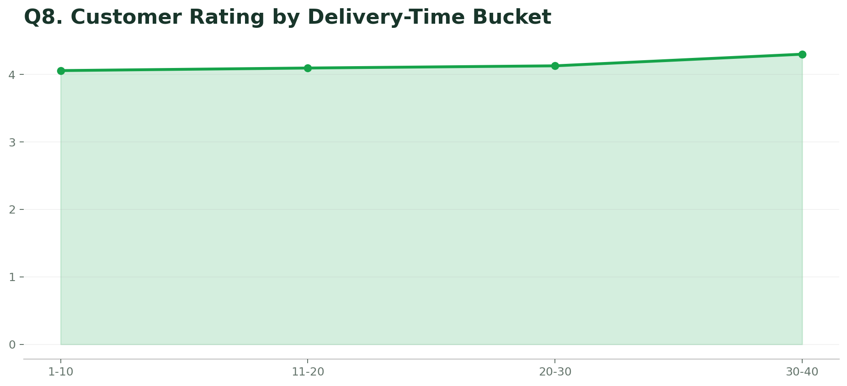
Q8. Customer Rating by Delivery-Time Bucket
12
Rating by delivery-time bucket
Key insight
The 30–40 minute bucket has the highest average rating at 4.30.
Excel pivot analysis
Blinkit Sales & Delivery Performance Analysis

Slide 13
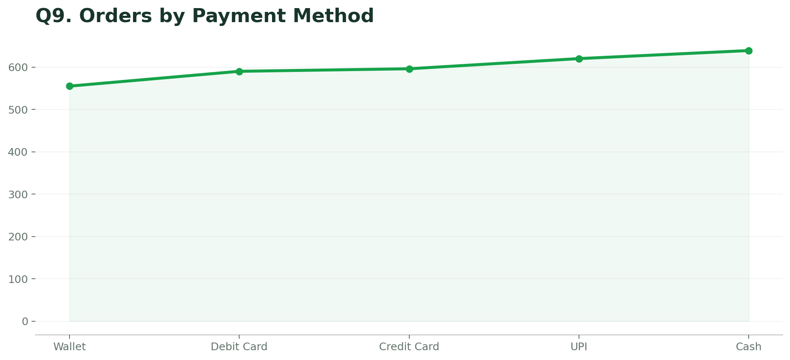
Q9. Orders by Payment Method
13
Payment method usage
Key insight
Cash is the most-used payment method with 639 orders, followed by UPI with 620.
Excel pivot analysis
Blinkit Sales & Delivery Performance Analysis

Slide 14
Key Insights
14
What the complete analysis tells us
Sales are strongest in Pune and Hyderabad.
Cold Drinks & Juices is a leading sales and profit category.
Cancellation rate of 19.07% is a clear operational concern.
Chennai and Kolkata have the highest late-delivery rates.
Delivery partners perform within a narrow average-time range.
Cash and UPI are the two most-used payment channels.
Blinkit Sales & Delivery Performance Analysis

Slide 15
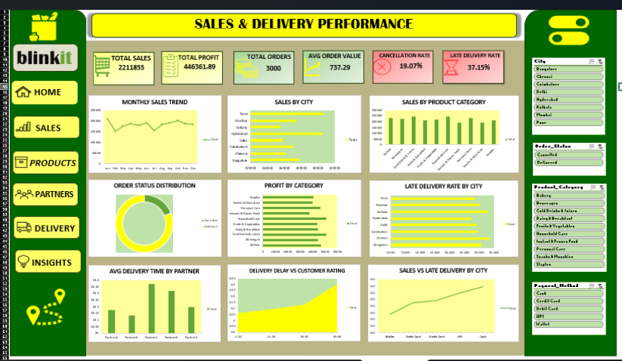
DASHBOARD
15
Blinkit Sales & Delivery Performance Analysis

Slide 16
Conclusion
The Excel order data provides a clear view of sales, profitability, customer experience and delivery performance.
Main focus areas: reduce cancellations • improve delivery in problem cities • strengthen high-performing categories

