Slide 1
Table of Contents
Introduction to the Problem Domain
Data Acquisition
Data Exploration
Data Preparation and Visualization
Model Selection and Training
Model Fine-Tuning
Solution Presentation

Slide 2
1. Introduction to the Problem Domain
Target: The goal is to build a machine learning model capable of detecting and classifying different cyber-attack types from network traffic data.
Project Type:
Machine Learning was chosen to identify patterns in the data.
Supervised Learning was selected because labeled data was available.
Classification was used to categorize events as either cyber attacks or not .
Multi class classification was used to identify the type of attack.

Slide 3
2. Data Acquisition
Dataset Link: https://www.kaggle.com/datasets/mohamedamineferrag/edgeiiotset-cyber-security-dataset-of-iot-iiot
From: Kaggle.com
Summary
The dataset is a comprehensive and realistic cybersecurity dataset designed for machine learning-based intrusion detection in both centralized and federated learning modes.
It includes 14 different cyberattacks grouped into five main threat categories: DoS/DDoS, information gathering, man-in-the-middle, injection, and malware attacks.
The dataset is accompanied by exploratory data analysis and ML performance evaluation across different learning modes.

Slide 4
3. Data Exploration
Data Summary
The dataset includes numerical columns representing various network traffic features.
The Attack_type column is a categorical variable containing string values that indicate the specific type attack.
There are two target variables:
Attack_label: used for binary classification (e.g., normal vs. attack).
Attack_type: used for multi-class classification (e.g., different types of attacks).

Slide 5
4. Data Preparation and Visualization
4.1 Data Cleaning:
Dropping irrelevant data from the data set for better training.
Check for Null values or NaN fields.
Validating or Analyzing the value counts for each column.
4.2 Data Visualization:
Distribution of Attack labels
Attack Type Classifications
Distribution of Attack Type

Slide 6
Irrelevant Features with respect to Dataset
features_to_remove = [
'ip.src_host', 'ip.dst_host', 'arp.dst.proto_ipv4', 'arp.src.proto_ipv4', 'http.file_data', 'http.request.uri.query', 'http.referer', 'http.request.full_uri', 'http.request.version', 'tcp.checksum’,
'tcp.options', 'tcp.payload', 'dns.qry.name', 'mqtt.protoname', 'mqtt.topic', 'mqtt.msg', 'mbtcp.trans_id’, 'mbtcp.unit_id', 'tcp.flags', 'tcp.checksum', 'tcp.connection.synack', 'tcp.seq', 'udp.time_delta’, 'mqtt.ver', 'arp.hw.size', 'icmp.transmit_timestamp', 'icmp.unused', 'http.request.method’, 'http.content_length', 'icmp.seq_le', 'http.tls_port', 'tcp.ack_raw', 'frame.time', 'dns.qry.name.len’, 'tcp.dstport', 'tcp.srcport', 'mqtt.topic_len', 'mqtt.proto_len', 'mqtt.conack.flags', 'tcp.len’, 'udp.port', 'mqtt.msg_decoded_as',
]

Slide 7
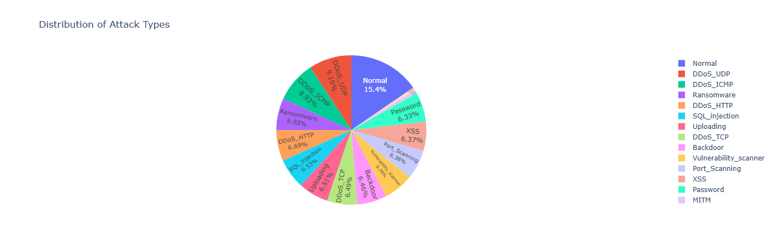
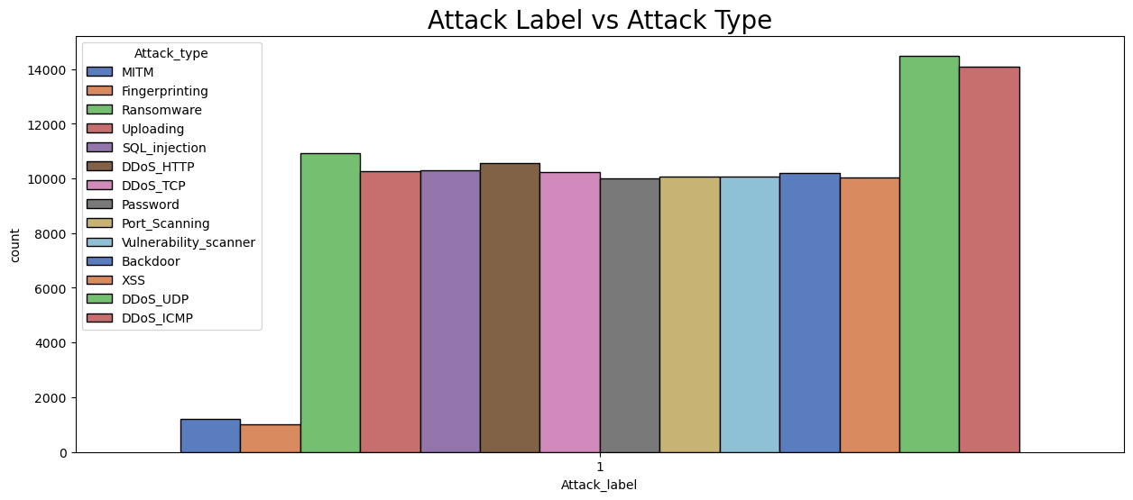
Visualization of Attack Label and Attack Type

Slide 8
Challenges
Class Imbalance
SOLUTIONS:
SMOTE (Synthetic Minority Over-sampling Technique): Generates synthetic examples.
Adjust Class Weights: Many models can be assigned weights to classes. Heavier weights for minority classes help the model treat them as more important.
Usage of Precision, F1 score and confusion matrix.
Nearest Probability
The possibility of the model that would predict the Attack label as 0.1, 0.2 or 0.99 which is not a valid Attack label. S
SOLUTION:
By adjusting threshold ( Ex: 0.5)

Slide 9
5. Model Selection & Training
BINARY CLASSIFICATION & MULTICLASS CLASSIFICATION
MODEL 1: Logistic Regression
MODEL 2: Decision Tree Classifier
MODEL 3: Random Forest Classifier
MODEL 4: XGBoost
MLP – MULTI LAYER PERCEPTRON

Slide 10
6. MODEL FINE TUNING
Hyper Parameter Tuning
Grid Search
Randomized search

Slide 11
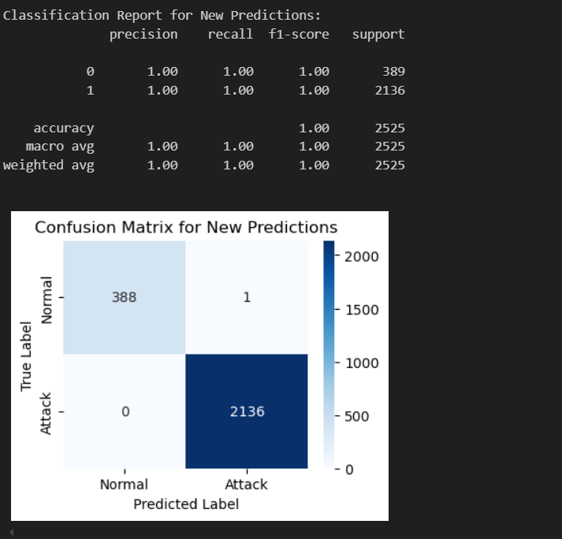
7. Solution Presentation
Binary Classification:
Best result by tuning hyper parameter with Random forest classifier

Slide 12
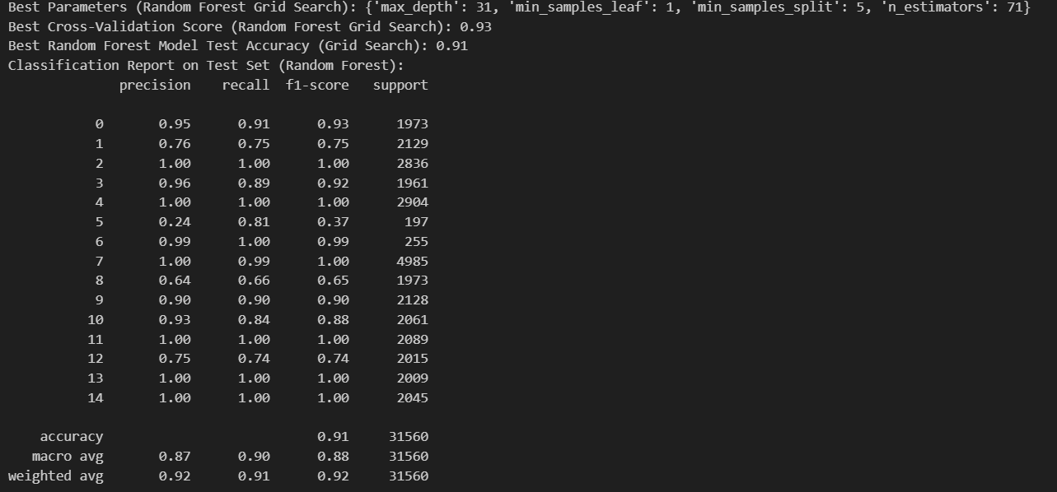
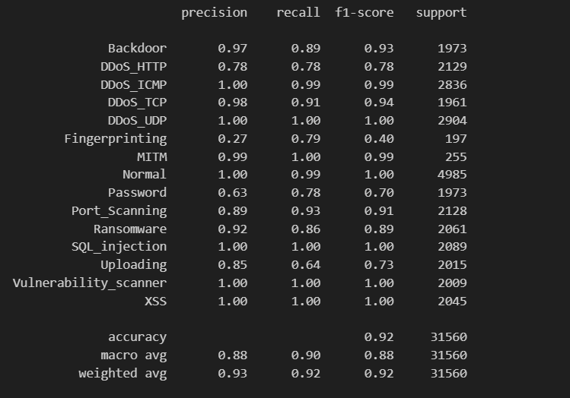
Multi Class Classification
Best Result by hyper Parameter tuning in Random Forest Classifier
Even Better result in XGBoost
Random forest
XGBoost

Slide 13
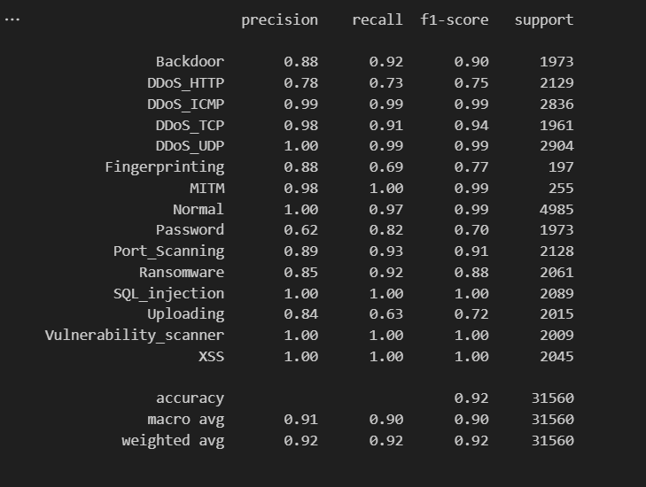
Multi Layer Perceptron (MLP):

Slide 14
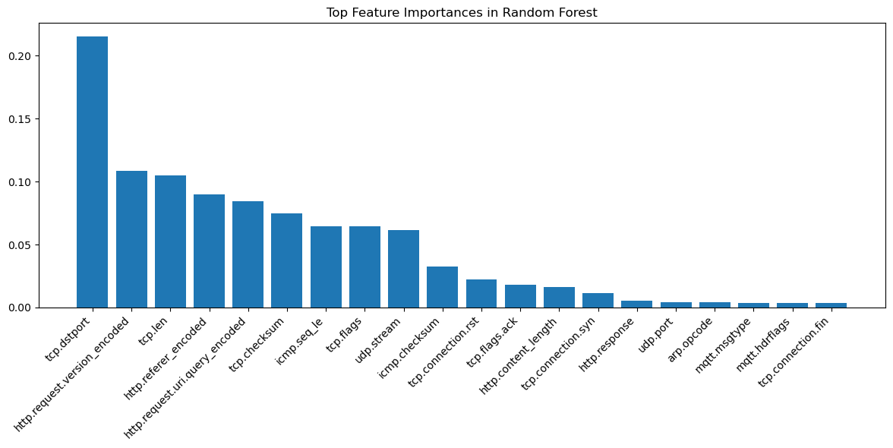
Feature Importance

Slide 15
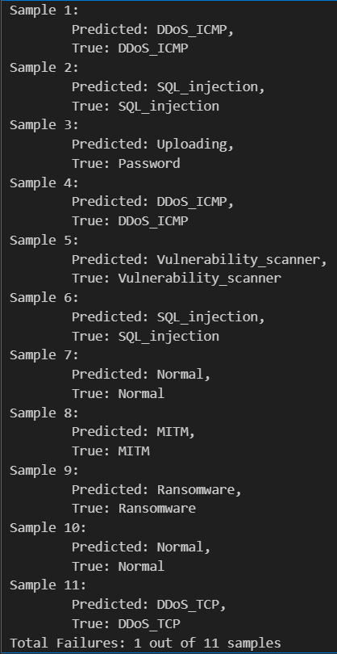
Result and Conclusion
GOAL / TARGET ACHIEVED:
Model can classify between attack and normal.
Model can specifically identify type of attack.
Limitations:
Model have some trouble in finding Attack_Types like Password, uploading. Because of limited data.
Final Result:
Out of 100%, the model can efficiently perform in classifying data with pass percentage of 92%.

