Slide 1

Moving Service Database presented by Talap Arshat SE-2001

Slide 2


IDEA Basically Moving Service provides services of moving from one apartment to another. It's important project, because it helps people to get their goods to the new house without any problems.

Slide 3
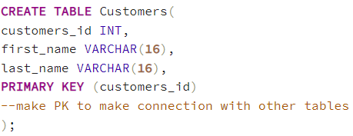
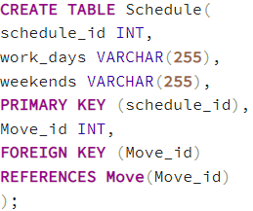
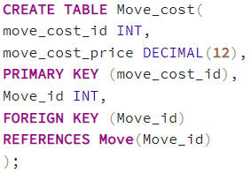
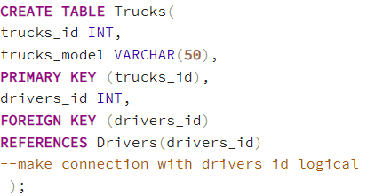
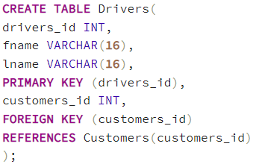
SQL
Specific tables with attributes and relations will be created in SQL which'll be relied on company's staff, to be exact, its drivers, trucks, schedule, move cost, and costumers themselves.

Slide 4
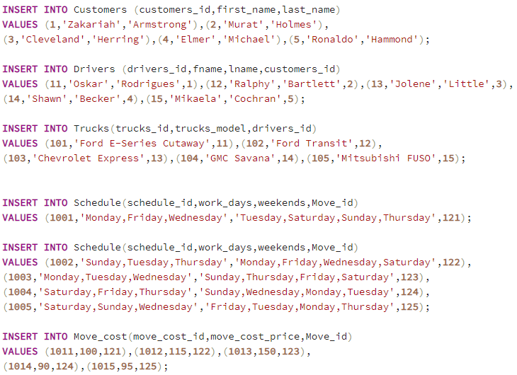
Inserting values

Slide 5
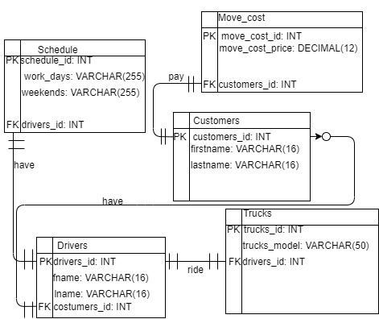
ERD

Slide 6
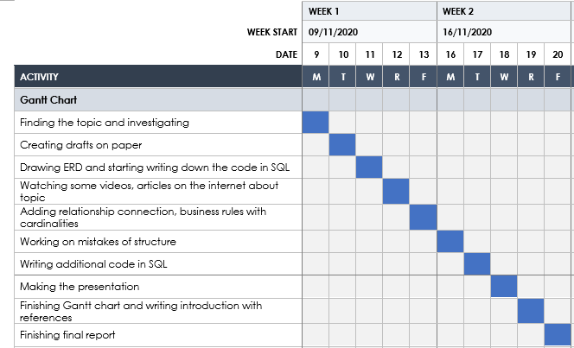
Gantt chart

Slide 7

Conclusion
People had particular struggles with moving process from old house to the new one, as transportation, packing/unpacking goods, choosing right relocation company itself. Considering these moments, this database was created during Educational Practice, which gathered all important information about the moving-service company, which are drivers, trucks, schedule, customer, move, move cost.

