Slide 1
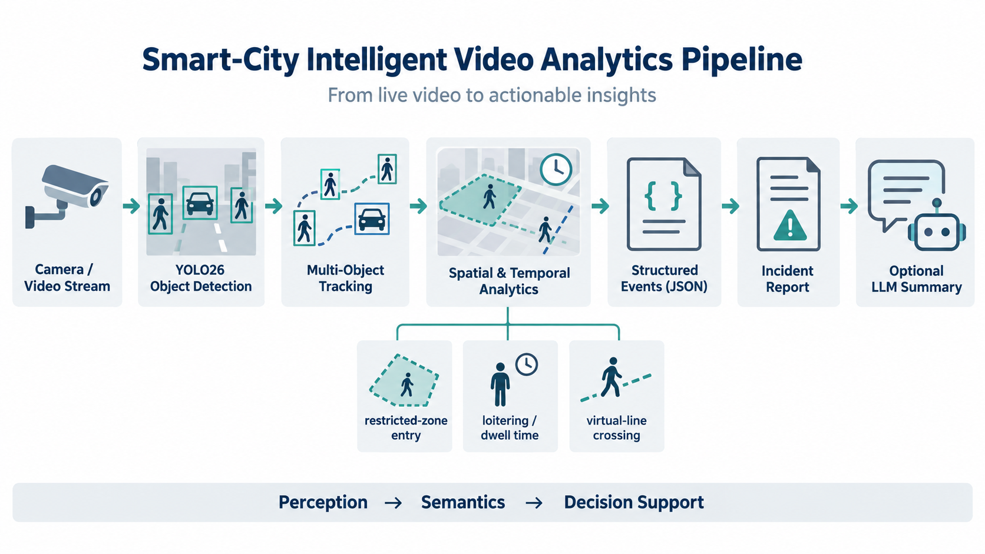
Week 11: Smart-City Intelligent Video Analytics
Demonstration
Camera/video → detection → tracking → event analytics → incident report → optional LLM summary
Applied Accelerated AI
Main idea: intelligent video analytics is not only a detector; it is a complete auditable system that turns video into structured events.
Week 11 — Smart-City Intelligent Video Analytics Demonstration

Slide 2
Lecture objectives
Overview
Understand intelligent video analytics as a system, not as a single neural-network call.
Explain the difference between detection, tracking, event logic, report generation, and LLM summarization.
Understand how spatial and temporal rules convert tracks into events.
Know the files and commands needed to run the Week 11 demonstration package.
Interpret the generated outputs: annotated video, event log, metrics, and incident report.
Evaluate the system at detection, tracking, event, and end-to-end performance levels.
Week 11 — Smart-City Intelligent Video Analytics Demonstration

Slide 3
End-to-end smart-city IVA pipeline
Theory
Week 11 — Smart-City Intelligent Video Analytics Demonstration

Slide 4
What problem does IVA solve?
Theory
Raw video is high-bandwidth, unstructured, and difficult to search.
Operators need compact, meaningful facts rather than thousands of frames.
Examples: a person entered a restricted region, a vehicle crossed a line, or crowd density exceeded a threshold.
IVA converts visual streams into structured events that can be stored, counted, queried, and summarized.
The final goal is decision support, not merely drawing bounding boxes.
Raw frames → low-level objects → object identity over time → application-level events.
Week 11 — Smart-City Intelligent Video Analytics Demonstration

Slide 5
System view of the lecture
Overview
Layer | Question answered | Demo artifact
Detection | What objects are present in this frame? | Bounding boxes and class labels
Tracking | Which object is the same across frames? | Track IDs
Event logic | What application event occurred? | events.jsonl
Reporting | What should the operator review? | incident_report.txt / .json
Performance | Can the pipeline keep up? | metrics.json
The live demo will expose one artifact from each layer.
Week 11 — Smart-City Intelligent Video Analytics Demonstration

Slide 6
Part 1: Detection
Section
Part 1: Detection
From a video frame to objects, boxes, classes, and confidence scores
YOLO26
Bounding boxes
Confidence
Week 11 — Smart-City Intelligent Video Analytics Demonstration

Slide 7
Object detection: frame-level perception
Detection
Object detection is applied independently to a frame or image.
The detector predicts a set of bounding boxes.
Each box has a class label such as person, car, bicycle, motorcycle, bus, or truck.
Each prediction also has a confidence score.
For a smart-city demo, detection gives the basic visual objects that later stages reason about.
Detection answer: what is here now?
Detector output per object:
class + bounding box + confidence
Limitation: a detector alone has no memory of earlier frames.
Week 11 — Smart-City Intelligent Video Analytics Demonstration

Slide 8
YOLO26 in the classroom package
Detection
The package uses Ultralytics YOLO26n for real-time object detection.
YOLO26n is selected because it is small enough for a classroom demo and fast enough on Colab GPU.
The model is loaded with the current Ultralytics API: YOLO("yolo26n.pt").
The demonstration focuses on common COCO-style smart-city classes: person, bicycle, car, motorcycle, bus, and truck.
Minimal load and inference
from ultralytics import YOLO
model = YOLO("yolo26n.pt")
results = model("frame.jpg")
In the demo, the detector output is not the final answer. It is the input to tracking and event logic.
Week 11 — Smart-City Intelligent Video Analytics Demonstration

Slide 9
Detection output: what the next stage needs
Detection
Field | Meaning | Used later for
xyxy box | Object location in the frame | center point, ROI test, line crossing
class id/name | Object category | rule filtering, e.g., only person for loitering
confidence | Detector certainty | thresholding, debugging, report metadata
frame index/time | When the object was seen | dwell time, event timestamp
Detection is the perception substrate: all downstream semantics depend on these low-level outputs.
Week 11 — Smart-City Intelligent Video Analytics Demonstration

Slide 10
Detection cannot answer temporal questions
Detection
A detector can say that a person is present in the current frame.
It cannot by itself know whether this is the same person from five seconds ago.
It cannot compute dwell time without identity over time.
It cannot robustly count line crossings without comparing positions across frames.
This is why tracking is the next required abstraction.
Transition: detection answers “what and where”; tracking answers “same object over time.”
Week 11 — Smart-City Intelligent Video Analytics Demonstration

Slide 11
Part 2: Tracking
Section
Part 2: Tracking
From independent detections to persistent object identities over time
Track ID
ByteTrack
Temporal state
Week 11 — Smart-City Intelligent Video Analytics Demonstration

Slide 12
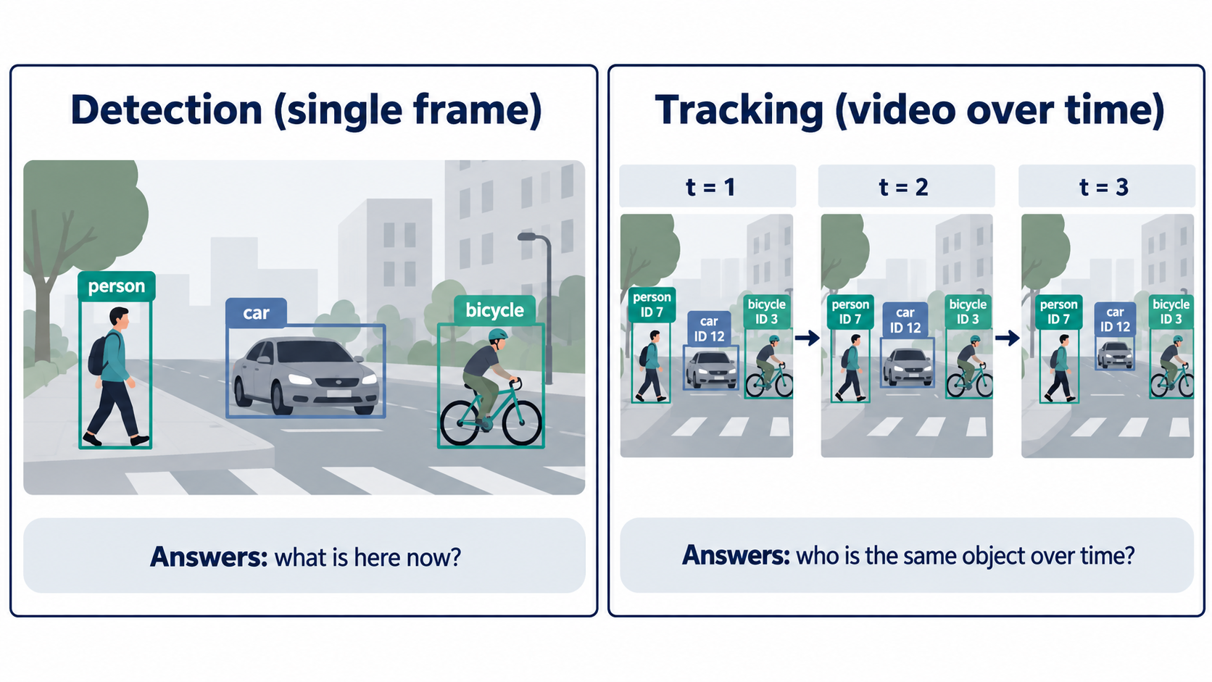
Detection versus tracking
Tracking
Week 11 — Smart-City Intelligent Video Analytics Demonstration

Slide 13
Multi-object tracking: definition
Tracking
Multi-object tracking associates detections across video frames.
The tracker maintains a track ID for each object that it believes is the same physical object over time.
The output still contains boxes, classes, and confidences, but now also includes IDs.
A track ID is not a person identity; it is only a temporary video-level object identity.
The demo uses track IDs to calculate zone entry, dwell time, and line crossing.
Important distinction: track ID ≠ real-world identity.
Week 11 — Smart-City Intelligent Video Analytics Demonstration

Slide 14
Tracking lifecycle in the demo
Tracking
1. YOLO predicts detections in the current frame.
2. The tracker compares these detections with existing tracks.
3. Matched objects keep their previous track IDs.
4. New objects receive new track IDs.
5. Tracks disappear when objects leave the scene or are not seen for several frames.
6. The event engine uses these IDs as temporal keys.
Week 11 — Smart-City Intelligent Video Analytics Demonstration

Slide 15
ByteTrack intuition
Tracking
ByteTrack is a tracking-by-detection method.
It starts from object detections and associates them over time.
A key idea is to make use of low-score detections during association instead of discarding them too early.
This can help maintain tracks when detections temporarily become weak because of occlusion, blur, or scale changes.
The package uses ByteTrack through the Ultralytics tracking interface.
Tracking call
result = model.track(
frame,
persist=True,
tracker="bytetrack.yaml"
)[0]
persist=True keeps tracking state across frames.
Week 11 — Smart-City Intelligent Video Analytics Demonstration

Slide 16
Tracking errors affect event correctness
Tracking
If a track ID switches, dwell-time logic may reset or attach time to the wrong object.
If a track is temporarily lost, a real zone entry may be missed.
If a false detection becomes a track, the event engine may emit a false alert.
If two nearby objects are confused, the line-crossing count may be wrong.
Therefore event-level quality depends on detection quality and tracking quality.
System lesson: errors propagate from lower-level perception to higher-level semantics.
Week 11 — Smart-City Intelligent Video Analytics Demonstration

Slide 17
Part 3: Event Analytics
Section
Part 3: Event Analytics
From tracked objects to spatial and temporal rules
ROI
Line crossing
Dwell time
Crowd count
Week 11 — Smart-City Intelligent Video Analytics Demonstration

Slide 18
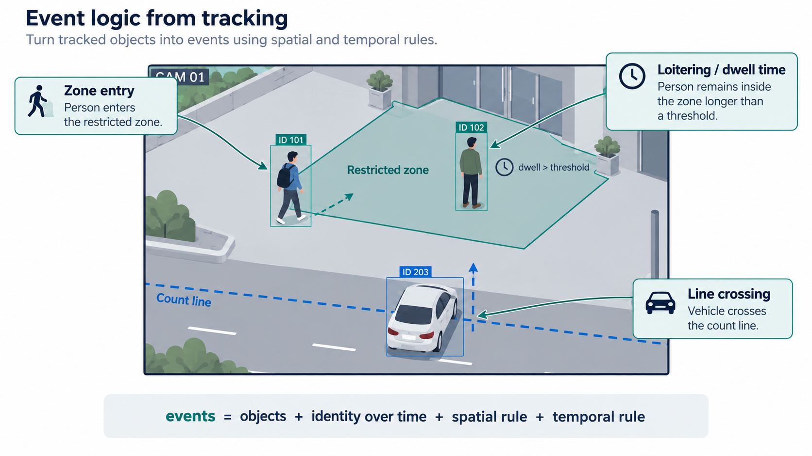
Event logic from tracking
Event Analytics
Week 11 — Smart-City Intelligent Video Analytics Demonstration

Slide 19
Why event logic is a separate layer
Event Analytics
The neural network detects visual objects; it does not automatically know the site-specific meaning of a region.
A restricted area, a queue region, a parking boundary, or a count line is usually defined by the application owner.
Event logic combines object class, track ID, geometry, and time.
This layer is deterministic in the demo, so it is easier to inspect and debug.
Keeping event logic separate also makes it easier to modify application rules without retraining the model.
Week 11 — Smart-City Intelligent Video Analytics Demonstration

Slide 20
Region of interest: from geometry to semantics
Event Analytics
A region of interest is a polygon drawn on the image plane.
The polygon by itself is only geometry; the application assigns meaning to it.
For example, a polygon can mean restricted zone, entrance area, waiting area, or road lane.
The demo tests whether the center of a tracked object lies inside the polygon.
This is simple and interpretable, but it depends on correct camera placement and ROI calibration.
Geometry: point inside polygon
Semantics: person inside restricted zone
Event: restricted-zone entry
Week 11 — Smart-City Intelligent Video Analytics Demonstration

Slide 21
Normalized coordinates for ROI configuration
Event Analytics
The demo stores polygon and line coordinates as normalized values between 0 and 1.
x = 0.10 means 10% of the image width.
y = 0.20 means 20% of the image height.
The advantage is that the same configuration style works for different video resolutions.
The limitation is that the coordinates still need to match the scene geometry.
config.yaml example
restricted_zone:
points:
- [0.55, 0.25]
- [0.95, 0.25]
- [0.95, 0.95]
- [0.55, 0.95]
always inspect the first frame before accepting the default region.
Week 11 — Smart-City Intelligent Video Analytics Demonstration

Slide 22
Restricted-zone entry rule
Event Analytics
The rule is triggered when a person track moves from outside the ROI to inside it.
The event uses the track ID, class name, timestamp, and zone name.
Only selected classes should trigger this event; in the demo, it is configured for person.
This rule demonstrates how a low-level detection becomes an application-level event.
Logical rule
previous_inside = False
current_inside = True
if class_name == "person"
and current_inside
and not previous_inside:
emit zone_entry
Event record: restricted_zone_entry with track_id and timestamp.
Week 11 — Smart-City Intelligent Video Analytics Demonstration

Slide 23
Loitering / dwell-time rule
Event Analytics
Loitering is a temporal rule, so it requires tracking.
When a person enters the ROI, the event engine stores the entry time for that track ID.
For each later frame, it checks how long the same track has remained inside the zone.
If the dwell time exceeds a threshold, the engine emits a loitering event.
A track loss or ID switch can affect this rule, which is why tracking reliability matters.
Dwell-time rule
entry_time[track_id] = t_enter
dwell = current_time - t_enter
if dwell >= loiter_seconds:
emit loitering
reduce loiter_seconds temporarily to experience the event quickly.
Week 11 — Smart-City Intelligent Video Analytics Demonstration

Slide 24
Virtual-line crossing rule
Event Analytics
A virtual line is defined by two endpoints in the image plane.
For each track, the engine stores the previous center point and the current center point.
These two points form a short motion segment.
If this segment intersects the virtual line, the
engine emits a line-crossing event.
This rule can count traffic flow, corridor movement, or objects entering a boundary.
Line-crossing idea
movement = segment(prev_center, center)
line = segment(p1, p2)
if intersects(movement, line):
emit line_crossing
Direction can be added later by comparing which side of the line the track came from.
Week 11 — Smart-City Intelligent Video Analytics Demonstration

Slide 25
Crowd-threshold rule
Event Analytics
Crowd threshold is an aggregate rule.
Instead of looking at only one track, the engine
counts multiple person tracks inside the ROI.
If the count is greater than or equal to a threshold K, it emits a crowd-threshold event.
A cooldown interval prevents the same event from being emitted on every frame.
This shows how individual tracks can be combined into scene-level information.
Crowd rule
inside_people = count(person tracks in ROI)
if inside_people >= crowd_threshold
and cooldown_has_elapsed:
emit crowd_threshold
This rule is useful for occupancy and congestion analytics.
Week 11 — Smart-City Intelligent Video Analytics Demonstration

Slide 26
Summary: event = object + identity + rule
Event Analytics
event = object + identity over time + spatial rule + temporal rule
Component | Example from demo
Object | person, car, bicycle, bus
Identity over time | track ID from ByteTrack
Spatial rule | inside restricted zone or crossing a line
Temporal rule | dwell time above threshold
Event record | JSON line with timestamp, type, severity, and metadata
Week 11 — Smart-City Intelligent Video Analytics Demonstration

Slide 27
Part 4: Structured Events and Reports
Section
Part 4: Structured Events and Reports
From application rules to auditable JSON and human-readable summaries
JSON Lines
Report
LLM summary
Week 11 — Smart-City Intelligent Video Analytics Demonstration

Slide 28
Structured events as auditable facts
Reports
The demo writes one JSON object per event to events.jsonl.
Each event contains timestamp, frame index, event type, severity, track ID, class name, and optional
zone or line information.
This format is easy to read line by line, append during streaming, and process later.
A structured event log is more useful than free text because it supports counting, filtering, search, and evaluation.
It also creates a safe interface for optional LLM summarization.
Example JSON event
{
"timestamp_s": 8.36,
"event_type": "restricted_zone_entry",
"track_id": 14,
"class_name": "person",
"severity": "high"
}
The event log is the main machine-readable output of the application.
Week 11 — Smart-City Intelligent Video Analytics Demonstration

Slide 29
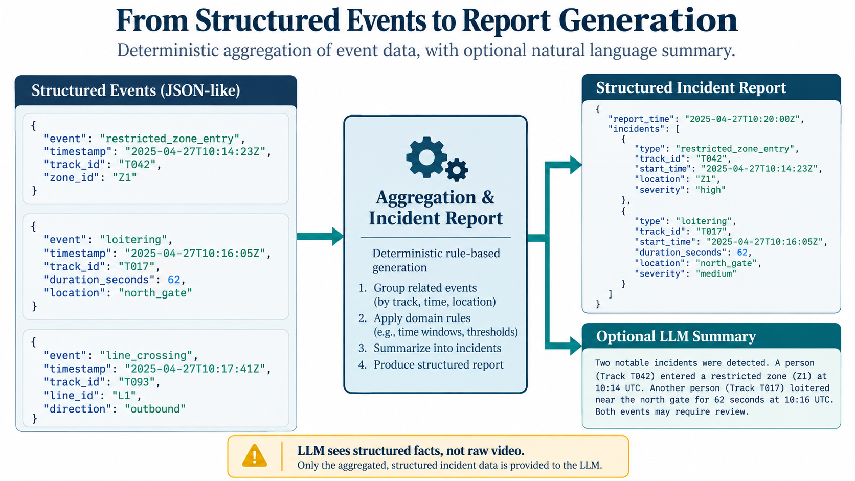
From structured events to incident reports
Reports
Week 11 — Smart-City Intelligent Video Analytics Demonstration

Slide 30
Deterministic report generation
Reports
The deterministic report is produced without an LLM.
It counts event types and severity levels.
It identifies high-priority events such as restricted-zone entries.
It creates recommended operator actions based on explicit rules.
This report is easy to audit because every line comes from the structured event log.
Report command
python summarize_events.py \
--events outputs/events.jsonl \
--out-dir outputs
Outputs: incident_report.json and incident_report.txt.
Auditable reporting should be shown before optional LLM summarization.
Week 11 — Smart-City Intelligent Video Analytics Demonstration

Slide 31
Optional LLM summary: correct role
Reports
The LLM does not inspect the video in this demonstration.
It receives only the structured incident report or event summary.
Its task is to write concise natural language for an operator.
It must not invent new events, identities, causes, or intentions.
This placement makes the LLM a presentation layer, not the source of truth.
Good use: summarize structured facts. Poor use: replace detection, tracking, or safety-critical event logic.
Week 11 — Smart-City Intelligent Video Analytics Demonstration

Slide 32
Guardrails for LLM summarization
Reports
Allowed behavior
Not allowed behavior
Summarize event counts and severities.
Mention timestamps and track IDs from the input.
Recommend human review where appropriate.
State uncertainty when the evidence is limited.
Invent events not present in the JSON.
Identify people or infer personal identity.
Infer intent, guilt, cause, or threat without evidence.
Override deterministic event logic.
The LLM should preserve the facts; it should not become an unverified perception system.
Week 11 — Smart-City Intelligent Video Analytics Demonstration

Slide 33
Part 5: Demonstration Package
Section
Part 5: Demonstration Package
Files, commands, configuration, and outputs for the classroom run
Colab
config.yaml
outputs
Week 11 — Smart-City Intelligent Video Analytics Demonstration

Slide 34
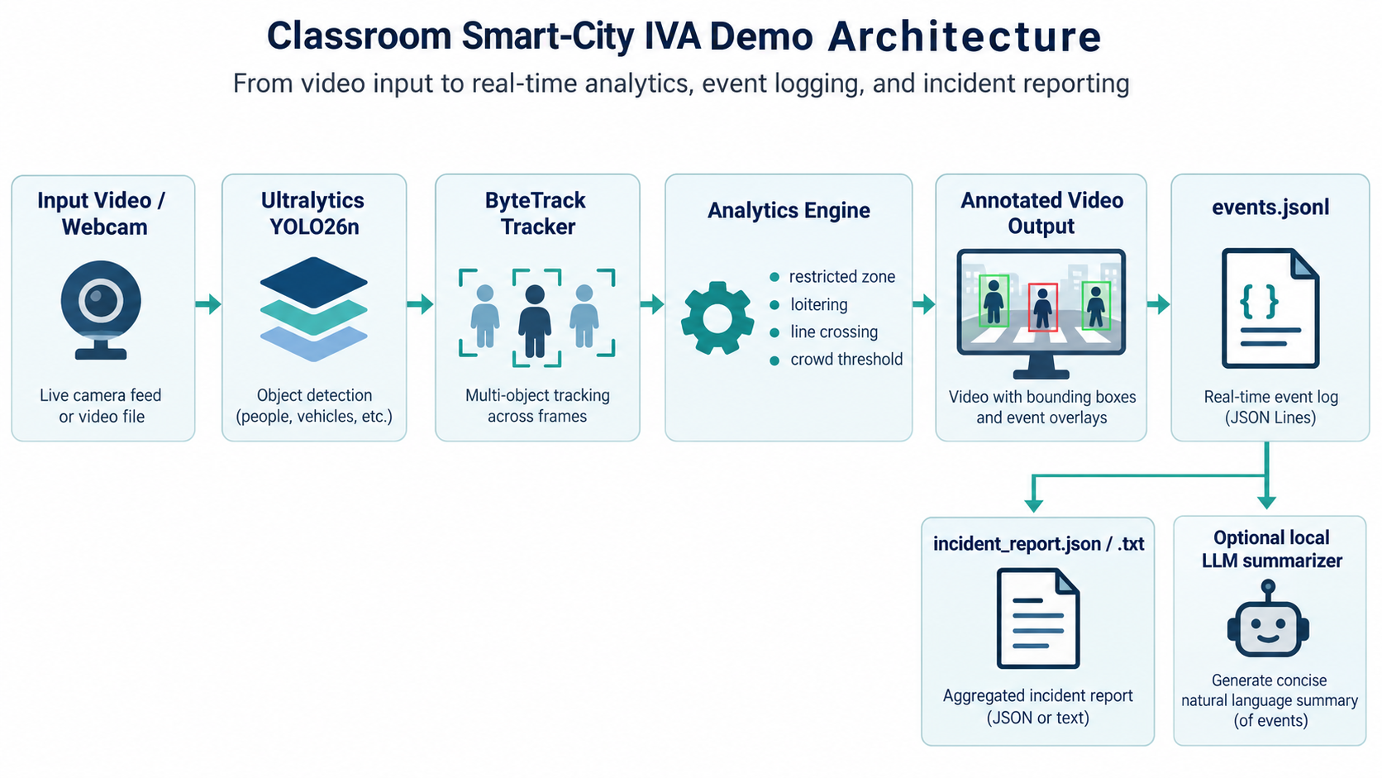
Classroom demo architecture
Demo Package
Week 11 — Smart-City Intelligent Video Analytics Demonstration

Slide 35
Demonstration package contents
Demo Package
File | Role
Week11_SmartCity_IVA_Demo.ipynb | Colab/Jupyter notebook for the complete demo
run_demo.py | Runs YOLO26 tracking, analytics, drawing, event logging, and metrics
config.yaml | Controls model, device, ROI, line, dwell time, and thresholds
src/events.py | Deterministic event engine
summarize_events.py | Builds deterministic report and optional LLM summary
smoke_test.py | Tests event rules without needing a video or model
README.md / INSTRUCTOR_RUNBOOK.md | Step-by-step operational guidance
Week 11 — Smart-City Intelligent Video Analytics Demonstration

Slide 36
Colab setup before running the demo
Demo Package
1. Upload the package or open the notebook.
2. Select Runtime → Change runtime type → GPU.
3. Install the required packages.
4. Verify CUDA availability if a GPU is expected.
5. Upload or download a short MP4 video.
6. Inspect the first frame before full processing.
Install and verify
pip install ultralytics==8.4.141 PyYAML yt-dlp
import torch
print(torch.cuda.is_available())
The demo also runs on CPU, but the speed discussion is clearer when a GPU runtime is available.
Week 11 — Smart-City Intelligent Video Analytics Demonstration

Slide 37
First-frame inspection and ROI adjustment
Demo Package
Run first-frame extraction before the full pipeline.
Check whether the default restricted zone and count line fall on meaningful scene regions.
Adjust normalized polygon and line coordinates in config.yaml if needed.
For the lecture, choose a clip where at least one object visibly enters the zone or crosses the line.
This step prevents a common failure: the model works, but no event fires because the ROI is misplaced.
First-frame command
python inspect_video.py \
--source input.mp4 \
--out outputs/first_frame.jpg
Configuration fields
restricted_zone.points
count_line.p1
count_line.p2
loiter_seconds
crowd_threshold
Week 11 — Smart-City Intelligent Video Analytics Demonstration

Slide 38
Quick run before the full run
Demo Package
A short run verifies that the model, tracker, ROI, line, and output writing all work.
Use the first 100–200 frames to save time.
Inspect the annotated video and the event log.
If no events appear, adjust the ROI, line, confidence threshold, or loitering threshold.
Only after this quick check should the full clip be processed live.
Quick test command
python run_demo.py \
--source input.mp4 \
--config config.yaml \
--output-dir outputs_quick \
--max-frames 200
This is the rehearsal stage that prevents avoidable classroom failures.
Week 11 — Smart-City Intelligent Video Analytics Demonstration

Slide 39
Full run and generated outputs
Demo Package
Full run
python run_demo.py \
--source input.mp4 \
--config config.yaml \
--output-dir outputs
Output | Purpose
annotated.mp4 | visual output with boxes, IDs, ROI, line, and alerts
events.jsonl | stream of structured events
metrics.json | frames, wall FPS, inference time, and event counts
incident_report.json | structured aggregated incident report
incident_report.txt | human-readable deterministic report
llm_summary.txt | optional local-LLM summary
Week 11 — Smart-City Intelligent Video Analytics Demonstration

Slide 40
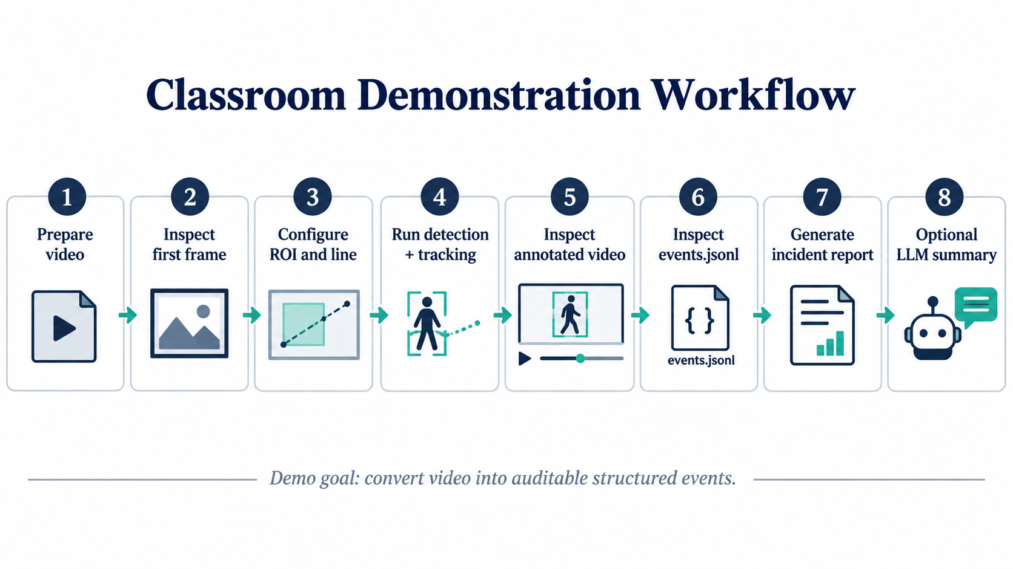
Complete classroom workflow
Demo Package
Week 11 — Smart-City Intelligent Video Analytics Demonstration

Slide 41
Part 6: Performance and Evaluation
Section
Part 6: Performance and Evaluation
How to measure the complete application, not only the model
Latency
FPS
Evaluation
Week 11 — Smart-City Intelligent Video Analytics Demonstration

Slide 42
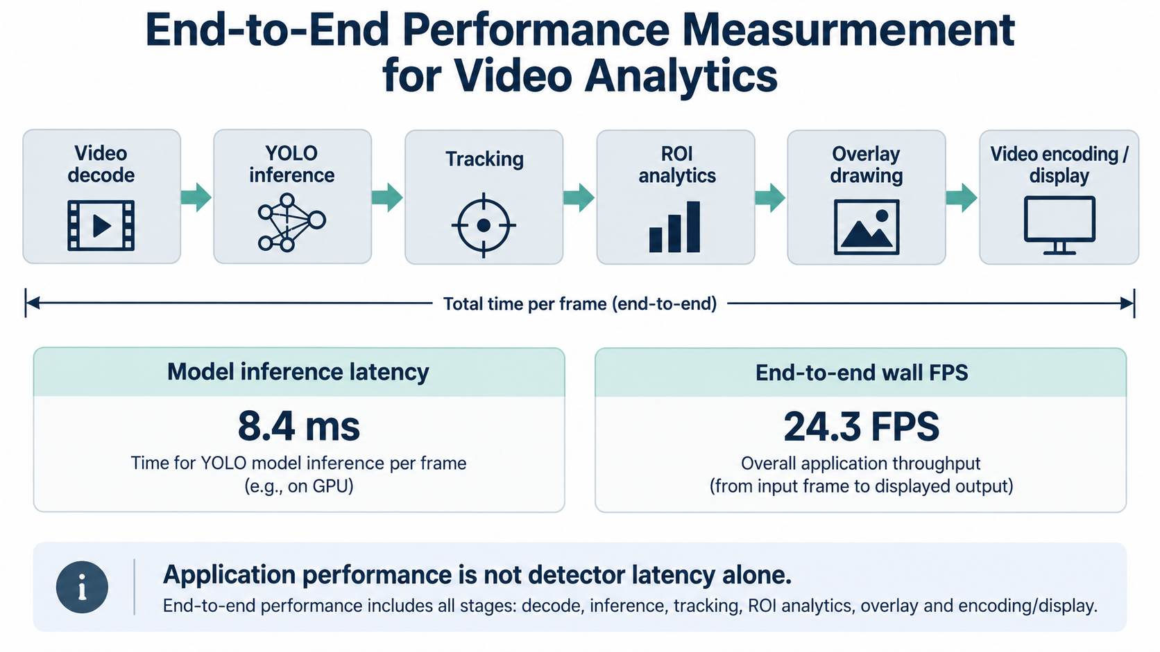
Measuring performance correctly
Performance
Week 11 — Smart-City Intelligent Video Analytics Demonstration

Slide 43
Model inference latency is not the whole story
Performance
Model inference latency measures the time spent by the detector on a frame.
End-to-end FPS measures the whole application throughput.
The application also spends time on video decoding, tracking, ROI logic, drawing overlays, and video encoding or display.
If the detector becomes faster, another stage may become the bottleneck.
Therefore the package reports both average inference time and wall FPS.
End-to-end latency = decode + inference + tracking + analytics + drawing + encoding/display
Correct comparison: run the same clip on CPU and GPU, then compare both detector latency and wall FPS.
Week 11 — Smart-City Intelligent Video Analytics Demonstration

Slide 44
CPU versus GPU classroom experiment
Performance
GPU / auto run
CPU run
Uses CUDA when available.
Shows accelerated neural-network inference.
Still includes non-model stages in wall FPS.
Useful for connecting to Week 9 serving topics.
Uses config_cpu.yaml.
Usually slower for YOLO inference.
May expose video decoding or drawing overheads.
Useful as a baseline for systems thinking.
Commands
python run_demo.py --source input.mp4 --config config.yaml --output-dir outputs_gpu
python run_demo.py --source input.mp4 --config config_cpu.yaml --output-dir outputs_cpu
Week 11 — Smart-City Intelligent Video Analytics Demonstration

Slide 45
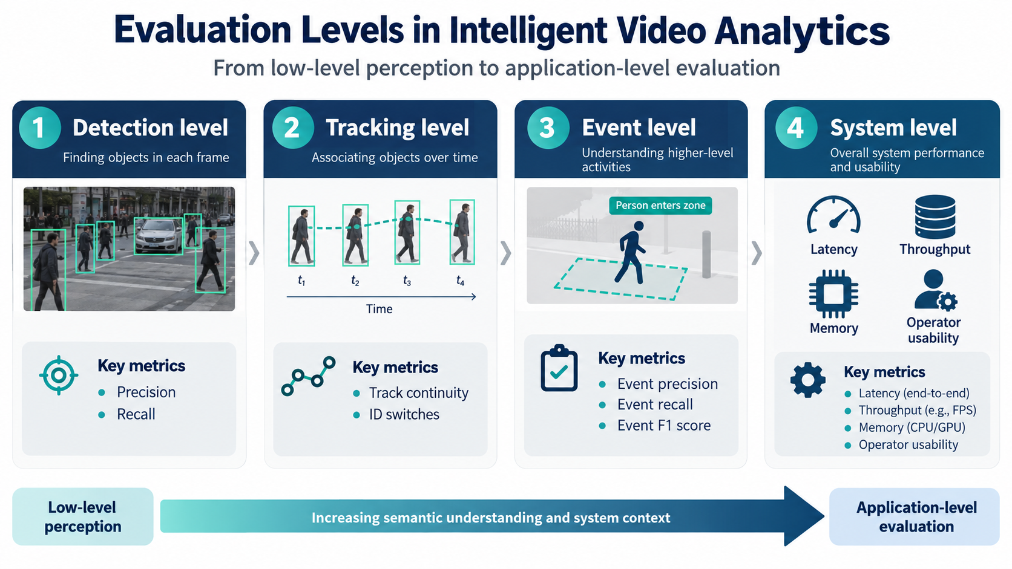
Evaluation levels in IVA
Evaluation
Week 11 — Smart-City Intelligent Video Analytics Demonstration

Slide 46
Detection, tracking, event, and system metrics
Evaluation
Level | Typical metrics | What it tells us
Detection | precision, recall, mAP | whether objects are found correctly
Tracking | ID switches, track continuity, MOT metrics | whether identities are stable over time
Event | event precision, recall, F1, timestamp tolerance | whether application events are correct
System | latency, throughput, memory, CPU/GPU usage | whether the application meets operational constraints
LLM summary | factual consistency, omissions, hallucinations | whether the summary preserves structured facts
A correct detector is not enough; the application must be evaluated at the event and system levels too.
Week 11 — Smart-City Intelligent Video Analytics Demonstration

Slide 47
Common failure modes and what they teach
Evaluation
Failure mode | Likely cause | Important point
No event fired | ROI/line not aligned with scene | site calibration matters
False zone entry | false detection or poor geometry | perception and rule errors propagate
Wrong dwell time | track ID switch or lost track | temporal identity is fragile
Wrong line count | missed track or line placement | event rules need validation
LLM adds unsupported claim | summary not constrained enough | LLM must be grounded in structured facts
Failure analysis is part of the lesson; students should learn to debug the pipeline stage by stage.
Week 11 — Smart-City Intelligent Video Analytics Demonstration

Slide 48
Part 7: Live Demonstration
Section
Part 7: Live Demonstration
Run the package after the theory is complete
Setup
Run
Inspect
Measure
Week 11 — Smart-City Intelligent Video Analytics Demonstration

Slide 49
Live demonstration sequence
Live Demo
1. Open the Colab notebook or local terminal.
2. Verify package installation and CUDA availability.
3. Upload or select the input video.
4. Inspect the first frame and adjust ROI/line if necessary.
5. Run a short quick test.
6. Run the full video analytics pipeline.
7. Open annotated.mp4 and events.jsonl.
8. Generate and inspect the incident report.
9. Optionally run the LLM summary.
10. Open metrics.json and discuss performance.
Week 11 — Smart-City Intelligent Video Analytics Demonstration

Slide 50
Live demo checkpoint 1: environment and video
Live Demo
Expected environment: Google Colab GPU or local Python environment.
Expected input: a short MP4 with visible people or vehicles.
Expected first action: verify that the runtime can import Ultralytics and load YOLO26n.
Expected second action: inspect the first video frame and ensure the ROI and virtual line are meaningful.
Environment check
pip install ultralytics==8.4.141 PyYAML yt-dlp
python - <<'PY'
import torch
print(torch.cuda.is_available())
PY
First frame
python inspect_video.py --source input.mp4 --out outputs/first_frame.jpg
Week 11 — Smart-City Intelligent Video Analytics Demonstration

Slide 51
Live demo checkpoint 2: quick run
Live Demo
The quick run verifies that the pipeline is functioning before the full demonstration.
Use max-frames to keep this step short.
Confirm that bounding boxes, track IDs, ROI, and line overlays appear.
If necessary, adjust config.yaml before continuing.
Quick run command
python run_demo.py \
--source input.mp4 \
--config config.yaml \
--output-dir outputs_quick \
--max-frames 200
Expected result: outputs_quick/annotated.mp4 and outputs_quick/events.jsonl.
Week 11 — Smart-City Intelligent Video Analytics Demonstration

Slide 52
Live demo checkpoint 3: full pipeline run
Live Demo
The full run processes the complete input video.
The console prints events as they are emitted.
The output directory contains the annotated video, event stream, and metrics.
This is the main demonstration moment: video becomes structured information.
Full run command
python run_demo.py \
--source input.mp4 \
--config config.yaml \
--output-dir outputs
During the run, watch for printed events such as restricted_zone_entry, loitering, line_crossing, or crowd_threshold.
Week 11 — Smart-City Intelligent Video Analytics Demonstration

Slide 53
Live demo checkpoint 4: inspect outputs
Live Demo
Open this file | What students should observe
annotated.mp4 | Detected objects, tracking IDs, ROI polygon, virtual line, and event overlay
events.jsonl | One structured JSON record per event
metrics.json | Frames processed, wall FPS, average inference time, event counts
incident_report.txt | Deterministic human-readable summary
llm_summary.txt | Optional natural-language summary from structured facts
Suggested order: annotated video → events.jsonl → incident report → metrics.
Week 11 — Smart-City Intelligent Video Analytics Demonstration

Slide 54
Live demo checkpoint 5: incident report and optional LLM
Live Demo
First generate the deterministic report from events.jsonl.
Then optionally run the local-LLM summary.
Compare the two outputs: the LLM should not add new facts that are absent from the structured report.
This demonstrates a safe agentic pattern: deterministic analytics first, language generation second.
Deterministic report
python summarize_events.py \
--events outputs/events.jsonl \
--out-dir outputs
Optional LLM summary
python summarize_events.py \
--events outputs/events.jsonl \
--out-dir outputs \
--llm
Week 11 — Smart-City Intelligent Video Analytics Demonstration

Slide 55
Troubleshooting during the live demo
Live Demo
Problem | Immediate fix
No CUDA | Continue on CPU or switch Colab runtime to GPU
No events | Move ROI/line or lower loiter_seconds
Weak detections | Use a clearer clip or lower confidence threshold
Track IDs unstable | Use a less crowded clip and verify tracker setting
Video does not play | Re-encode annotated output with H.264 if needed
LLM too slow | Skip LLM summary; deterministic report is sufficient
The safest plan is to keep a pre-generated output folder as backup, but still run the live commands if time permits.
Week 11 — Smart-City Intelligent Video Analytics Demonstration

Slide 56
Ethics, privacy, and deployment caution
Discussion
The classroom demo is for technical education, not an endorsement of uncontrolled surveillance.
No face recognition, identity inference, or personal profiling is required.
A real deployment must consider consent, signage, access control, audit trails, retention policy, and legal requirements.
False detections, ID switches, and poor ROI calibration can produce false alerts.
The output should be treated as decision support and should require human review in sensitive settings.
Responsible design: structured evidence, clear limitations, human review, and careful data governance.
Week 11 — Smart-City Intelligent Video Analytics Demonstration

Slide 57
Extensions after the classroom demo
Discussion
Wrong-way movement: compare track direction against an allowed direction.
Queue length: count people inside a waiting zone over time.
Parking dwell: detect vehicles remaining in a zone longer than a threshold.
Multi-camera IVA: merge events from multiple cameras into one reporting layer.
Acceleration study: compare PyTorch, ONNX Runtime, TensorRT, and different image sizes for the detector stage.
Formal evaluation: create labeled clips and compute event-level precision, recall, and F1.
For any new rule, define required objects, spatial condition, temporal condition, event record, failure cases, and evaluation metric.
Week 11 — Smart-City Intelligent Video Analytics Demonstration

Slide 58
Final synthesis
Summary
camera → detection → tracking → event logic → structured report → decision support
Detection gives objects in individual frames.
Tracking gives identity over time.
Event logic gives application semantics.
Structured logs give auditability and evaluation support.
LLM summarization is useful only when grounded in structured facts.
End-to-end measurement is required for real accelerated-AI deployment.
Now the live demo should be interpretable: every output file corresponds to one layer of the system.
Week 11 — Smart-City Intelligent Video Analytics Demonstration

Slide 59
References and implementation sources
References
Ultralytics documentation: Multi-Object Tracking with Ultralytics YOLO; tracking API supports model.track(...) with tracker configuration.
Ultralytics documentation: YOLO26 model family and yolo26n.pt quick-start usage.
Zhang et al., “ByteTrack: Multi-Object Tracking by Associating Every Detection Box,” ECCV 2022.
Course package: Week11_SmartCity_IVA_Complete_Demo_Package.zip, including notebook, run_demo.py, event engine, report generator, and evaluation plan.
Optional local summarization model: Qwen2.5-0.5B-Instruct or any small instruction-tuned model available in the classroom environment.
The figures in this deck are AI-generated academic-style teaching figures prepared specifically for this lecture.
Week 11 — Smart-City Intelligent Video Analytics Demonstration

Slide 60
Thank you
Week 11
Smart-City IVA Demonstration
Video → detection → tracking → event analytics → incident report
Ready for live demonstration
Week 11 — Smart-City Intelligent Video Analytics Demonstration

