Slide 1


NPTEL
Applied Accelerated Artificial Intelligence
Instructor: Dr. Satyajit Das
Dept. of Computer Science and Engineering
Indian Institute of Technology Guwahati, Assam, India

Slide 2
Week 09
Accelerated Inference and Serving Toolchain
Seg 1: Inference Fundamentals | Seg 2: Graph Tracing, Batching & Concurrency | Seg 3: ONNX Runtime | Seg 4: TensorRT & Hardware Acceleration | Seg 5: Quantization & LLM Inference Optimization

Slide 3

Segment 1
Inference Acceleration Fundamentals
Why inference differs from training, where latency comes from, and how hardware is matched to AI serving workloads

Slide 4
Learning Objectives — Segment 1
01
Distinguish the inference compute pattern from training: batch size 1 vs large, memory-bandwidth-bound vs compute-bound
02
Define and calculate latency, throughput, and TTFT/TPOT metrics for a production LLM serving system
03
Identify the five main sources of inference latency: model loading, tokenisation, prefill, decode, and post-processing
04
Explain why the KV cache is the dominant memory consumer during LLM decode and calculate its size
05
Map inference workload characteristics to GPU/CPU/NPU hardware capabilities and explain why H100 NVL is preferred for LLM serving

Slide 5
Training vs Inference: Two Fundamentally Different Compute Patterns
Training Characteristics
  Large batch sizes (64–4096 samples) — maximises GPU FLOP utilisation
  Deterministic computation — same graph every step
  Compute-bound: weights accessed once, large matmuls fill Tensor Cores
  Throughput metric: samples/sec or tokens/sec overall
  Tolerance for latency — users wait seconds to minutes
  Parallelism: data, tensor, pipeline parallelism across many GPUs
Inference Characteristics
  Batch size 1 (online serving) to 256 (offline batch) — often memory-bandwidth-bound
  Dynamic computation — sequence length and routing vary per request
  Autoregressive decode: one token per forward pass — serial dependency
  Latency metrics: TTFT, TPOT, P50/P99 latency — users feel every ms
  Throughput: tokens/sec at target latency SLO
  Memory: weights + KV cache must fit in GPU HBM together
Ref: Pope et al., Efficiently Scaling Transformer Inference, MLSys 2023

Slide 6
Training vs Inference: Two Fundamentally Different Compute Patterns
The Memory Bandwidth Bottleneck in Decode
  Decode: batch=1, one token forward pass — tiny compute but must load ALL weights
  Weight read: 7B × 2B = 14 GB per decode step from HBM
  Compute: 7B × 2 FLOP = 14 GFLOP at batch=1
Arithmetic intensity = FLOP / bytes = 14G/14G = 1 FLOP/byte
  H100 peak: 3.35 TB/s BW, 3958 TFLOPS FP8 → ridge point = 1181 FLOP/byte
  At intensity 1: completely memory-bandwidth-bound — GPU is at 0.08% of peak FLOP
Batching is essential: increasing batch from 1 to 64 raises intensity 64-fold.
Key Inference Metrics
  TTFT: Time To First Token — latency of the prefill phase (user-facing responsiveness)
  TPOT: Time Per Output Token — decode step latency (streaming speed perception)
  P50/P99 latency: Median and tail latency — SLO contracts are usually on P99
  Throughput: Tokens/sec across all concurrent requests at target P99
  QPS: Queries per second — system-level capacity metric
  MFU: Model FLOP Utilisation — efficiency relative to hardware peak
Ref: Pope et al., Efficiently Scaling Transformer Inference, MLSys 2023

Slide 7
Training vs Inference: Two Fundamentally Different Compute Patterns
Prefill vs Decode: Two Phases of LLM Inference
  Prefill: process the entire input prompt in parallel — one forward pass, large batch of tokens, compute-bound, fast
  Decode: generate output tokens one at a time, autoregressive — serial, memory-bandwidth-bound, slow
  For a 1000-token prompt + 200-token output: prefill takes ~20ms, decode takes ~200ms on H100
KV Cache: The Memory Bottleneck of LLM Serving
  Each transformer layer stores Key and Value tensors for all previous tokens
  KV cache size = 2 x n_layers x n_heads x d_head x seq_len x bytes
  LLaMA-3-70B, seq=8192, BF16: 2x80x64x128x8192x2 = 21 GB per request
  H100 80GB: weights=140GB across 2 GPUs, only 20GB left per GPU for KV cache
  KV cache is the primary constraint on maximum batch size and context length
Ref: Pope et al., Efficiently Scaling Transformer Inference, MLSys 2023

Slide 8
Inference Hardware: Matching Workload to
Accelerator
GPU: The Dominant Inference Platform
  NVIDIA H100 SXM5: 3.35 TB/s HBM3, 80 GB — primary LLM serving GPU
  NVIDIA H100 NVL: two H100 dies, 188 GB total — fits 70B model without tensor parallelism
  NVIDIA L40S: 864 GB/s GDDR6, 48 GB — cost-efficient for smaller models
  NVIDIA A10G (cloud): 600 GB/s, 24 GB — common in AWS/GCP instances
  NVIDIA RTX 4090: consumer, 1 TB/s GDDR6X, 24 GB — viable for 7B models locally
Why HBM Bandwidth Matters More Than FLOPS for Inference
  Decode throughput ≈ min(HBM_bandwidth / model_size, peak_FLOPS / arithmetic_intensity)
  H100: 3.35 TB/s / 140 GB (70B BF16) = 24 token/s theoretical max per request at bs=1
  Increasing batch to 32 raises throughput proportionally until compute-bound
  Conclusion: for LLM serving, memory bandwidth is the primary hardware metric
Specialised AI Inference Accelerators (2024–2025)
  Google TPU v5p: 459 TB/s HBM2e, 96 GB — dominant for Google internal serving
  AWS Inferentia2: 2.3 TB/s, 32 GB — cost-efficient for Neuron-compiled models
  AMD MI300X: 5.3 TB/s HBM3, 192 GB — growing LLM inference use
  Groq LPU: SRAM-based, no HBM — extremely low latency, limited model size
Ref: Kwon et al., Efficient Memory Management for LLM Serving with PagedAttention, SOSP 2023

Slide 9
Inference Hardware: Matching Workload to
Accelerator
CPU Inference: When and Why
  CPU inference viable for: models under 2B params, batch=1, latency-insensitive workloads
  llama.cpp: highly optimised CPU inference using AVX-512/AVX2 SIMD
  Apple M-series: unified memory up to 192 GB — fits 70B models at 4-bit in RAM
  Intel AMX (Advanced Matrix Extensions): dedicated matrix multiplication on Sapphire Rapids
  Intel Gaudi 2: 300 GB/s HBM2e, 96 GB — competitive with A100 for inference
The Serving Latency Stack
  1. Network: client to load balancer (~1ms)
  2. Request queue: waiting for GPU slot (~0–100ms depending on load)
  3. Tokenisation: BPE/SentencePiece encode (~0.1ms for 1K tokens)
  4. Prefill: process prompt on GPU (~20ms for 1K tokens on H100)
  5. Decode: autoregressive generation (~5ms/token on H100, batch=1)
  6. Detokenisation + postprocess: (~0.1ms)
  7. Network: response to client (~1ms)
  Total P99 for 200-token response at bs=1: ~1.1 seconds on H100
Ref: Kwon et al., Efficient Memory Management for LLM Serving with PagedAttention, SOSP 2023

Slide 10
Inference Hardware: Matching Workload to
Accelerator
Key Optimisation Levers
  Continuous batching: Removes idle gaps; up to 10-23x throughput gain
  PagedAttention: Eliminates KV cache fragmentation; enables 3-4x more concurrent requests
  Speculative decoding: Up to 3x TTFT/TPOT improvement at same hardware cost
  Quantization: 4-bit: 4x more concurrent requests in same VRAM
Ref: Kwon et al., Efficient Memory Management for LLM Serving with PagedAttention, SOSP 2023

Slide 11
PagedAttention and Continuous Batching: The Foundation of Modern LLM Serving
The Problem: KV Cache Fragmentation
  Traditional serving pre-allocates KV cache for max_seq_len tokens per request — wastes 60–80% of GPU memory on average
  If max_seq_len=4096 and average output=200 tokens: 95% of allocated KV memory is never used
  Cannot handle dynamic output lengths — must reserve worst case upfront
PagedAttention (vLLM, Kwon et al., SOSP 2023)
  Divides KV cache into fixed-size pages (blocks) of 16 tokens — analogous to OS virtual memory paging
  Each request's KV cache is a logical sequence of non-contiguous physical pages
  Physical pages allocated on demand as tokens are generated — no pre-allocation waste
  Sharing: multiple requests sampling the same prefix share physical pages (prefix caching)
  Result: 3–4× more concurrent requests on same GPU, higher throughput at same latency
  # vLLM uses PagedAttention by default
  from vllm import LLM, SamplingParams
  llm = LLM(model='meta-llama/Llama-3-8B', gpu_memory_utilization=0.90)
  outputs = llm.generate(['What is ML?'], SamplingParams(max_tokens=200))
Ref: Kwon et al., Efficient Memory Management with PagedAttention, SOSP 2023; Yu et al., Orca, OSDI 2022

Slide 12
PagedAttention and Continuous Batching: The Foundation of Modern LLM Serving
Continuous Batching (Orca, Yu et al., OSDI 2022)
  Traditional static batching: wait for all requests in a batch to finish before starting new ones — GPU starves waiting for the slowest request
  Continuous batching: insert new requests into the batch at the token level — new requests begin decode immediately when a slot becomes available
  Each iteration, the scheduler checks for completed sequences and adds new ones
  Result: GPU utilisation rises from ~30% to 70–90%; 10–23x throughput improvement reported by vLLM
Speculative Decoding: Hiding Decode Latency
  Draft model (small, fast) generates K candidate tokens; target model (large) verifies all K in one pass
  If tokens accepted: K tokens generated for cost of 1 target step + K draft steps
  Acceptance rate ~80% means 2–3x effective speedup on H100
  Works best when draft and target models share vocabulary and embeddings (e.g., LLaMA-3-8B drafting for LLaMA-3-70B)
  vLLM, TensorRT-LLM, and SGLang all implement PagedAttention + continuous batching as the baseline.
Ref: Kwon et al., Efficient Memory Management with PagedAttention, SOSP 2023; Yu et al., Orca, OSDI 2022

Slide 13
Inference Serving Frameworks: vLLM, TGI, and SGLang
vLLM (UC Berkeley, 2023–2025)
  PagedAttention + continuous batching as core innovations
  Supports: LLaMA, Mistral, Qwen, Gemma, DeepSeek and 100+ HuggingFace models
  Tensor parallelism via Megatron-LM-style TP for multi-GPU serving
  OpenAI-compatible API server — drop-in replacement for GPT-4 API
  # Launch vLLM OpenAI-compatible server
  python -m vllm.entrypoints.openai.api_server \
  --model meta-llama/Llama-3.1-70B-Instruct \
  --tensor-parallel-size 2 \
  --max-model-len 32768 \
  --gpu-memory-utilization 0.90
HuggingFace TGI (Text Generation Inference)
  Battle-tested at HuggingFace scale — powers HuggingFace Inference API
  Flash Attention 2 + continuous batching + tensor parallelism
  Docker-native deployment with Prometheus metrics out of the box
  Best for: HuggingFace Hub model deployment, production reliability
  docker run --gpus all ghcr.io/huggingface/text-generation-inference \
  --model-id meta-llama/Llama-3.1-8B-Instruct \
  --num-shard 1 --max-input-length 4096
Ref: Zheng et al., SGLang: Efficient Execution of Structured Language Model Programs, NeurIPS 2024

Slide 14
Inference Serving Frameworks: vLLM, TGI, and SGLang
SGLang (Stanford, 2024)
  RadixAttention: automatic KV cache reuse across requests sharing a common prefix
  Structured generation: JSON/regex-constrained decoding without overhead
  Runtime parallelism: pipeline multiple generation calls within one program
  Up to 5× faster than vLLM on prefix-heavy workloads (RAG, few-shot prompts)
  import sglang as sgl
  @sgl.function
  def multi_turn_chat(s, question):
  s += sgl.system('You are a helpful assistant')
  s += sgl.user(question)
  s += sgl.assistant(sgl.gen('answer', max_tokens=200))
Framework Selection Guide (2025)
  vLLM: General-purpose LLM serving, good default choice, widest model support
  TGI: HuggingFace ecosystem, production reliability, Docker/k8s native
  SGLang: Prefix-heavy workloads (RAG, agents), structured output, research
  TensorRT-LLM: Maximum throughput on NVIDIA hardware, requires compilation step
  Ollama: Local development, consumer hardware, ease of use over performance
Ref: Zheng et al., SGLang: Efficient Execution of Structured Language Model Programs, NeurIPS 2024

Slide 15
Inference Serving Frameworks: vLLM, TGI, and SGLang
Production Deployment Stack
  Load balancer (NGINX/HAProxy) → serving framework → GPU pool
  Autoscaling: Kubernetes HPA + KEDA based on queue depth or GPU util
  Observability: Prometheus (latency/throughput) + Grafana dashboards
Ref: Zheng et al., SGLang: Efficient Execution of Structured Language Model Programs, NeurIPS 2024

Slide 16
Segment 1 Summary: Inference Acceleration Fundamentals
  Inference is memory-bandwidth-bound at decode time (batch=1, intensity = 1 FLOP/byte vs H100 ridge point of 1181). Batching is the primary throughput lever — raising batch 64x raises compute utilisation proportionally.
  Key metrics: TTFT (prefill latency), TPOT (per-token decode latency), P99 latency, and throughput (tokens/sec at SLO). KV cache = 2 x n_layers x d_model x seq_len x bytes — 21 GB per request for LLaMA-3-70B at seq=8192 BF16.
  PagedAttention (vLLM) eliminates KV cache fragmentation via OS-style paging — 3-4x more concurrent requests on same GPU. Continuous batching removes idle GPU time between requests — 10-23x throughput improvement.

Slide 17
Segment 1 Summary: Inference Acceleration Fundamentals
  H100 NVL (188 GB) is the preferred serving GPU for 70B models — fits weights without tensor parallelism. AMD MI300X (192 GB, 5.3 TB/s) is the leading alternative. Memory bandwidth, not FLOPS, determines LLM serving capacity.
  vLLM is the dominant open-source serving framework. SGLang leads for prefix-heavy workloads (RAG, agents). TGI is preferred for HuggingFace ecosystem production deployments. TensorRT-LLM maximises throughput on NVIDIA hardware.

Slide 18
Segment 2:
Graph Tracing, Batching, and Concurrency
Optimising the compute graph for inference: tracing, operator fusion, dynamic shapes, and concurrent request handling

Slide 19
Learning Objectives — Segment 2
01
Explain the difference between eager execution and traced/compiled graphs for inference and the overhead each eliminates
02
Use torch.jit.trace, torch.jit.script, and torch.export to capture an inference graph and apply optimisations
03
Implement dynamic batching and explain how it improves GPU utilisation without increasing latency beyond SLO
04
Describe CUDA Graphs and explain why they are mandatory for low-latency small-batch inference
05
Configure concurrent request handling in a serving framework using async processing and request queuing

Slide 20
Graph Tracing: Capturing the Computation Graph for Inference
Why Trace a Graph for Inference?
  Eager execution incurs Python overhead on every forward pass: ~3–10 µs per operator call
  For a 32-layer Transformer with 200 ops/layer: 32 x 200 x 5µs = 32ms of pure Python dispatch overhead per step
  Graph capture eliminates this: Python runs once to trace, then compiled graph executes without Python
  Additional benefit: graph-level optimisations (fusion, layout optimisation, dead code elimination)
  torch.jit.trace: Tensor-Shape-Specific Tracing
  import torch
  model = MyModel().eval()
  example_input = torch.randn(1, 512)
  # trace records ops for this specific input shape
  traced = torch.jit.trace(model, example_input)
  torch.jit.save(traced, 'model_traced.pt')
  # Load and run — no Python, pure TorchScript
  loaded = torch.jit.load('model_traced.pt')
  output = loaded(example_input)
  Limitation: does not handle Python control flow (if/else on tensor values)
  Use for: CNNs, Encoders, models with fixed-shape forward passes
Ref: PyTorch TorchScript docs; torch.export RFC, PyTorch 2024

Slide 21
Graph Tracing: Capturing the Computation Graph for Inference
torch.jit.script: Control-Flow-Aware Compilation
@torch.jit.script
def beam_search_step(logits: torch.Tensor,
beam_scores: torch.Tensor,
k: int) -> torch.Tensor:
# if/for loops compiled to TorchScript IR
scores = logits + beam_scores.unsqueeze(-1)
top_scores, top_ids = scores.topk(k)
return top_ids
  Compiles Python to TorchScript IR — supports if/for/while
  Restriction: type annotations required; limited Python stdlib support
  torch.export (PyTorch 2.x): The Modern Approach
  from torch.export import export
  # Capture with dynamic shape support
  exported = export(
  model,
  args=(example_input,),
  dynamic_shapes={'x': {0: torch.export.Dim('batch', min=1, max=256)}},
  )
  # Export to TensorRT, ONNX, or run directly
  torch.export is the recommended API for PyTorch 2.x inference
  Supports dynamic dimensions (batch size, sequence length) unlike JIT trace
  Integrates with torch.compile for end-to-end optimisation
Ref: PyTorch TorchScript docs; torch.export RFC, PyTorch 2024

Slide 22
Graph Tracing:
Capturing the Computation Graph for Inference
Why Trace a Graph for Inference?
  Eager execution incurs Python overhead on every forward pass: ~3–10 µs per operator call
  For a 32-layer Transformer with 200 ops/layer: 32 x 200 x 5µs = 32ms of pure Python dispatch overhead per step
  Graph capture eliminates this: Python runs once to trace, then compiled graph executes without Python
  Additional benefit: graph-level optimisations (fusion, layout optimisation, dead code elimination)
torch.jit.trace: Tensor-Shape-Specific Tracing
  import torch
  model = MyModel().eval()
  example_input = torch.randn(1, 512)
  # trace records ops for this specific input shape
  traced = torch.jit.trace(model, example_input)
  torch.jit.save(traced, 'model_traced.pt')
  # Load and run — no Python, pure TorchScript
  loaded = torch.jit.load('model_traced.pt')
  output = loaded(example_input)
  Limitation: does not handle Python control flow (if/else on tensor values)
  Use for: CNNs, Encoders, models with fixed-shape forward passes
Ref: PyTorch TorchScript docs; torch.export RFC, PyTorch 2024

Slide 23
Graph Tracing: Capturing the Computation Graph for Inference
torch.jit.script: Control-Flow-Aware Compilation
@torch.jit.script
def beam_search_step(logits: torch.Tensor,
beam_scores: torch.Tensor,
k: int) -> torch.Tensor:
# if/for loops compiled to TorchScript IR
scores = logits + beam_scores.unsqueeze(-1)
top_scores, top_ids = scores.topk(k)
return top_ids
  Compiles Python to TorchScript IR — supports if/for/while
  Restriction: type annotations required; limited Python stdlib support
Ref: PyTorch TorchScript docs; torch.export RFC, PyTorch 2024

Slide 24
Graph Tracing: Capturing the Computation Graph for Inference
torch.export (PyTorch 2.x): The Modern Approach
  from torch.export import export
  # Capture with dynamic shape support
  exported = export(
  model,
  args=(example_input,),
  dynamic_shapes={'x': {0: torch.export.Dim('batch', min=1, max=256)}},
  )
  # Export to TensorRT, ONNX, or run directly
  torch.export is the recommended API for PyTorch 2.x inference
  Supports dynamic dimensions (batch size, sequence length) unlike JIT trace
  Integrates with torch.compile for end-to-end optimisation
Ref: PyTorch TorchScript docs; torch.export RFC, PyTorch 2024

Slide 25
CUDA Graphs: Eliminating CPU Overhead in Low-Latency Inference
The CPU Overhead Problem at Small Batch Sizes
  Each CUDA kernel launch requires a CPU-GPU round trip: ~5–10 µs of CPU time
  A Transformer forward pass launches 500–2000 kernels — up to 20ms CPU overhead
  At batch=1 with 5ms actual GPU compute, 20ms CPU overhead dominates
  GPU sits idle waiting for CPU to issue the next kernel — CPU-bound not GPU-bound
CUDA Graphs: Record Once, Replay Many Times
  Record phase: GPU records all kernel launches and their arguments into a graph
  Replay phase: single CUDA graph launch replays all kernels with zero CPU involvement
  CPU overhead: O(1) per step instead of O(n_kernels) — ~3 µs vs ~20 ms
Ref: CUDA Programming Guide: CUDA Graphs; NVIDIA TensorRT-LLM CUDA Graphs documentation 2024

Slide 26
CUDA Graphs: Eliminating CPU Overhead in Low-Latency Inference
CUDA Graph Capture with torch.cuda.CUDAGraph
  # Warmup — required to initialise cuDNN and NCCL
  for _ in range(3):
  output = model(static_input)
  torch.cuda.synchronize()
  # Capture the graph
  g = torch.cuda.CUDAGraph()
  with torch.cuda.graph(g):
  static_output = model(static_input)
  # Replay: just copy new input, replay graph
  static_input.copy_(new_input)
  g.replay()
result = static_output.clone()
  CRITICAL: input/output tensors must be the same memory addresses — use copy_()
Ref: CUDA Programming Guide: CUDA Graphs; NVIDIA TensorRT-LLM CUDA Graphs documentation 2024

Slide 27
CUDA Graphs: Eliminating CPU Overhead in Low-Latency Inference
torch.compile + CUDA Graphs: The Recommended Pattern
# torch.compile automatically uses CUDA Graphs
# when mode='reduce-overhead'
model = torch.compile(
model,
mode='reduce-overhead', # enables CUDA Graphs
)
# First call triggers compilation + graph capture
output = model(x) # slow
# Subsequent calls replay the graph
output = model(x) # fast: O(1) CPU overhead
Ref: CUDA Programming Guide: CUDA Graphs; NVIDIA TensorRT-LLM CUDA Graphs documentation 2024

Slide 28
CUDA Graphs: Eliminating CPU Overhead in Low-Latency Inference
Limitations of CUDA Graphs
  Static shapes required: graph is captured for specific (batch, seq_len) — dynamic shapes require separate captures per shape
  Memory must be static: no dynamic allocation inside the graph
  Cannot contain CPU-GPU synchronisation points (e.g., .item(), print)
  Workaround for dynamic batch sizes: capture a graph per batch size (1, 2, 4, 8, 16, 32, 64) — pad smaller batches
Speedup in Practice
  Without CUDA Graphs (bs=1): ~25ms per step (20ms CPU + 5ms GPU)
  With CUDA Graphs (bs=1): ~5.3ms per step (0.3ms CPU + 5ms GPU)
  Speedup: ~5x at batch=1, ~1.2x at batch=64
  CUDA Graphs are mandatory for competitive low-latency LLM inference. All major serving frameworks use them.
Ref: CUDA Programming Guide: CUDA Graphs; NVIDIA TensorRT-LLM CUDA Graphs documentation 2024

Slide 29
Dynamic Batching and Concurrency for Maximum Throughput
Static vs Dynamic Batching
  Static batching: collect exactly B requests, run as one batch — simple but forces all requests to wait for the slowest
  Dynamic batching: accumulate requests up to max_batch OR until a timeout — better latency-throughput trade-off
  Continuous batching (see Seg 1): at the token level — current best practice for LLM serving
  Triton Inference Server: Production Batching Configuration
  # config.pbtxt — model serving configuration
  name: "llama3_8b"
  backend: "vllm"
  max_batch_size: 128
  dynamic_batching {
  preferred_batch_size: [1, 4, 8, 16, 32, 64, 128]
  max_queue_delay_microseconds: 5000 # wait up to 5ms to fill batch
  }
  instance_group [
  { count: 1 kind: KIND_GPU gpus: [0] }
  ]
Ref: Sheng et al., FlexGen: High-Throughput Generative Inference, ICML 2023; vLLM Scheduling Internals 2024

Slide 30
Dynamic Batching and Concurrency for Maximum Throughput
Concurrency: Handling Multiple Requests Simultaneously
  Single-threaded serving: requests queue behind each other — terrible utilisation
  Async serving: use asyncio to overlap tokenisation, preprocessing, and inference scheduling
  Multi-instance: run N model replicas on N GPUs — linear throughput scaling
  # FastAPI + vLLM async serving pattern
  from fastapi import FastAPI
  from vllm import AsyncLLMEngine, AsyncEngineArgs
  app = FastAPI()
  engine = AsyncLLMEngine.from_engine_args(AsyncEngineArgs(
  model='meta-llama/Llama-3.1-8B-Instruct',
  max_num_seqs=256, # max concurrent sequences
  max_num_batched_tokens=8192, # max tokens per iteration
  ))
  @app.post('/generate')
  async def generate(request: GenerateRequest):
  async for output in engine.generate(request.prompt, ...):
  pass
  return {'text': output.outputs[0].text}
Ref: Sheng et al., FlexGen: High-Throughput Generative Inference, ICML 2023; vLLM Scheduling Internals 2024

Slide 31
Dynamic Batching and Concurrency for Maximum Throughput
Request Scheduling Strategies
  FCFS (First-Come First-Served): Simple, fair — default in most frameworks
  Priority scheduling: SLA-based priority; short requests jump queue
  Chunked prefill (vLLM 0.4+): Break long prefills into chunks to reduce TTFT spikes
  Chunked prefill halves P99 TTFT by preventing long prompts from blocking the decode loop.
Ref: Sheng et al., FlexGen: High-Throughput Generative Inference, ICML 2023; vLLM Scheduling Internals 2024

Slide 32
Operator Fusion and Kernel Optimisation for Inference
Fused Kernels Reduce Memory Traffic
  Unfused: each op reads from and writes to HBM — multiple round trips for simple sequences
  Fused: sequential ops computed in registers — one HBM read + one HBM write total
  Fused LayerNorm + Dropout + Add: 3x HBM reads → 1x; 3x HBM writes → 1x
  Fused GELU FFN: column-parallel matmul + GELU applied in-register, no HBM for intermediate
Flash Attention: The Inference Kernel Standard (2024)
  Flash Attention 3 (Dao et al., 2024): H100-specific, uses WGMMA and TMA instructions
  Never materialises the full T×T attention score matrix — tiled computation in SRAM
  FA3 FP16 throughput on H100: up to 740 TFLOPS (74% of H100 FP16 peak)
  Memory: O(T) instead of O(T²) — enables 128K+ context serving
  Flash Decoding (Tri Dao, 2023): parallelises attention over sequence dimension for long KV caches — 8x speedup vs FA2 at seq=8192
Ref: Dao et al., FlashAttention-3, arXiv 2024; PyTorch torch.compile inference documentation 2024

Slide 33
Operator Fusion and Kernel Optimisation for Inference
xFormers and Custom Kernels
  Meta's xFormers library: memory-efficient attention, fused ops for Transformers
  Triton: write custom CUDA-like kernels in Python — auto-tuned by hardware
  # Using Flash Attention in PyTorch (built-in since 2.0)
  with torch.backends.cuda.sdp_kernel(
  enable_flash=True,
  enable_math=False,
  enable_mem_efficient=False):
  output = F.scaled_dot_product_attention(q, k, v)
Ref: Dao et al., FlashAttention-3, arXiv 2024; PyTorch torch.compile inference documentation 2024

Slide 34
Operator Fusion and Kernel Optimisation for Inference
torch.compile for Inference: Modes and When to Use Them
import torch
model = MyModel().eval()
# Default: balanced compile time vs speedup
opt = torch.compile(model, mode='default')
# reduce-overhead: CUDA Graphs, best for fixed-shape inference
opt = torch.compile(model, mode='reduce-overhead')
# max-autotune: exhaustive search (slow compile, fastest runtime)
opt = torch.compile(model, mode='max-autotune')
# For inference: disable gradient computation
with torch.no_grad():
output = opt(input)
Ref: Dao et al., FlashAttention-3, arXiv 2024; PyTorch torch.compile inference documentation 2024

Slide 35
Operator Fusion and Kernel Optimisation for Inference
Speedup from torch.compile at Inference
  Small model (BERT-base): 1.5–2.0x vs eager
  LLaMA-3-8B (prefill): 1.3–1.5x vs eager
  LLaMA-3-8B (decode, bs=1): 2–5x vs eager with CUDA Graphs
  Stable Diffusion UNet: 1.8–2.5x vs eager
Weight Tying and Quantisation Fusion
  Weight tying: share embedding and LM head weights — saves 512 MB for LLaMA-3-8B
  FP8 matmul fusion: H100 Transformer Engine computes FP8 matmul + accumulate in FP32 in a single kernel
  AWQ fused: quantised weight dequant + matmul fused — minimal dequant overhead
Ref: Dao et al., FlashAttention-3, arXiv 2024; PyTorch torch.compile inference documentation 2024

Slide 36
Segment 2 Summary: Graph Tracing, Batching, and Concurrency
  Traced/compiled graphs eliminate Python dispatch overhead (~5µs/op × 1000 ops/step = ~5ms) — critical for low-latency serving. torch.export is the recommended API for PyTorch 2.x with dynamic shape support.
  CUDA Graphs reduce per-step CPU overhead from O(n_kernels) to O(1): ~5x speedup at batch=1 where CPU overhead dominates. torch.compile(mode='reduce-overhead') enables CUDA Graphs automatically.
  Dynamic batching with a queue delay (5–10ms) improves GPU utilisation by grouping concurrent requests. Continuous batching (token-level) with chunked prefill is the 2025 standard for LLM serving.

Slide 37
Segment 2 Summary: Graph Tracing, Batching, and Concurrency
  Flash Attention 3 achieves 740 TFLOPS on H100 FP16 — 74% of peak — and eliminates the O(T²) attention memory constraint. Flash Decoding provides 8x speedup for long-context KV cache attention during decode.
  Operator fusion reduces HBM traffic from multiple round-trips to one per fused block. torch.compile automatically applies fusion; Flash Attention, fused LayerNorm, and FP8 matmul are the highest-impact fusions for Transformer inference.

Slide 38
Segment 3:
ONNX Runtime for Model Serving
Cross-framework model portability, graph optimisations, and hardware-agnostic acceleration with ONNX and ORT

Slide 39
Segment 3
ONNX Runtime for Model Serving
Represent
Validate
Execute
Week 09 — Accelerated Inference and Serving Toolchain

Slide 40
Learning objectives — Segment 3
ONNX Runtime
Explain ONNX as a portable computation-graph format.
Identify graph nodes, tensor edges, weights, types, shapes, and opset versions.
Export a PyTorch model using the current torch.export-based ONNX path.
Validate the exported graph before deployment.
Run an ONNX model with ONNX Runtime and suitable Execution Providers.
Week 09 — Accelerated Inference and Serving Toolchain

Slide 41
Why do we need ONNX?
ONNX Runtime
Training framework and deployment platform are often different.
PyTorch
TensorFlow
JAX
ONNX
portable graph
CPU
GPU
NPU / Edge
Main idea
Export once into a common graph representation, then choose a runtime for the target hardware.
Ref: ONNX and ONNX Runtime documentation

Slide 42
What is inside an ONNX model?
ONNX Runtime
Graph
Metadata
Nodes are operators.
Edges are named tensors.
Weight W
Bias b
Types, shapes, opset version.
Weights are initializers.
Input
X
MatMul
Add
ReLU
Y
Ref: ONNX specification

Slide 43
Opsets and dynamic shapes
ONNX Runtime
Two details often decide whether a model export works in deployment.
Opset version
Dynamic shapes
ONNX operators evolve over time.
A model declares the operator-set version it expects.
Exporter and runtime must support the chosen opset.
Batch size and sequence length may vary.
Use symbolic dimensions when flexibility is needed.
More static shape information can improve optimization.
Fixed example
Dynamic example
[1, 128] means one fixed batch and fixed sequence length.
[B, S] allows deployment-time batch and sequence lengths.
Week 09 — Accelerated Inference and Serving Toolchain

Slide 44
Exporting PyTorch to ONNX — corrected view
ONNX Runtime
Current PyTorch uses the torch.export-based ONNX exporter path.
onnx_program = torch.onnx.export(
model,
example_inputs,
dynamo=True,
)
onnx_program.save('model.onnx')
Capture
Python-less graph
Translate
to ONNX ops
Older examples may use TorchScript or dynamo_export.
API names change; the export pipeline is the important idea.
Unsupported operators and data-dependent Python control flow can still fail.
Ref: PyTorch ONNX exporter documentation

Slide 45
Validate before deployment
ONNX Runtime
Exported
model
Structural
check
Numerical
check
Performance
check
Structural
Numerical
Performance
Use onnx.checker to verify the graph is a legal ONNX model.
Compare PyTorch and ORT outputs with a tolerance.
Measure latency and throughput on the actual target workload.
Week 09 — Accelerated Inference and Serving Toolchain

Slide 46
ONNX Runtime is the execution engine
ONNX Runtime
ONNX is the format. ONNX Runtime is the engine that executes it.
CPU EP
ONNX model
.format
ORT
session
Target
hardware
CUDA EP
OpenVINO EP
An Execution Provider is a backend for a hardware or software target.
Provider order matters; unsupported nodes may fall back to a later provider.
Fallback is correct, but can be slow because of transfers and synchronization.
Ref: ONNX Runtime Execution Providers

Slide 47
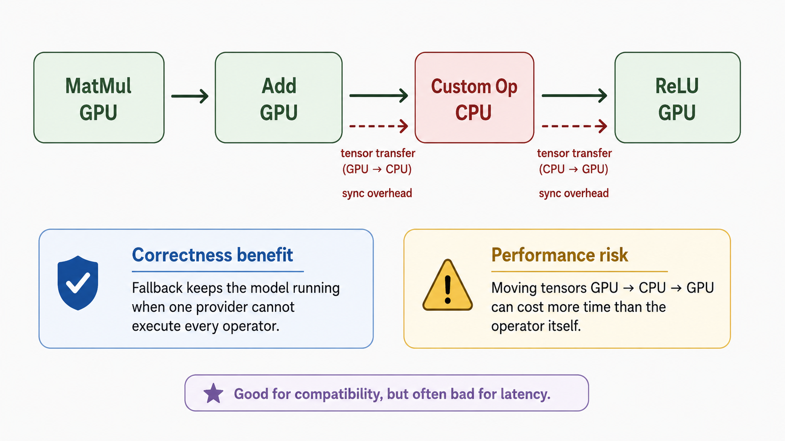
Execution-provider fallback can hurt performance
ONNX Runtime
Week 09 — Accelerated Inference and Serving Toolchain

Slide 48
Graph optimizations in ONNX Runtime
ONNX Runtime
ORT optimizes the graph when the session is created.
Basic
Extended
All
constant folding
simple fusions
remove redundant nodes
more operator fusions
prepacking opportunities
backend-aware patterns
layout optimizations
hardware-specific fusions
maximum optimization level
Important tuning rule
More threads, parallel graph execution, and higher optimization levels should be measured on the real model and hardware.
Ref: ONNX Runtime graph optimization and threading documentation

Slide 49
Minimal ORT inference workflow
ONNX Runtime
import onnxruntime as ort
opts = ort.SessionOptions()
opts.graph_optimization_level = (
ort.GraphOptimizationLevel.ORT_ENABLE_ALL
)
providers = ['CUDAExecutionProvider',
'CPUExecutionProvider']
session = ort.InferenceSession(
'model.onnx', opts, providers=providers
)
outputs = session.run(['logits'], inputs)
Session creation
Loads the model, applies graph optimizations, and plans provider placement.
Provider order
ORT tries higher-priority providers first and falls back when necessary.
Inputs
In the Python API, inputs are usually NumPy arrays with matching names and types.
Ref: ONNX Runtime Python API documentation

Slide 50
When is ORT a good choice?
ONNX Runtime
Good fit
Less ideal alone
Cross-platform deployment
Serverless or edge deployment
CPU inference with optimized kernels
Maximum NVIDIA GPU throughput
Models with many unsupported custom ops
Highly specialized LLM serving workloads
Practical rule
Use ONNX + ORT as the portable boundary. Move to TensorRT, OpenVINO, CoreML, or other specialized runtimes when the deployment target is known and performance matters.
Week 09 — Accelerated Inference and Serving Toolchain

Slide 51
Segment 3 summary
ONNX Runtime
ONNX stores the model as a portable graph, not as PyTorch Python code.
Opset versions and dynamic shapes are deployment-compatibility decisions.
The modern PyTorch path uses torch.onnx.export with dynamo=True.
Validation means structural checks, numerical comparison, and performance measurement.
ONNX Runtime executes the graph through Execution Providers and may fall back across providers.
Week 09 — Accelerated Inference and Serving Toolchain

Slide 52
Segment 4
TensorRT and Hardware Acceleration Concepts
Specialize
Compile
Accelerate
Week 09 — Accelerated Inference and Serving Toolchain

Slide 53
Learning objectives — Segment 4
TensorRT
Explain TensorRT as an NVIDIA inference compiler and runtime.
Identify the major optimization steps: fusion, tactic selection, memory planning, and shape specialization.
Explain dynamic-shape optimization profiles using min, opt, and max shapes.
State the TensorRT 11 precision-model correction: strong typing and explicit quantization.
Understand why TensorRT-LLM adds LLM-specific serving features.
Week 09 — Accelerated Inference and Serving Toolchain

Slide 54
TensorRT is closer to a compiler than a converter
TensorRT
ONNX or
model graph
TensorRT
build phase
Optimized
engine / plan
Core idea
TensorRT sacrifices some portability to specialize inference for NVIDIA GPUs.
Ref: NVIDIA TensorRT documentation

Slide 55
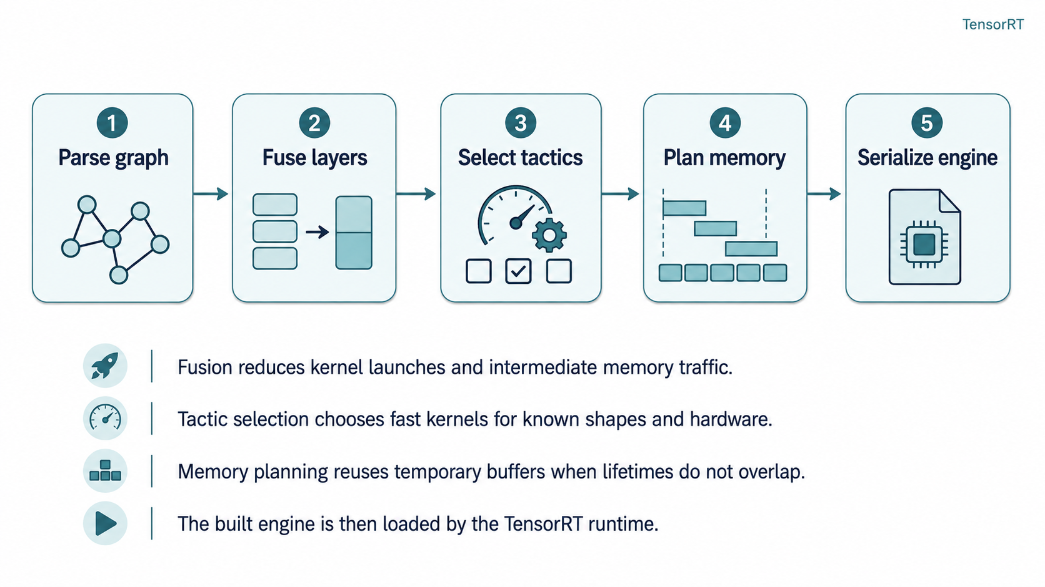
TensorRT optimization pipeline
TensorRT
Week 09 — Accelerated Inference and Serving Toolchain

Slide 56
Layer fusion reduces memory traffic
TensorRT
Unfused execution
Conv
BN
ReLU
Output
intermediate tensors written and read repeatedly
Fused execution
Conv + BN + ReLU
one fused kernel
Output
Why it matters
Inference is often limited by memory movement and launch overhead, not only by arithmetic.
Week 09 — Accelerated Inference and Serving Toolchain

Slide 57
Tactic selection: same operation, many kernels
TensorRT
For a given matrix shape and GPU, TensorRT can test/select a fast implementation.
tactic A
GEMM shape
M × K × N
TensorRT
builder
fastest
choice
tactic B
tactic C
The best kernel depends on tensor shape, layout, GPU generation, and datatype.
Build time can be higher; inference time becomes lower and more predictable.
Week 09 — Accelerated Inference and Serving Toolchain

Slide 58
Dynamic shapes require optimization profiles
TensorRT
A compiler cannot optimize equally for every possible shape. TensorRT uses profiles.
MIN
1 × 128
OPT
8 × 128
MAX
64 × 128
Practical rule
Give TensorRT realistic shape ranges. Bad profiles can waste memory, reduce optimization quality, or reject valid inputs.
Week 09 — Accelerated Inference and Serving Toolchain

Slide 59
Precision model correction for TensorRT 11
TensorRT
Older weak-typing workflow
Current TensorRT 11 view
Set flags such as FP16 or INT8 during engine build.
Old examples and slides may still show this style.
Older INT8 calibrator classes also appear in legacy code.
Use strong typing.
Represent precision and quantization explicitly.
Q/DQ nodes and model-optimization tools are common paths.
Key point
The concept is stable: lower precision can improve performance. The exact API changes across TensorRT versions.
Ref: NVIDIA TensorRT 10.x to 11.x migration documentation

Slide 60
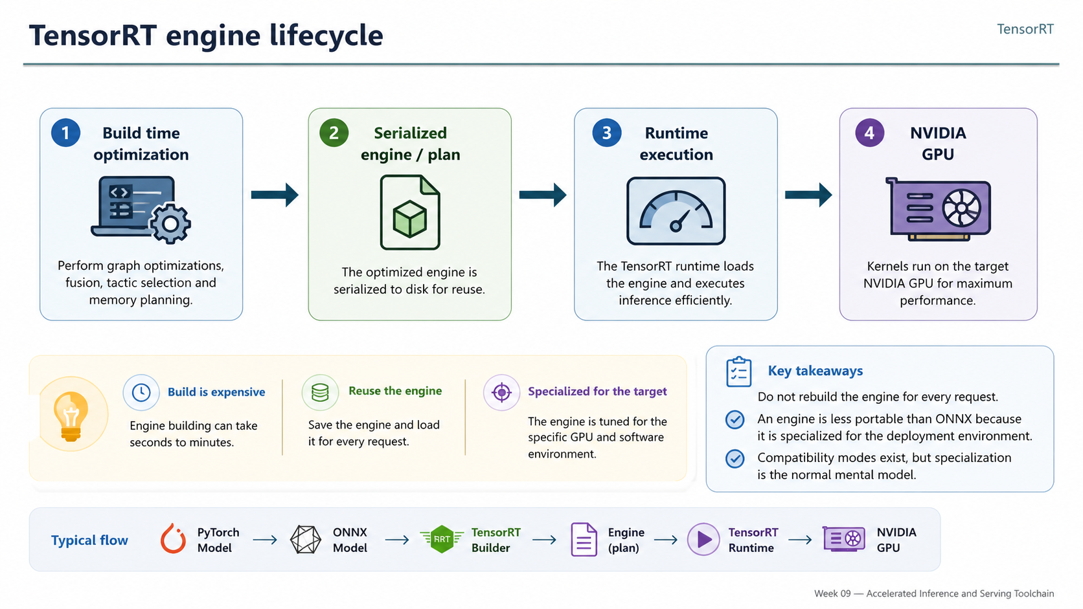
TensorRT engine lifecycle
TensorRT
Week 09 — Accelerated Inference and Serving Toolchain

Slide 61
TensorRT-LLM adds LLM-specific runtime features
TensorRT
Autoregressive LLM serving needs more than a static graph compiler.
Paged KV cache
In-flight batching
Parallelism
Reduces memory fragmentation and improves request concurrency.
Adds/removes requests at generation time instead of waiting for a fixed batch.
Supports tensor parallelism and optimized attention/GEMM plugins.
Key distinction
TensorRT optimizes kernels and engines. TensorRT-LLM also manages the generation-time serving problem.
Ref: NVIDIA TensorRT-LLM documentation

Slide 62
Choosing the hardware acceleration path
TensorRT
Cross-platform
NVIDIA path
Intel path
ONNX Runtime
Execution Providers
server / edge / mobile
TensorRT
TensorRT-LLM
Triton deployment
OpenVINO
AMX / DNNL kernels
CPU / GPU / VPU
No runtime is universally best.
The right choice depends on model type, hardware, latency target, portability, and engineering time.
Measure on the actual deployment path.
Week 09 — Accelerated Inference and Serving Toolchain

Slide 63
Segment 4 summary
TensorRT
TensorRT specializes inference for NVIDIA GPUs; it is closer to a compiler than a file converter.
Main speedups come from fusion, tactic selection, memory planning, precision-aware execution, and shape specialization.
TensorRT 11 uses strong typing and explicit quantization rather than older weak-typing precision flags.
TensorRT-LLM adds the runtime features needed for efficient autoregressive generation.
The performance story is empirical: always benchmark the actual model and target system.
Week 09 — Accelerated Inference and Serving Toolchain

Slide 64
Segment 5
Quantization and LLM Inference Optimization
Compress
Accelerate
Fit
Week 09 — Accelerated Inference and Serving Toolchain

Slide 65
Learning objectives — Segment 5
Quantization
Explain quantization using scale, zero point, and reconstruction error.
Compute the basic memory impact of FP16, INT8, and INT4 weights.
Distinguish PTQ, static calibration, dynamic quantization, and QAT.
Explain GPTQ, AWQ, bitsandbytes/NF4, QLoRA, GGUF, and llama.cpp at a high level.
Choose a quantization strategy based on hardware, memory, speed, and accuracy.
Week 09 — Accelerated Inference and Serving Toolchain

Slide 66
Start with memory: why quantization matters
Quantization
A 70B-parameter model is dominated by weight storage.
FP16
INT8
INT4
Reality
~140 GB
weights
~70 GB
raw weights
~35 GB
raw floor
larger than
raw floor
Important correction
Actual memory also includes scales, metadata, non-quantized tensors, KV cache, and runtime buffers.
Week 09 — Accelerated Inference and Serving Toolchain

Slide 67
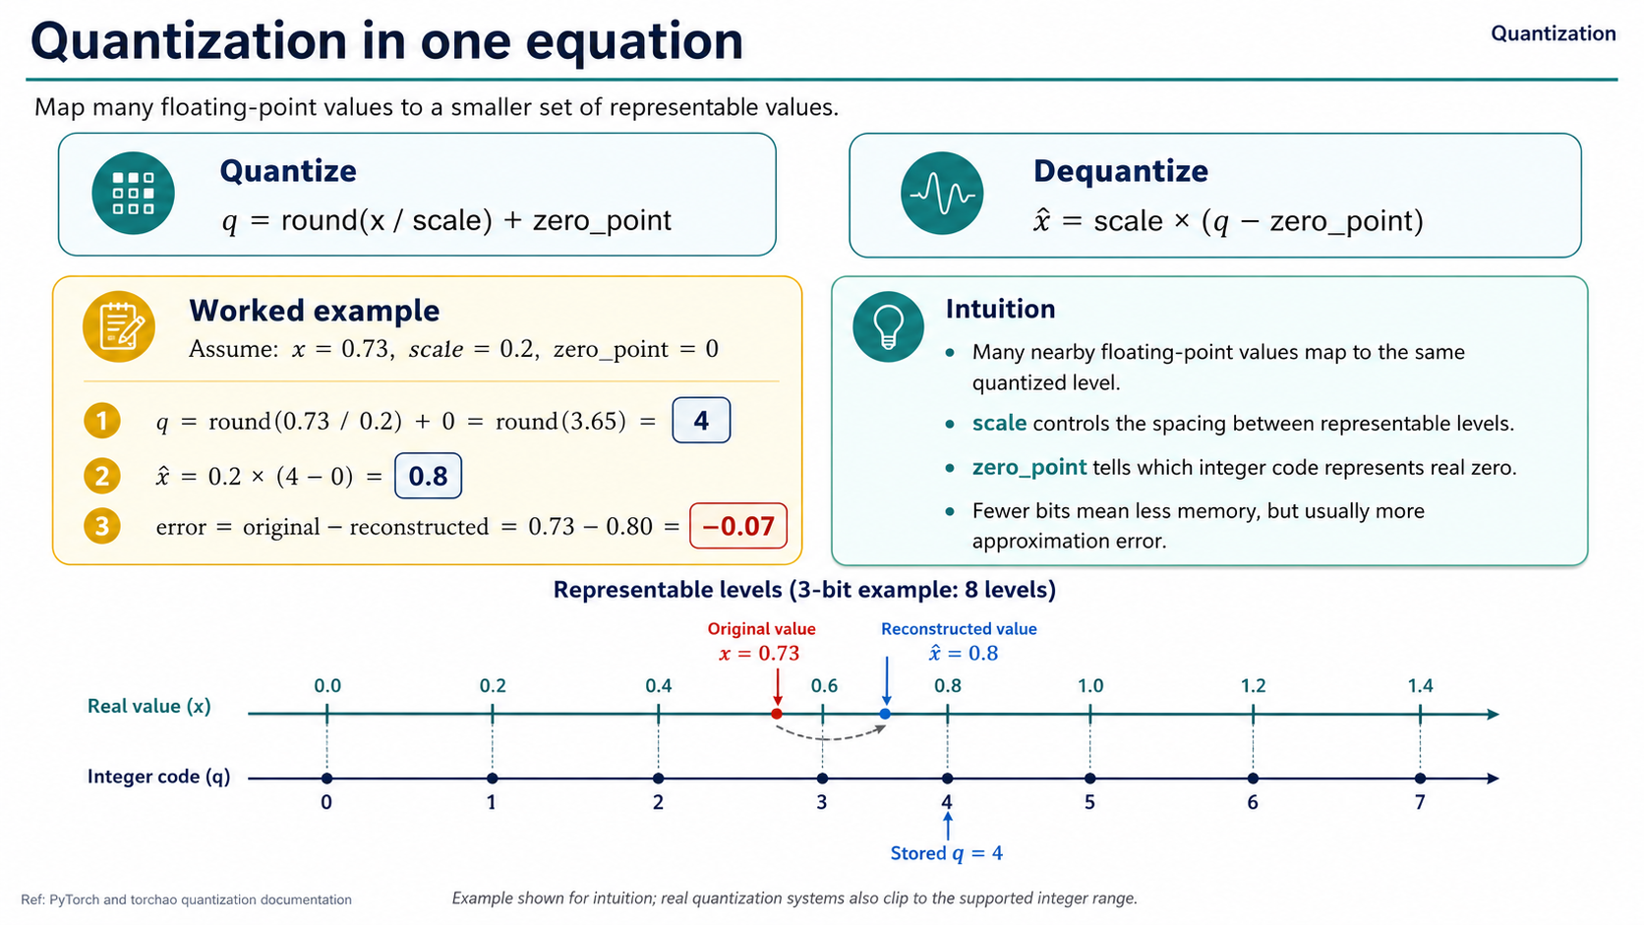
Ref: PyTorch and torchao quantization documentation

Slide 68
Scale choices: accuracy vs overhead
Quantization
Per tensor
Per channel
Group-wise
one scale for the whole matrix
simple
more error
one scale per output channel
better for weights
moderate overhead
one scale per group
common in LLMs
often 32 / 64 / 128 weights
Trade-off
Smaller groups usually reduce quantization error, but require more scale metadata and suitable kernels.
Week 09 — Accelerated Inference and Serving Toolchain

Slide 69
What do W8A8, W8A16, and W4A16 mean?
Quantization
W8A8
W8A16
W4A16
8-bit weights
8-bit activations
can enable INT8 compute
8-bit weights
16-bit activations
main benefit is weight memory
4-bit weights
16-bit activations
common for LLM inference
Important
W4 does not fully specify how computation runs. The runtime may unpack or dequantize weights before the matrix multiplication.
Week 09 — Accelerated Inference and Serving Toolchain

Slide 70
PTQ vs QAT
Quantization
PTQ: Post-Training Quantization
QAT: Quantization-Aware Training
Train the model first.
Quantize after training.
Fast and cheap.
Calibration may be needed for activations.
Best first attempt for deployment.
Simulate quantization during training or fine-tuning.
More expensive.
Model adapts to quantization error.
Often better accuracy when PTQ fails.
Practical order
Try PTQ first. Use QAT when accuracy loss is not acceptable.
Ref: PyTorch quantization and torchao documentation

Slide 71
Static, dynamic, and weight-only quantization
Quantization
Dynamic PTQ
Static PTQ
Weight-only LLM PTQ
weights quantized
activation scales may be computed dynamically
useful for CPU Linear layers
calibration data estimates activation ranges
better for activation quantization
needs representative inputs
compress weights
activations often stay FP16/BF16
basis for GPTQ, AWQ, NF4, GGUF
LLM decode reason
During decode, weight memory traffic is very large, so weight-only compression can be highly valuable.
Week 09 — Accelerated Inference and Serving Toolchain

Slide 72
LLM quantization is harder than ordinary rounding
Quantization
LLM weights and activations can contain outlier channels.
Naively clipping outliers can damage attention and MLP layers.
Small errors can accumulate across many layers and generated tokens.
Modern LLM PTQ methods use calibration and reconstruction objectives to control error.
Naive rounding
LLM-aware PTQ
Simple and fast, but may lose model quality.
Uses statistics or error compensation to preserve quality.
Ref: GPTQ and AWQ papers

Slide 73
GPTQ: layer-wise error-aware quantization
Quantization
Goal: keep each layer output close after weight quantization.
Original layer
Quantized layer
Y = XW
Ŷ = XWq
Quantizes one layer at a time.
Uses approximate second-order information to compensate for quantization error.
Does not retrain the full model with backpropagation.
Widely used for compact 3-bit and 4-bit LLM checkpoints.
Ref: Frantar et al., GPTQ, ICLR 2023

Slide 74
AWQ: activation-aware weight quantization
Quantization
AWQ starts from one observation: not all channels are equally important.
Representative
calibration data
Activation
statistics
Find salient
channels
Scaled
quantization
Large activation channels are more sensitive to weight quantization error.
AWQ scales important channels so that quantization damages them less.
Efficient GEMM-friendly kernels often make AWQ attractive for production.
Ref: Lin et al., AWQ, MLSys 2024

Slide 75
GPTQ vs AWQ: difference, not universal winner
Quantization
GPTQ
AWQ
Error-compensation view
Layer-wise reconstruction
Approximate second-order information
Common for compact 4-bit checkpoints
Activation-aware view
Finds salient channels
Uses scaling before quantization
Often strong with GEMM-friendly kernels
Selection rule
The best choice depends on model, runtime kernels, hardware, context length, and quality target.
Week 09 — Accelerated Inference and Serving Toolchain

Slide 76
bitsandbytes, NF4, and QLoRA
Quantization
bitsandbytes
NF4
QLoRA
Loads large Transformer models in 8-bit or 4-bit forms.
A 4-bit format used heavily in QLoRA-style workflows.
Freeze a 4-bit base model and train small LoRA adapters.
Correct historical point
QLoRA demonstrated fine-tuning a 65B model on a single 48-GB GPU. It is mainly a memory-efficient fine-tuning method.
Ref: Dettmers et al., QLoRA, NeurIPS 2023; Hugging Face bitsandbytes documentation

Slide 77
FP8 is different from INT8/INT4 weight-only quantization
Quantization
FP8 / Transformer Engine
INT4 / GPTQ / AWQ / GGUF
Native low-precision floating point on supported NVIDIA hardware.
Used for high-throughput training and inference.
Scaling is managed by framework/runtime.
Usually weight-compression oriented.
Activations may remain FP16/BF16.
Packing format and kernels decide real speed.
Do not compare datatype names only
Compare the full execution path: datatype, kernel, runtime, hardware, batch size, sequence length, and accuracy.
Ref: NVIDIA Transformer Engine and TensorRT quantization documentation

Slide 78
GGUF and llama.cpp: local and CPU-friendly LLM inference
Quantization
HF model
GGUF
file
llama.cpp
CPU / GPU
local run
GGUF stores quantized tensors plus model/tokenizer metadata.
Q4_K_M and Q5_K_M trade model size against quality.
Useful for laptops, workstations, Apple Silicon, and consumer GPUs.
Ollama adds convenient model management and a simple serving layer.
Ref: llama.cpp GGUF documentation

Slide 79
Decision guide: choose the serving path
Quantization
Maximum NVIDIA throughput
Low-memory fine-tuning
TensorRT-LLM + FP8 / explicit quantization
QLoRA: 4-bit base + LoRA adapters
Fast open-source serving
Cross-platform portability
vLLM or TGI with BF16, AWQ, or GPTQ
Export to ONNX and choose an Execution Provider
CPU / edge deployment
Consumer local use
ORT INT8, OpenVINO, or GGUF / llama.cpp
GGUF quantization + llama.cpp / Ollama
Final selection variables
hardware, latency SLO, model size, context length, accuracy target, portability need, and engineering budget
Week 09 — Accelerated Inference and Serving Toolchain

Slide 80
Segment 5 summary
Quantization
Quantization reduces memory traffic and can improve throughput, especially during LLM decode.
The raw INT4 storage floor is simple arithmetic; real deployed memory is larger.
PTQ is cheap; QAT gives the model a chance to adapt to quantization error.
GPTQ and AWQ are LLM-aware post-training methods for high-quality weight compression.
QLoRA is mainly for memory-efficient fine-tuning; GGUF and llama.cpp are central for local inference.
Week 09 — Accelerated Inference and Serving Toolchain

Slide 81
End-to-end story: representation → specialization → precision
Wrap-up
Trained
model
ONNX
ORT
TensorRT
Quantization
Serving
ONNX: portable model boundary.
ONNX Runtime: execute the graph across backends.
TensorRT: specialize for NVIDIA GPUs.
Quantization: reduce data size and improve deployment feasibility.
Measure latency, throughput, memory, accuracy, build time, and portability.
Week 09 — Accelerated Inference and Serving Toolchain

Slide 82
Thank you!
Next: measuring and comparing serving stacks on real workloads
Week 09 — Accelerated Inference and Serving Toolchain

