Slide 1

NPTEL
Applied Accelerated Artificial Intelligence
Instructor: Dr. Satyajit Das
Dept. of Computer Science and Engineering
Indian Institute of Technology Guwahati, Assam, India

Slide 2
Segment 2: Memory Hierarchy, RAM, Storage & Data Movement
How data flows from disk to compute units - and why this journey dominates AI system performance

Slide 3
Learning Objectives - Segment 2
01
Map the full data movement path from NVMe storage to GPU compute cores
02
Quantify bandwidth and capacity at each level of the memory hierarchy
03
Explain HBM (High Bandwidth Memory) and why it is critical for AI accelerators
04
Identify bottlenecks in DataLoader pipelines and apply pinned memory optimisation
05
Describe NUMA (Non-Uniform Memory Access) effects in multi-socket AI servers

Slide 4
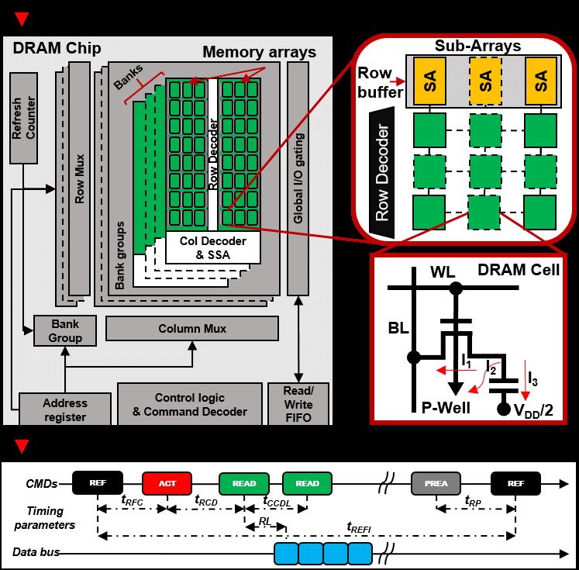
DRAM Fundamentals: DDR, LPDDR, and HBM
DDR SDRAM Architecture
Dynamic: capacitor-based cells; must refresh every ~64 ms
Double Data Rate: transfers on both rising and falling clock edges
DDR5 (2021): 4800-6400 MT/s, 64-bit wide bus, 51.2 GB/s per channel
12-channel EPYC (DDR5): peak ~614 GB/s system bandwidth
Ref: Jedec HBM3 Standard JESD238; NVIDIA H100 Tensor Core GPU Architecture Whitepaper (2022)

Slide 5
DRAM Fundamentals: DDR, LPDDR, and HBM
LPDDR (Mobile/Edge AI)
LPDDR5X: 8533 MT/s, lower voltage, used in Apple M-series, Jetson
Apple M2 Ultra: 800 GB/s unified memory bandwidth (LPDDR5)
ECC Memory in AI Servers
Single-bit errors corrected, double-bit detected automatically
Critical for long-running training jobs (bit flip = silent data corruption)
~2-4% performance overhead but non-negotiable in production AI

Slide 6
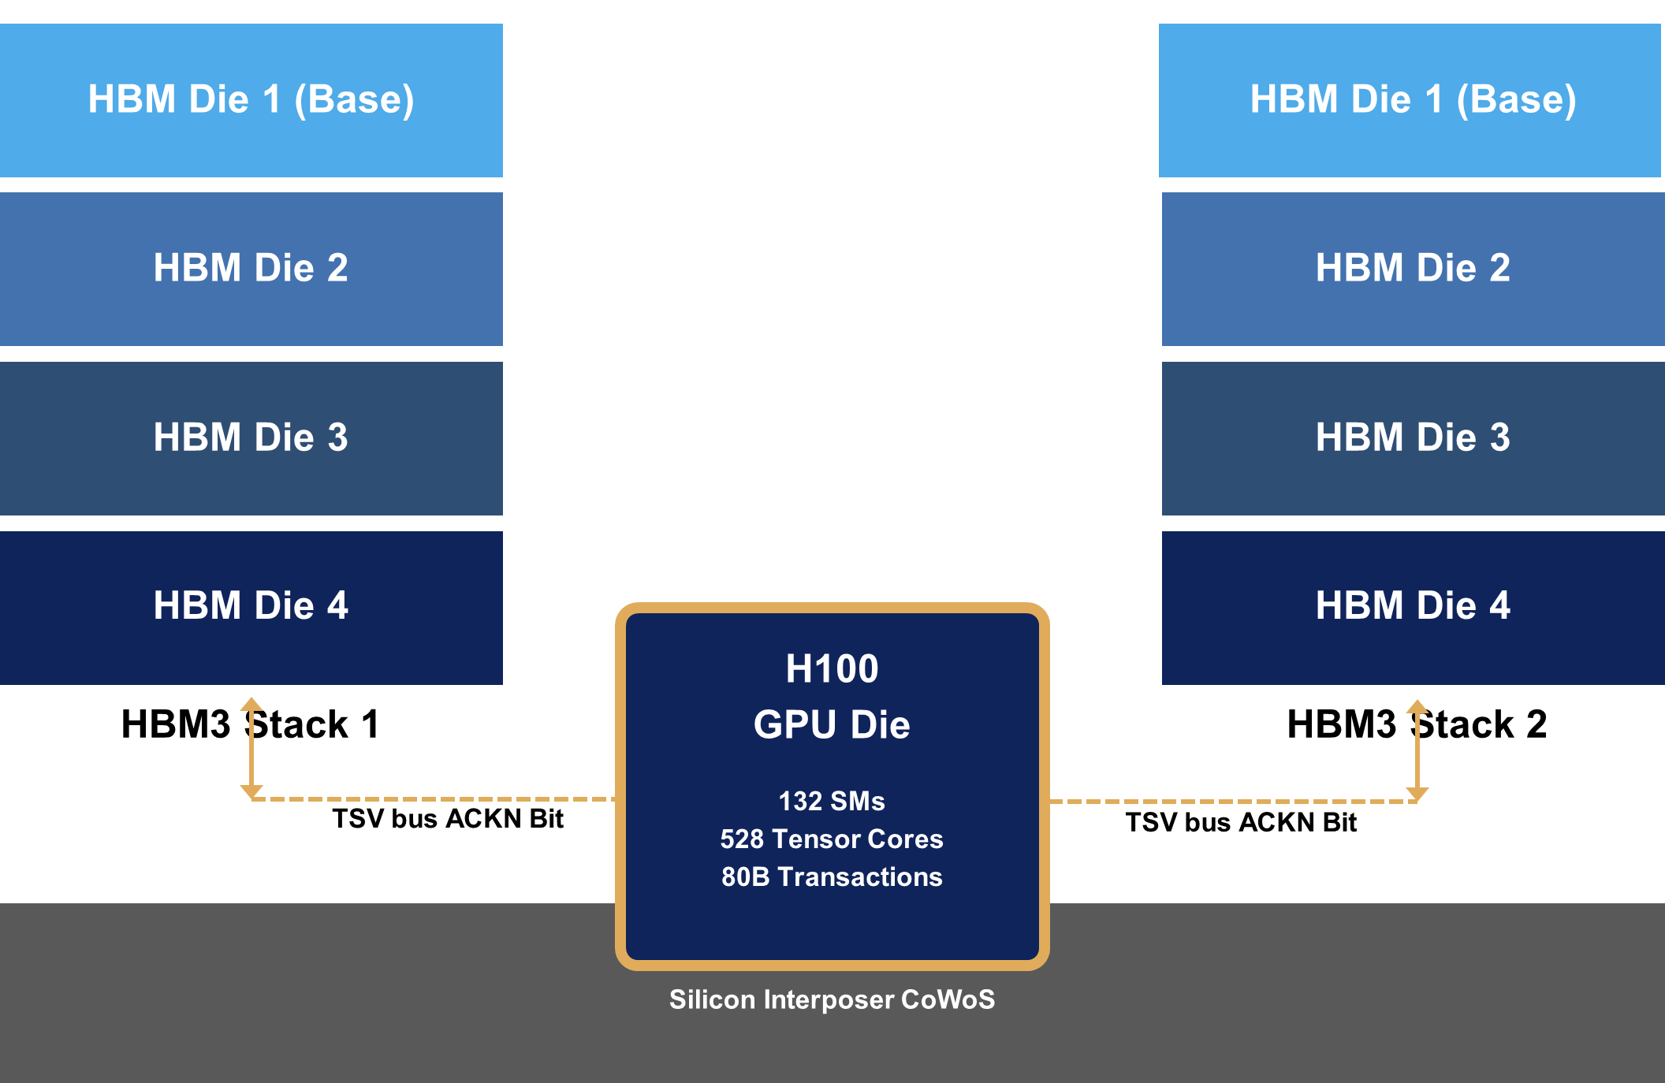
DRAM Fundamentals: DDR, LPDDR, and HBM
HBM: Game Changer for Accelerators
HBM stacks multiple DRAM dies vertically on a silicon interposer:
HBM3 (H100): 3.35 TB/s bandwidth, 80 GB capacity
HBM3e (H200): 4.8 TB/s bandwidth, 141 GB capacity
vs GDDR6X (RTX 4090): 1.008 TB/s - still 3x less than HBM3
Fig 4: HBM3 Stacked Die Architecture on Silicon Interposer
Ref: Jedec HBM3 Standard JESD238; NVIDIA H100 Tensor Core GPU Architecture Whitepaper (2022)

Slide 7
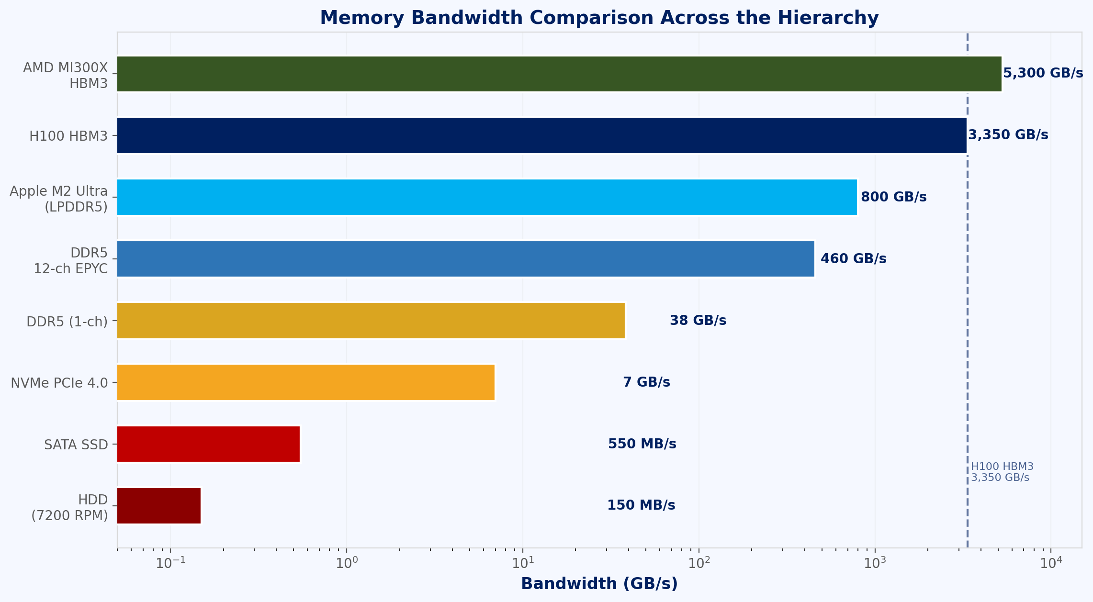
Storage Tiers & the Data Ingestion Pipeline
Storage Hierarchy for AI Datasets
HDD (7200 RPM): ~150 MB/s sequential, ideal for cold storage of raw datasets (terabyte scale)
SATA SSD: ~550 MB/s sequential, good for warm data staging buffers
NVMe SSD (PCIe 4.0): ~7 GB/s sequential, 1M+ IOPS - preferred for AI training scratch space
NVMe RAID-0 (8 drives): ~56 GB/s - matches PCIe 4.0 x16 bandwidth (64 GB/s)
Fig 5: Bandwidth Comparison across Storage & Memory Tiers
consider a typical ImageNet training job: 1.2 million images, roughly 150 gigabytes total. You need to read through all of them every epoch. At 7 gigabytes per second from NVMe, that is about 21 seconds per epoch just for I/O — which is actually fine for large models where the compute time per epoch is minutes.
Ref: PyTorch DataLoader docs; NVIDIA GPUDirect Storage Tech Brief (2022); MLPerf Storage Benchmark

Slide 8
Storage Tiers & the Data Ingestion Pipeline
Data Pipeline Bottleneck Analysis
Typical ImageNet training: 1.2M images, ~150 GB; need >3 GB/s to feed 8x GPUs
PyTorch DataLoader: num_workers controls parallel prefetching processes
Rule: num_workers = 2-4x number of GPUs; pin_memory=True for CUDA transfers
Fig 5: Bandwidth Comparison across Storage & Memory Tiers
Ref: PyTorch DataLoader docs; NVIDIA GPUDirect Storage Tech Brief (2022); MLPerf Storage Benchmark

Slide 9
Storage Tiers & the Data Ingestion Pipeline
Network Storage for Distributed AI
NFS/GPFS/Lustre: parallel file systems used in HPC clusters and SLURM environments
WekaFS, VAST Data, DDN EXAScaler: purpose-built for AI training throughput
GPUDirect Storage (GDS): bypass CPU, DMA data directly NVMe → GPU memory
Fig 5: Bandwidth Comparison across Storage & Memory Tiers
Ref: PyTorch DataLoader docs; NVIDIA GPUDirect Storage Tech Brief (2022); MLPerf Storage Benchmark

Slide 10
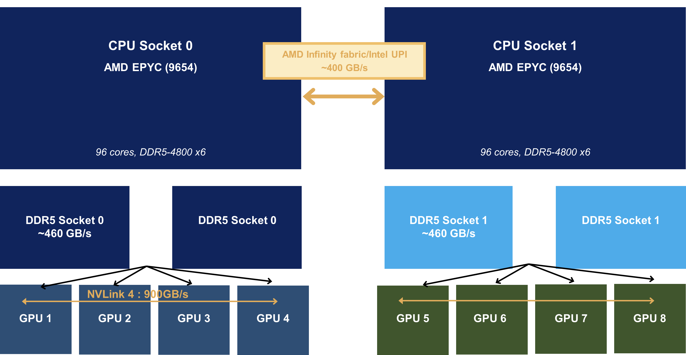
NUMA Architecture in Multi-Socket AI Servers
What is NUMA?
Non-Uniform Memory Access: each socket has local DRAM
Accessing remote (cross-socket) memory adds ~2x latency
AMD EPYC uses NUMA internally even within a single socket (CCX/CCD topology)
NUMA in Multi-GPU Servers (DGX H100)
2x CPU sockets, each with 4x GPUs attached via PCIe switches
GPU 0-3 have NUMA affinity to Socket 0 RAM; GPU 4-7 to Socket 1 RAM
Cross-NUMA data transfer: ~400 GB/s (UPI) vs 614 GB/s local bandwidth
Fig 6: NUMA Dual-Socket Server Topology
Ref: AMD EPYC 9004 Architecture Guide; NVIDIA DGX H100 System Architecture (2023)

Slide 11
NUMA Architecture in Multi-Socket AI Servers
Memory Bandwidth Summary
DDR5-4800 (1 channel): 38.4 GB/s
12-ch DDR5 (EPYC): ~460 GB/s per socket
NVLink 4 (H100): 900 GB/s (bidirectional) GPU-GPU
PCIe 5.0 x16: 128 GB/s bidirectional (CPU-GPU)
HBM3 (H100): 3.35 TB/s (GPU on-chip)
Fig 6: NUMA Dual-Socket Server Topology
Ref: AMD EPYC 9004 Architecture Guide; NVIDIA DGX H100 System Architecture (2023)

Slide 12
Data Movement Costs: The Hidden Performance Tax
Why Data Movement Matters More Than Compute
Moving 1 byte across PCIe bus costs ~700 pJ of energy vs ~1 pJ for a FP32 MAC on-chip
H100 peak compute: 3.958 PFLOPS (FP8); H100 system bandwidth (PCIe): 128 GB/s - 30,000x gap
Optimal AI system design minimises data movement, maximises data reuse in fast memory
Techniques to Reduce Data Movement
Operator Fusion: combine LayerNorm + Dropout + Activation into one GPU kernel (Flash Attention)
Tiling: partition large matrices to fit in L2/SRAM, enabling data reuse without DRAM accesses
Gradient Checkpointing: recompute activations during backward pass instead of storing them all
Prefetching: overlap data transfer with compute using CUDA streams and async copy
Quantifying Impact in Practice
Flash Attention v2 (Dao 2022): 3-5x speedup via tiled HBM access - memory, not compute, was the limit
Gradient Accumulation: accumulate gradients over N mini-batches to simulate large batch with small VRAM
Mixed Precision (BF16/FP16): halves memory bandwidth requirement vs FP32 - often 1.5-2x speedup
“The free lunch is over for compute. The next frontier is memory-efficient algorithms.”
- Adapted from Sutter (2005), applied to modern AI systems
Ref: Dao et al., FlashAttention-2, ICLR 2024; Rajbhandari et al., ZeRO, SC’20

Slide 13
Segment 2 Summary: Memory Hierarchy & Data Movement
Memory hierarchy spans registers (<1 ns) through DRAM (60 ns) to NVMe (100 us) - latency governs AI pipeline design
HBM3 (3.35 TB/s) vs DDR5 (460 GB/s per socket): on-chip bandwidth is 7x higher - keep hot data in GPU VRAM
NUMA topology determines which CPU cores and memory channels have lowest-latency GPU access - always pin affinity
DataLoader optimisation (pinned memory, num_workers, prefetch) is essential to prevent GPU starvation
Data movement energy cost dwarfs arithmetic cost - operator fusion, tiling, and mixed precision are first-order optimisations

Slide 14
Thank you!

