Slide 1

PRELIMINARY SDP EVALUATION
A study of swarm intelligence algorithms for optimal feature selection
Supervised By: Dr. Subrat Kumar Nayak
Group No.: L2
Abhipsha Sahu (1941012775)
Sanjivani Sharan (1941012634)
Arshdeep Dubey (1941012662)
Abhisman Sarkar (1941012779)
Department of Computer Sc. and Engineering
Faculty of Engineering & Technology (ITER)
Siksha ‘O’ Anusandhan (Deemed to be) University
Bhubaneswar, Odisha
‹#›

Slide 2
Presentation Outline
Introduction
  Overview/Specifications
  Motivations
Literature Survey/Background Details
  Existing System
  Problem Identification
  Dataset Description
Schematic Layout/Model Diagram
Methods/Tools/Algorithms used
Summary
  Uniqueness of proposed System
  Limitations of Proposed System
  Future Scope of Proposed System
  Bibliography
‹#›

Slide 3
Introduction
In this project, the process of feature selection is performed involving Swarm Intelligence optimization algorithms such as Particle Swarm Optimization, Ant Colony Optimization, Cuckoo Search Algorithm, and Artificial Bee Colony Optimization.
Feature Selection is the method of reducing the input variable in the machine learning model by using only relevant data and getting rid of noise in data.
Swarm intelligence algorithms are nature-inspired algorithms developed based on the interactions between living organisms such as flocks of birds, ants, and fish. These algorithms help in the enhancement of fitness functions in combinatorial and numerical optimization problems
Feature selection is crucial in model training as not all original features in a dataset are useful and redundant features can lead to poor performance. Relevant features in comparison improve learning model performance. Swarm Intelligence is the best optimizing technique for feature selection due to its decentralized control, flexibility, robustness, and scalability.
‹#›

Slide 4
Literature Survey
Swarm Intelligence Algorithm | Feature Selection Approach | Representation used | Single/Multi Objective function | Objective function | Outcomes
BPSO (Binary Particle Swarm Optimization) [1] | Hybrid- Filter, Wrapper | Binary | Multi- Objective | Accuracy and size f feature subset | The proposed approach performs better than filter and wrapper executed independently.
MBPSO (Multi- Objective Binary PSO) [2] | Filter | Binary | Multi- Objective | This approach focussed on maximization of relevance between features and class labels and minimization of feature repetition | Generates better and smaller subset of feature with high accuracy
Binary ABC (Binary Artificial Bee Colony) [3] | Wrapper | Binary | Multi- Objective | Uses the well-known similarity measures in Jaccard coefficient | Effective feature selection with high accuracy
MBACO (Modified Binary Coded Ant Colony Optimization) [4] | Wrapper | Binary | Multi- Objective | High Accuracy, with fewer features | This approach leads to a robust and highly efficient FS method
GCACO (Graph Clustering Ant Colony Optimization) [5] | Filter | Continuous | Single- Objective | A new separability index has been introduced and integrated with graph clustering strategy. | Claimed to be better than the compared both filter and wrapper methods.
Binary Cuckoo Search [6] | Wrapper | Binary | Single- Objective | Improve Accuracy | This approach uses optimum forest path as a classifier to produce 40% better results with better feature subsets
‹#›

Slide 5
Dataset Description
While mentioning description of dataset, we will consider different aspects such as dataset size, feature space, target variable, data distribution, dataset source and its availability.
Cancer dataset and wine datasets is widely used as common datasets along with iris dataset, annealing dataset, Breast cancer, Meta data, Zoo dataset, Cloud dataset and much more.

Slide 6
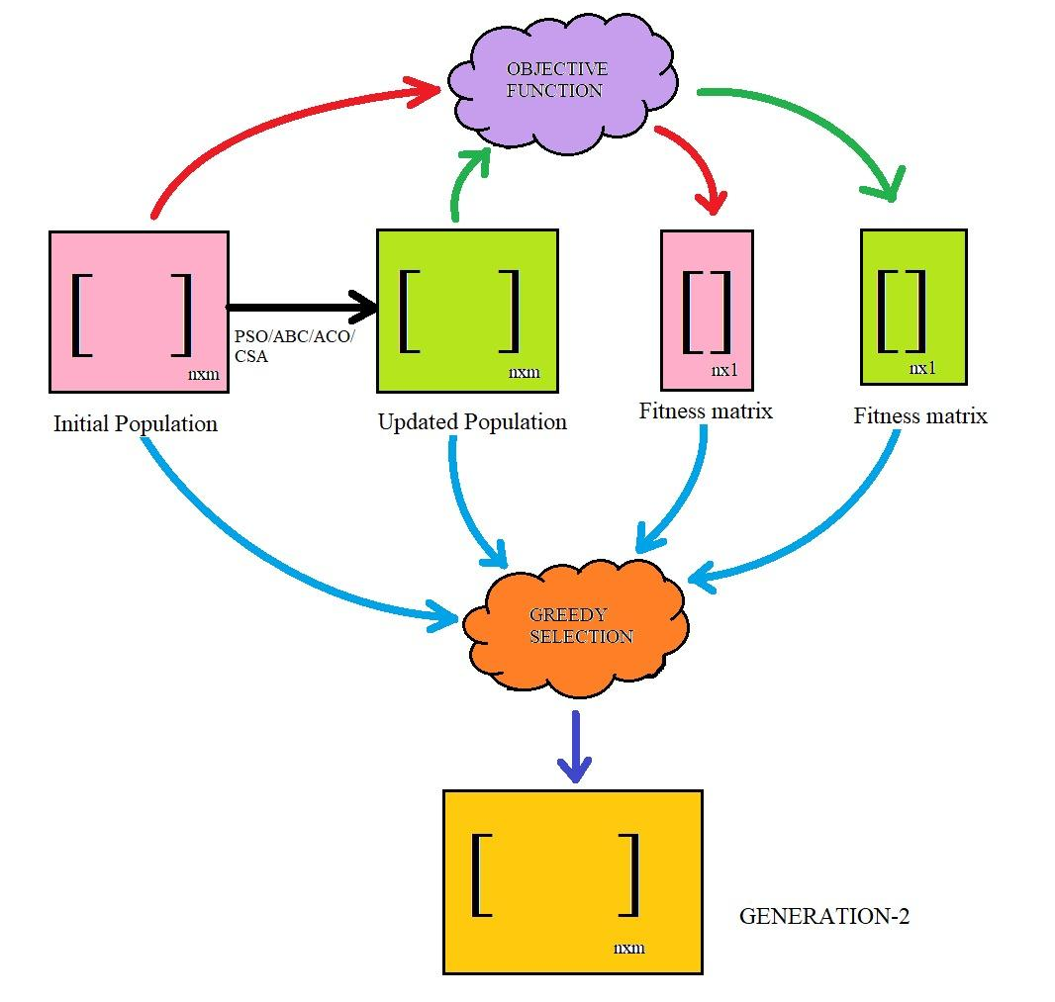
Schematic Layout/Model Diagram
A generalized working principle of Swarm Intelligence
‹#›

Slide 7
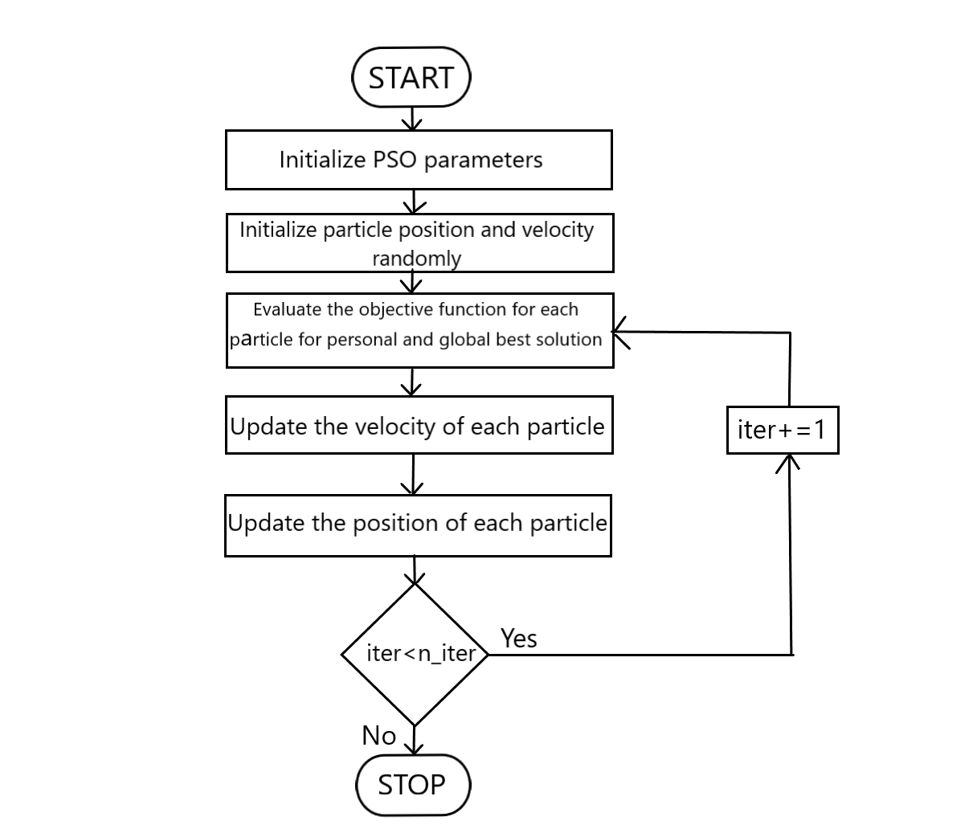
Methods/Tools/Algorithms used
Particle Swarm Optimization (PSO):
PSO is inspired by the collective behavior of social organisms, such as flocks of birds or schools of fish.
Equation used for calculating velocity:
v_{i}^{k} = wv_{i}^{k} +c₁r₁ (pbest_{i}^{k} - x_{i}^{k}) + c₂r₂ (gbest^{k} - x_{i}^{k})
Equation used for calculating position:
x_{i}^{k+1} = x_{i}^{k} + v_{i}^{k+1}
where vik is the velocity of the i th particle at the K th iteration, and xik is the current position of the i th particle at the k th iteration. c1, c2 are positive constants, and
r1 , r2 are two random variables with uniform distribution between 0 and 1.w is the inertia weight
‹#›

Slide 8
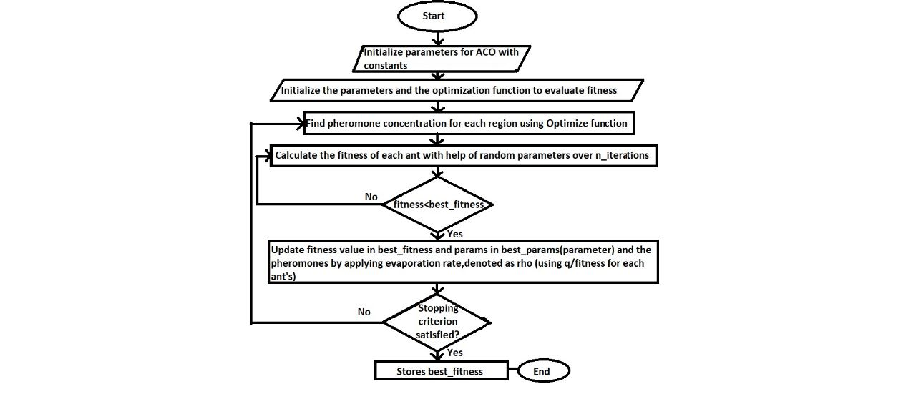
Ant Colony Optimization (ACO):
ACO is inspired by the foraging behavior of ants.
Edge Selection :
[p(x,y)]^k = [Ƭ(x,y)]^𝝰 * [ƞ(x,y)]^𝛃 / ∑(z E allowed(x)) * [Ƭ(x,z)]^𝝰 * [ƞ(x,z)]^𝛃
Pheromone Update :
Global pheromone updating rule :
Ƭ(x,y) ← (1-𝘱)Ƭ(x,y) + ∑(k to m){Δ[Ƭ(x,y)]^k}
where Ƭ(x,y) is the amount of pheromone deposited for a state transition x,y
{Δ[Ƭ(x,y)]^k} = {Q/L(k) : if ant k uses curve xy in its tour; 0 : otherwise }
where L(k) is the cost of the kth ant's tour (typically length) and Q is a constant.

Slide 9
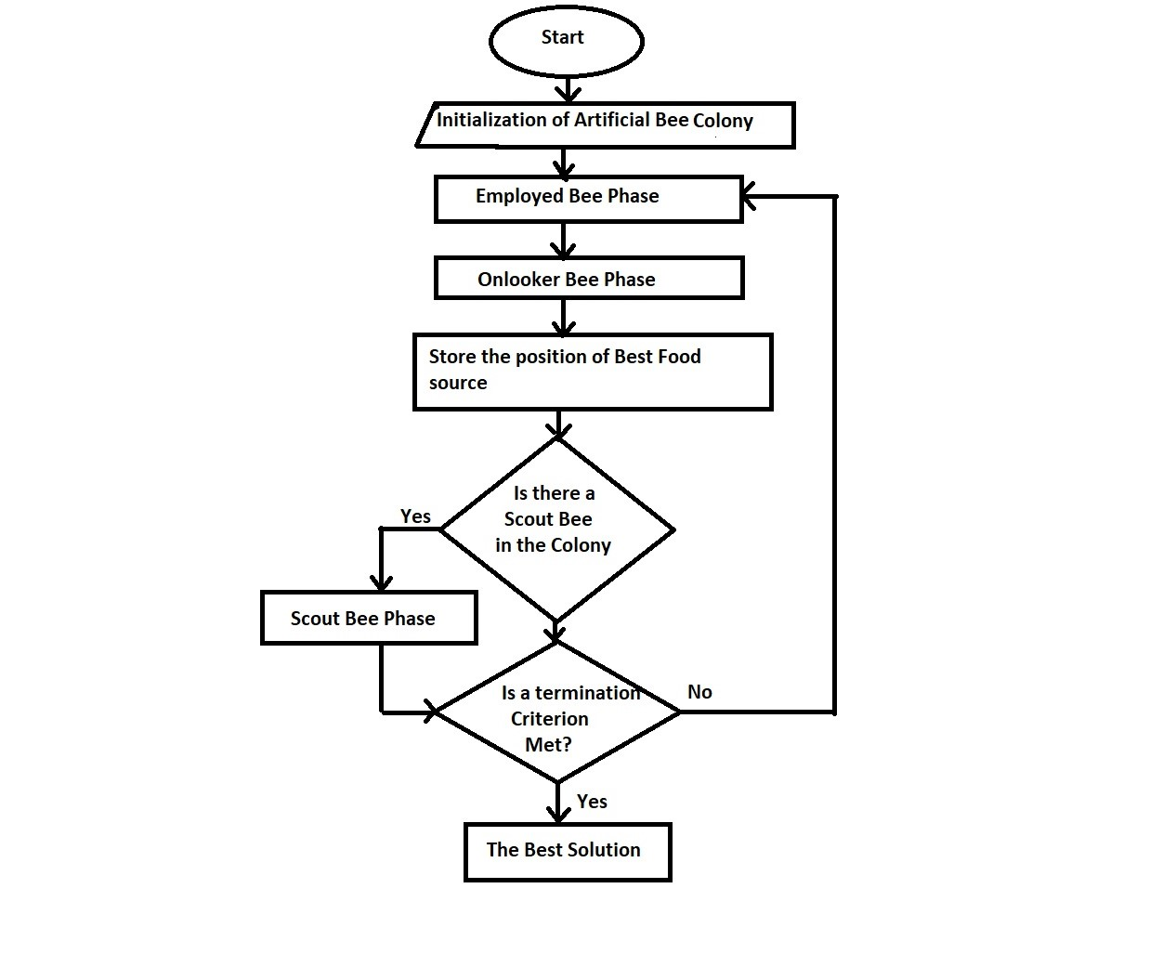
Artificial Bee Colony (ABC):
ABC is inspired by the foraging behavior of honeybees.
Each employed bee X(i) generates a new candidate solution V(i) in the neighborhood of its present position as equation below:
v(i,k) = x(i,k) + ∮(i,k) * (x(i,k) - x(j,k))
Roulette wheel selection mechanism is described as :
P(i) = fit(i) / ∑(j) fit(j)
The scout bee discovers a new food source to be replaced with ith as in the equation below:
x(i,k) = lb(k) + ∮(i,k) * ((ub(k) - lb(k))

Slide 10
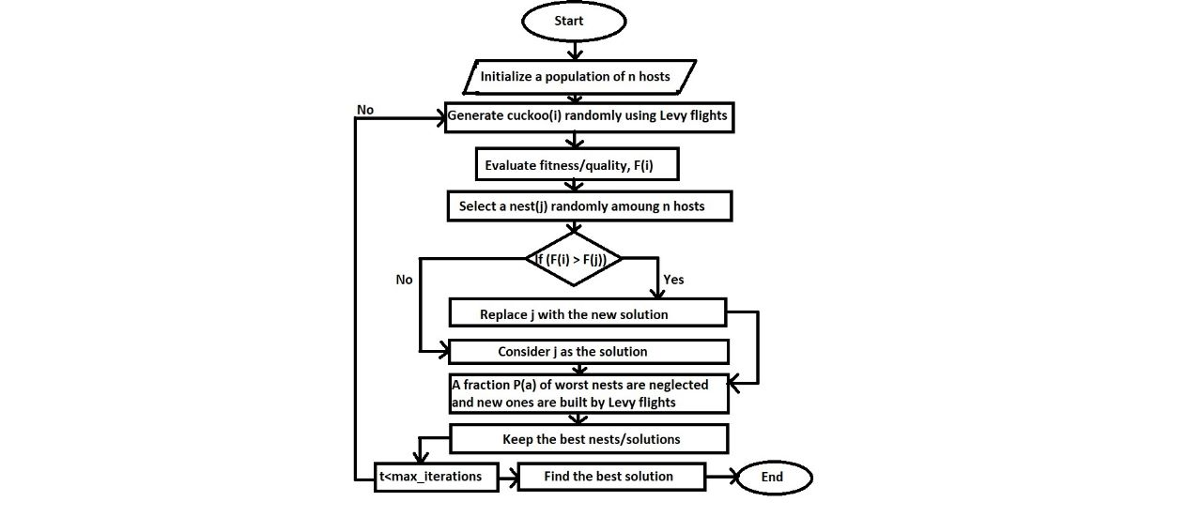
Cuckoo Search Algorithm (CSA):
CSA is inspired by the behavior of cuckoo birds during their reproduction process.
An important issue is the applications of Lévy flights and random walks in the generic equation for generating new solutions
x(t+1) = x(t) + sE(t),
where
E(t) is drawn from a standard normal distribution with zero mean and unity standard deviation for random walks

Slide 11
Summary
  Uniqueness of Proposed System: The study is unique as it evaluates the performance of these algorithms on the same dataset, under the same experimental conditions, and using the same performance metrics.
  Limitations of Proposed System:
  It only focuses on comparing these four algorithms, and there may be other swarm intelligence algorithms that can also be effective for feature selection.
  Additionally, the study does not consider the impact of different parameter settings on the performance of the algorithms.
  Future Scope of Proposed System: The proposed system has the potential for future extensions, such as evaluating the performance of different swarm intelligence algorithms on different datasets, exploring the impact of different parameter settings, and combining the strengths of different algorithms to develop hybrid approaches for feature selection.
‹#›

Slide 12
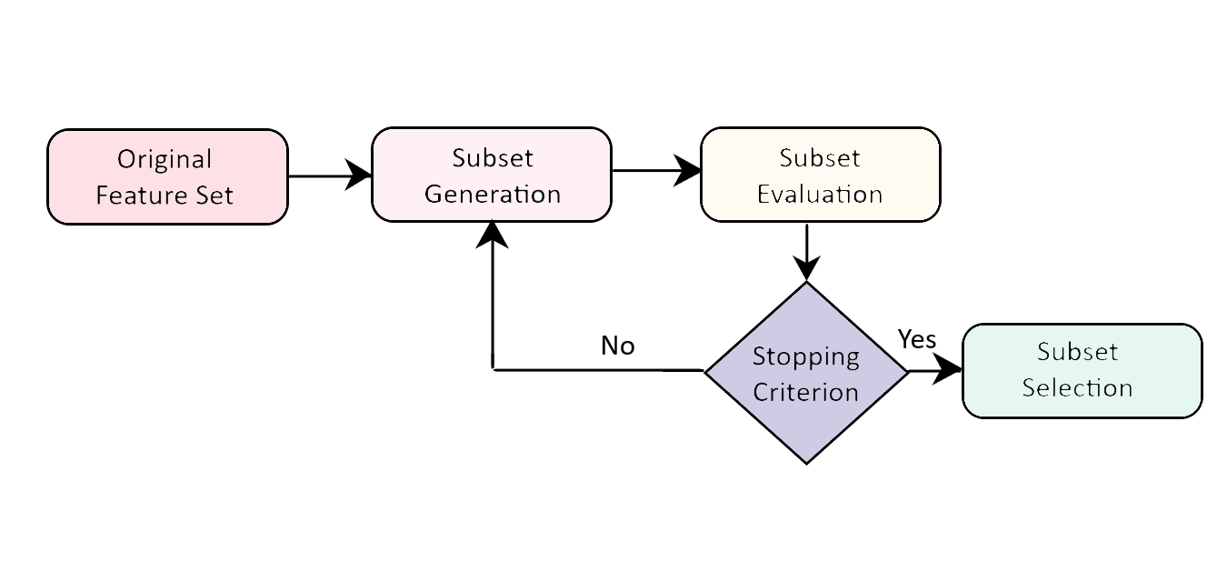
Feature Selection as future scope:

Slide 13
Bibliography
[1] Koumi, F., Aldasht, M., & Tamimi, H. (2019, June). Efficient feature selection using particle swarm
optimization: a hybrid filters-wrapper approach. In 2019 10th international conference on information
and communication systems (ICICS) (pp. 122-127). IEEE.
[2] Xue, B., Zhang, M., Browne, W. N., & Yao, X. (2015). A survey on evolutionary computation
approaches to feature selection. IEEE Transactions on evolutionary computation, 20(4), 606-626.
[3] Hancer, E., Xue, B., Karaboga, D., & Zhang, M. (2015). A binary ABC algorithm based on advanced
similarity scheme for feature selection. Applied Soft Computing, 36, 334-348.
[4] Wan, Y., Wang, M., Ye, Z., & Lai, X. (2016). A feature selection method based on modified binary
coded ant colony optimization algorithm. Applied Soft Computing, 49, 248-258.
[5] Moradi, P., & Rostami, M. (2015). Integration of graph clustering with ant colony optimization for
feature selection. Knowledge-Based Systems, 84, 144-161.
[6] Rodrigues, D., Pereira, L. A., Almeida, T. N. S., Papa, J. P., Souza, A. N., Ramos, C. C., & Yang, X. S.
(2013, May). BCS: A binary cuckoo search algorithm for feature selection. In 2013 IEEE International
symposium on circuits and systems (ISCAS) (pp. 465-468). IEEE.

Slide 14

‹#›

