Slide 1

Customer Bank Loan Analysis

Slide 2

Bank of America
Financial services company
The Bank of America Corporation is an American multinational investment bank and financial services company.
States
The Bank of America has presence in 50 states of United states, operating around 30k accounts.
Customers
$
Around 30K customers are taking their loan from Bank of America, having average income of around 69k.
Loan Stats
Bank funded $336M amount of loan to customers, with avg. interest rate of 12% & max. term to repay amount is 60 months.

Slide 3
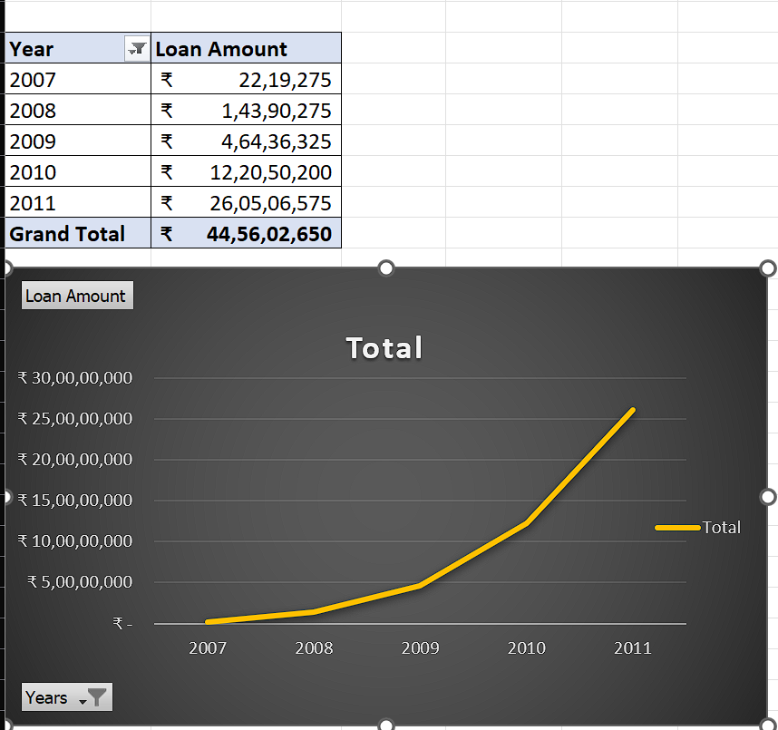
KPI1 -> Year wise Loan amount Stats
By observing the chart we can see how Loan Amount is increasing by year.
Starts from 2007 the loan amount is 22,19,275 and in the 2011 the loan amount is 26,05,06,575. We can subtract the new value to the old value to see the difference.
26,05,06,575 - 22,19,275 = 25,82,87,300
25,82,87,300 increased in the duration of 4 years
And Grand Total of all years is 44,56,02,650.00

Slide 4
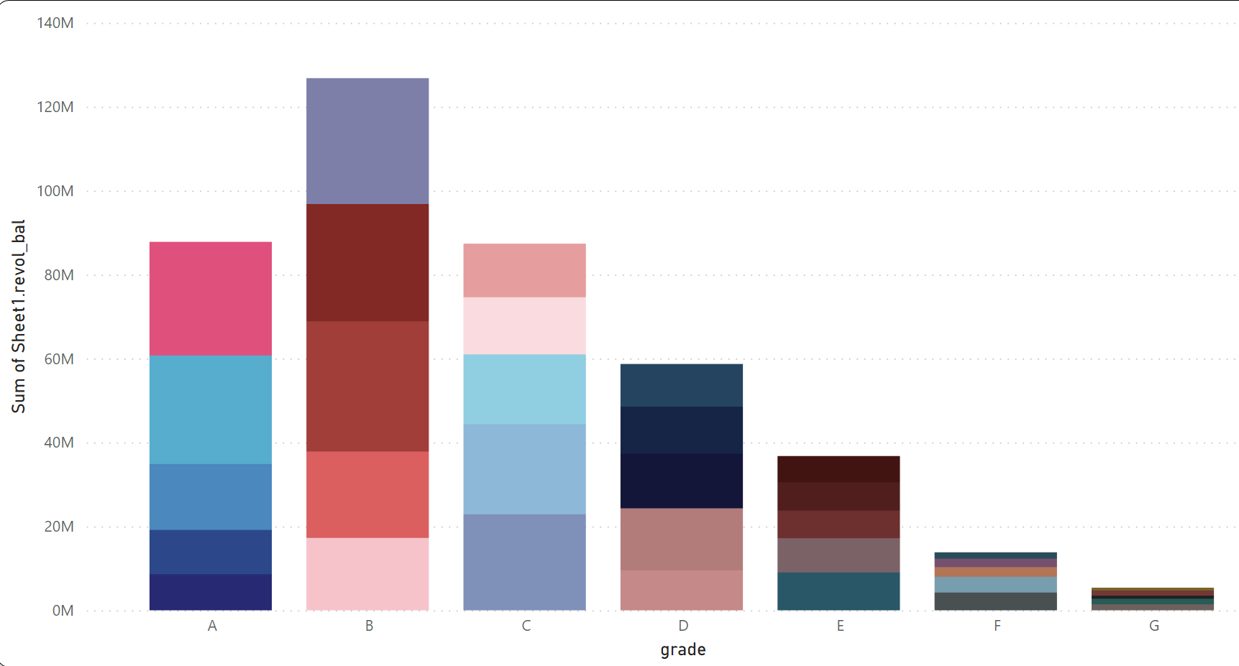
KPI2 -> Grade and sub grade wise revol_bal
Analysis
In this Grade and subgrade wise revol balance we notice Grade-B have more revol balance then any other grade & Grade-G have very low revol balance.
Detail
As we can see that Grade B customers has higher annual income for 10+ years of employment period, so higher the annual income lower the Debt to income ratio and hence, more number of customers took loan in Grade B .
Conclusion
It goes for other grades also B>A>C>D>E>F>G order for revol balance as per annual income.

Slide 5
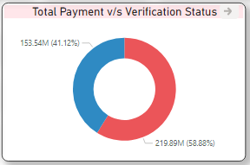
KPI3 -> Total Payment for Verified Vs Non Verified Status
Highest Payment for the Purpose of Debt Consolidation is 257M & Lowest Payment for the Purpose of renewable Energy is 0.9M.
Count of Home Ownership for Different Verification Status are:
Not Verified:- 16921
Verified:- 12809
Source Verified:- 9987
Total Installment for Not Verified is 4.3M, for Verified is 5.6M & for Source Verified is 2.8M.
Loan Amount for Verification Status are:
Not Verified:- 142.24M
Verified:- 100.8M
Source Verified:- 202.2M

Slide 6
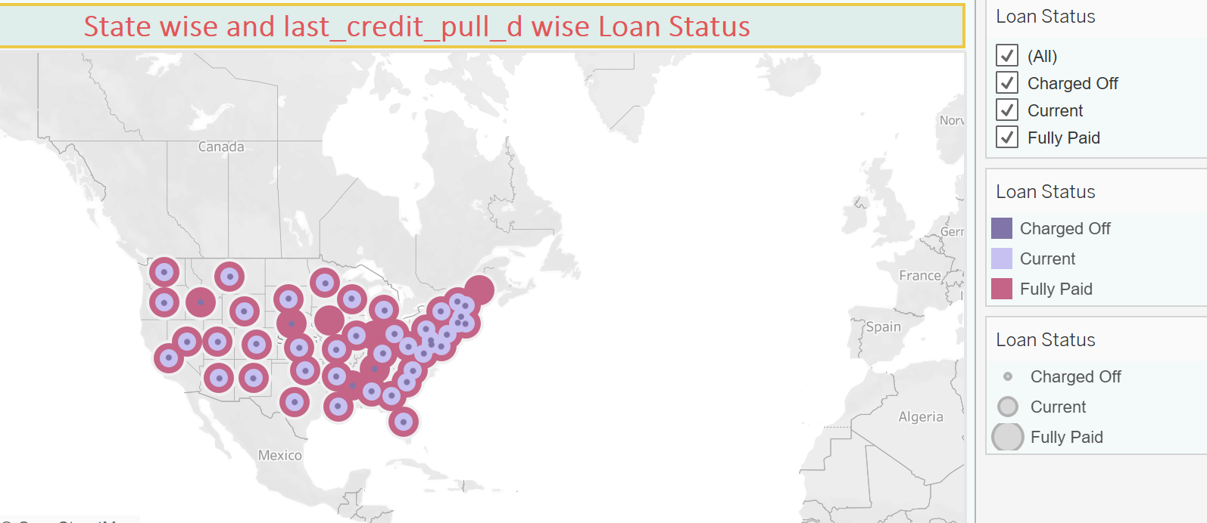
KPI4 -> State wise and last credit pull d wise loan status
The right graph shows the count of Loan Status in each state of USA on particular last credit pull date.
CA state has highest no. of Customers (7099), Who took a loan from bank.
ME state has the lowest loan amount (9200).
Loan Status of 32950 Customers is Fully Paid, Which is Highest.

Slide 7
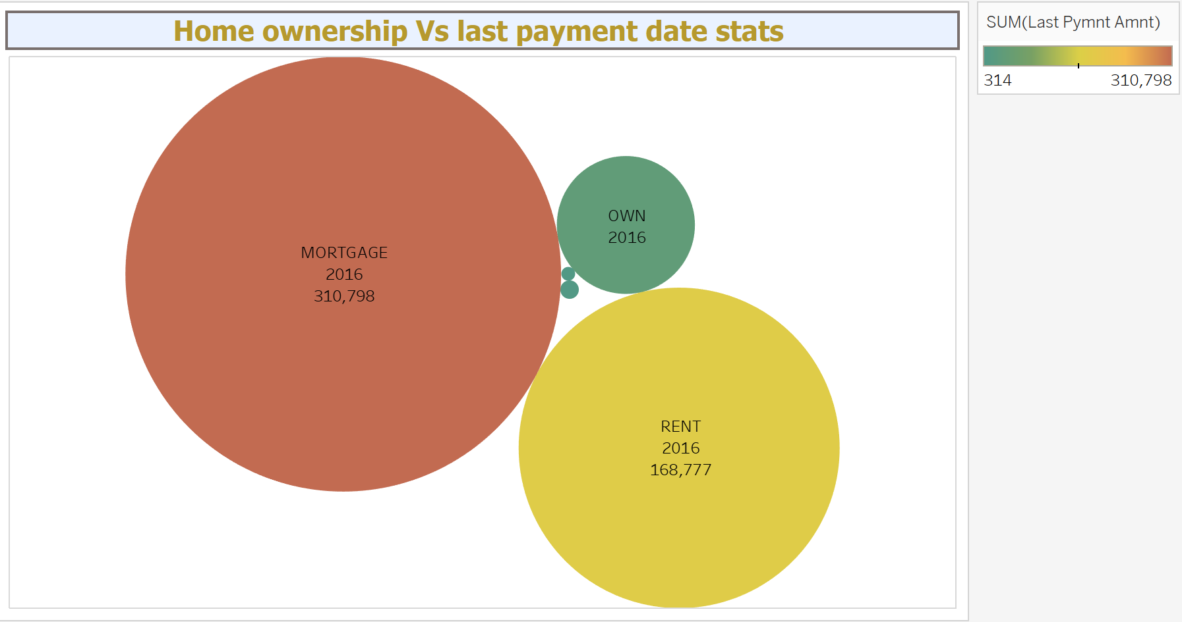
KPI5 -> Home ownership v/s last payment date stats
Here, we can see that maximum latest amount paid by customers with MORTGAGE home ownership is 3,10,798.
Year 2012 has highest last payment amount of 16.7M for Home Ownership.
ANALYSIS
CONCLUSION
It concludes that many of the customers are about to repay their loan amount for their particular home ownership.
Total funded amount for home ownership is 43.4M.
The graph shows the Home ownership and the amount paid for each on last payment date.

Slide 8

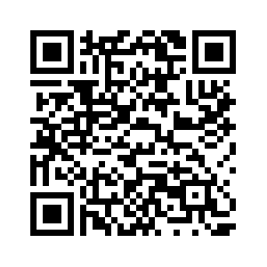
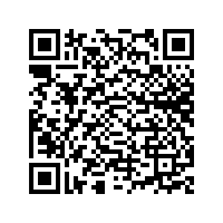
Scan the QR code
to join world’s fastest growing bank
& get bonus worth $100 by opening
a checking account

