Slide 1
Flight Delay Analysis

Slide 2
Info
Airline
Airports
Flights
Total 14 Airline operates large domestic & international route network across the states.
There are 322 airports working in the Country United states.
Number of 54 states and more than 300 cities serving approx. 6M flights every year.

Slide 3
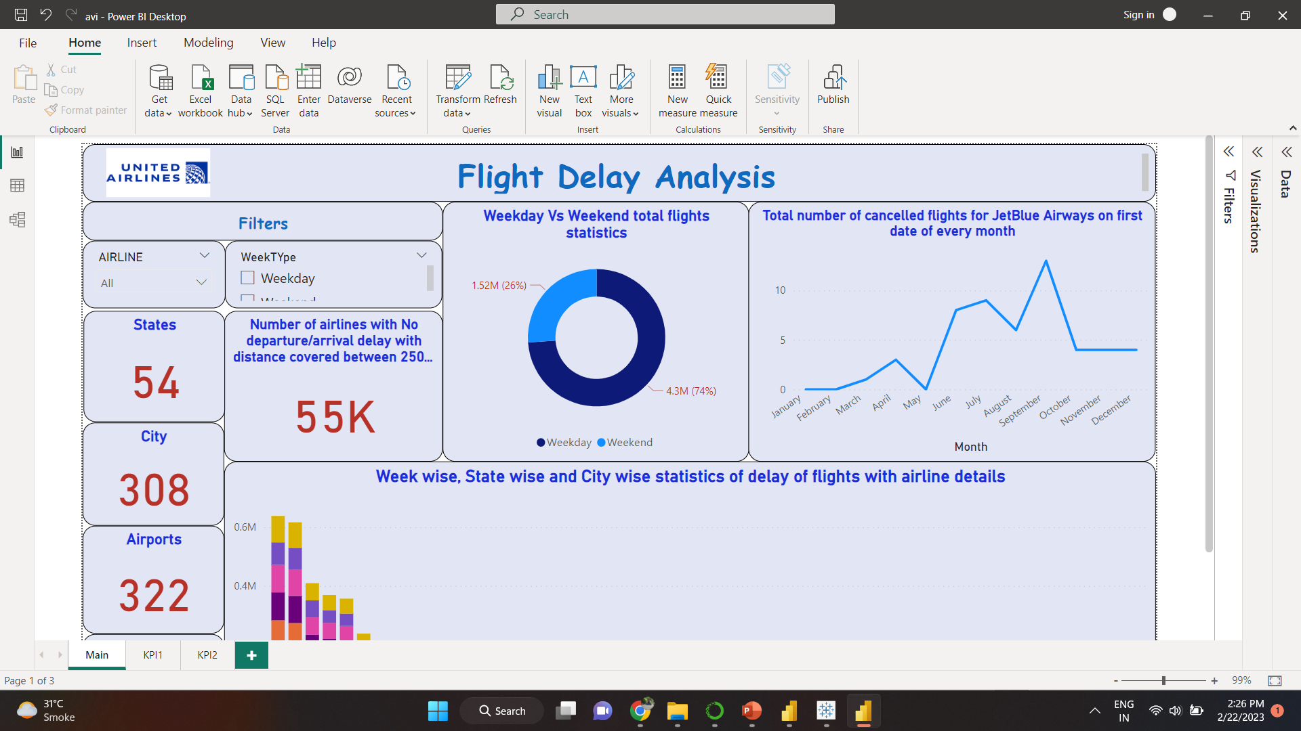
Weekday Vs Weekend total flight stats
Total number of Flights:
Weekdays : 4.3M
Weekends: 1.52M
Maximum Number of Flights by
[ Southwest Airlines ] :
Weekday : 9.3 Lacs
Weekend : 3.24 Lacs
Minimum Number of Flights by
[ Virgin America ] :
Weekday : 46K
Weekend : 15K

Slide 4
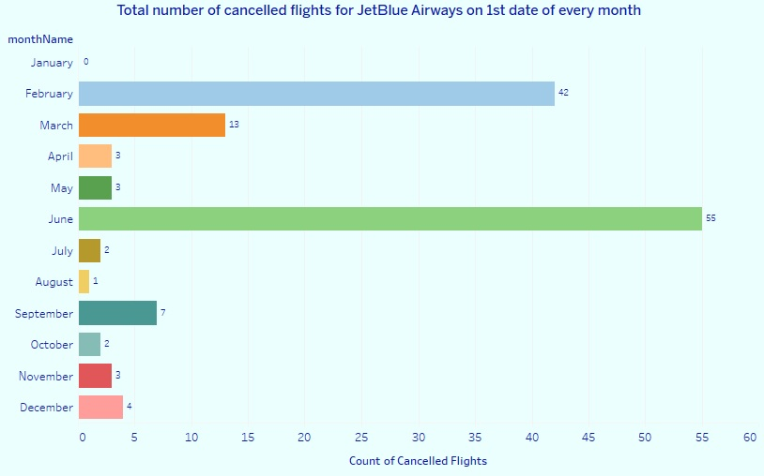
Total number of cancelled flights for JetBlue Airways on 1st date of every month
01
02
Minimum flight delayed in month of January (0), followed by August (1), July-October (2).
Maximum flight delayed in month of June (55), followed by February (42), March (13).

Slide 5
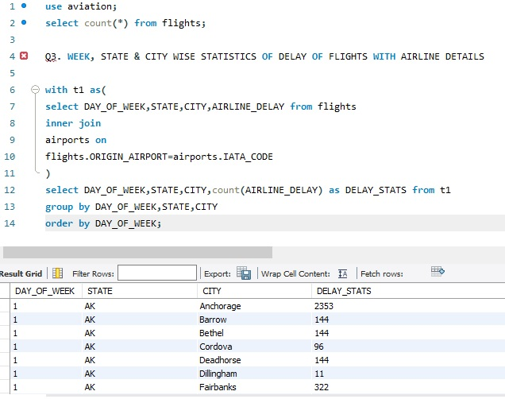
Week wise, State wise and City wise statistics of delay of flights with airline details
TX(Texas) State has most no. of airline delay – 1,26,886 & AS(Alaska) state has least no. of airline delay – 31.
Chicago city has most no. of airline delay-83936 & Moab city has least no. of airline delay – 4.
Most no. of airlines delayed on Thursday – 1,71,692 & In the June month most no. of airlines are delayed.
Maximum no. of airline delays are from Southwest airlines & minimum count of delays are from Hawaiian Airlines.

Slide 6
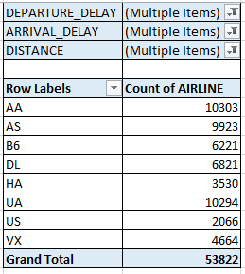
Number of airlines with No departure/arrival delay with distance covered between 2500 and 3000
Number of Airlines with No departure/arrival delay with distance between 2500 and 3000 are 53822.
Delay flights on weekday – 38526 where as on weekend - 15296
American Airlines has max no. of delay flights – 10303.
US Airways has least no. of
Delay flights – 2066.
Most no. of delay flights are from CA State – 17186. Least no. of delay flights are from AS state – 37.

Slide 7
Thank You
Southwest Airlines has most number of cancelled flights, max. delayed is due to departure delay.
Phoenix Sky Harbour International Airport (Arizona) has most number of security delays.
For Customer centric approach, Airlines have to minimise the system delays & if the delay is because of natural activity, they have informed the customer in earliest possible way and also in emergency type situation arrange the another ongoing flight for customer is plus bonus for their satisfaction.

