Slide 1
ClearPath Recovery
A UiPath Maestro Case workflow that prevents telecom service cases from closing until authoritative evidence proves recovery.
Track 1 · Maestro Case · Governed Telecom Recovery

Slide 2
02 · PROBLEM AND SOLUTION
Problem statement and proposed solution
Problem
Solution
Telecom service recovery can look complete in CRM, order, billing, and support systems while the customer still lacks working service. The danger is wrongful closure, repeat contact, SLA exposure, and an audit trail that cannot explain why the case closed.
ClearPath Recovery uses agents to interpret ambiguous evidence into structured signals, deterministic policy to decide whether closure is allowed, Maestro Case to route dynamic exceptions, Action Center for human review, and Data Fabric/Orchestrator for durable audit proof.
Agents interpret. Policy decides. Maestro routes. Humans own exceptions.
SERVICE RECOVERY
02

Slide 3
03 · BENEFITS AND TECHNOLOGIES
Benefits and technologies used
End user
Telecom service recovery teams, activation/restoration owners, exception reviewers, audit/compliance teams.
User department
Customer operations, network operations, field operations, service assurance, compliance.
Industries
Telecom, broadband, managed connectivity, enterprise service operations.
UiPath products used
Maestro Case, Action Center, Orchestrator, Data Fabric, Test Manager, UiPath CLI.
Other integrations / APIs
Simulated CRM/order, billing, network telemetry, inventory, dispatch, support notes; optional Gemini/Vertex LLM interpreter.
Benefits: fewer wrongful closures, lower repeat contacts, better SLA control, safer agent adoption, and an auditable chain from raw agent recommendation to policy decision to human action.
SERVICE RECOVERY
03

Slide 4
04 · SOLUTION ARCHITECTURE
Solution architecture
01
02
03
04
05
Evidence
→
Agent
→
Policy
→
Maestro Case
→
Human review
CRM, billing, telemetry, inventory, dispatch, notes
Structured interpretation of ambiguous text
Closure guard and allowed route
Dynamic stage routing and lifecycle
High-impact exception ownership
Track 1 fit: unpredictable evidence-driven routes, human-in-the-loop decisions, exception handling, visibility, and auditability.
SERVICE RECOVERY
04

Slide 5
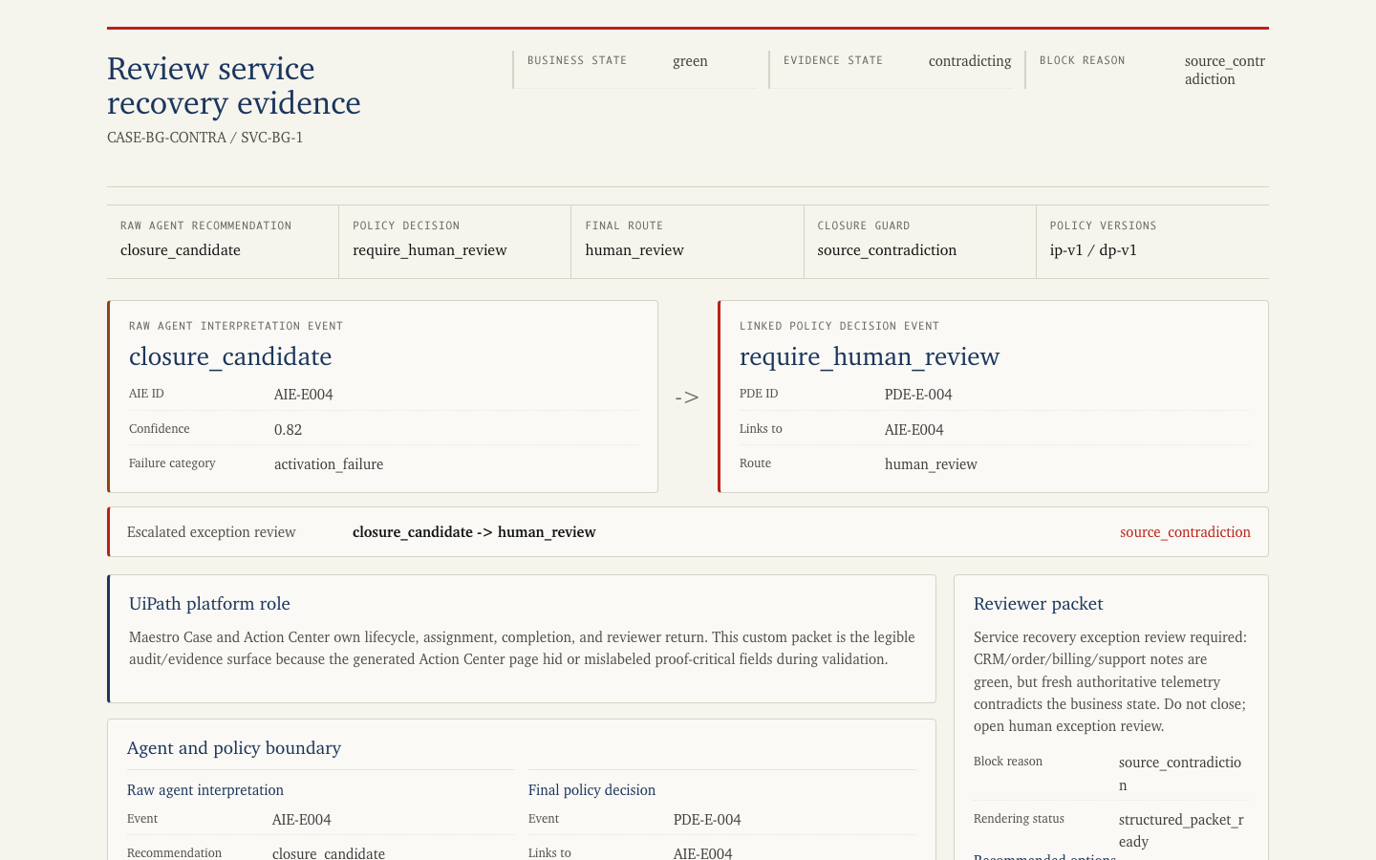
05 · DEMO PROOF
Running proof and repository
Core proof: same green business systems, different authoritative evidence, different route.
Missing/stale evidence routes to telemetry verification. Fresh contradiction routes to human review. The raw agent recommendation, final policy decision, reviewer packet, and audit chain are visible.
GitHub: github.com/Arshgill01/uipath-agenthack-service-recovery
SERVICE RECOVERY
05

