Slide 1
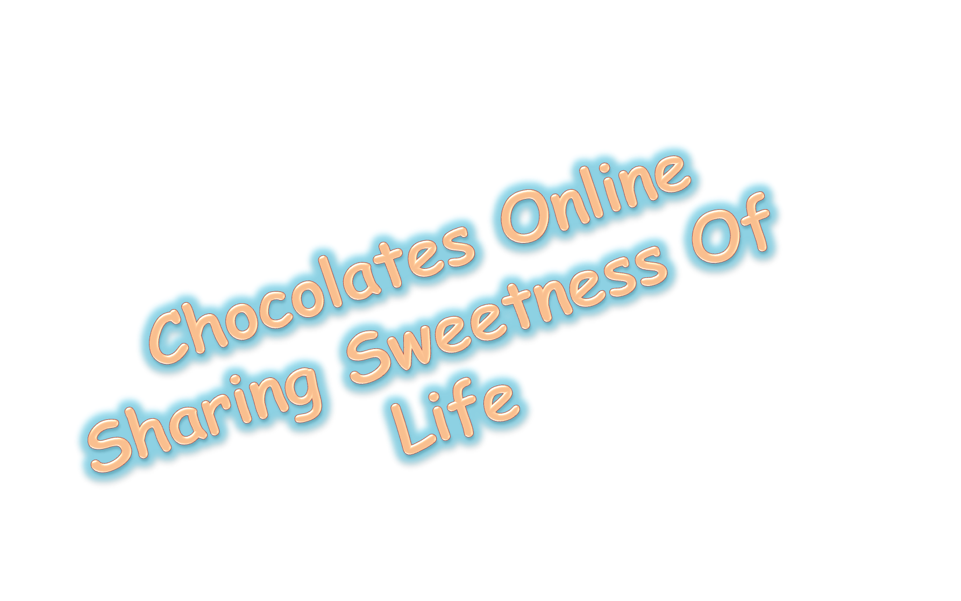
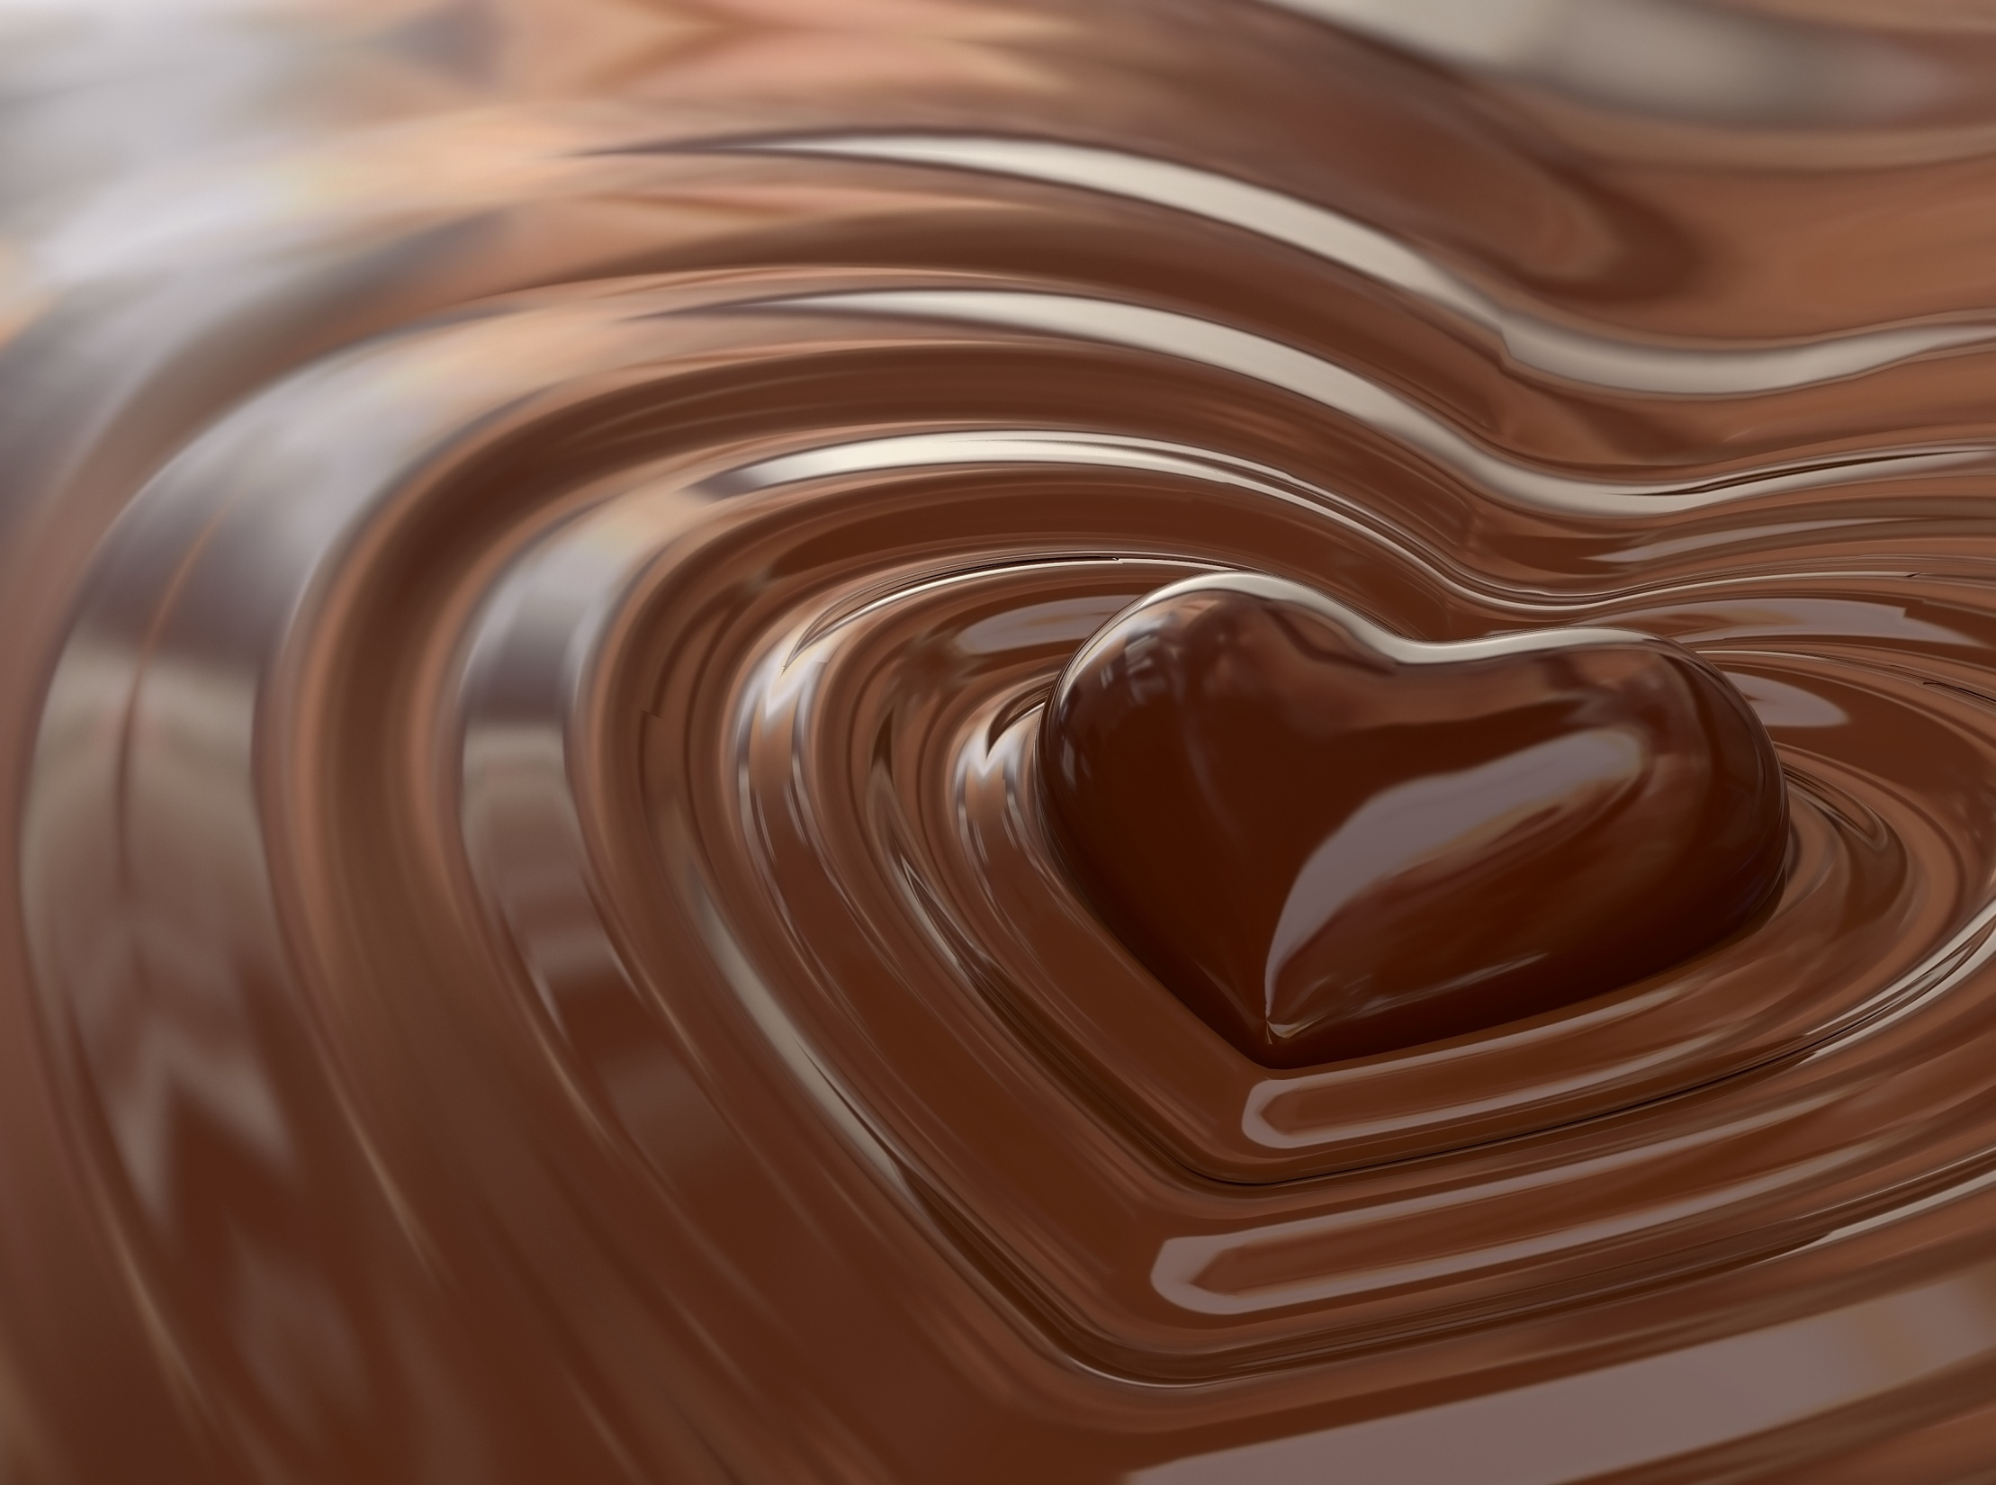

Slide 2

“Life is like a box of chocolates, you never know what you’re gonna get.”

Slide 3
“There is nothing better than a friend unless it is a friend with Chocolate.”

Slide 4


“Life without chocolate is like a beach without water.”

