Slide 1
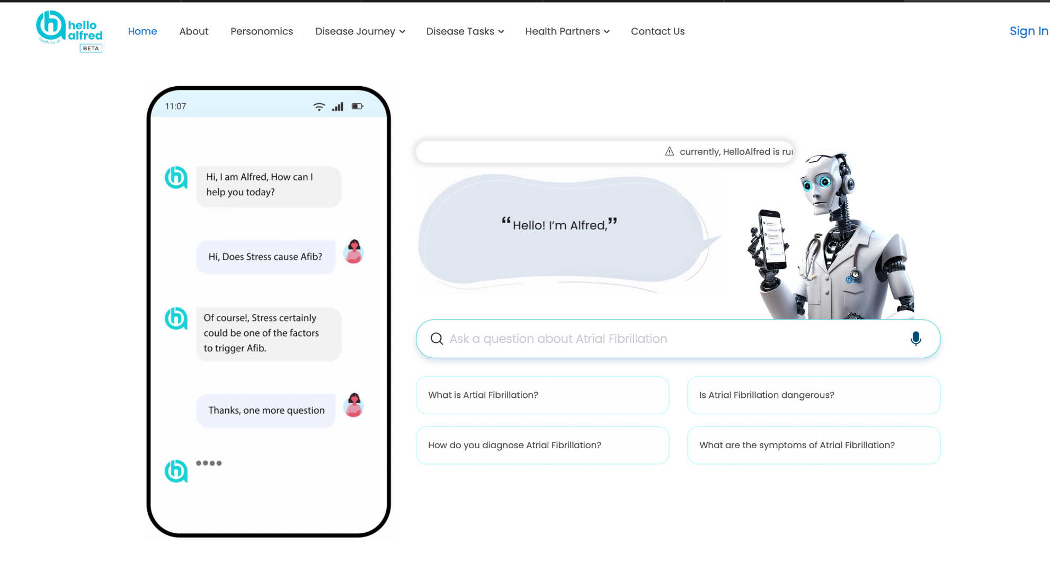
LIGHTNING TALK
Building Patient Classification Models for Personalized Healthcare Plans at HelloAlfred.AI
Sponsor: Dr. Ajay Tripuraneni
Course section: Fall Capstone (29745)
Name: Arshia Thota
Date: 10/24/2025

Slide 2
MOTIVATION FOR PROJECT
01
02
03
04
HelloAlfred.AI’s mission is to make healthcare more proactive and personalized through conversational AI.
Many patients face challenges staying consistent with care plans and healthy behaviors.
There’s a growing need for AI-driven tools that can understand both behavioral and clinical factors.
My project addresses this by helping to develop ML models that classify patients to deliver tailored support and recommendations.

Slide 3
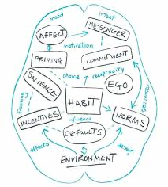

Current State of Project
Conducted research on nudge classifiers and behavioral frameworks to group patients effectively.
Collaborated with team members working on behavioral and clinical data integration.
Began reading Inside the Nudge Unit by David Halpern to apply real-world behavioral insights into patient classification.
Currently developing a framework that connects behavioral and health data for personalized care.
Expected/Potential Outcomes
Working prototype or conceptual model for patient segmentation using behavioral and health characteristics.
A framework that helps Alfred AI recommend more personalized patient plans.
Deeper understanding of how behavioral science can enhance AI-driven healthcare tools.

