Slide 1
Closed-loop force tracking
via PhysTwin's differentiable simulator
Malak Gamal Eldin · UC Irvine
Notes:
Open: "Hi, I'm Malak. I'm going to talk about closed-loop force
tracking on deformable objects, built on top of PhysTwin's
differentiable simulator." Keep it under 15 seconds — the real
content starts on slide 2.

Slide 2
Goal
invert PhysTwin: target force → gripper motion
Forward (prior work):
video → particle tracking → fit physics → contact forces
(slow, offline, per-video optimization)
Inverse (ours):
target F*(t) → policy → gripper Δ → realized force
(real-time, closed-loop, one shared policy)
Build the policy. Close the loop. One network, three materials.
Closed-loop force tracking via PhysTwin · Malak
2
Notes:
Two arrows. The TOP arrow is what PhysTwin already does: it
takes RGB-D video, tracks particles, fits a spring-mass
simulator to that motion, and recovers the contact forces.
Slow — minutes to hours per video.
The BOTTOM arrow is what WE do: given a target force
trajectory, learn a policy that picks gripper motions so the
realized force tracks the target — in real time, with one
shared policy across rope, cloth, and stuffed animal.
One sentence to deliver: "PhysTwin solves the forward problem
slowly; we invert it, fast, with a learned policy."

Slide 3
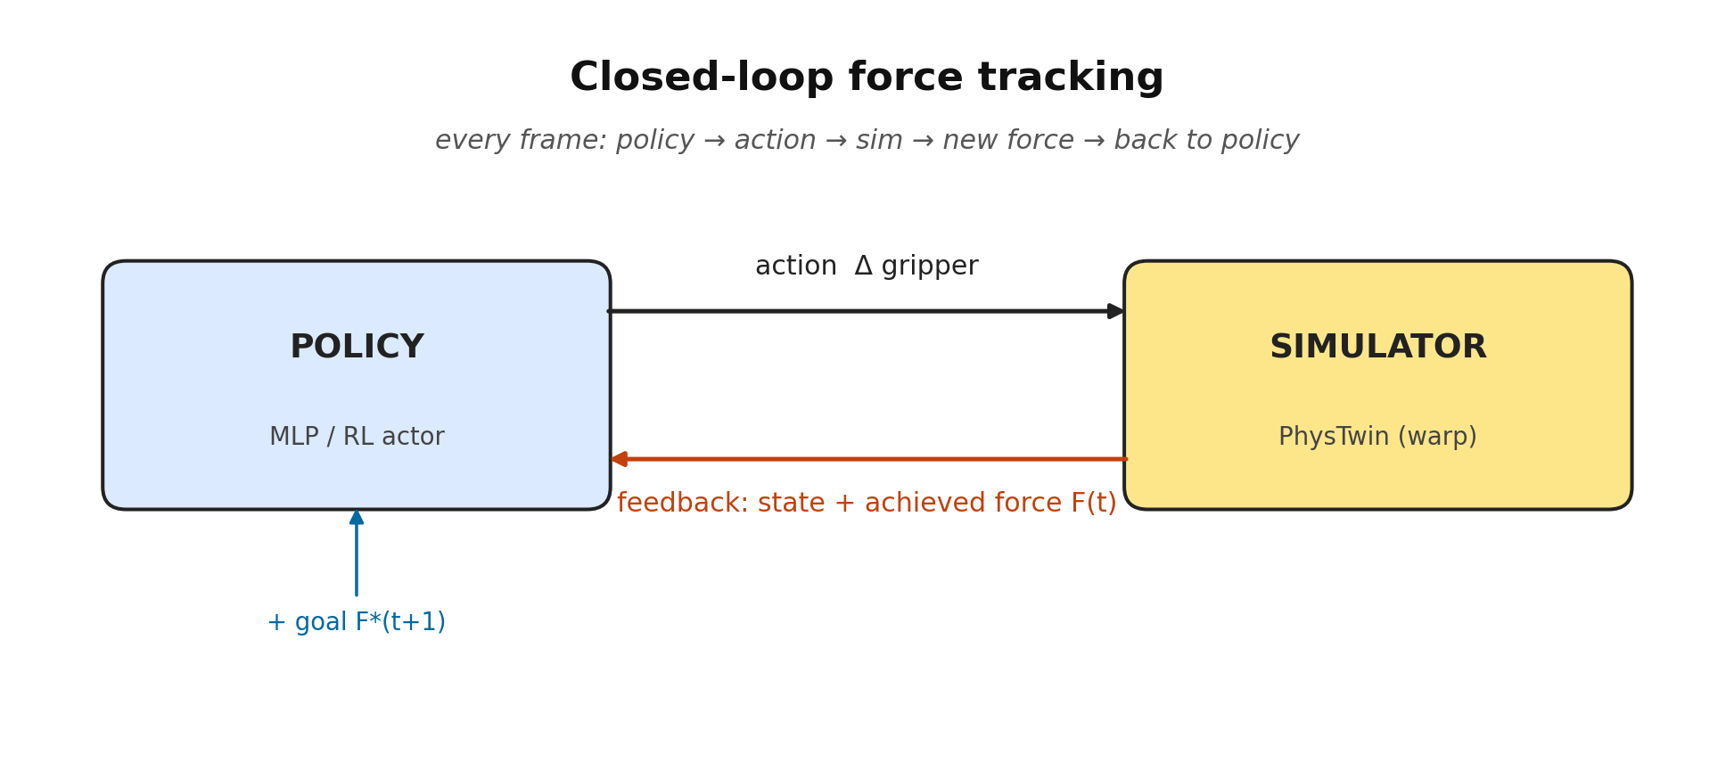
What does “closed-loop” mean?
policy reads achieved force every frame, not a script
Open-loop drifts ~6 mm/frame. Closed-loop exposes state-distribution shift.
Closed-loop force tracking via PhysTwin · Malak
3
Notes:
Quick definition slide so nobody is confused later.
Closed-loop just means: every frame, we MEASURE the achieved
force from the simulator and FEED IT BACK to the policy as
input. The policy then picks the next gripper move based on
what actually happened, not on a pre-baked schedule.
Point at the orange feedback arrow when you say "this is what
makes it closed." If you cut that arrow, it becomes open-loop
— you just play back a recorded action sequence and accumulate
error.
Foreshadowing: the BC policy fails specifically because it
never SAW the closed-loop input distribution at training time.
That's what RL fixes.

Slide 4
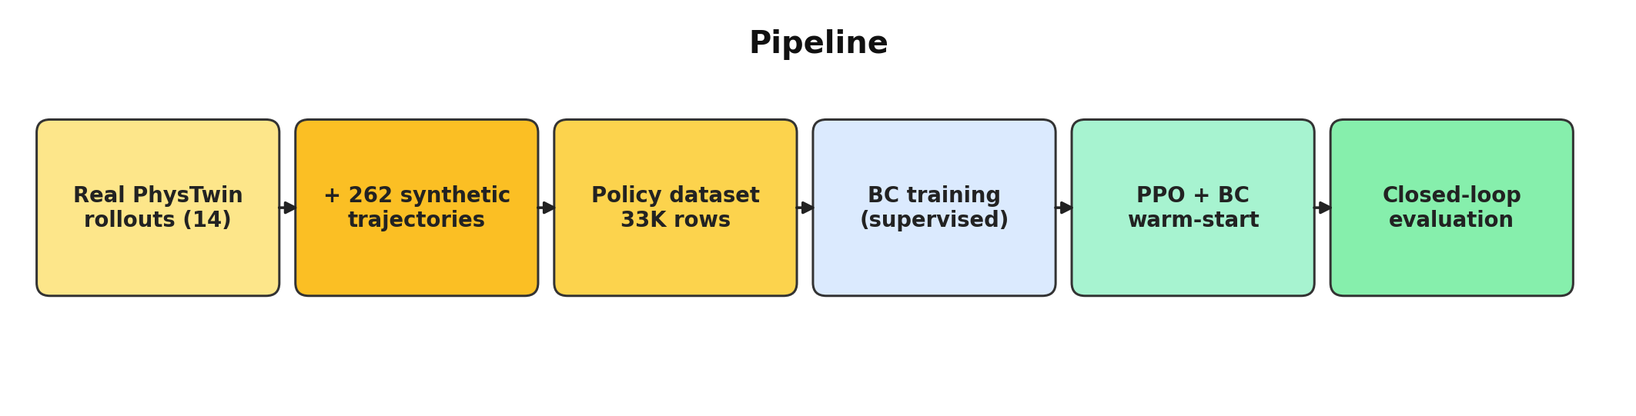
Pipeline
data → BC → closed-loop eval → PPO+BC warm-start → eval
Synthetic motions on the calibrated simulator expand 14 real cases → 33K dataset rows.
Same MLP shape end-to-end. RL actor = BC weights + exploration head.
Closed-loop force tracking via PhysTwin · Malak
4
Notes:
How the whole project is wired, left to right.
Step 1: take the 14 cases PhysTwin already calibrated.
Step 2: drive the SAME calibrated simulator with synthetic
motions (push, sinusoid, random walk, hold-release, ramp) —
262 new trajectories — so the dataset isn't just 14 cases but
~33K state-action pairs.
Step 3: supervised BC on that dataset — one shot, fast.
Step 4: warm-start a PPO policy from those BC weights and let
it roll out in the simulator with reward = closed-loop force
tracking error.
Step 5: same 14-case eval at the end so BC and RL are directly
comparable.
One sentence: "Same MLP all the way through. The RL actor is
literally the BC weights plus an exploration head on top."

Slide 5
What’s new
first PPO + BC warm-start on PhysTwin’s diff sim with material conditioning
Closed-loop driver inside PhysTwin
+200 LOC in trainer_warp.py · runs any policy frame-by-frame
Synthetic-trajectory data augmentation
14 real cases → 262 synthetic motions on same calibrated sim → 33K dataset rows
Inverse-dynamics BC policy + material conditioning
43-dim MLP · [log_spring_Y, log_mean_force] → one policy across rope / cloth / sloth
PPO + BC warm-start, from scratch
no SB3 · critic warm-up · log-ratio clipping
Diagnosis: state-distribution shift
4 goal-side fixes failed before we picked RL — that’s evidence, not noise
Closed-loop force tracking via PhysTwin · Malak
5
Notes:
This is your "What's New" slide — the 4-minute heart of the talk.
1. CLOSED-LOOP DRIVER: a new method we wrote inside PhysTwin's
warp simulator (~200 LOC) that lets ANY policy drive the
simulator frame-by-frame, with feedback. Upstream PhysTwin
only does offline batch optimization — no notion of a
controller-in-the-loop.
2. DATA AUGMENTATION: 14 real cases is tiny. We generate 262
synthetic motions on the SAME calibrated simulator, so the
training data covers behaviors the real videos don't (e.g.,
ramps that go up AND come back down). Mention: this alone
fixed the BC release problem on rope (0.04 -> 0.84) before
RL was even on the table.
3. MATERIAL CONDITIONING: a 2-d descriptor — log of mean spring
stiffness, log of mean recorded force — lets one shared MLP
specialize per case at inference time.
4. PPO + BC WARM-START: built our own minimal PPO (no SB3) so
we control critic warmup and log-ratio clipping. Both
tricks are needed; without critic warmup, the random critic
destroys the BC-warm-started actor in the first update.
5. DIAGNOSIS: we tried 4 goal-side fixes (hindsight relabeling,
hierarchical sub-goals, incremental shaping, synthetic ramp
data) — three failed, one partially worked. That negative-
results chain is what motivated turning to RL.
Punchline to land: "First end-to-end PPO + BC-warm-start with
material conditioning on PhysTwin's differentiable simulator."

Slide 6
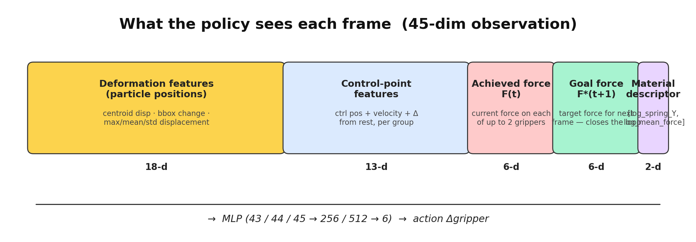
What the policy sees
45-dim observation per frame, same vector for BC and RL
Deformation + control point + force feedback + “what material am I?”
Closed-loop force tracking via PhysTwin · Malak
6
Notes:
30-second slide. Walk left to right across the five blocks:
- Deformation features (18 dims): summary stats over particle
positions — centroid displacement, bounding-box change,
max/mean/std per axis. This is "how is the object shaped
right now compared to rest?"
- Control-point features (13 dims): the gripper's current
position, velocity, and displacement from rest.
- Achieved force (6 dims): the force currently being applied
on each gripper (up to 2 grippers, 3 axes each). THIS is
the feedback signal that makes it closed-loop.
- Goal force (6 dims): the target force on the NEXT frame.
- Material descriptor (2 dims): log spring stiffness + log
typical force magnitude, per case. Lets one MLP specialize.
Total 45 dimensions. Both BC and RL use the same vector — the
only difference between them is HOW the weights were trained,
not what they look at.
Mention: "the 'closed-loop' part of the project lives in the
red Achieved Force block — that's the input that comes from
the simulator each frame, not from training data."

Slide 7
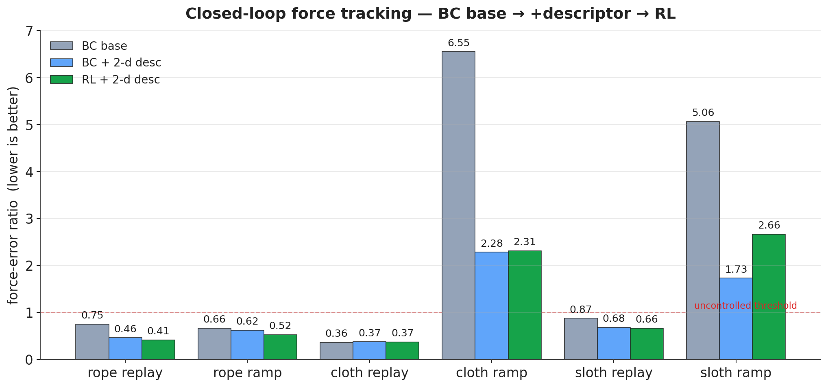
Results
force-error ratio (lower is better) · closed-loop evaluation
Material conditioning helps both. RL’s edge: rope replay 0.75 → 0.41, ramp release 0.04 → 0.87.
Closed-loop force tracking via PhysTwin · Malak
7
Notes:
The headline slide. Read it as TWO SUB-STORIES across the bars.
Lower bars = better tracking. The dashed red line at y=1.0 is
the "uncontrolled" threshold — above it, the policy is failing.
SUB-STORY 1 (compare gray to blue): adding the 2-d material
descriptor improves both BC and RL across the board. Most
dramatic on cloth ramp: 6.55 -> 2.28. One MLP can specialize.
SUB-STORY 2 (compare blue to green): switching from BC to RL
helps where the closed-loop input is OUT of training
distribution. Headline: rope ramp release jumps from 0.04
(BC barely retracts at all) to 0.87 (RL retracts cleanly).
Rope replay drops from 0.75 to 0.41 — a 45% improvement.
Honest beat: cloth ramp and sloth ramp are still above 1.0 —
we'll talk about that on the limitations slide. RL doesn't fix
everything.
One-liner: "Material conditioning helps both methods. RL adds
a release fix that supervised learning can't get."

Slide 8
Sub-story 1 · Material conditioning
one policy across rope / cloth / sloth
rope rep
cloth ramp
sloth ramp
BC base
0.75
6.55
5.06
BC + 2-d desc
0.46
2.28
1.73
RL + 2-d desc
0.41
2.31
2.66
Adding [log Y, log F] descriptor unlocks generalization — cloth ramp 6.55 → 2.28.
Closed-loop force tracking via PhysTwin · Malak
8
Notes:
Zoom-in on the material-conditioning sub-story. Just three
numbers per row, three rows. Read down the columns:
- "rope rep" = closed-loop replay on rope cases (recorded
goal). 0.75 -> 0.46 -> 0.41 — every step helps.
- "cloth ramp" = synthetic ramp on cloth. 6.55 -> 2.28 -> 2.31.
The descriptor alone fixes most of it; RL barely moves it.
- "sloth ramp" = synthetic ramp on the stuffed animal.
5.06 -> 1.73 -> 2.66. Descriptor helped, but RL regressed —
this is the case that motivates the Fix-G future work.
Takeaway: "A two-dimensional material descriptor — log
stiffness, log force magnitude — gets a single MLP to
specialize across three very different materials."

Slide 9
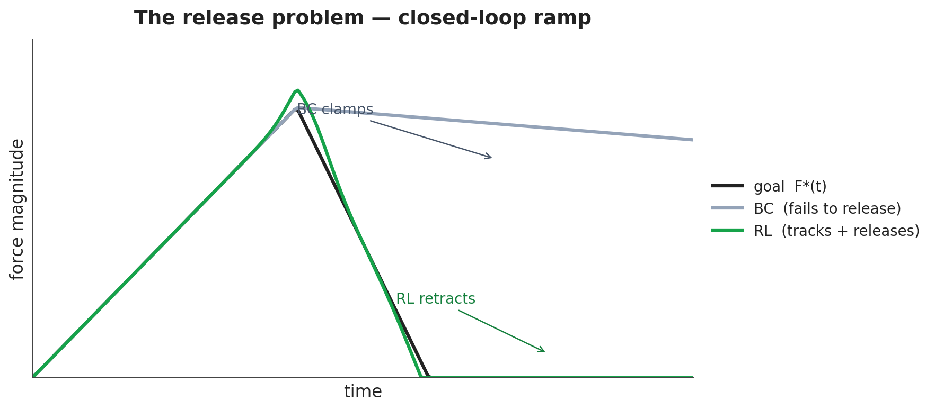
Sub-story 2 · The release problem
why BC stalls and RL doesn’t
Why?
BC never saw the input
“F(t) high, F*(t+1) low”
at training time.
RL collects its OWN
closed-loop rollouts —
sees that state, learns
to retract.
Release fraction
BC base: 0.04
RL + 2-d: 0.87
Closed-loop force tracking via PhysTwin · Malak
9
Notes:
The mechanistic "why does BC fail?" slide. Spend 50 seconds
here — this is the conceptual core of the BC -> RL story.
Black line: the goal force trajectory — ramp up, ramp down,
ending at zero.
Gray line (BC): tracks the rise OK, but when the goal drops
back to zero, BC keeps applying force. It clamps at the peak.
Why? Because supervised data was collected from OPEN-LOOP
trajectories — so the BC policy never SAW an input where
"current force is high and goal is low at the same time."
Green line (RL): RL collects ITS OWN closed-loop rollouts. It
encounters that "release" state during training, gets bad
reward when it doesn't retract, and learns to retract.
Concrete number on the right panel: release fraction goes
from 0.04 to 0.87 — basically from "doesn't retract" to
"retracts almost completely."
One-liner: "The reason BC fails here is exactly the reason
RL works here — closed-loop states that supervised data
never contained."

Slide 10
Live demo
best supervised tracking · RL release fix
BC + descriptor · cloth lift · err 0.22
RL + descriptor · rope ramp · release 0.04 → 0.87
same closed-loop driver · same simulator · same 45-dim input
Closed-loop force tracking via PhysTwin · Malak
10
Notes:
Live videos, ~30 seconds total — keep it tight.
LEFT (BC + descriptor on cloth lift, err 0.22): "This is what
supervised learning gets you when the test situation is in
distribution. Cleanest single result in the project — error
ratio 0.22."
Let it play 8 seconds, then transition.
RIGHT (RL + descriptor on rope ramp): "And this is what RL
adds on top — when the goal drops to zero, BC stalls but the
RL policy retracts. Release fraction 0.04 to 0.87."
Let that play ~12 seconds. The visual of the gripper actually
pulling back at the right moment is the selling point.
Note: same network architecture in both. Same simulator.
Same 45-dim input. The only difference is HOW the weights
were trained.

Slide 11
Honest limitations
where the policy is still uncontrolled
cloth ramp
err 2.31 · still above the uncontrolled threshold
sloth ramp
err 2.66 · release worked, magnitude undershoots
rope_4 outlier
gentle force regime, training underrepresented
Fix G shaped reward
validated on cloth, regressed sloth ramp — next step: per-material α
Closed-loop force tracking via PhysTwin · Malak
11
Notes:
Honest 30 seconds — don't oversell.
Three concrete things to call out:
1. CLOTH RAMP error ratio is still 2.31 — above the
"uncontrolled" threshold of 1.0.
2. SLOTH RAMP regressed from BC (1.73) to RL (2.66). RL
learned to retract on rope and overfit that behavior on
sloth.
3. ROPE_4 outlier: a "gentle push" case (peak force ~2.5 kN
vs typical ~15 kN) underrepresented in training.
I also tried a stiffness-shaped reward (Fix G) to fix the
sloth-ramp regression — it worked on cloth but didn't move
sloth ramp. Why is one of the next steps.
Don't dwell. Move on within 30 seconds.

Slide 12
Next steps for the final report
concrete deliverables
1. Per-material reward shaping
Fix G failed because α was global. Train with rope α=0, cloth α=500, sloth α=2000.
Deliverable: extra row in the headline table, target cloth ramp ≤ 2.0.
2. Can BC catch up to RL with more data?
Generate 5× more synthetic trajectories and retrain BC on them.
If BC matches RL → data buys the win. If not → RL is doing something supervised data can’t.
3. MPC on the diff simulator (stretch)
Rollout-shooting MPC over 10 steps for ramp release reference.
Deliverable: 4th video showing MPC oracle vs RL on the same trajectory.
Closed-loop force tracking via PhysTwin · Malak
12
Notes:
Three concrete deliverables for the final report. Spend 2
minutes here — this is the "what's next" budget.
1. PER-MATERIAL REWARD SHAPING. Fix G used one global alpha
across all materials. Next try: alpha per material —
rope=0, cloth=500, sloth=2000. Deliverable: extra row on
the bar chart. Target cloth ramp below 2.0 without
regressing rope.
2. CAN BC CATCH UP TO RL WITH MORE DATA? Current BC dataset
is 33K rows. Generate 5x more synthetic trajectories,
retrain BC, see if it matches RL. This isolates "is the
win really from RL, or could supervised learning have
gotten there with more data?"
Deliverable: one extra row "BC + 5x synth" on the same bar
chart, plus a single-sentence verdict.
3. STRETCH — MPC ON THE DIFFERENTIABLE SIMULATOR. PhysTwin is
differentiable, so we can rollout-shoot MPC over ~10 steps
as an oracle baseline for the ramp-release problem.
Deliverable: a fourth video showing MPC reference vs RL on
the same trajectory.
Emphasize CONCRETE — the grader is asking for that.

Slide 13
Questions I’d love feedback on
pick whichever you have an answer to
1.
Is on-policy PPO the right choice on a differentiable simulator,
or should we be using analytic-policy-gradient / short-horizon BPTT?
2.
Material descriptor is just [log Y, log F].
Is a richer descriptor (anisotropy, mesh density, damping) worth chasing?
3.
Fix G’s shaped reward failed on sloth ramp.
Cleaner formulation than per-material α tuning? (CMDP? Lagrangian?)
Closed-loop force tracking via PhysTwin · Malak
13
Notes:
Spend ~1.5 minutes here. Pick whichever 2 of 3 feel most
relevant during the talk:
Q1 (PPO vs policy gradient on a diff sim): the most
technically interesting one. PhysTwin is differentiable but
we treat it as a black box for PPO. Why not analytic policy
gradients or short-horizon BPTT? Honestly, I'd love an
opinion.
Q2 (richer material descriptor): we use [log Y, log F] — 2
dimensions. Should we add anisotropy, mesh density, damping?
Or is 2-d already saturated?
Q3 (cleaner alternative to per-alpha tuning): if Fix G failed
because alpha was wrong, next attempt tunes alpha per
material. But that's not principled. Is CMDP / Lagrangian /
some other formulation cleaner?
Don't try to answer yourself. Pause after each, let people
respond.

Slide 14
Thanks!
Closed-loop force tracking via PhysTwin
Code + writeups: my_work/code, my_work/docs/closed_loop_control
Notes:
Closing. Two lines:
- "Thanks. Happy to take questions."
- If anyone asks where the code lives:
my_work/code (all scripts) and
my_work/docs/closed_loop_control (all reviews).

