Slide 1
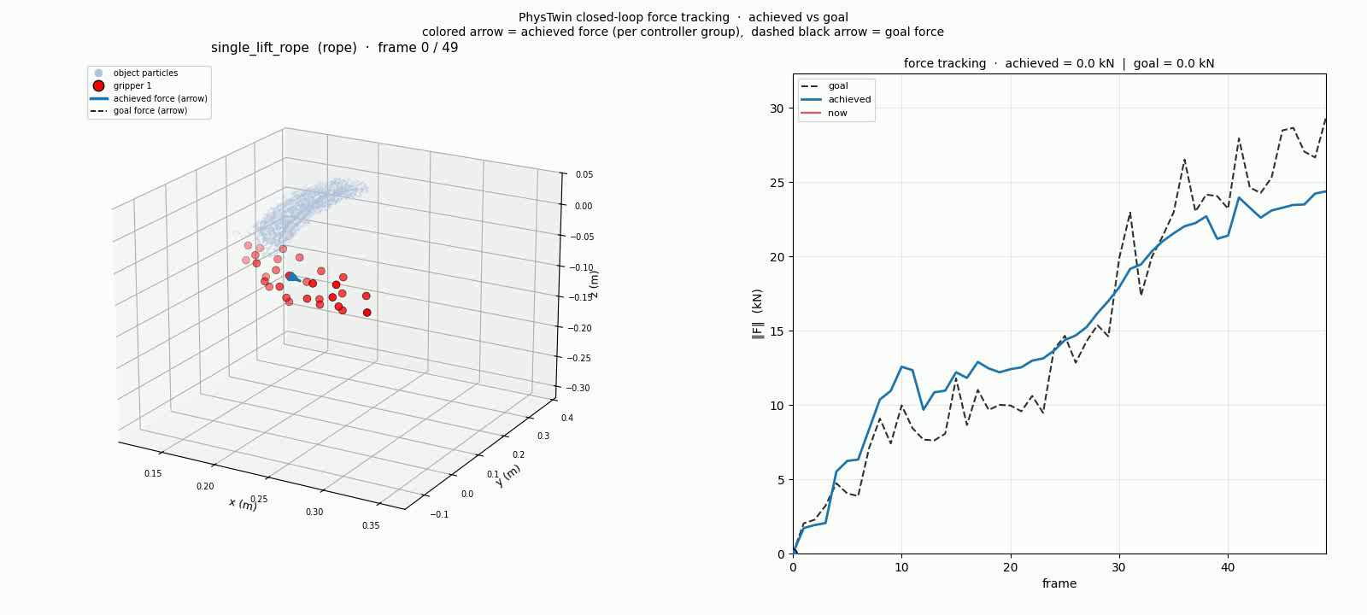
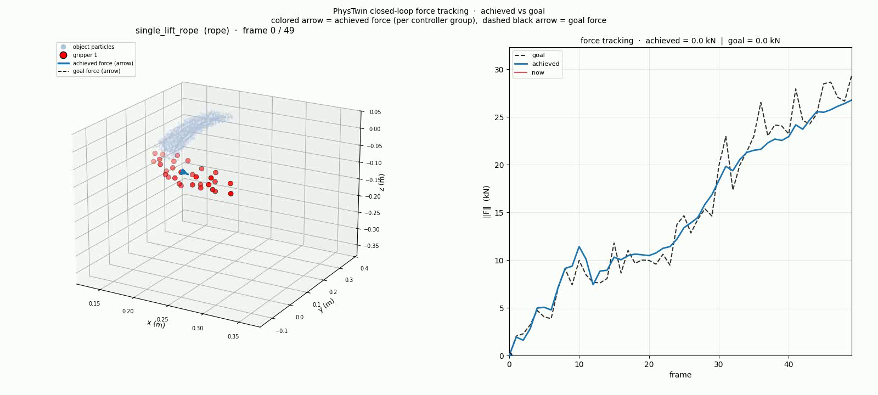
Contribution 1 · Material descriptor
same network, two extra static numbers in the input — rope replay (single_lift_rope)
BC (no descriptor)
BC + 2-d descriptor
err 0.36 · tracks shape, but lags
err 0.13 · tracks closely (−62%)
Same MLP. Same supervised loss. The only difference is the [log_Y, log_F] descriptor in the input.
Notes:
~25 seconds. Both rollouts are on the SAME case
(single_lift_rope, replay profile). Same supervised
training pipeline. The only variable is whether the policy
sees the 2-d material descriptor.
LEFT (BC base, no descriptor): error ratio 0.36. The
policy tracks the general shape of the goal force, but
lags noticeably and undershoots peaks.
RIGHT (BC + 2-d descriptor): error ratio 0.13 — a 62%
improvement. Same MLP architecture, same loss; the only
extra input is two static numbers (log of mean stiffness,
log of mean recorded force magnitude). With that hint the
policy tracks the goal closely.
Both posters show the actual force-tracking curves —
achieved vs goal magnitude over time. The right poster
shows tighter alignment.
One-liner: "Telling the network 'this is rope, force
scale ~15 kN' — two static numbers in the input —
cuts tracking error by more than half."

Slide 2
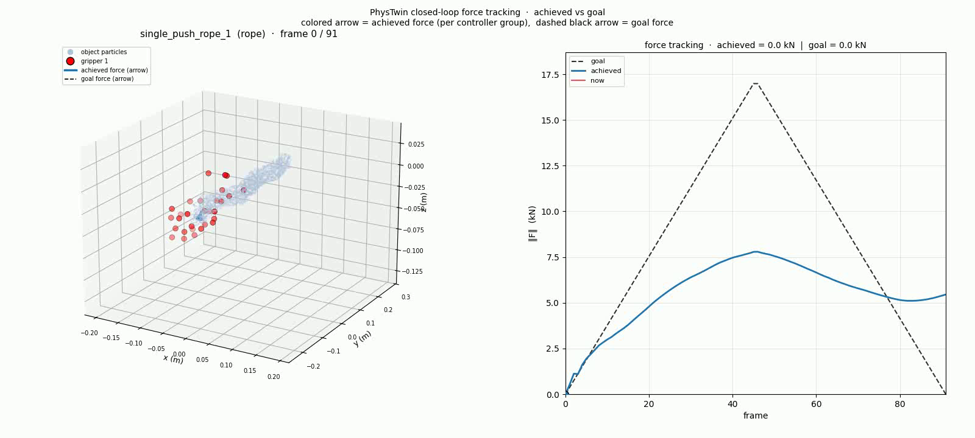
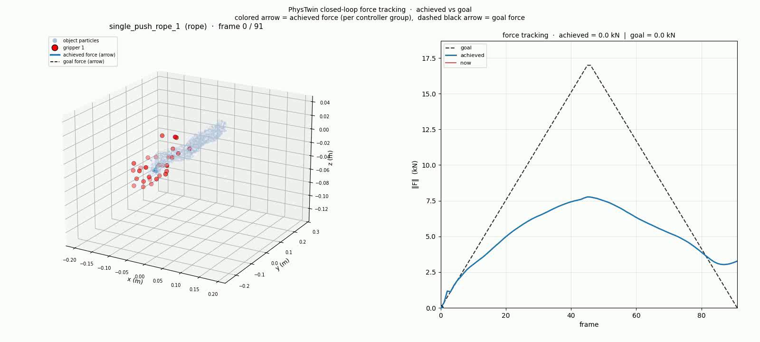
Contribution 2 · PPO with BC warm-start
isolated RL effect — both already have the descriptor (rope ramp, single_push_rope_1)
BC + 2-d descriptor
RL + 2-d descriptor
fall fraction 0.30 · partial retraction
fall fraction 0.58 · near-double retraction
Modest but measurable: RL nearly doubles the retraction the descriptor alone provides.
Notes:
~20 seconds. Both policies already have the material
descriptor, so the only variable on THIS slide is BC vs
PPO refinement.
LEFT (BC + descriptor on rope ramp): rises to ~7800 N
peak, then partially retracts. Fall fraction 0.30 —
roughly a third of the peak force decays by the end.
RIGHT (RL + descriptor on the same case): same rise, but
retracts further. Fall fraction 0.58 — nearly double the
BC retraction.
Be honest here: this is a modest improvement, not a
transformation. The big "BC barely retracts at all"
failure is the bare baseline without ramp data or
descriptor — that's what the next slide shows.
One-liner: "On top of the descriptor, RL roughly doubles
the retraction. The bigger story — what RL plus the
descriptor together accomplish — is on the next slide."
If asked why the err_ratio change is modest (0.62 → 0.52):
the rising portion dominates the average and looks the
same for both. Fall fraction isolates the falling-edge
behavior — the closed-loop state where they actually
differ.

Slide 3
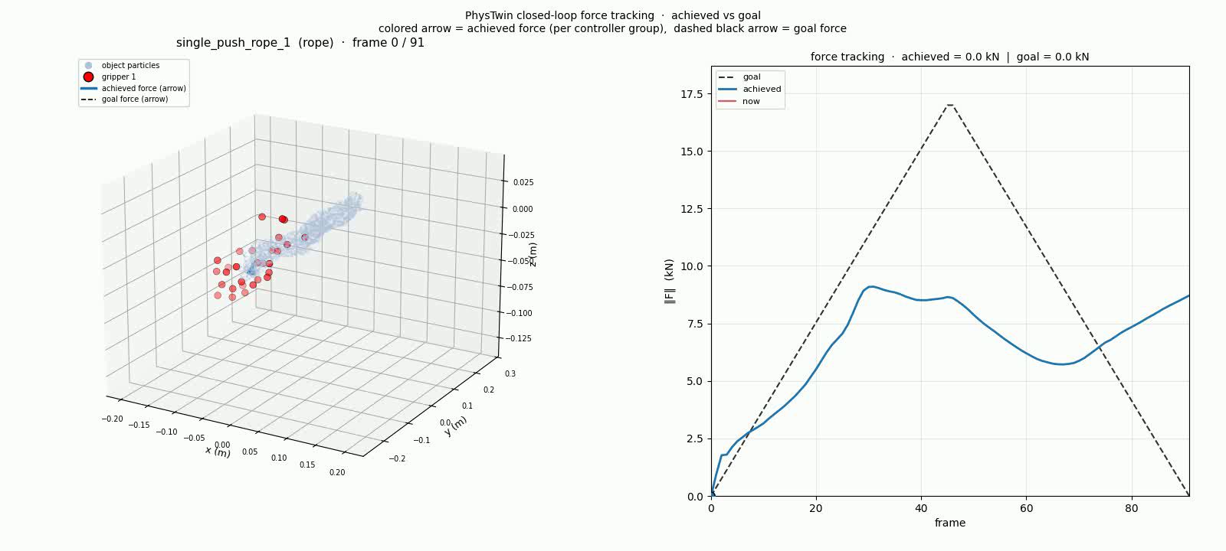
Full pipeline · BC base vs everything stacked
what the final system does that the supervised baseline can't — rope ramp
BC base (no descriptor, no ramp data)
RL + 2-d descriptor
fall fraction 0.04 · doesn’t retract at all · final 8.7 kN
fall fraction 0.58 · retracts to 3.3 kN · goal end 0 kN
Stacked contributions: synthetic ramp data + material descriptor + RL refinement.
Notes:
~20 seconds. This slide is the FULL system delta — bare
baseline on the left, complete pipeline on the right.
LEFT (BC base, Step 2): no material descriptor, trained
without the synthetic ramp augmentation. When the goal
force drops back to zero at the end, the policy keeps
pushing — the final force is 8.7 kN, almost the same as
the peak. Fall fraction 0.04.
RIGHT (RL + descriptor, full pipeline): retracts to 3.3 kN
by the end. Fall fraction 0.58.
Honest framing: this is descriptor + ramp data + RL
stacked, NOT a clean RL-only delta. The previous slide
shows the isolated RL contribution (0.30 → 0.58). Most of
the retraction was unlocked by the descriptor + ramp data;
RL refined it further.
One-liner: "The end-to-end win is real — bare BC doesn't
retract, the full system does. The credit is shared
across three improvements; RL is the smallest of them but
still adds measurable lift."
If anyone asks "which contribution mattered most" — the
material descriptor; details on the bar chart slide.

