Slide 1


AgriRelay
Field Intelligence for the People Who Serve Farmers
Where seeds meet satellites — through the people in between.

Slide 2
#01 THE REAL PROBLEM
The Problem
₹92,000 Cr
The Story Behind the Number
India has 140 million farming households. When harvest season peaks, every farmer in a district harvests at the same time — and floods the same local mandi. Supply spikes. Prices crash. Perishables rot. Middlemen buy at ₹3/kg and sell at ₹30/kg two districts over.
The farmer doesn't know that 80km away, the same tomatoes are selling for 4x the price.
He never did. And no app changed that.
worth of crops lost annually to post-harvest inefficiency in India.
"The problem isn't that farmers lack technology. It's that the right people lack the right tools."

Slide 3

#02 WHAT EVERYONE ELSE BUILT
Why Existing Solutions Fail
Weather Apps
Disease Detectors
Price Dashboards
Built for smartphone users. Most farmers have feature phones. Ignored.
Useful after the damage is done. Doesn't move the crop. Doesn't get the farmer a fair price.
Raw data with no action. Farmer sees price. Has no way to act on it.
Every solution was built for a literate, smartphone-carrying farmer sitting next to a WiFi router. That farmer doesn't exist in most of rural India.

Slide 4

#03 OUR INSIGHT
The Insight
There are 1.2 lakh Agriculture Extension Officers in India. BSc Agriculture graduates. Government-posted. Tech-literate. Already in the village. Already trusted by farmers. They had no tools.
We didn't build an app for farmers. We built a command center for the people who already serve them.
AI Infrastructure
Data-driven decision support
Trusted Intelligence Flow
Farmer
Extension Officer
Local adoption and action
Trusted, tech-literate intermediary
AgriRelay bridges the gap between national agricultural data infrastructure and the millions of farmers who depend on extension officers for guidance — turning raw intelligence into actionable advice at the village level.

Slide 5

#04 INTRODUCING AGRIRELAY
AgriRelay
Asymmetric Market Intelligence Platform for Agricultural Extension Officers
1
2
Demand Forecast Engine
Harvest Timing Advisor
Analyzes historical mandi prices, regional sowing trends, and supply chain delays to predict where demand will spike — 2–3 weeks ahead.
Tells the officer exactly when each crop in their zone should be harvested to hit peak market windows — not just peak ripeness.
3
4
Smart Mandi Router
One-Click SMS Relay
Recommends the optimal mandi — not just the nearest one — based on live supply/demand imbalance across a 200km radius.
Officer selects farmers from their registered list and sends pre-formatted, vernacular SMS alerts. No smartphone needed on the farmer's end.

Slide 6
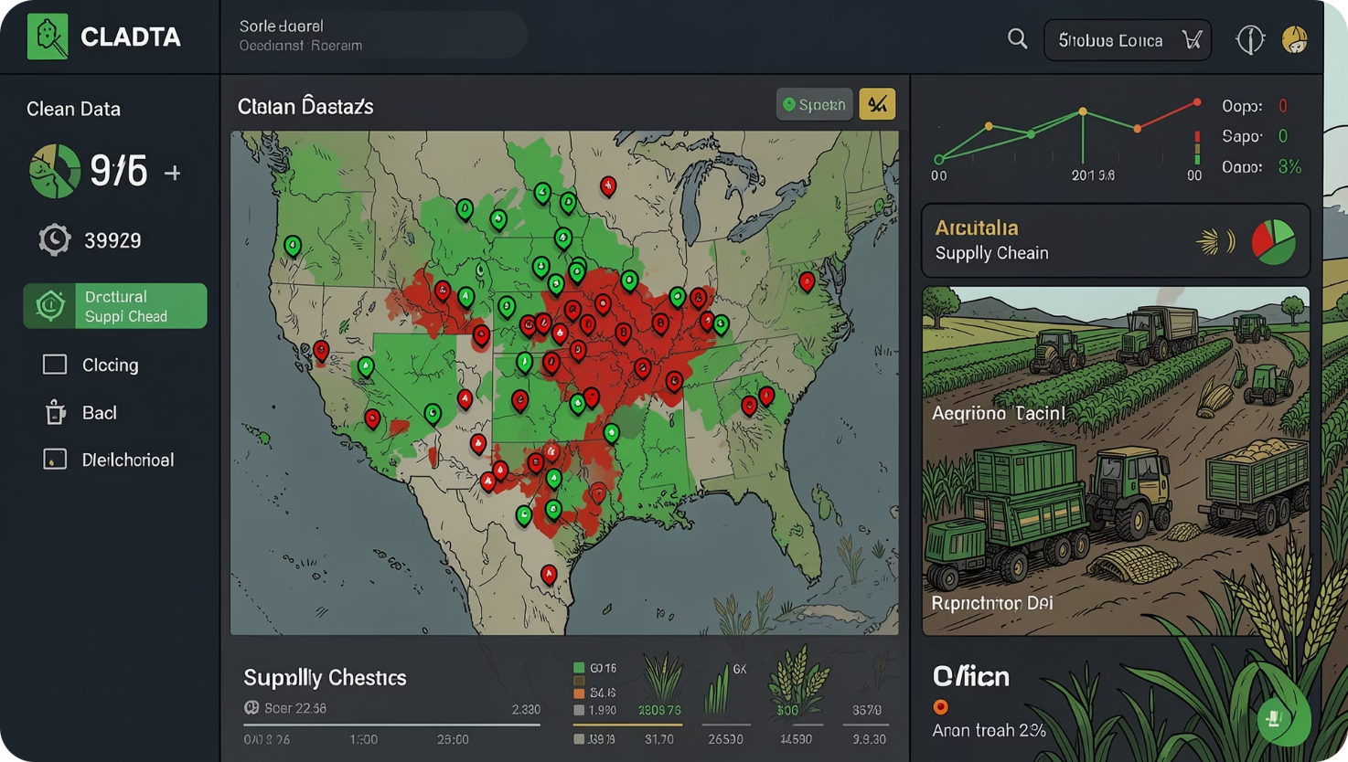

#05 THE LAYER NO ONE ELSE HAS
Contamination Audit Trail + Supply Chain Trust Score
When diseased or substandard produce enters the supply chain undetected, it damages everyone — buyers reject entire consignments, prices crater, and healthy farmers suffer.
AgriRelay gives extension officers a geo-referenced contamination flagging tool. They tag infected batches before they leave the farm. That data feeds back into the system:
Mandis receiving supply from flagged zones get a depressed Trust Score
Aggregators and FPOs can see which zones have clean supply — and route procurement there
The dataset compounds over time into a national produce quality map
This is the only solution in this room that protects both ends of the supply chain — and builds a data asset that gets more valuable every season.

Slide 7
#06 THE FLOW
How It Works
01
02
Data Ingestion
AI Prediction
AgriRelay pulls live mandi prices from AgMarkNet/eNAM APIs, satellite-based sowing trend data, and weather/logistics feeds across 200+ districts.
Our demand forecasting model identifies supply-demand imbalances across regions and calculates optimal harvest windows and sell destinations per crop per zone.
03
04
Officer Dashboard
Farmer Relay
The extension officer opens their zone dashboard. They see: where to route each crop, when to advise harvest, what price to demand, and any govt scheme updates. Works offline — syncs when signal returns.
Officer selects farmer groups and sends pre-written SMS alerts in their local language. Farmer receives: which mandi, when to go, what price to hold for.
05
06
Contamination Flag
Outcome
Officer spots infected produce — logs it with crop type, severity, and GPS location. System auto-updates trust scores for downstream mandis.
Farmer sells at 2–4x the local mandi rate. Officer fulfills their government mandate with data-backed decisions. Supply chain gets cleaner data season over season.

Slide 8
#07 BUILT WITH
Tech Stack
Frontend
AI / Data
React.js + Tailwind CSS
Leaflet.js (zone maps)
Recharts (price trend graphs)
PWA / Service Workers (offline-first)
Demand forecasting model (time-series, ARIMA/LSTM)
Satellite NDVI data for sowing trend estimation
Regional crop calendar integration
Infrastructure
Backend
Cloudflare Pages / Railway
GitHub Actions (CI/CD)
Node.js / Python FastAPI
PostgreSQL + PostGIS (geospatial queries)
AgMarkNet / eNAM APIs (mandi price data)
Twilio / MSG91 (SMS gateway)

Slide 9

#08 THE SCALE OF IMPACT
Impact at Scale
1.2L
40–60%
₹0
Extension Officers
Loss Reduction
Cost to Farmer
Already in place across India — waiting for tools like this
Reduction in post-harvest losses when market routing is optimized (ICAR, 2022)
The officer is already salaried by the government
Employment
Equity
Scalability
BSc Agri graduates get a meaningful, tech-enabled role — not just paperwork
Farmers who never owned a smartphone get AI-grade market intelligence
One officer serves 500–1000 farmers. The system scales with existing govt infrastructure.

Slide 10
#10 THE VISION
The Vision
Every season, India's farmers make the same mistake — not because they're uninformed, but because no one gave the right person the right tool at the right time.
AgriRelay doesn't replace the farmer. It doesn't replace the officer. It makes the system they're already part of finally work for them.
Where seeds meet satellites — through the people in between.
AgriRelay | https://github.com/Lalitya31/AgriRelay | ArcNight 2026

