Slide 1
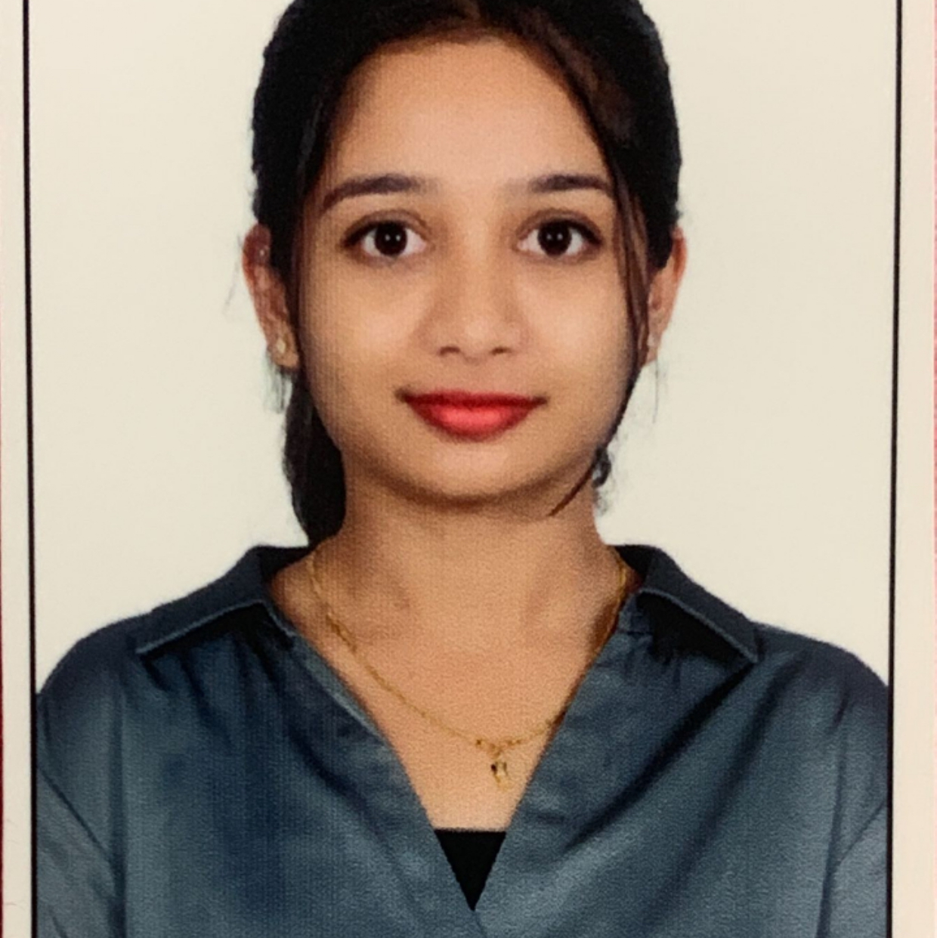



Harshita R
Analyst/Software Engineer
Mater of Computer Application
2018-2020
Skills Java
Spring Boot
Spring MVC
MERN Stack
NodeJS
MongoDB
Database
SQL database –MySQL
No SQL database – MongoDB
Web Technologies
HTML5
CSS3
JavaScript
AddOns
Github
Postman
Additional Details
Leadership
Quick Learner
Team management
Bangalore
harshita.a.r@capgemini.com
+917338201019
A4
Software Engineer who is Strong in design and integration with intuitive problem-solving skills. Passionate about implementing and launching new projects.
Ready to learn new technologies and implement them to further improve my knowledge.
Eager to work in a team of dedicated people and serve a key role in the enhancement and development of the project.
Has working knowledge on Angular and Java Microservice Development using Spring framework on an intermediate level.
https://github.com/Arshita-R
Online Railway Reservation :
Completed end to end case study of Online Railway Reservation along with JWT authentication, Swagger and payment testing using Braintree in MERN Stack. Material-UI and Angular used for user interface.
https://www.linkedin.com/in/harshita-r-929721234/
Check out my work on GitHub & Video Profile

