Slide 1
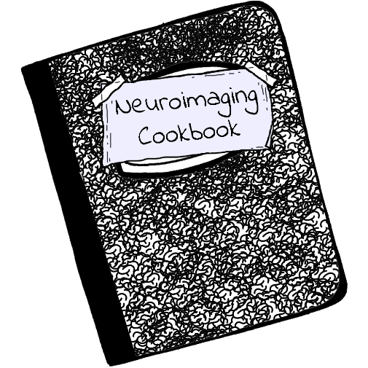

Centralized, simple, searchable code snippets (recipes) for neuroimaging data
Project leader: Shawn Rhoads
@ShawnRhoads56
Mattermost, GitHub: @shawnrhoads
https://github.com/neuroimaging-cookbook
https://brainhack.org/global2020/project/project_93
https://mattermost.brainhack.org/brainhack/channels/neuroimaging-cookbook

Slide 2
Why a cookbook?
Cooking eggs
Fried
Scrambled
Boil (soft or hard)
Sunny side up
Omelet
Poached

Slide 3
Why a cookbook?

Slide 4
Why a cookbook?
Cooking eggs
Extracting a mask from parcellation
Fried
Scrambled
Boil (soft or hard)
Sunny side up
Omelet
Poached
3dcalc –a atlas.nii.gz –prefix mask67.nii.gz –expr ‘amongst(a, 67)’
fslmaths atlas.nii.gz –thr 67 –uthr 67 –bin mask67.nii.gz
imcalc ??
nilearn (Python) ??

Slide 5
Why a cookbook?
Countless software packages with widely different commands and options to perform all sorts of different functions when working with neuroimaging data.
Remembering them all is nearly impossible!

Slide 6
Why a cookbook?
Centralized location for all of your recipes!
Increase productivity!
Save time!
Help others!

Slide 7
Two teams

Slide 8
Two teams
Web Development Team
Design user interface
Front-end
Back-end
Scalability
Documentation / README
Code of Conduct
Contribution Guidelines

Slide 9
Two teams
Web Development Team
Design user interface
Front-end
Back-end
Scalability
Documentation / README
Code of Conduct
Contribution Guidelines
Code Snippets (Recipes) Team
Determine first batch of recipes
Create templates
Organize recipes
fMRI recipes?
dMRI recipes?
sfMRI recipes?
Utility (e.g., cleaning, processing, analysis)
Software package (e.g., AFNI, FSL)
Programming language (e.g., Bash, Python, R, MATLAB)

Slide 10
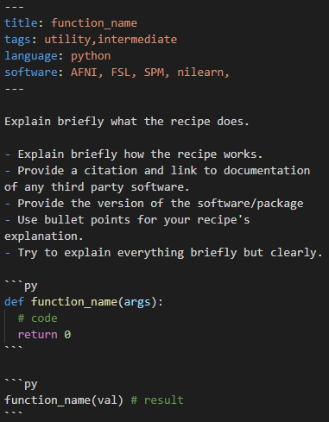
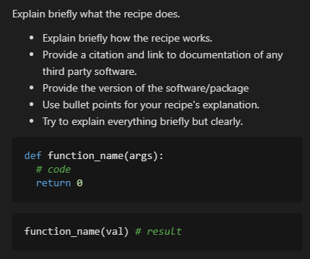

Slide 11
Skills
Web Development Team
Looking for people with HTML/CSS and/or JavaScript experience for website!
Anyone looking to work with Markdown
Some experience with Git/GitHub
Code Snippets (Recipes) Team
Any experience with neuroimaging data
Any software package of choice
(AFNI, FSL, SPM, Freesurfer, ANTs, nilearn, nibabel, dipy)
Any programming language
(Bash, Python, R, MATLAB)

Slide 12
Questions?

