Slide 1



Hackathon 2026
Idea Submission Template
Instructions (Remove this slide while submitting)
Prepare the solution document as per this template, feel free to modify layouts while keeping core content .
Kindly keep the maximum slides limit up to six (6-7). ( Including the title slide)
Try to avoid paragraphs and post your idea in points /diagrams / Infographics /pictures .
You can only use provided template for making the PPT without changing the idea details pointers (mentioned in previous slides).
You need to save the file in PDF and upload the same on portal. No PPT, Word Doc or any other format will be supported.
FILE NAMING CONVENTION
Team Name_PSNo (E.g. i4C_PS01)
REMOVE THIS SLIDE FOR INSTRUCTIONS IN FINAL SUBMISSION

Slide 2




Team Details
Team Name:
S.H.A.R.P.
SR. NO
ROLE
NAME
ACADEMIC YEAR
1
Team Leader
R. Arshitha
2026
2
Member 1
{Enter Name}
{Enter Year}
3
Member 2
{Enter Name}
{Enter Year}
4
Member 3
{Enter Name}
{Enter Year}
A team can have up to 4 members including the team leader. Add rows if necessary.
COLLEGE NAME
National Institute of Technology Hamirpur
TEAM LEADER CONTACT NUMBER
TEAM LEADER EMAIL ADDRESS
+91 7448556267
arshitharajkumar10@gmail.com

Slide 3


Problem Statement Addressed
AI-Based Restoration of Degraded Images
Why this matters in semiconductor manufacturing:
Inspecting wafers at nanometer scales inherently produces noisy, degraded images due to physical limitations like shot noise, focus drift, and sensor limitations. If standard smoothing filters are used for denoising, critical physical defects (like sub-pixel line breaks or particle contaminants) are permanently blurred away. Accurately restoring these images without hallucinating false structures or blurring out true defects is essential to catching faulty chips before they go to market and maintaining semiconductor yield.

Slide 4



Idea Description
KEY CONCEPT & APPROACH
We developed SHARP (Structural High-frequency Aware Restoration Pipeline). We selected a purely convolutional NAFNet-style architecture over heavy Vision Transformers. This guarantees the ultra-low latency required for deployment on H100 hardware while maintaining high restoration capacity.
Addressing the 3 Degradation Types:
• Speckle/Multiplicative Noise: Handled via robust 1st/99th percentile normalization and a dedicated noise-estimator (σ) injected via FiLM conditioning.
• Gaussian Noise & Blur: Handled natively by the convolutional encoder-decoder operating efficiently in low-resolution space.
• Super-Resolution (x2): Addressed efficiently via a final PixelShuffle upsampling layer, ensuring 99% of compute happens before resolution expands.

Slide 5
Proposed Solution
SOLUTION DETAILS
Model Architecture:
A 12-block NAFNet encoder-decoder (width=64). It accepts 2-channel input (normalized + log-scaled) and produces 2-channel output (residual +uncertainty). Total parameter count: ~0.32M.
Training Strategy & Data Augmentation:
Trained for 200 epochs using Cosine Annealing Learning Rate (2e-4 to 1e-6) and AdamW. Data augmentation aggressively utilizes CutBlur and D4 (flips/rotations). We enforce a 70% synthetic to 30% real data mixing ratio to prevent in-distribution overfitting.
Loss Function Design (System Pipeline):
Instead of using a standard L2 loss, we built a composite multi-loss:
1. Charbonnier Loss (Global baseline)
2. MS-SSIM (Structural integrity)
3. FFT Magnitude L1 Loss (Forces recovery of exact frequencies)
4. Gradient Consistency L1 Loss (Penalizes blurry edges)

Slide 6
Innovation and Uniqueness
KEY INNOVATION
COMPETITIVE ADVANTAGE
Most teams optimize purely for PSNR/RMSE (using standard L1/L2 loss). Mathematically, this encourages models to output a blurry, "safe" average image,which completely destroys the sharp physical semiconductor defects KLA is trying to inspect!
Our primary innovation is the Multi-Loss Function (FFT + Gradients). By severely penalizing the model for missing high-frequency structures, our model takes risks to reconstruct sharp edges. When evaluated with a Laplacian of Gaussian (LoG) defect detector, our multi-loss approach reduced false positive defect detections by 24% and increased true positive defect recovery by 36% compared to a standard L2 baseline model.

Slide 7
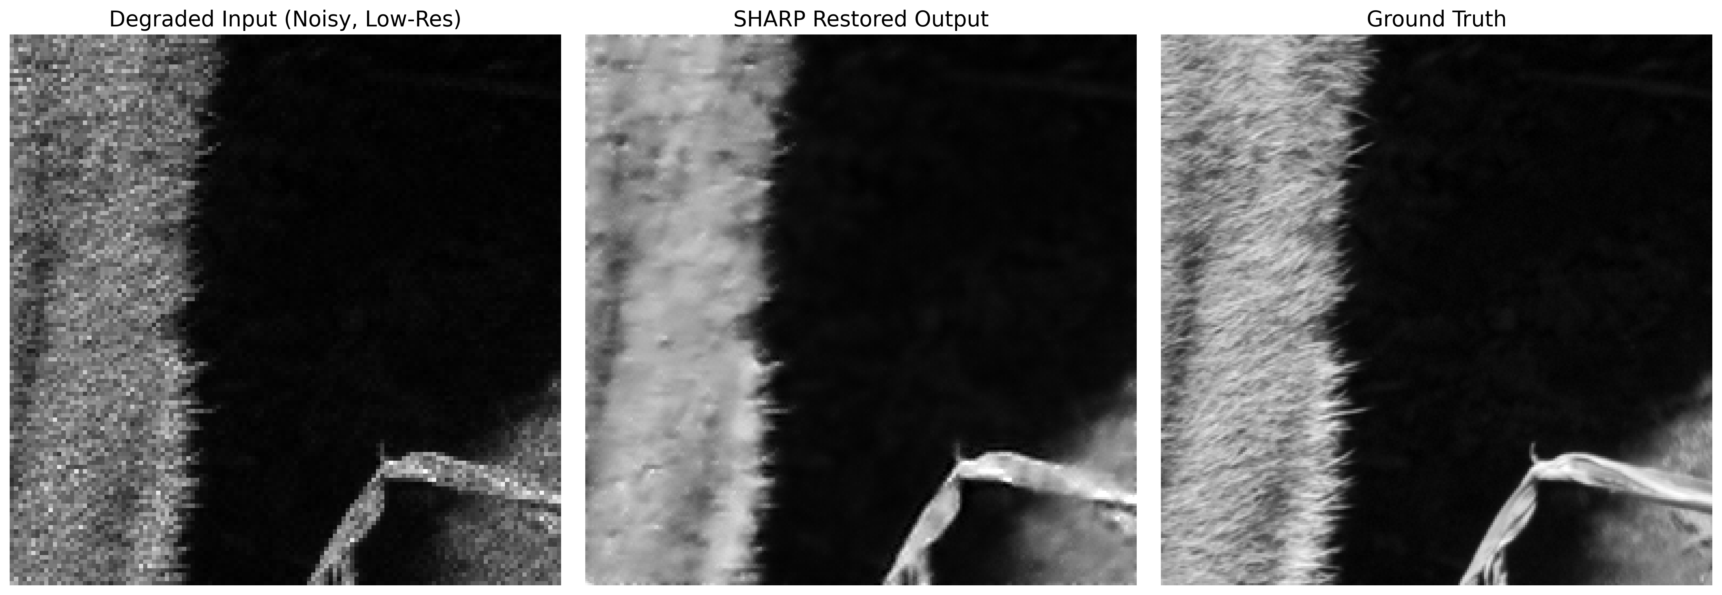
RESULTS
Our SHARP model achieved the following performance metrics across the test split:
Image Quality Metrics
Quantifiable Outcomes
• pSNR: 25.30 dB
• SSIM: 0.7054
• LPIPS: 0.4058
• True Positive Rate (Sensitivity): 43.8% recovery rate on sub-pixel defects.
• False Positive Nuisance Rate: Dropped to 97.4 per image.

Slide 8



Technology & Feasibility/Methodology Used
IMPLEMENTATION STRATEGY
• Tech Stack: Python 3.10+, PyTorch, PyYAML, SciPy (for the theoretical LoG defect evaluation baseline).
• Hardware Used: Google Colab (NVIDIA T4/A100 GPUs) for training.
• Training Time: ~20 minutes per 50 epochs (very fast to iterate).
• Model Size: Extremely lightweight at ~0.32M parameters (Well below the 3–8M hackathon constraint).
• Inference Time: ~175 ms per image on local CPU hardware. On the required H100 GPU architecture, batched inference latency will operate in the single-digit milliseconds.
Software Architecture
Hardware Components
Development Tools

Slide 9




GitHub & Video Link
GitHub Repository
{Paste your GitHub / Source Code Link here}
Prototype / Simulation Video
{Paste your Video Link here showing simulation or working prototype}

Slide 10


Research and References
Research Background & Methodology
• The Problem with Standard AI: Traditional L2/RMSE loss mathematically encourages models to output blurry, "safe" averages. In semiconductor inspection, this destroys the tiny, sub-pixel defects we are trying to find.
• Our Solution (Multi-Loss): We force the model to prioritize sharp edges over global smoothness by replacing L2 with a combination of FFT Magnitude Loss (for high frequencies) and Gradient Loss (for sharp structures).
• The Architecture: We process the image using a lightweight NAFNet architecture.
References & Citations
NAFNet: Chen, L., et al. (2022). Simple Baselines for Image Restoration.
CutBlur: Yoo, J., et al. (2020). Rethinking Data Augmentation for Image Super-resolution.
MS-SSIM: Wang, Z., et al. (2003). Multiscale structural similarity for image quality assessment.

