Slide 1


Slide 2
Team Introduction

Slide 3
Resume

Slide 4
Weapons

Slide 5
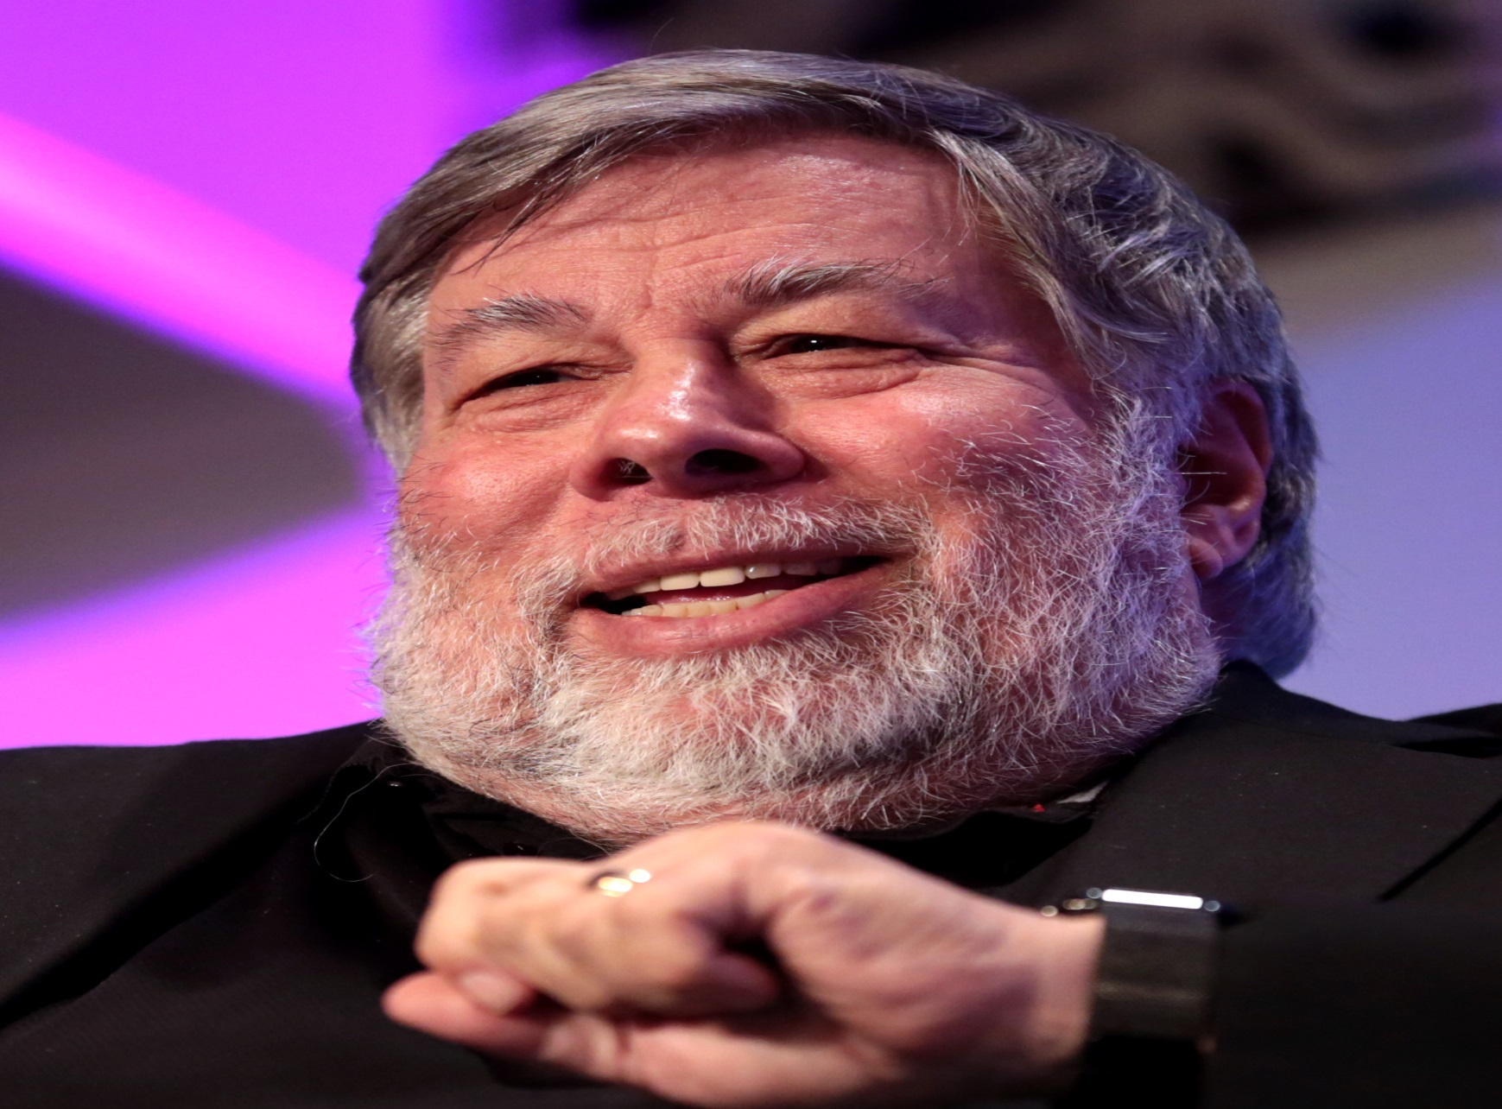
Story _ 1

Slide 6
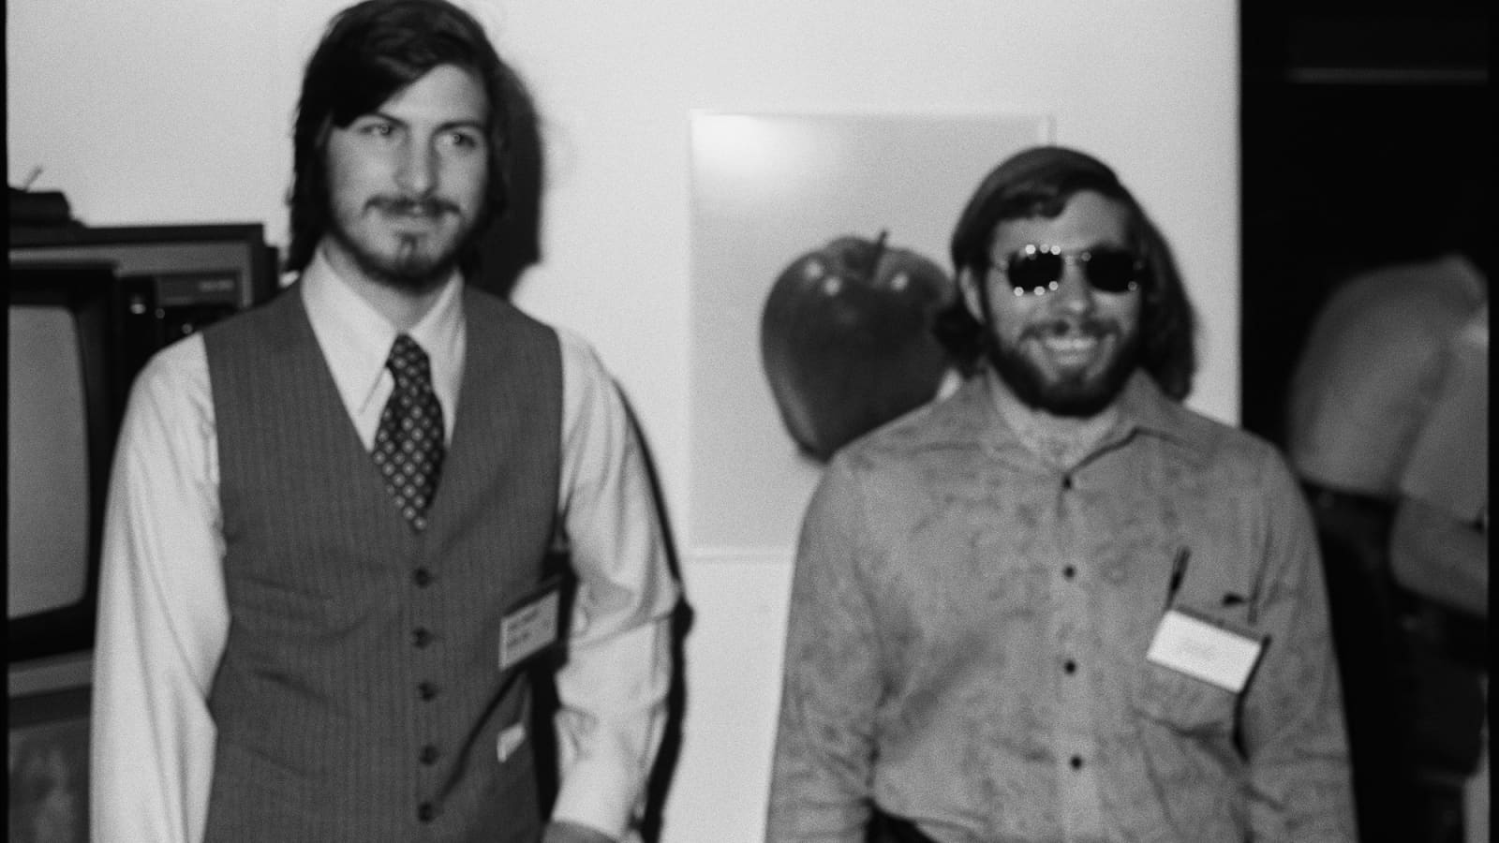

Story _ 1

Slide 7
Story _ 1: Steve Woznaik

Slide 8
Calculator

Slide 9
Computer
Programming Language
Python

Slide 10
There are magic boxs for you to help in accomplishing some tasks in data science
task_1(functionality_1) function_1
task_2(functionality_2) function_2
task_3(functionality_3) function_3
task_4(functionality_4) function_4
task_5(functionality_5) function_5
task_6(functionality_6) function_6
task_7(functionality_7) function_7
task_8(functionality_8) function_8
task_9(functionality_9) function_9
task_10(functionality_10) function_10
task_11(functionality_11) function_11
task_12(functionality_12) function_12

Slide 11
There are magic boxs for you to help in accomplishing some tasks in data science
task_1(functionality_1) function_1
task_2(functionality_2) function_2
task_3(functionality_3) function_3
task_4(functionality_4) function_4
task_5(functionality_5) function_5
task_6(functionality_6) function_6
task_7(functionality_7) function_7
task_8(functionality_8) function_8
task_9(functionality_9) function_9
task_10(functionality_10) function_10
task_11(functionality_11) function_11
task_12(functionality_12) function_12
These are present inside the magic box(these magic boxes are package or library)

Slide 12
Organised Structure
class_1
function_1
function_2
function_3
class_2
function_4
function_5
function_6
class_3
function_7
function_8
function_9
class_4
function_10
function_11
function_12

Slide 13
Organised Structure
module_1
class_1
function_1
function_2
function_3
class_2
function_4
function_5
function_6
module_2
class_3
function_7
function_8
function_9
class_4
function_10
function_11
function_12

Slide 14
Organised Structure
package/library
library
module_1
class_1
function_1
function_2
function_3
class_2
function_4
function_5
function_6
module_2
class_3
function_7
function_8
function_9
class_4
function_10
function_11
function_12

Slide 15
Package
Package: sklearn
Modules:preprocessing,feature_selection,ensemble,tree,cluster,model_selection,metrics
Classes:Imputer,SelectKBest,RandomForestClassifier,GridSearchCV,accuracy_score

Slide 16
Package
Packages (library):
pandas, numpy, tensorflow, keras, sklearn, matplotlib, seaborn, dash, plotly, nltk,
Spacy, Hugging Face, Standford Core NLP, Pytorch, OpenCV, Grapviz, Pydotplus,teradatasql,sqllite
Categorising packages based on our usage
Machine Learning:
Sklearn, pandas, numpy
Python Visualaisation:
matplotlib, seaborn, dash, plotly
Deep Learning:
Tensorflow, keras, Pytorch
Natural Language Processing
Nltk, Spacy, Hugging Face, Stonford Core NLP

