Slide 1
Employee Payroll Management
TEAM :
1)Ammepalli Sudarshan 6)Anugu Srikanth Reddy
2)Anamika Dwivedi 7)Arnab Roy
3)Anand 8)Arshi X
4)Ankita Vijay Awasarmol 9)Arvind X
5)Anmol Binjwe 10)Ashish Kumar

Slide 2
Introduction of our app
Payroll management process is very essential in any of the concern which consist of more than one employee. Moreover, it is a requirement for compliance with federal and state laws. Payroll management process refers to the administration of an employee’s financial records which includes the salaries, wages, bonuses, deductions and net pay. That record should be maintained for the federal requirements in future. In recent days there are various automated software’s are available to maintain the payroll management process it will reduce the manual work.

Slide 3
Literature Survey
According to” steven m. bragg” (2011), payroll management is designed for both professional accounts and students. since both can benefit from its detailed descriptions of payroll systems, control, procedures and regulation.
According to chetan wain (2014), payroll being the most vital part of hr generalist have maximum number of jobs to offer and make enable them to handle payroll calculation of employees independently.

Slide 4
Tools and Technologies
Front-End: Angular
Server-side: Spring Boot.
Back-end: MYSQL, Hibernate.
Server: Tomcat

Slide 5
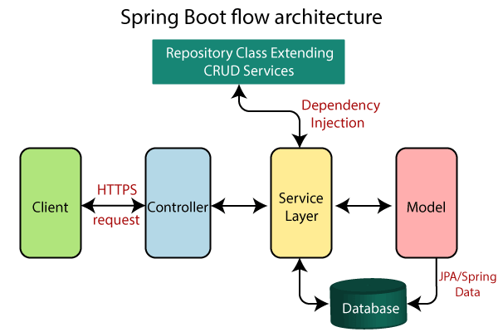
Spring Boot Flow Architecture

Slide 6
Design
Register Admin to the web.
Login to the web page.
Admin can add the details of the employee. The web uses our backend data. Check the Database, search the suitable details of the employees, or can add, delete, update the details to the database.
Admin can assign the project details to the employee with the start date to the end date.
All the data is storing to the backend for the better security.

Slide 7
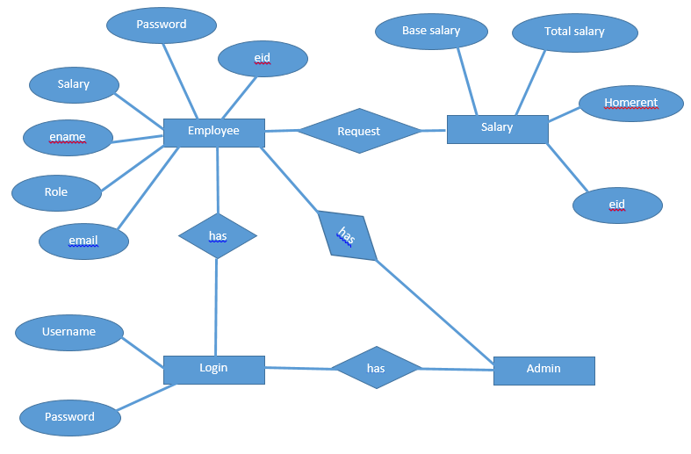
ER Diagram

Slide 8
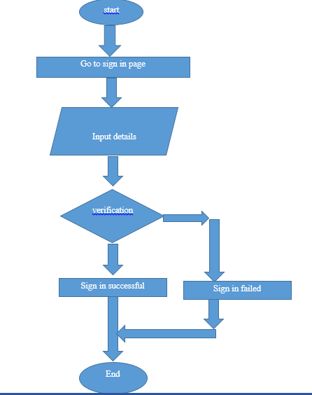
Code Flow 1)sign in

Slide 9
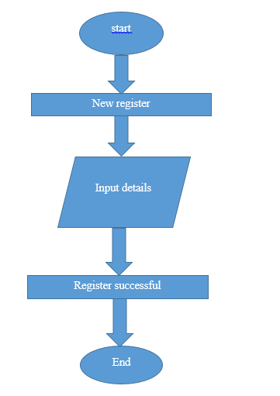
Code Flow 1)New register

Slide 10
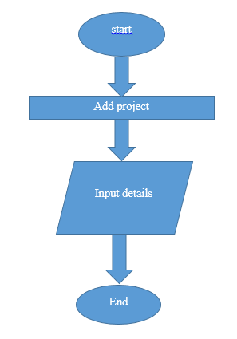
Code Flow 1)Add project

Slide 11
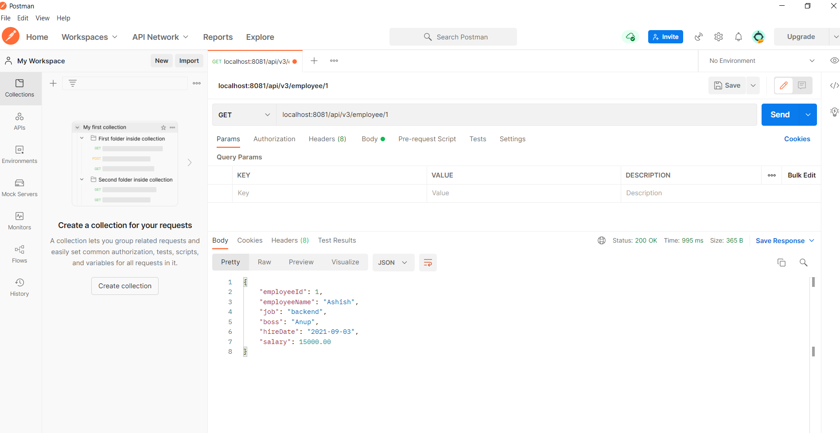
Output (Back-End-API)

Slide 12
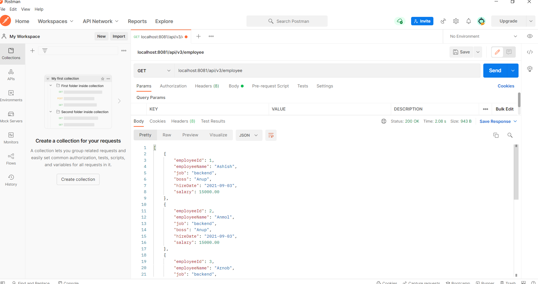

Slide 13
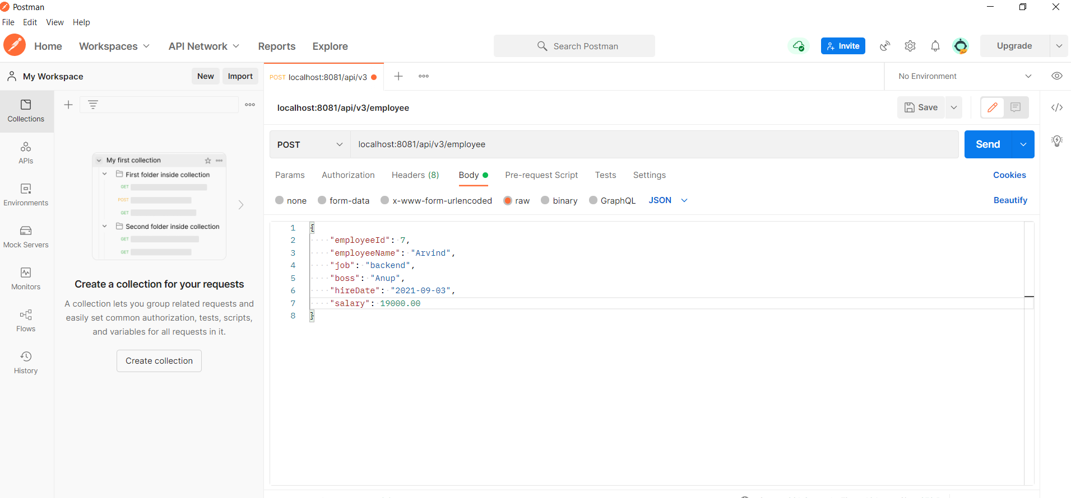

Slide 14
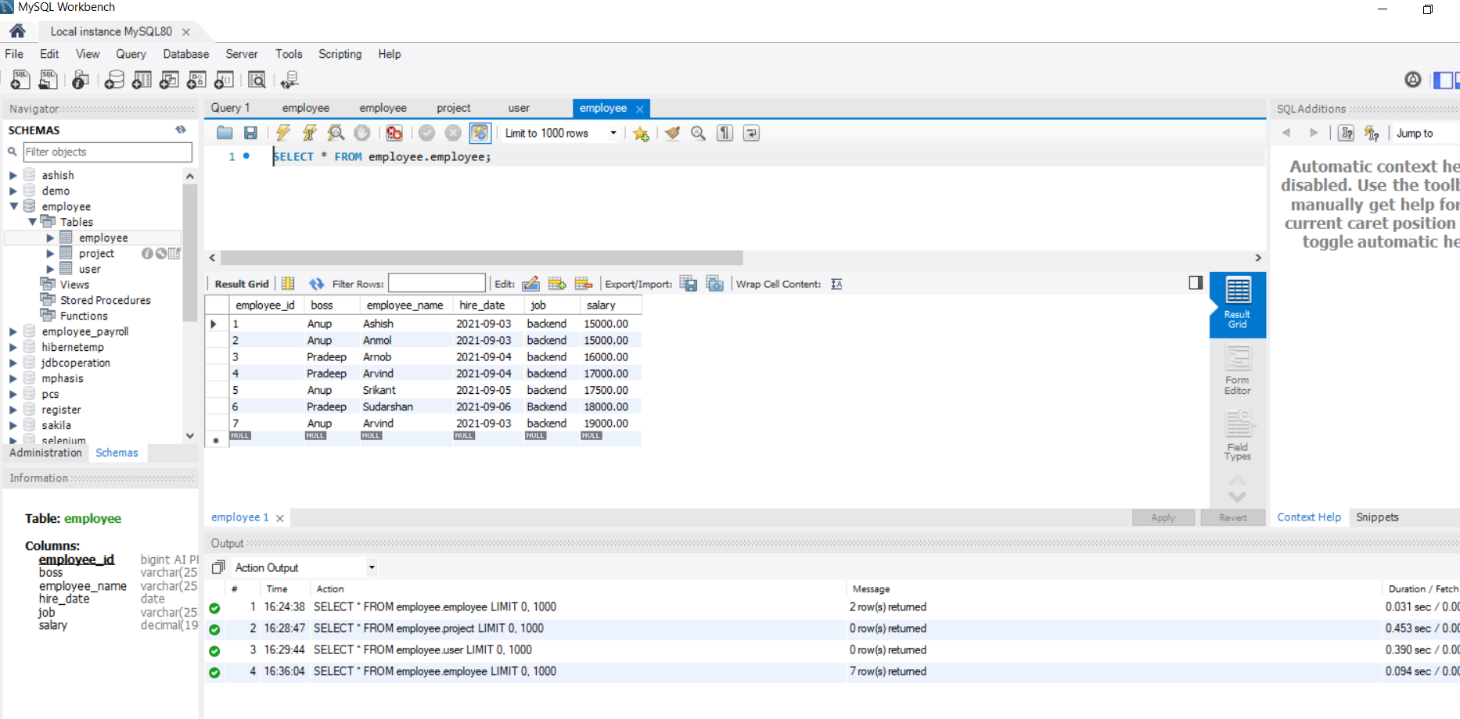

Slide 15
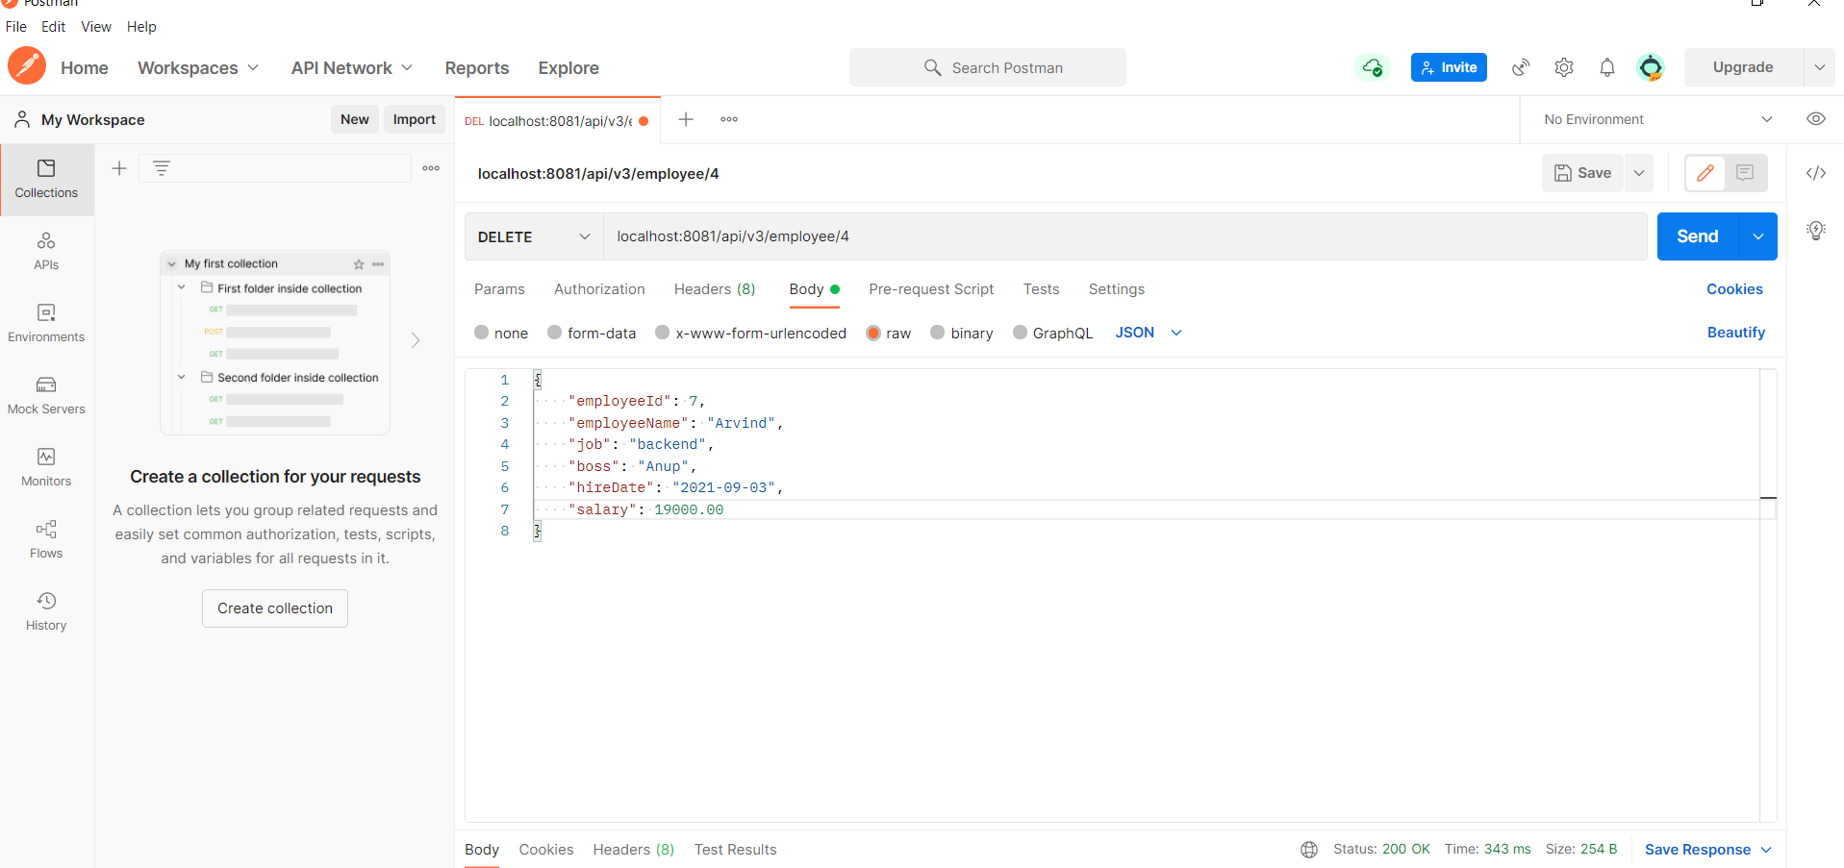

Slide 16
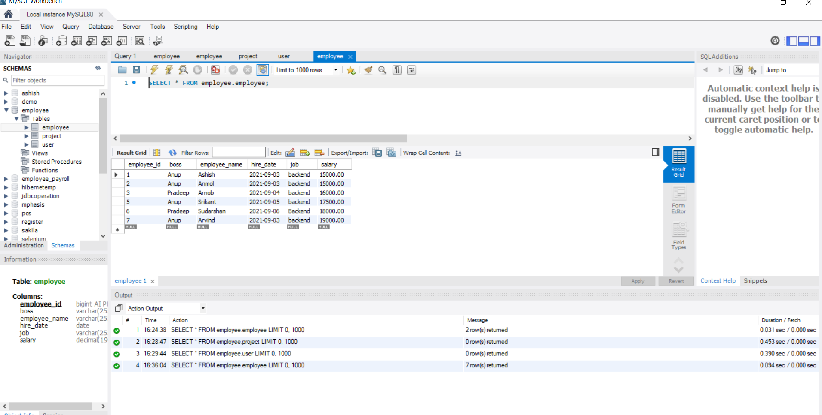

Slide 17
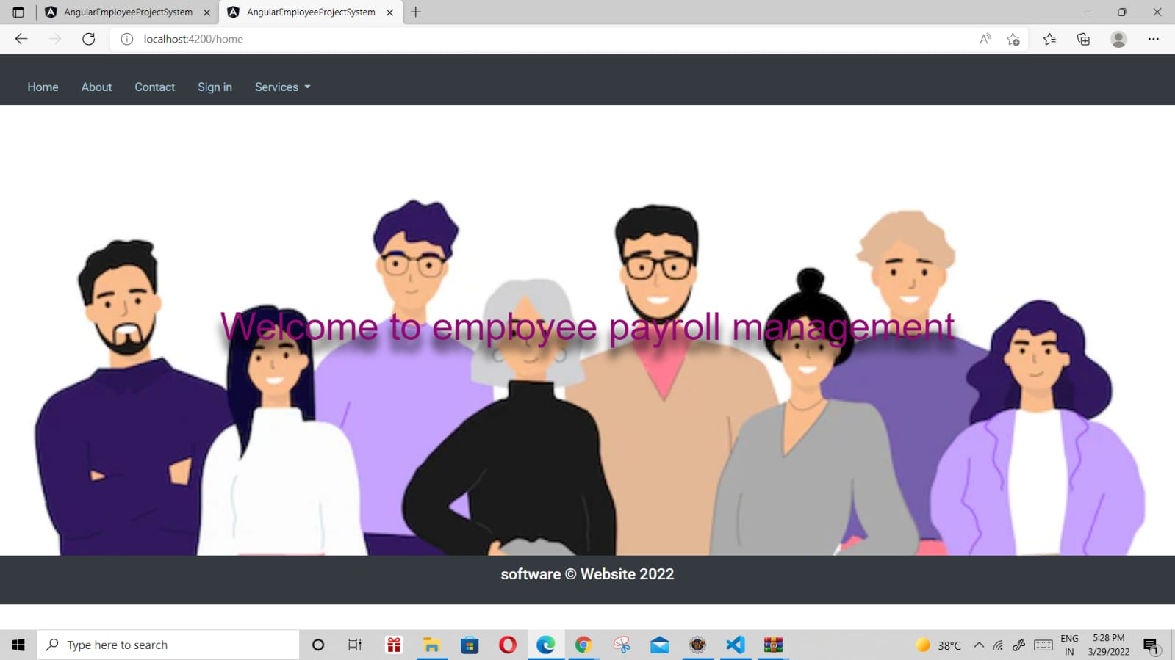
Output of website

Slide 18


Slide 19


Slide 20
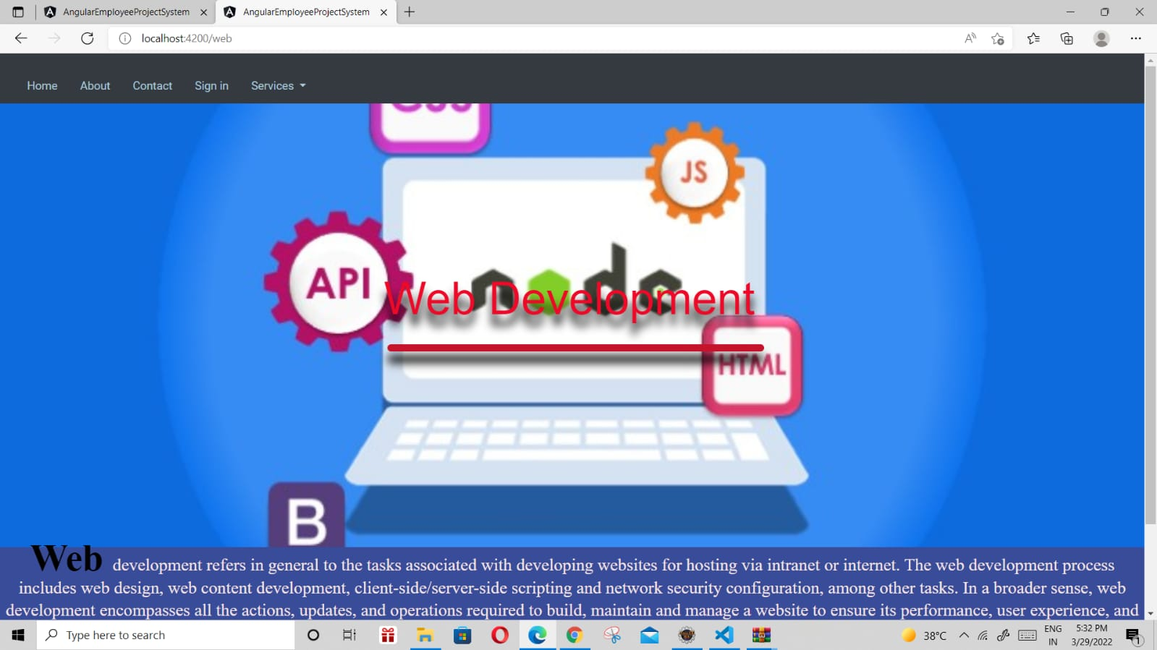

Slide 21
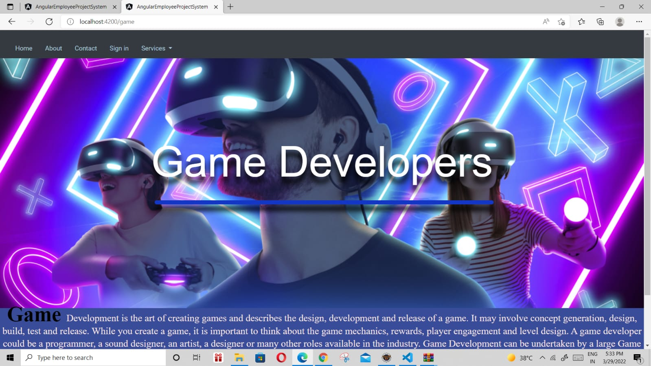

Slide 22
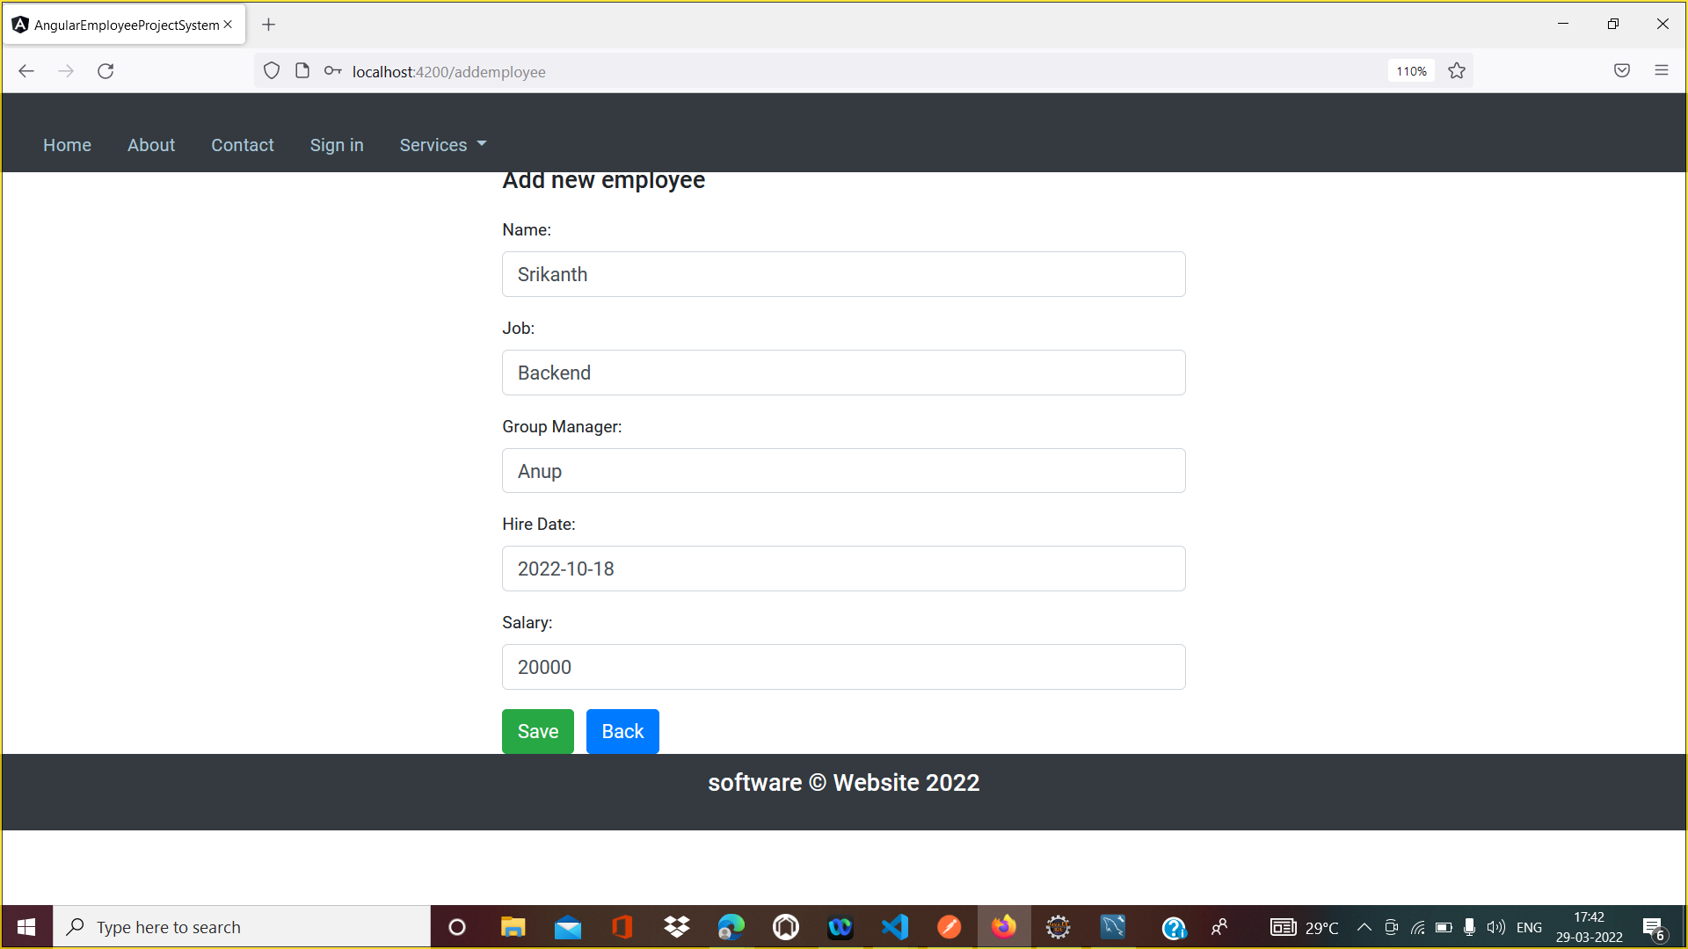

Slide 23
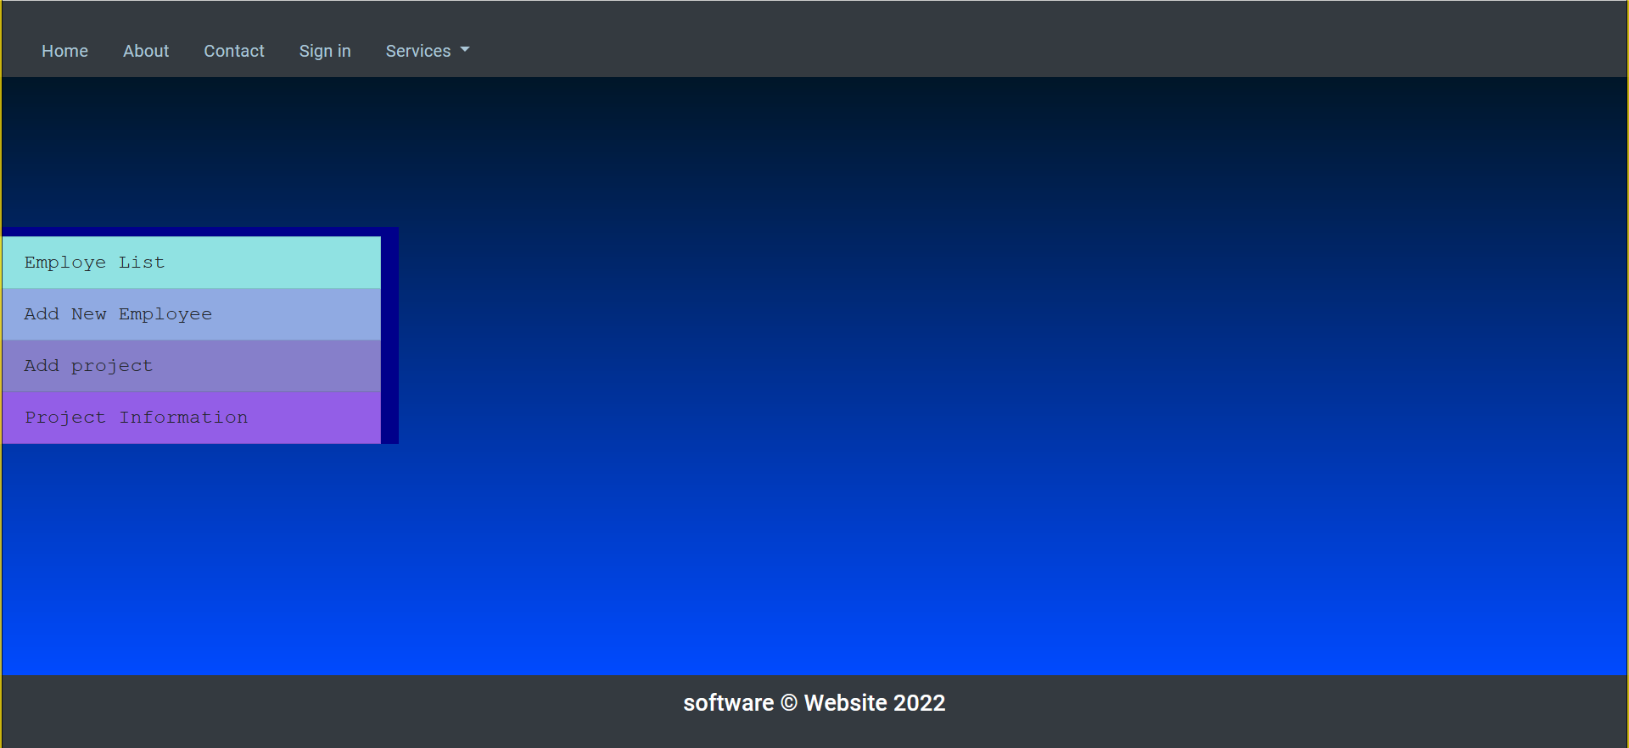

Slide 24
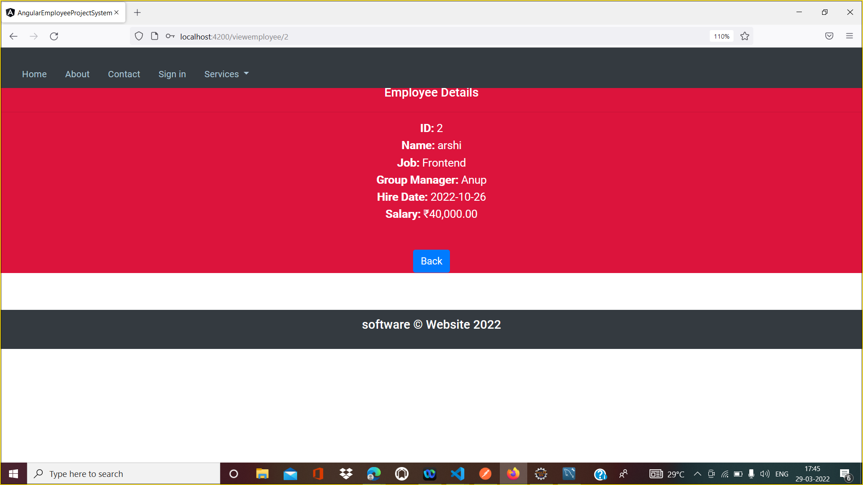

Slide 25
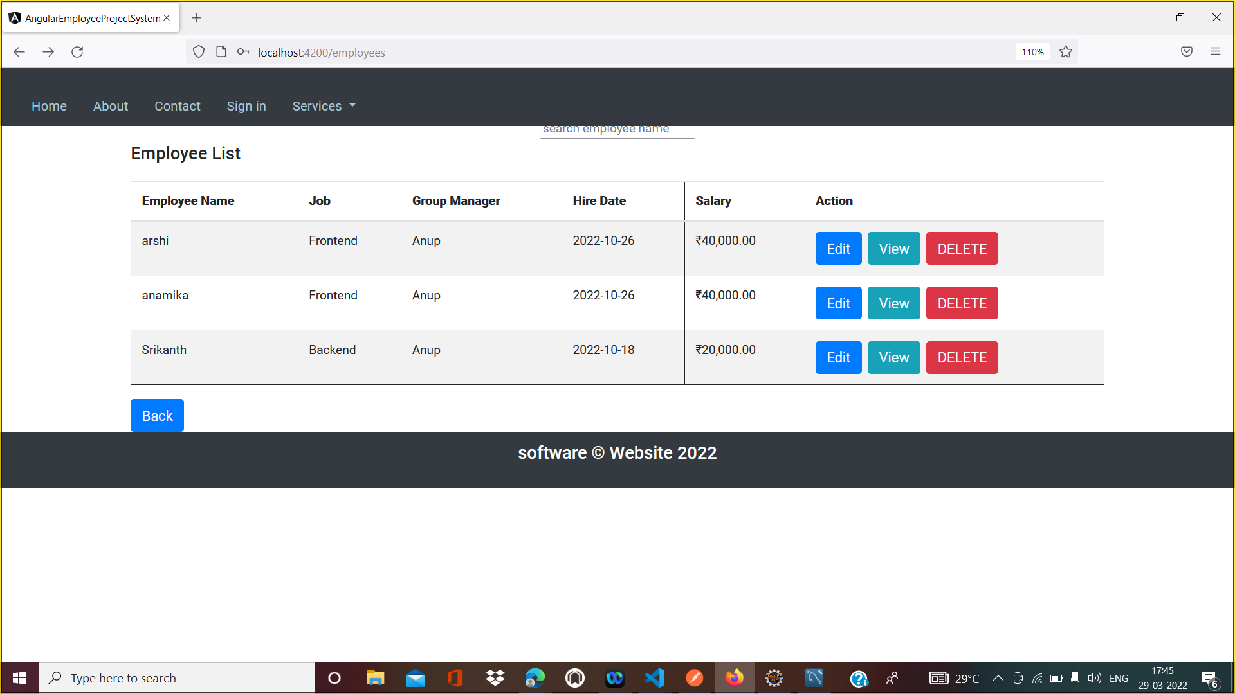

Slide 26
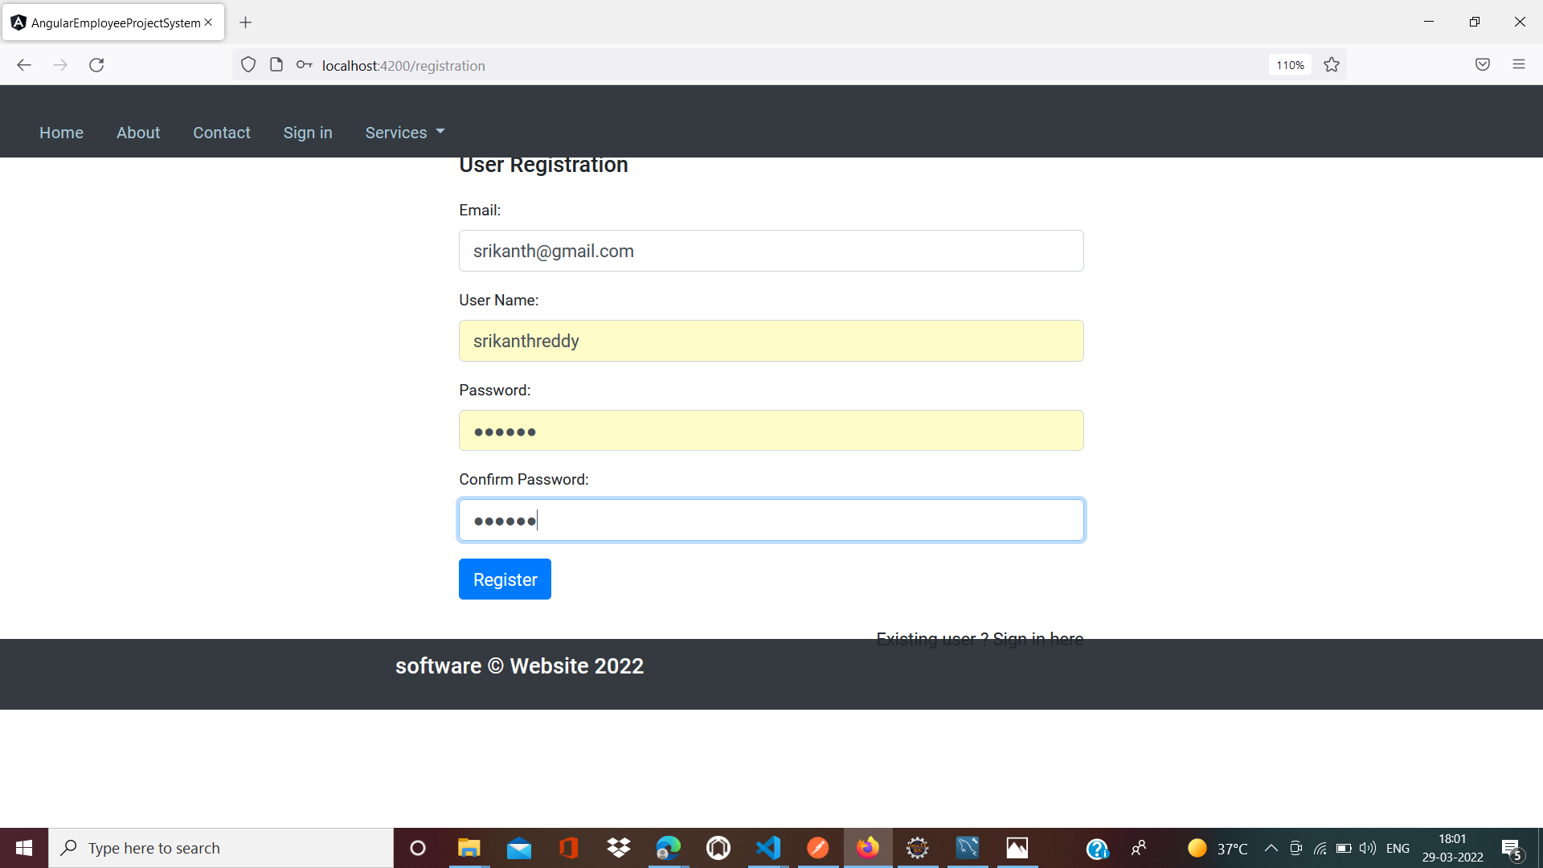

Slide 27
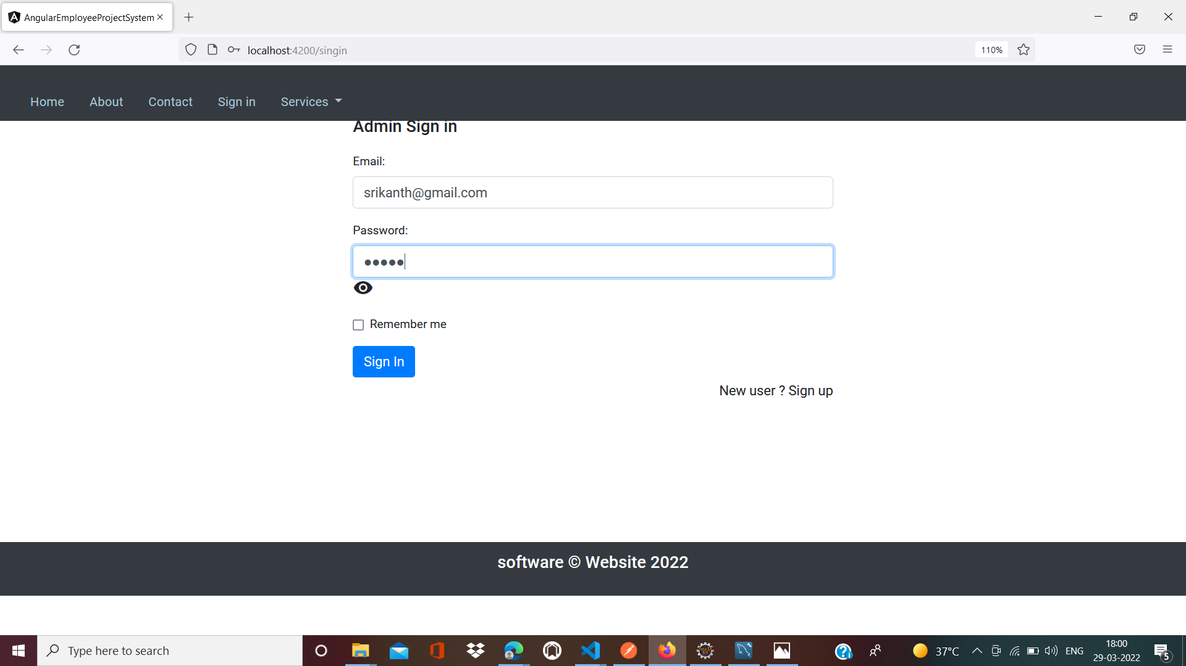

Slide 28
Thank you for the opportunity!

