Slide 1

Application Of Information Technology in Accounting
BY
ARSHIYA BEGUM
2013H149026U

Slide 2

Agenda
Introduction
Accounting Information System
Objectives of the Study
Proposed Project Design
Methodology
Mile Stones – Work Accomplished
Project Progress Report
Conclusion

Slide 3

Introduction
What is Accounting?
  Accounting refers to the process of summarizing, analysing and reporting financial transactions.
  Accounting information is maintained in the form of financial statements such as Balance Sheet, Income Statement, Cash flow statements etc.
  All businesses ranging from SME’s to MNC’s have accounting process incorporated in their organizations.
Information Technology
  Information technology can be briefly defined as using computers and telecommunication systems to store and share information.
  Businesses use information technology to automate many kinds of tasks, which can save both time and money.
  Businesses who successfully automate can then use that time and money
  for other business purposes.

Slide 4
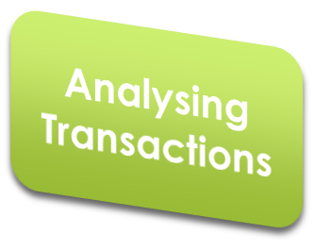

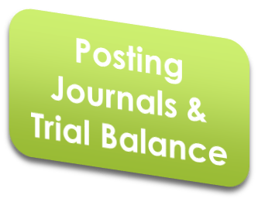
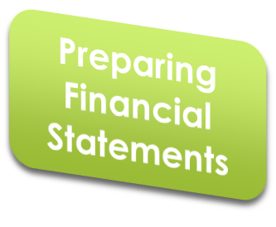



Accounting Information System
AIS is the whole of the related software and hardware components that are put together to collect information, raw data or ordinary data and transform them into financial data for the purpose of reporting them to decision makers.
In one of the study AIS is interpreted as below:
Present Account Information Systems require the first 2 stages Analysing transactions, Recording transactions to be manually intervened by the accountants
The accountant needs to Analyze the transactions and record their effects. Major computations are left to the computer.

Slide 5
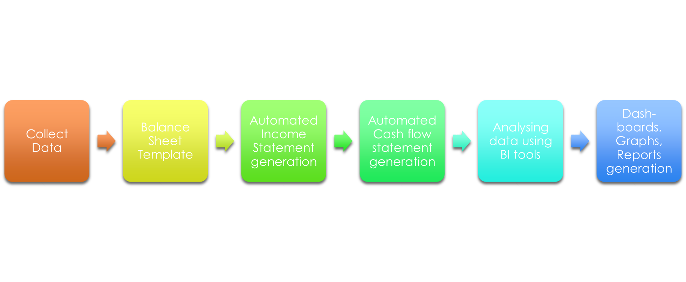
Proposed Accounting Information System Design

Slide 6

Objective of the Study
The objective of this project is to determine the application of different information technology applications in effective maintenance of accounting information and using accounting knowledge for decision making process.

Slide 7

Project Design & Overview
Stage 1 – Literature Review
Stage 2 – Project Design
Stage 3 – Balance Sheet Preparation & Data Validation Using Excel
Stage 4 – Software Program to generate Income Statement
Stage 5 – Software Program to generate Cash flow statement
Stage 6 – Tableau BI tool for analysis of the financial information.

Slide 8
Methodology
Microsoft Excel
Start
Balance Sheet Excel Template
Output Balanced Sheet
Python Code
Tableau BI tool
Python Code for automation
Analysing Financial Information
Cash Flow
Statement
Income Statement
Dash-boards, Graphs, Weekly reports etc..

Slide 9


Mile-Stones : Work Accomplished
Work Completed
Work In Progress
Work to be done

Slide 10
Project Progress Report
Key Achievements
Literature Review Balance Sheet Template Design Balance Sheet Template development Python Program for Income Statement generation design Program Code and Output
Project Metrics
Scope |  | Overall Status:
Schedule
Risk
Quality
Resources
S
I
M
S
S
Activities Planned This Month
Python Code to generate Cash flow statement design Program Coding Testing
S
Mile-Stones | Schedule Date | Target Date | Status
Literature Review | 20/10/2015 | 27/10/2015
Balance Sheet Template | 27/09/2015 | 30/09/2015
Income Statement Program | 08/10/2015 | 17/10/2015
Cash Flow Statement Program | 26/11/2015
Tableau Analysis | 31/11/2015
Dash-boards, Reports generation | 12/12/2015
Documentation | 27/12/2015
Assumptions
Balance Sheet template provides basic rules for data validation but the user should have due diligence to enter in balanced manner. Input for BI tool should be a journal
Legends Used : | Major Issues - | Some Issues - | Satisfactory -
M
I
S

Slide 11

Conclusion
The project is intended to identify the capability of information technology in the accounting field. The project focuses on to establish a reliable connection between the information technology and the organization accounting department to enhance the organizations performance through automation.

Slide 12


