Slide 1

Application of Information Technology in Accounting
By
ARSHIYA BEGUM
2013H149026U

Slide 2

Agenda
Introduction
Background
Problem Statement
Objective
Literature review overview
Proposed System
Approach
Future Scope
Conclusion
References

Slide 3

Introduction
What is Accounting?
  Accounting refers to the process of summarizing, analysing and reporting financial transactions.
  Accounting information is maintained in the form of financial statements such as Balance Sheet, Income Statement, Cash flow statements etc.
  All businesses ranging from SME’s to MNC’s have accounting process incorporated in their organizations.
Information Technology
  Information technology can be briefly defined as using computers and telecommunication systems to store and share information.
  Businesses use information technology to automate many kinds of tasks, which can save both time and money.
  Businesses who successfully automate can then use that time and money for other business purposes.

Slide 4
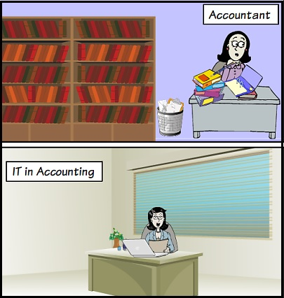

Slide 5

Why Accounting needs IT?
Speed
Accuracy
Flexibility
Book Keeping & Storage
Information Accessibility
Security & Authorization
Up to date information
Easy maintenance and management of information
Improved Quality
Cost reduction in long run

Slide 6

Background
The advancement in technology has opened up the possibility of generating and using accounting information for organizations performance and profitability.
AIS is the whole of the related components that are put together to collect information, raw data or ordinary data and transform them into financial data for the purpose of reporting them to decision makers.
Incorporating AIS in the organizations process, an organization can achieve
  Better adaptation to the dynamic changing environment
  Optimal utilization of resources
  Greater flow of information internal and external to the organization
  High automation of accounting process

Slide 7

Problem Statement
Lack of awareness and understanding of technology suitable for organization to be adapted in accounting.
Choosing efficient and effective BI tools for analysing and reporting of financial statements.
Lack of validation of accounting entries.

Slide 8

Objective
To examine and review the potentials of application of IT in accounting.
To assess the pros and cons of adoption of IT in accounting to the organizations.
To reduce manual intervention of accounting process.
To study BI tools for analysing accounting statements for effective decision making

Slide 9

Literature Review Overview
Different of AIS ranging at different complexity level will have different impact on an organizations overall performance.
  AIS need not be too complex to achieve efficient output
The degree of accuracy of the AIS output may have impact on the decision making process in an organization there by affecting the conflicts between the principals and agents of an organization
  Accurate information can enhance decision making process of an organization there by reducing conflicts in organization.
Financial managers use AIS output to evaluate the firm’s past performance and to map future plans.
  AIS must be capable of analysing present data
  for projecting data for future use.
Effectiveness of output of AIS completely depends on
the input data quality provided to the AIS.
  Input data quality has direct impact on the output
  of the AIS.

Slide 10
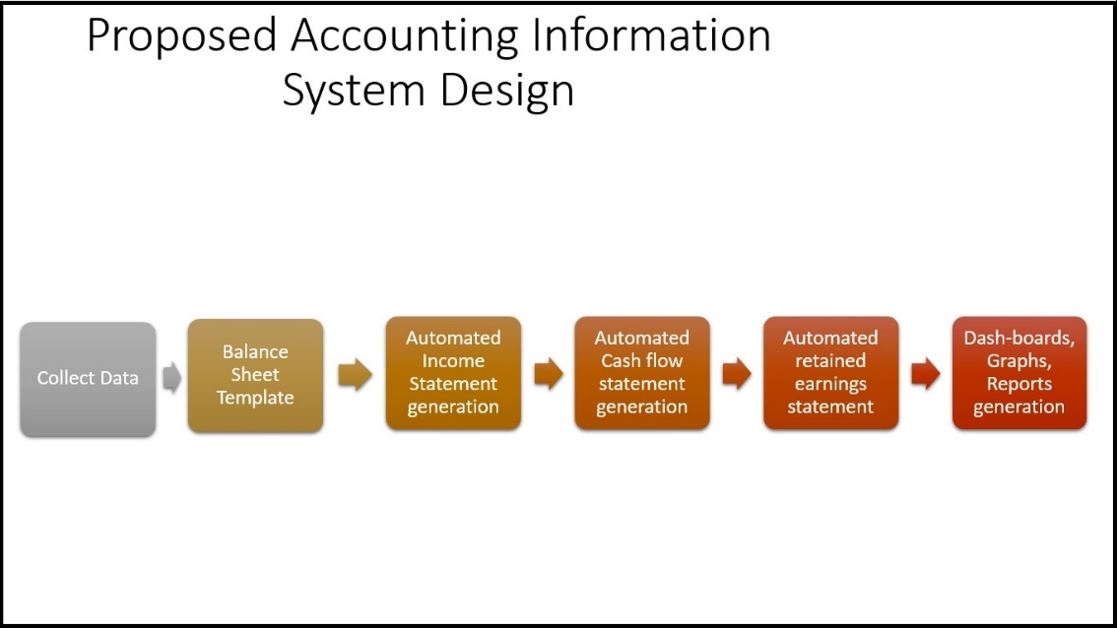
Proposed System

Slide 11
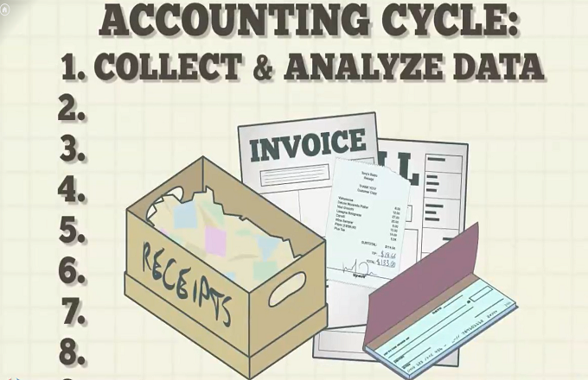
AIS System Design & Approach

Slide 12
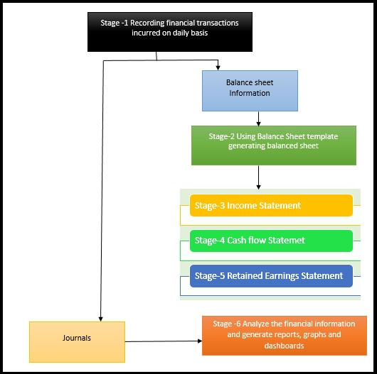
AIS System Design

Slide 13
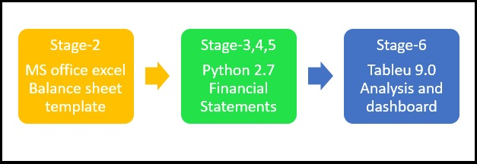
AIS System Approach

Slide 14
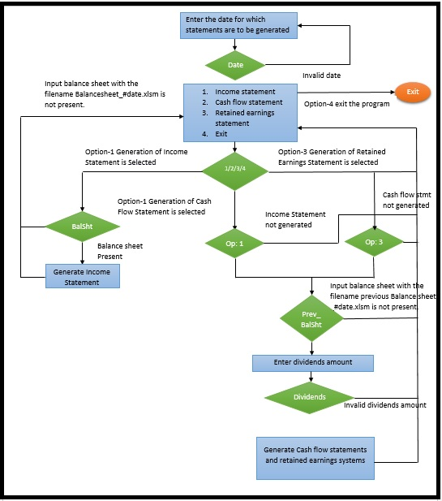

Slide 15
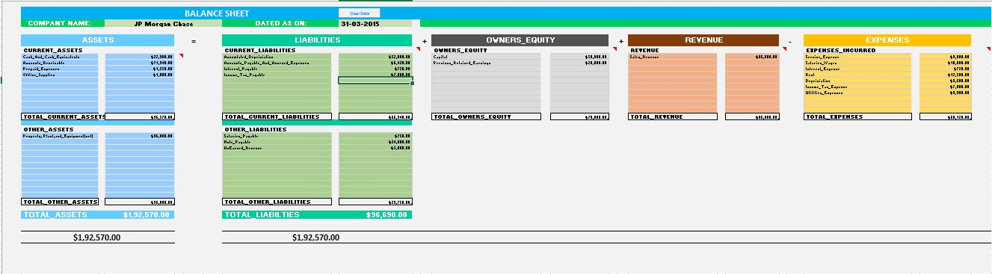
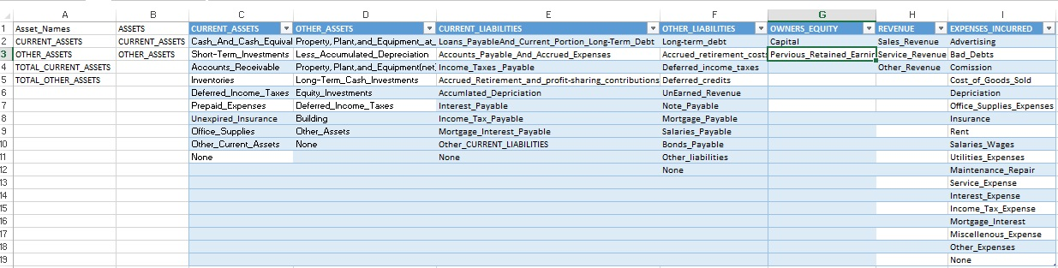
Step-1 Balance Sheet Template

Slide 16
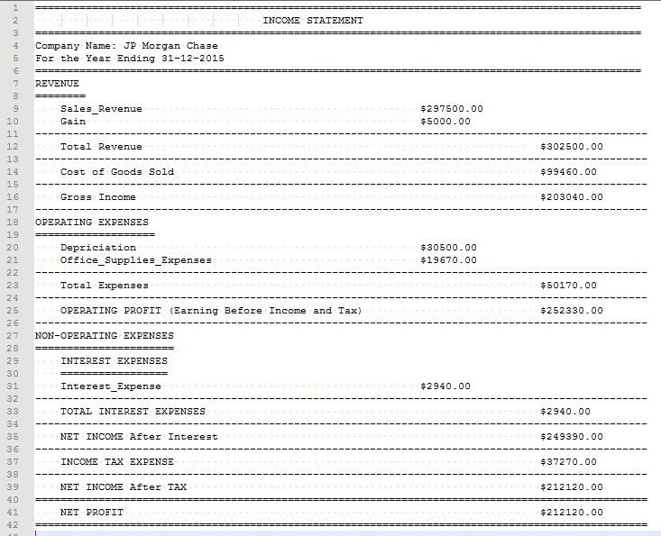
Step-2 Generating Financial Statements
Income Statement

Slide 17
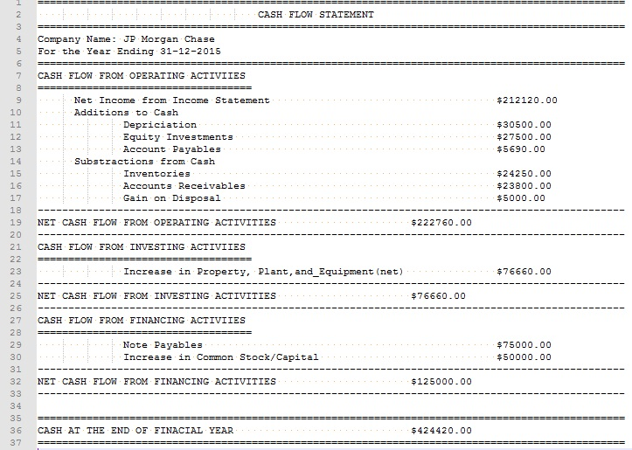
Step-2 Generating Financial Statements
Cash Flow Statement

Slide 18
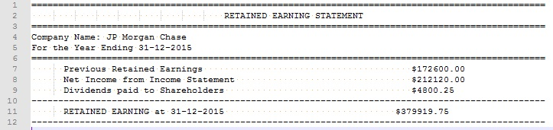
Step-2 Generating Financial Statements
Retained Earnings Statement

Slide 19
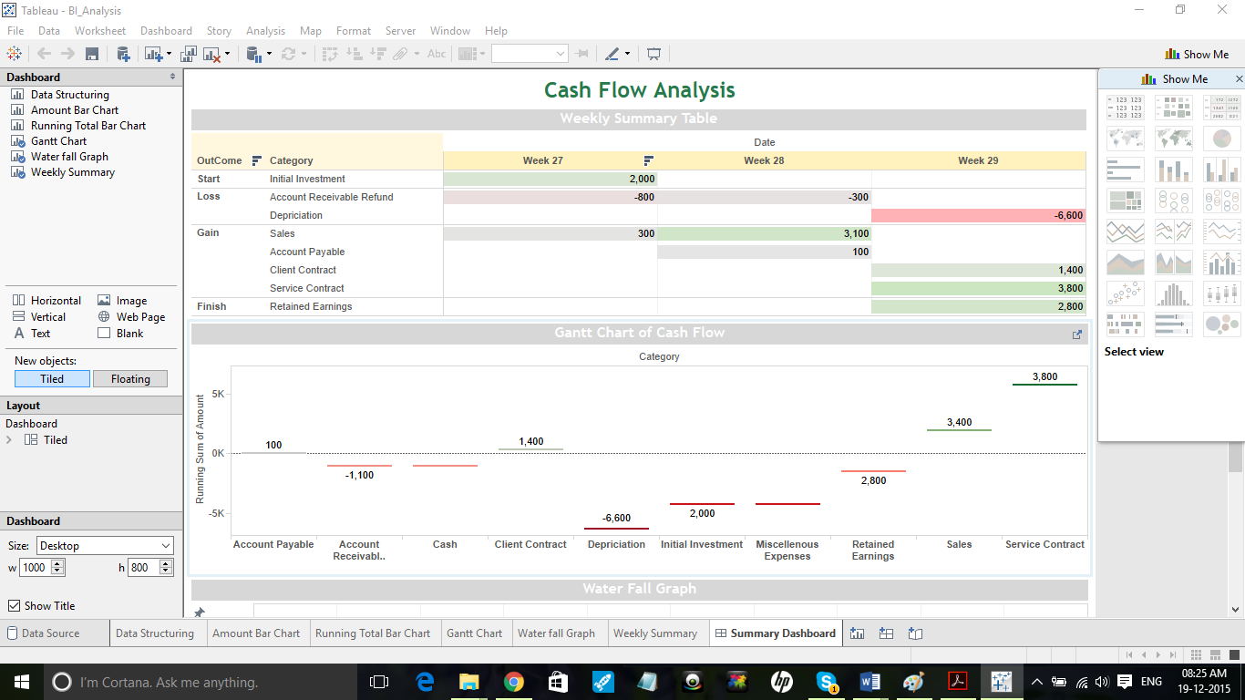
Step-3 BI Analysis

Slide 20

Future Scope
Though the proposed AIS is extensively worked upon there are many more future enhancement opportunities. Few identified research opportunities are:
  The manual intervention of collecting financial information with respect to the transactions occurred in the organization may not be totally removed but can be minimized to a greater extent.
  In this system balance sheet validation with few advanced features are handled but generation of balance sheet can also be automated if the collection is automated in a proper desirable format.
  Automation of not only generating financial statements but also enhancing it to provide possible financial ratios
  Tableau features can be further explored to get even more analysed and processed information so that management task can be further minimised.

Slide 21

Conclusion
The aim of this project was intended to identify the capability of information technology in the accounting field.
The project focuses on establishment of a reliable connection between the information technology and the organization accounting department to enhance the organizations performance through automation and business intelligence analysis of the financial statements to enable and offer extended capability with respect to the decision making process ultimately leading to organization profitability and reduction of opportunity cost over other equally competitive organizations in the market.

Slide 22
References
Francis Pol C. (2013); “Impact of Information Technology on Accounting Systems”
Shirzad Amiri , Nikzad Amiri ;“Information Technology (IT) and its Role in Accounting Practice”
M. Krishna Moorthy, Ong Oi Voon, Cik Azni Suhaily Binti Samsuri, M. Gopalan, King-Tak Yew; “Application of Information Technology in Management Accounting Decision Making “
James A.Hall, 8th edition “Accounting Information System”
Josepa Alemany i Costa, “Accounting: An Information System for Organizations “
Rom, A. and Rohde, C. (2007); Management accounting and integrated information systems: A literature review, International Journal of Accounting Information Systems
Accounting Information Systems, 9e Ulric J. Gelinas, Jr., Richard B. Dull, and Patrick R. Wheeler

Slide 23


