Slide 1

Application of IT in Accounting
By
Arshiya Begum
2013H149026U

Slide 2

Agenda
Introduction
Background
Problem Statement
Objectives
Scope
Plan of Work
References

Slide 3


Introduction
Accounting has been practiced since 8500 BC till today and there are not many changes to the way accounts are maintained. However, IT is changing fast and changing every day.
The relationship between IT and accounting:
  IT in accounting can simplify the calculation process.
  Better presentable options of the business data for effective decision making.
  Improve accounting efficiency by producing result effortlessly, timely and accurately.
  Reduces book keeping.

Slide 4
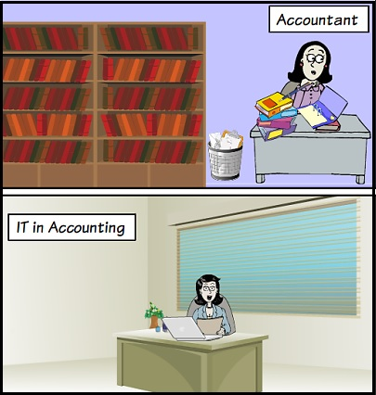

Slide 5

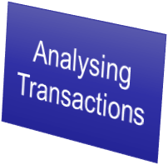
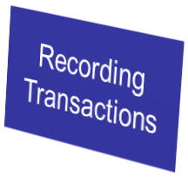
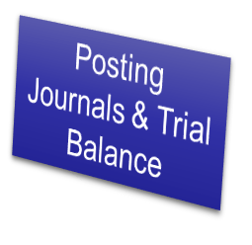
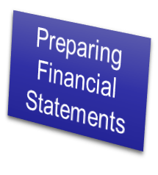


Background
Accounting Information System:
An accounting information system is generally a computer-based method for tracking accounting activity in conjunction with information technology resources.
Steps Involved:

Slide 6

Present Scenario
Present Account Information Systems require the first 2 stages Analysing transactions, Recording transactions to be manually intervened by the accountants
The accountant needs to Analyze the transactions and record their effects. Major computations are left to the computer.
Manually entries need to be validated.

Slide 7
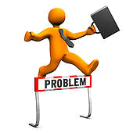
Problem Statement
Lack of awareness and understanding of technology suitable for organization to be adapted in accounting.
Choosing efficient and effective BI tools for analysing and reporting of financial statements.
Lack of validation of accounting entries.

Slide 8

Objectives
To examine and review the potentials of application of IT in accounting.
To assess the pros and cons of adoption of IT in accounting to the organizations.
To reduce manual intervention of accounting process.
To study BI tools for analysing accounting statements for effective decision making

Slide 9

Scope
Automation of validation of the accounting data.
Study and usage of BI tool for analysis of accounting data for preparing reports and dashboards

Slide 10
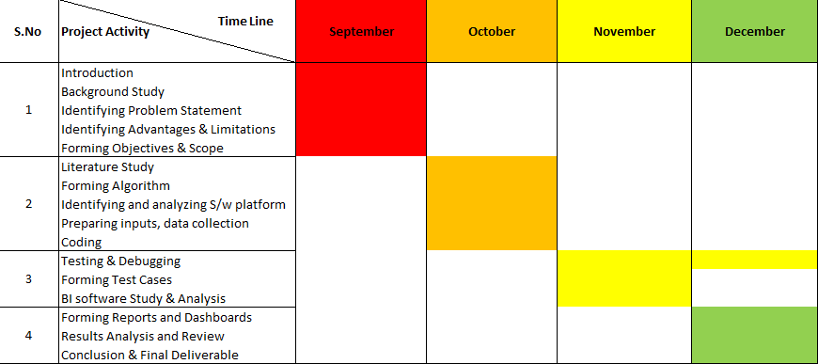

Plan of Work

Slide 11

References
Francis Pol C. (2013); “Impact of Information Technology on Accounting Systems”
Shirzad Amiri , Nikzad Amiri ;“Information Technology (IT) and its Role in Accounting Practice”
M. Krishna Moorthy, Ong Oi Voon, Cik Azni Suhaily Binti Samsuri, M. Gopalan, King-Tak Yew; “Application of Information Technology in Management Accounting Decision Making “
James A.Hall, 8th edition “Accounting Information System”
Josepa Alemany i Costa, “Accounting: An Information System for Organizations “
Rom, A. and Rohde, C. (2007); Management accounting and integrated information systems: A literature review, International Journal of Accounting Information Systems
Accounting Information Systems, 9e Ulric J. Gelinas, Jr., Richard B. Dull, and Patrick R. Wheeler

Slide 12


