Slide 1
Prediction and Recommendation System for Airbnb
Team Perceptrons
Manisha Shivshette
Arshiya Pathan
Tarun Arora

Slide 2
Dataset
Review Details (802k records)
Calendar Details(16.2M records)
Size of Dataset: 910.7MB
Problems Addressed
How to interpret text review ?
Which listings should be recommended to user?
What should be optimum price of listing to increase profit ?

Slide 3
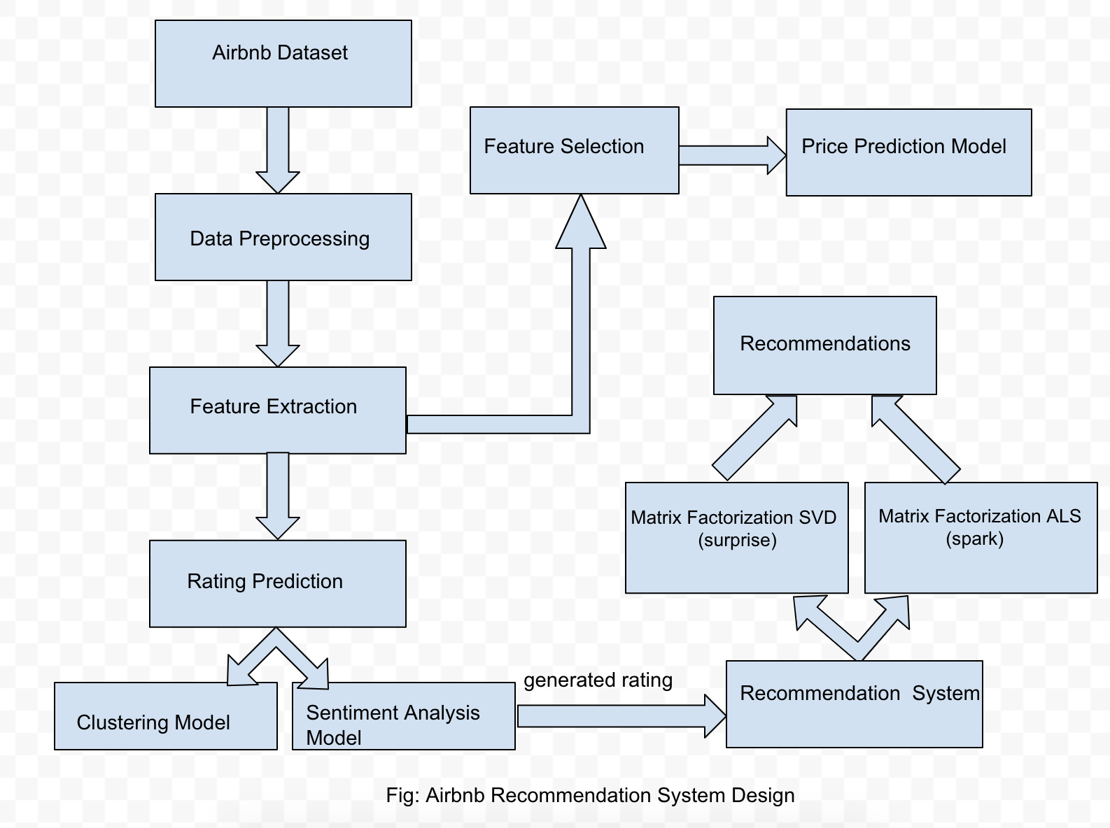
System Design

Slide 4
Solutions
Rating Prediction
Rating Prediction using K-Means Clustering
Create TF-IDF Matrix from input review comments
Generate Clusters of similar review comments
Identify the cluster containing maximum positive tokens
Replace the cluster label with the rating
Rating Prediction using Sentiment Analysis
Clean Review Comment text data
Using NLTK Sentiment analyzer generate polarity scores
Using positive and negative polarity scores, compute the rating

Slide 5
Solutions (Cont.)
Recommendation System
Approach 1 - Matrix factorization - SVD
Tuning the parameters using Grid search
Evaluate the model. Compare biased and unbiased accuracy.
Using K fold cross validation train the model.
Build the test set by considering users and all the listings which user has not given reviews for.
Approach 2 - Matrix factorization - Alternating Least Squares (ALS)
Train and tune the hyperparameters such as maximum iterations, rank and regularization parameter
Improve the performance score using k-fold cross validation
Test the model on test set and calculate RMSE.
Recommend top 3 listings to all users

Slide 6
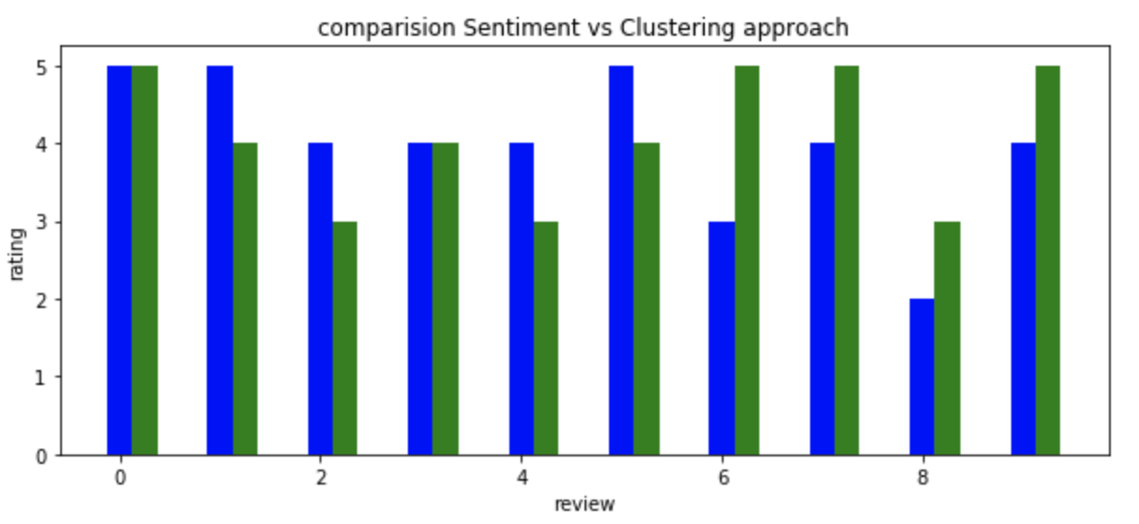
Analysis of Rating Prediction
blue: Sentiment Analysis green:Clustering
Fig:Comparative Evaluation
Advantages of Sentiment Analysis over Clustering approach
Scalable
Evaluates negative component i.e differentiates “good” from not “good”
Independent of review length

Slide 7
Analysis of Recommendation System
SVD
SVD gives better accuracy over ALS
RMSE for model using SVD is 0.85
Good for medium sized dataset.
Not suitable for very large and sparse dataset
ALS (Spark)
Good for recommendations using large and sparse dataset.
Accuracy is not as good as SVD.
RMSE is 2.1

Slide 8
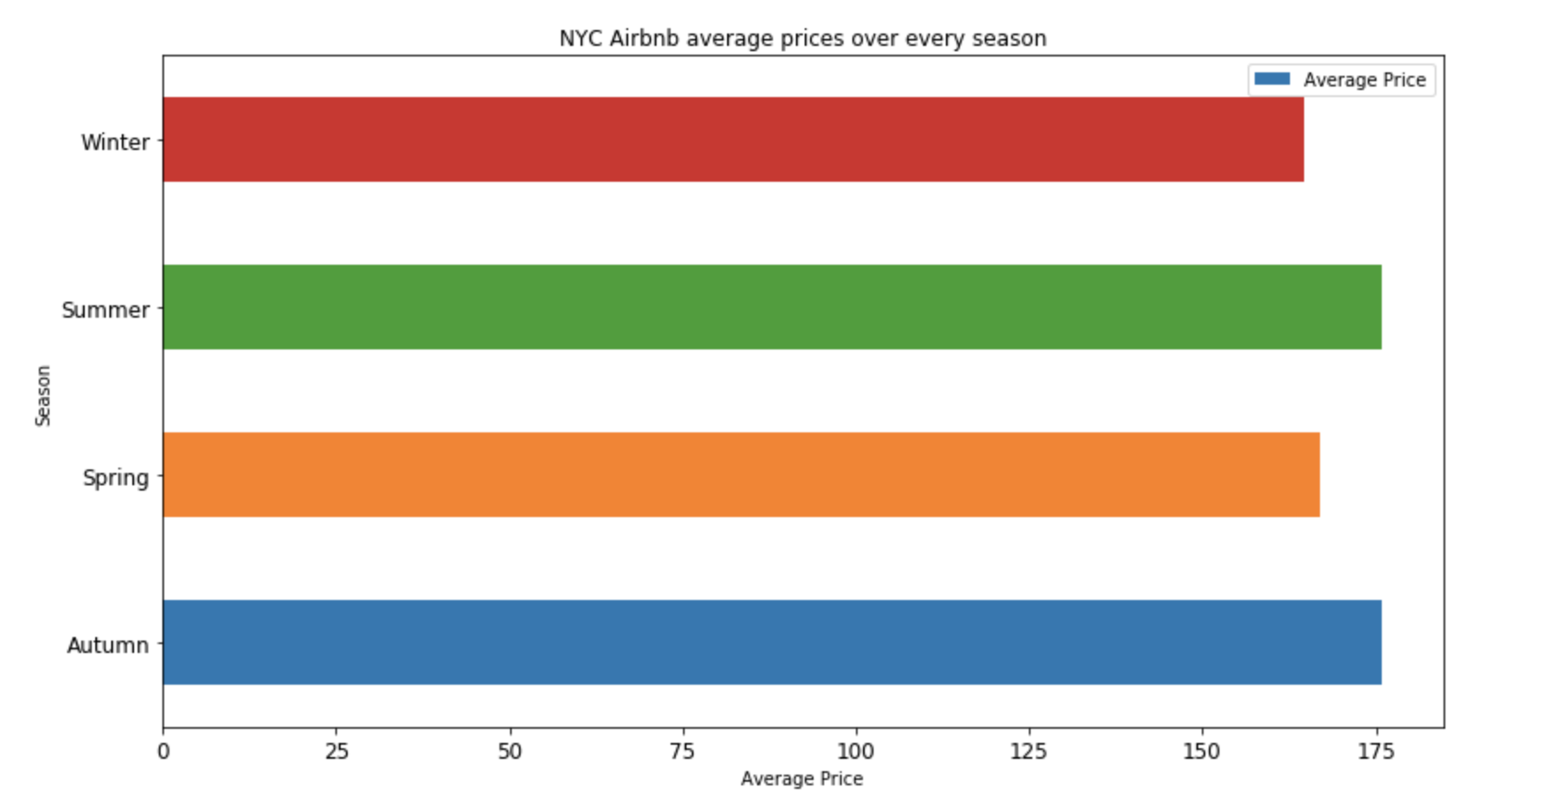
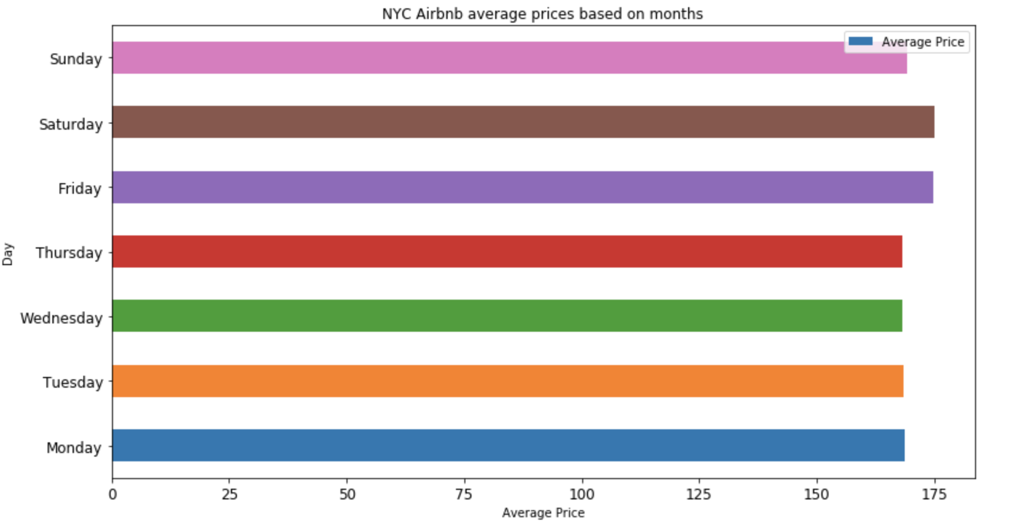
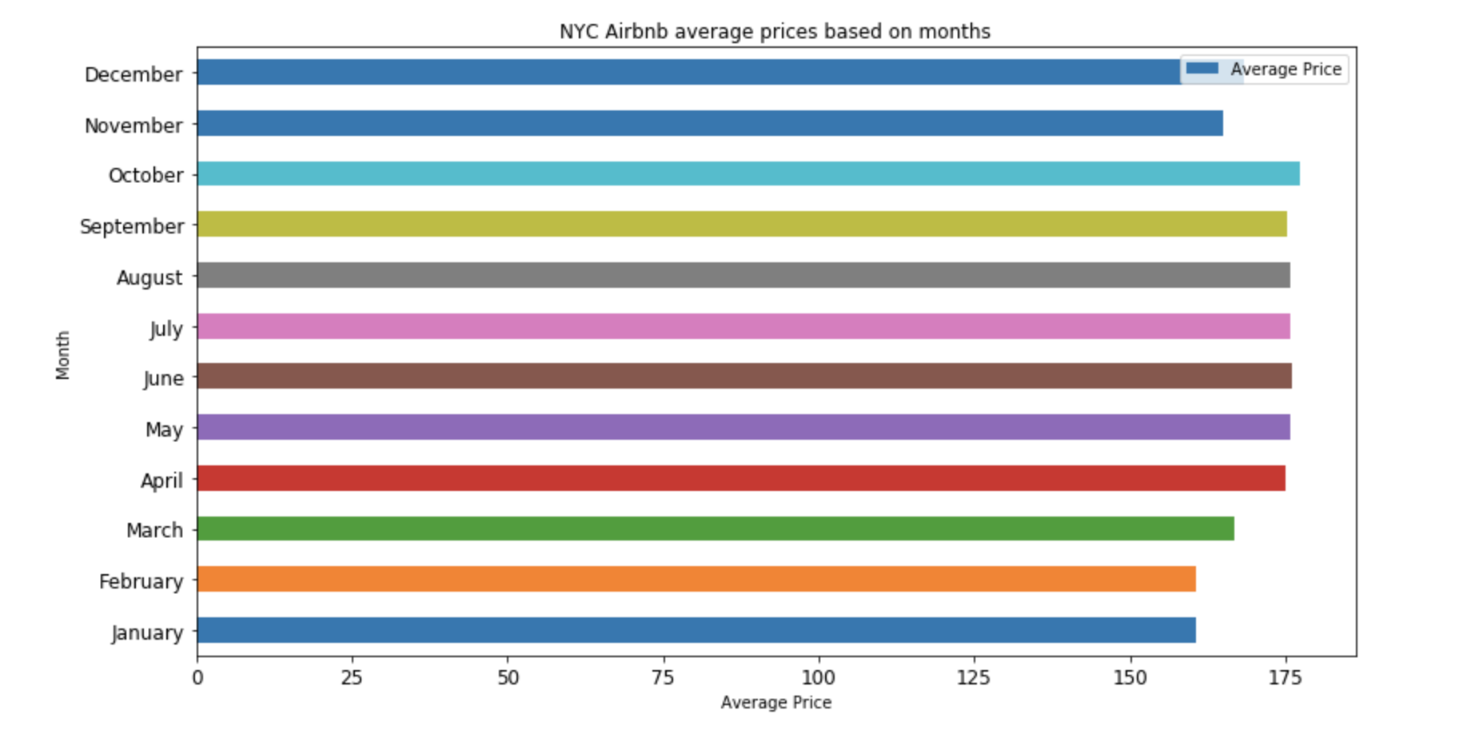
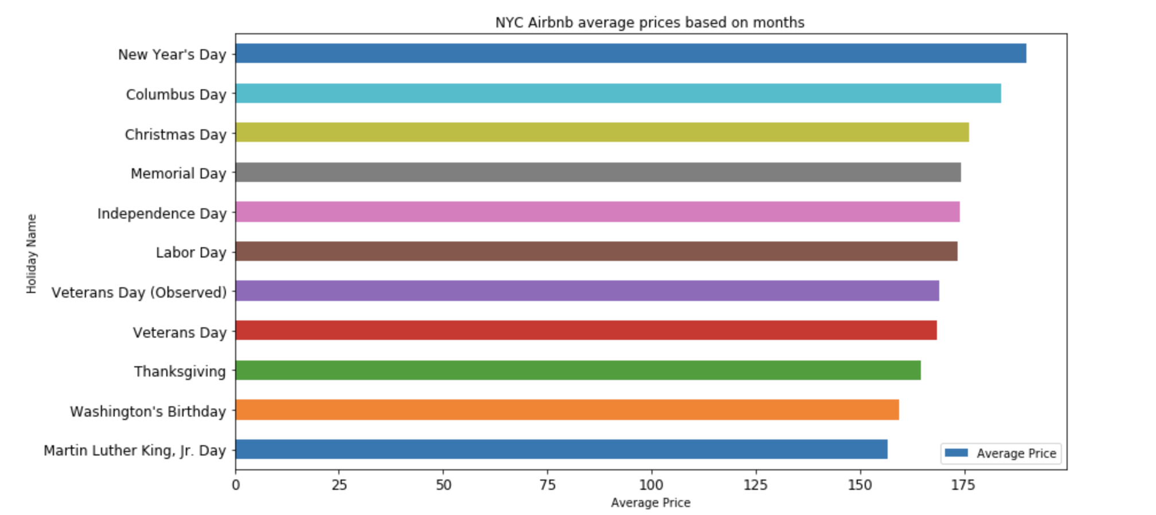
Price Prediction Analysis

Slide 9
Difficulties
Very large dataset
Lot of effort in preprocessing the data
Evaluation of predicted rating
Things that worked well
Effective use of data with various pre processing techniques
Models creation using clustering and sentiment analysis
Matrix factorization using SVD and ALS supported large and sparse dataset to predict ratings
Things that did not work well
As the AirBnb dataset is very large and users have given only one or two reviews, user based and item based algorithm could not be used to build and evaluate model.
Matrix built is very big. Difficult to predict ratings.

Slide 10
Conclusion
After evaluating clustering and sentiment analysis based approaches, we decided to use rating generated by the sentiment analysis model to train the recommendation algorithm.
After evaluating different collaborative filtering algorithms ,we concluded that matrix factorization is the best algorithm to provide recommendations for the large and sparse dataset like Airbnb dataset.
Also in order to provide recommendations over the large dataset, Spark’s ALS implementation is more suitable.
Building this module helped to build skills required for 1) data preprocessing 2) building ML models for large-scale data 3) evaluating methods. 4) visualize data and use it for predictions.

