Slide 1
CMPE 180-94 Project
Virtual Memory Management
Team Members: Uttara Vishwas Kulkarni
Arshiya Hayatkhan Pathan
Bing Shi
Instructor: Hungwen Li

Slide 2
Outline
Introduction
Background and Problem Description
Methodology
Result and Analysis

Slide 3
Introduction
Need: Virtual Memory Management
Scarcity of Main Memory.
For execution, a program must reside in ‘Main Memory’
Concept: Virtual Memory Management
Maintains a copy of memory of all programs (secondary storage)
Coordinates the process of address translation
Main Memory appears to be larger than its actual size.

Slide 4
Background and Problem Description
The virtual memory manager is simulating the process of logical to physical address translation
Logical address => Page Number + Offset
Physical address => Frame Number + Offset
Steps involved:
Extract ‘Page Number’ and ‘Offset’ (Logical address)
Map ‘Page Number’ to corresponding ‘Frame Number’, using TLB, page table, backing store
Concatenate: ‘Frame Number’ and ‘Offset’ to get the corresponding ‘Physical address’.

Slide 5
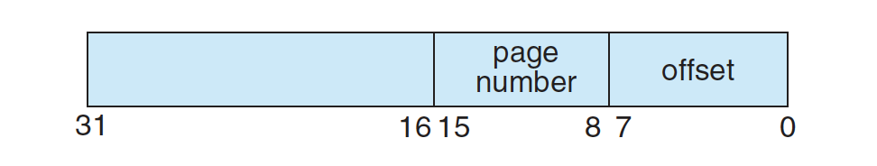
Background and Problem Description (cont.)
Key Components
Logical address : 32 bit
Physical address space : 256 frames
TLB : 16 Entries
Page Table: 256 Entries
Backing Store: 65536 Entries
address.txt : contains logical addresses to be translated (1000 entries)

Slide 6
Methodology
Language: Python 3.6
Data: integer
TLB (Translation Lookaside Buffer)& PageTable: List
Physical Memory: Dictionary
BackingStore: BinaryFile (BackingStore.bin)
Input/ Output File: Txt File (address.txt; output.txt)
Table Update method: LRU(Least Recent Use)

Slide 7
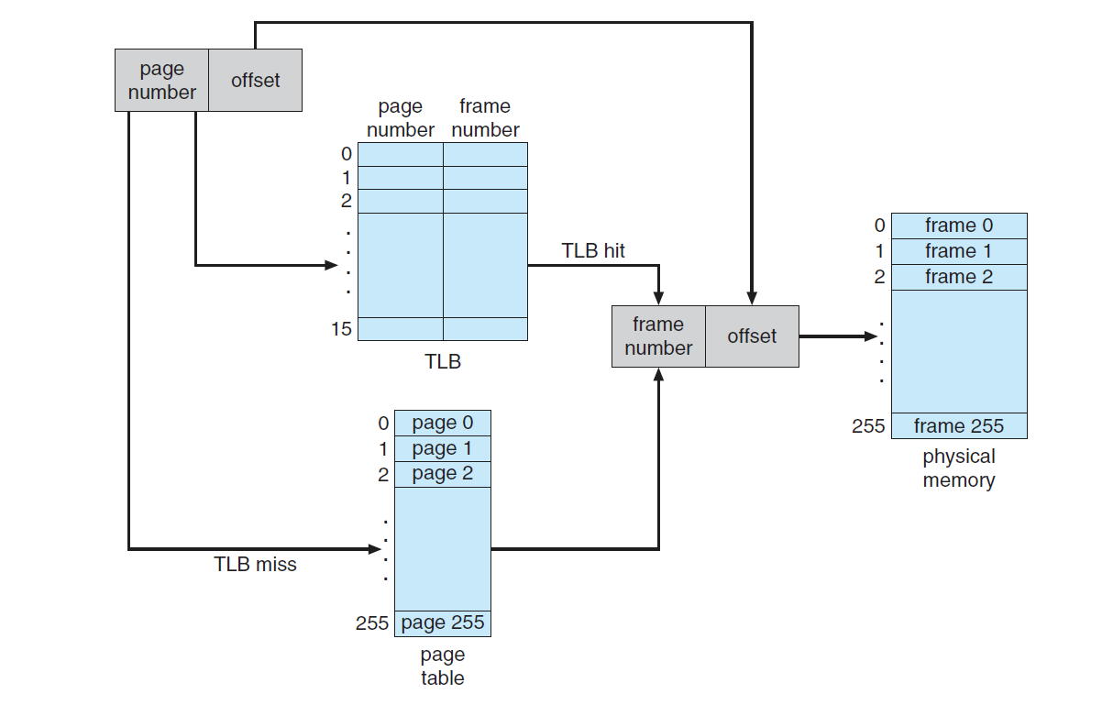
Methodology(cont.)
Step1
Step2
Step4
Step3
Notes:
Step 2: Map frame number with page number
Search TLB
Search Page Table

Slide 8
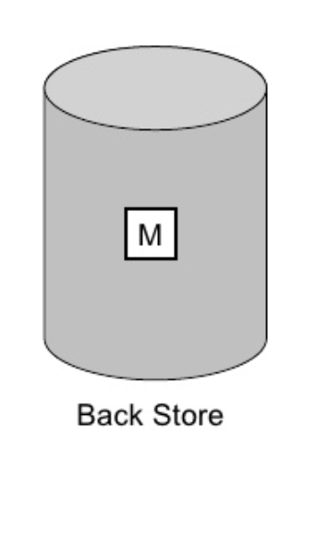

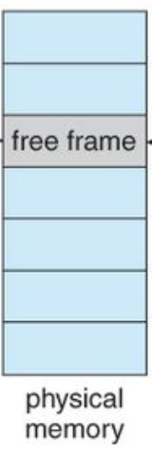
Methodology(cont.)
Step1
Frame Number
Step2
Step3.Update TLB and Page Table (LRU)
Handle Page Fault
Notes:
Step 2: Map frame number with page number
Search TLB
Search Page Table

Slide 9
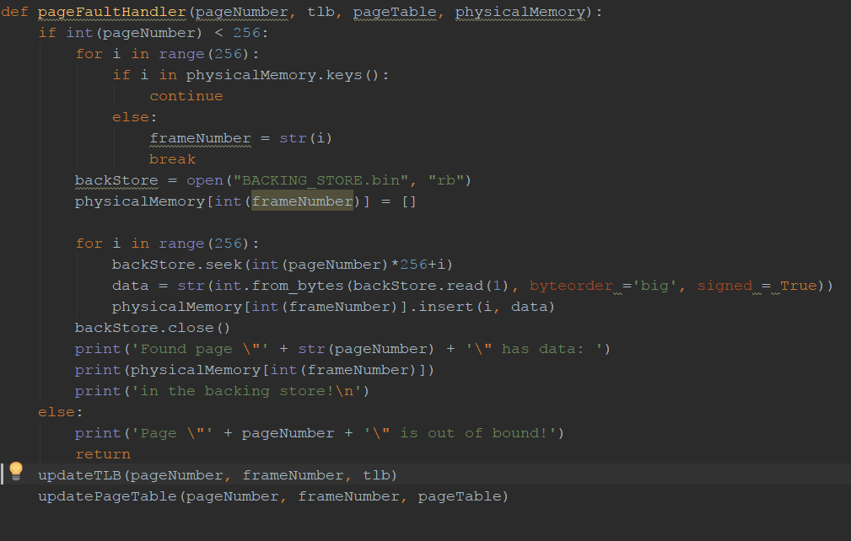
Page Fault Handling

Slide 10
Result and Analysis
Program displays and stores the following values to output.txt
The logical address being translated
The corresponding physical address
The signed byte value stored at the translated physical address.
Page-fault rate - The percentage of address references that resulted in page faults.
TLB hit rate - The percentage of address references that were resolved in the TLB.

Slide 11
Result and Analysis (cont.)
Sample output:
Virtual address: 62493 Physical address: 285 Value: 0
11110100 00011101 00000001 00011101 285
Page No Offset Frame No. Offset
Number of Translated Addresses = 1000
Page Faults = 244
Page Fault Rate = 0.244
TLB Hits = 56
TLB Hit Rate = 0.056

Slide 12
Thank you!

