Slide 1
$ python -m pip install requests beautifulsoup4 pandas playwright
WEB SCRAPING WITH PYTHON
FOUNDATIONS
slides 1–7
HTML & THE WEB
slides 8–13
REQUESTS & HTTP
slides 14–18
BEAUTIFULSOUP
slides 19–29
PANDAS & DATA
slides 30–32
SCALING UP
slides 33–36

Slide 2
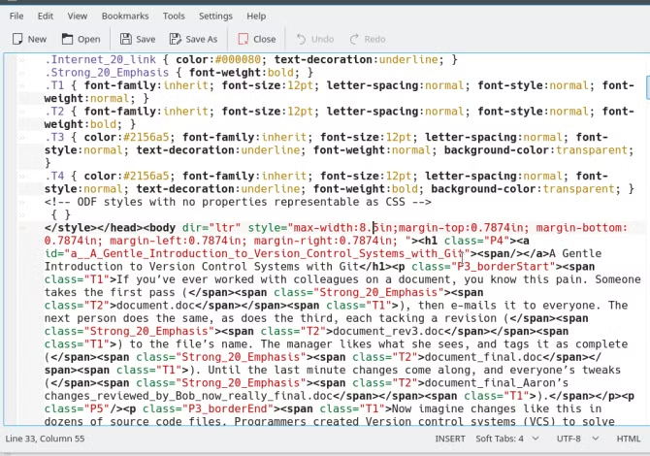
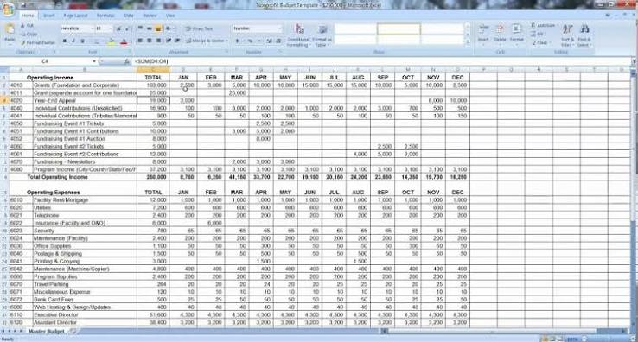
FOUNDATIONS
01
Introduction to Web Scraping
Automatically extracting data from websites instead of copying it by hand
Turns unstructured web pages into structured, usable data
Powers price trackers, search engines, research datasets, and LLM training corpora
1 / 36

Slide 3
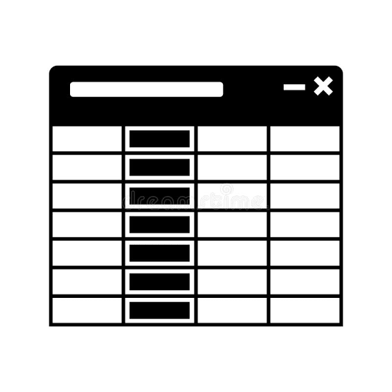

FOUNDATIONS
02
Structured vs Unstructured Data
Structured: rows & columns - spreadsheets, databases, CSVs
Unstructured: free-form - a webpage's HTML, images, paragraphs of text
Web scraping's whole job: pull structure out of unstructured HTML
2 / 36

Slide 4




FOUNDATIONS
03
Real-World Applications of Web Scraping
Price comparison & retail aggregators
Job boards (Indeed and similar pull listings from thousands of sites)
Research & citation datasets
Most LLM training data started as scraped web text
3 / 36

Slide 5


FOUNDATIONS
04
Web Crawler vs Web Scraper
Crawler: discovers and follows links across a site or the whole web (breadth)
Scraper: extracts specific data from pages it already has (depth)
Google's crawler indexes the web; a scraper you write extracts one dataset
Real systems often combine both: crawl to find pages, then scrape each one
4 / 36

Slide 6


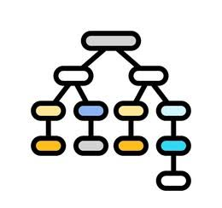
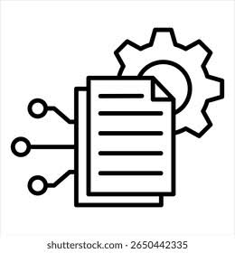

FOUNDATIONS
05
How Web Scraping Works
1. Send an HTTP request to a URL
2. Receive the HTML response
3. Parse the HTML into a navigable structure
4. Locate the elements you need
5. Extract and structure the data
6. Store or export it (CSV, JSON, a database)
5 / 36

Slide 7
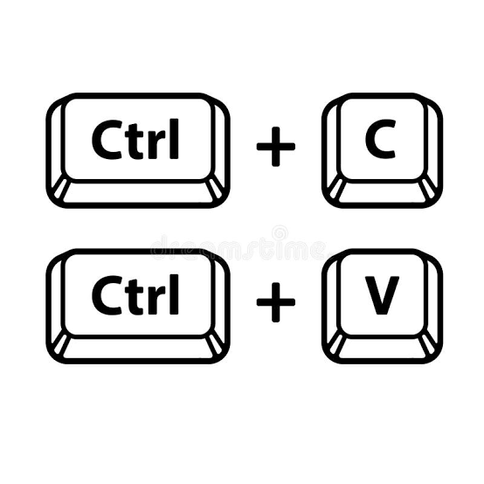




FOUNDATIONS
06
Types of Web Scrapers
Manual copy-paste - not really scraping, doesn't scale
Browser-extension scrapers - point-and-click, limited flexibility
Code-based scrapers (Python) - flexible, scalable, fully customizable
Headless-browser scrapers (Playwright/Selenium) - for JavaScript-heavy sites
Large-scale frameworks (Scrapy) - for production crawling at scale
6 / 36

Slide 8



FOUNDATIONS
07
Web Scraping Tools in Python
requests - fetch pages over HTTP
BeautifulSoup - parse and search HTML
pandas - structure and export scraped data
Playwright / Selenium - handle JavaScript-rendered pages
Scrapy - a full framework for large, production-scale crawls
7 / 36

Slide 9
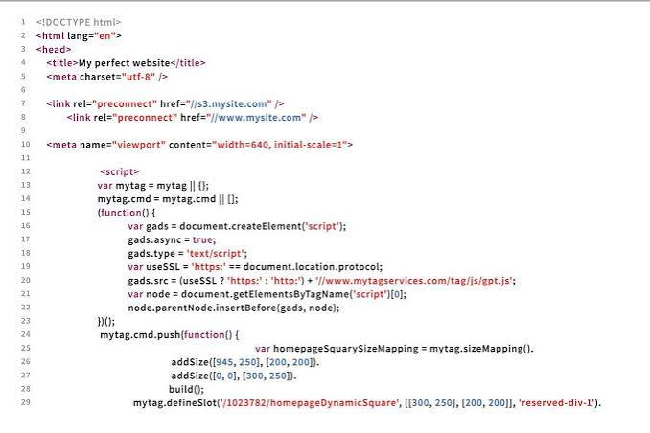
HTML & THE WEB
08
Introduction to HTML
HTML is the structure - the skeleton - of every webpage
Built from nested elements called tags
Browsers render HTML into what you see; scrapers read the HTML directly
8 / 36

Slide 10
HTML & THE WEB
09
HTML Tags and Attributes
Tag: <h1>, <p>, <a>, <div> - defines an element
Attribute: extra info inside a tag - class, id, href, src
Attributes are usually exactly what you target when scraping
<!DOCTYPE html>
<html>
<body>
<h1>My First Heading</h1>
<p>My first paragraph.</p>
<a href="https://www.google.com">This is a link</a>
</body>
</html>
9 / 36

Slide 11
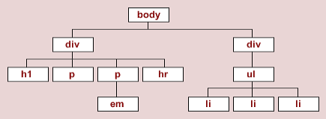
HTML & THE WEB
10
HTML Tree Traversal
HTML nests inside itself: parent, child, and sibling relationships
A parser turns this into a tree you can walk in code
Understanding the tree is the key to navigating to any element you want
10 / 36

Slide 12
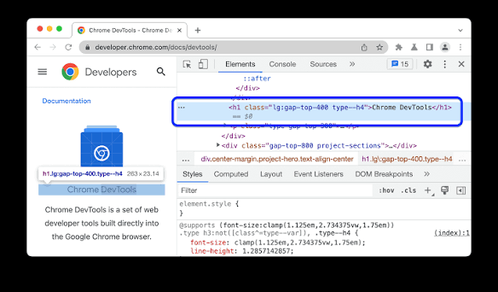
HTML & THE WEB
11
Exploring HTML with Inspect & View Page Source
View Page Source: the raw HTML the server sent - what requests sees
Inspect Element: the live DOM after JavaScript ran - what your eyes see
Always confirm your target data exists in View Source before writing a scraper
11 / 36

Slide 13

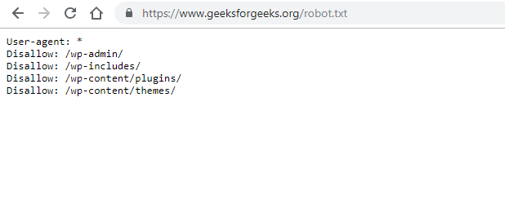
HTML & THE WEB
12
Web Scraping Legality & robots.txt
robots.txt states what a site's owner allows and disallows for bots
Respect rate limits; avoid scraping personal or private data
Read the Terms of Service, especially before scraping anything commercial
Legality varies by site and jurisdiction - when in doubt, check first
12 / 36

Slide 14


HTML & THE WEB
13
APIs vs Web Scraping
API: the site deliberately gives you structured data - use it when it exists
Scraping: extracting data from pages that weren't designed for that purpose
APIs are faster, more stable, and explicitly permitted - always check first
13 / 36

Slide 15
REQUESTS & HTTP
14
Installing Python Packages
pip install requests beautifulsoup4 pandas
Virtual environments keep a project's dependencies isolated
requirements.txt records exact package versions for reproducibility
14 / 36

Slide 16
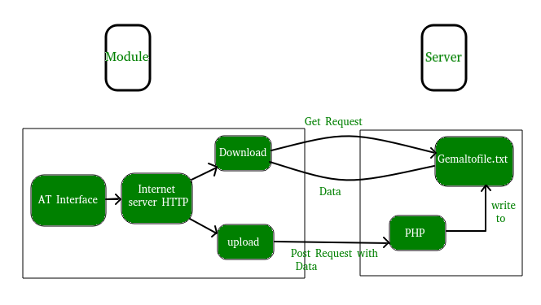
REQUESTS & HTTP
15
HTTP Requests with requests
requests.get(url) sends an HTTP request and returns a Response object
Handles the messy parts for you: headers, encoding, redirects
response = requests.get(url)
15 / 36

Slide 17
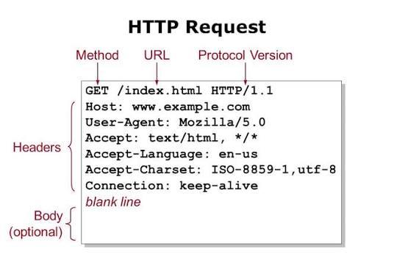
REQUESTS & HTTP
16
HTTP GET Requests
GET means "give me this page" - the method scraping uses almost exclusively
Other methods exist (POST, PUT, DELETE) - for submitting data, not typically for scraping
16 / 36

Slide 18
REQUESTS & HTTP
17
HTTP Response & Status Codes
200 - request successful
300 - redirection
400 - client-side error
404 - page not found
500 - server-side error
Always check response.status_code before trusting the content
17 / 36

Slide 19
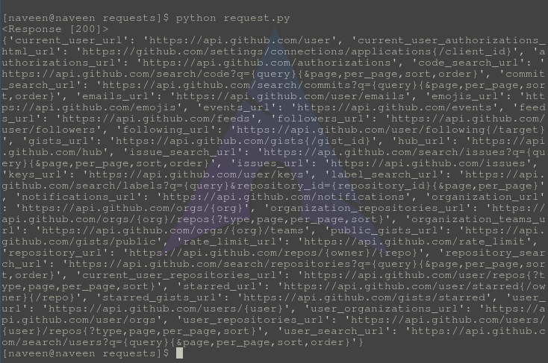
REQUESTS & HTTP
18
Exploring Response Properties
response.status_code, .text, .content, .headers, .url
.content is raw bytes; .text is requests' decoded string
18 / 36

Slide 20
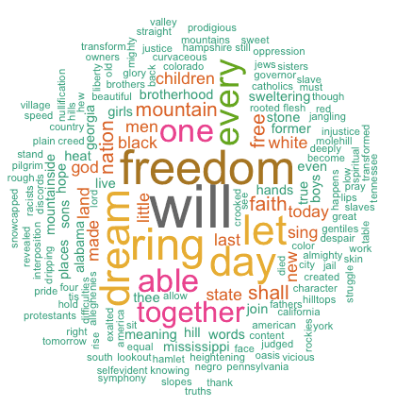
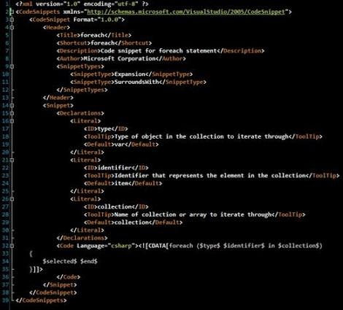
BEAUTIFULSOUP
19
HTML Parsing
Raw HTML is just text until a parser structures it
Parsing builds a navigable tree of tags and text you can search in Python
19 / 36

Slide 21

BEAUTIFULSOUP
20
Introduction to BeautifulSoup
A Python library for parsing and searching HTML/XML
Turns response.content into a queryable "soup" object
soup = BeautifulSoup(response.content, "html.parser")
20 / 36

Slide 22
from bs4 import BeautifulSoup
soup = BeautifulSoup(response.text, 'html.parser')
print(soup.prettify()) # prints well-formatted HTML
BEAUTIFULSOUP
21
BeautifulSoup Objects
Tag - an HTML element: a name, attributes, and children
NavigableString - the text inside a tag
BeautifulSoup - the top-level parsed document itself
from bs4 import BeautifulSoup
soup = BeautifulSoup(response.text, 'html.parser')
print(soup.prettify()) # prints well-formatted HTML
21 / 36

Slide 23


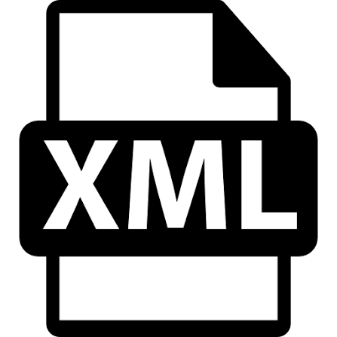
BEAUTIFULSOUP
22
HTML Parsers
html.parser - built into Python, no install needed
lxml - fast, needs a separate install
html5lib - most lenient with broken HTML
xml - for XML documents specifically
22 / 36

Slide 24
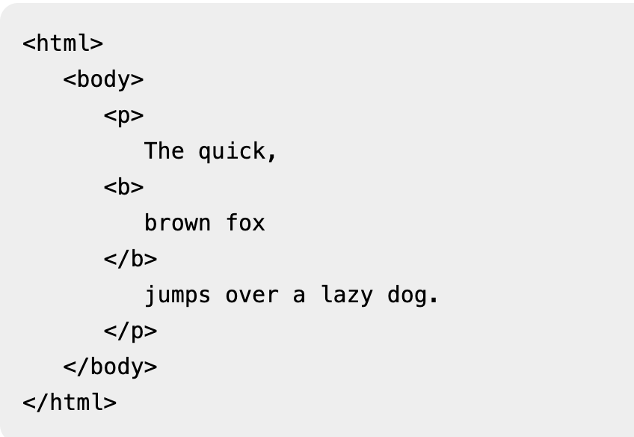
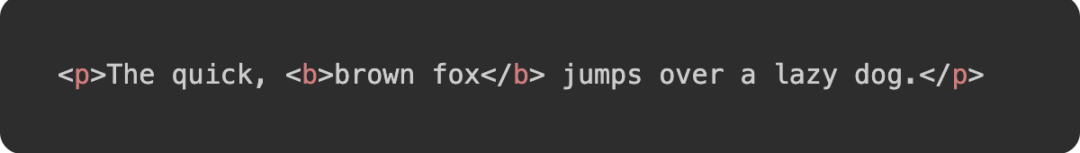
BEAUTIFULSOUP
23
prettify()
soup.prettify() formats HTML with proper indentation
Great for exploring a page's structure before writing selectors
23 / 36

Slide 25
BEAUTIFULSOUP
24
Navigating HTML with BeautifulSoup
soup.title, soup.h1, soup.a - direct access to the first matching tag
.parent, .children, .next_sibling - moving around the tree manually
24 / 36

Slide 26
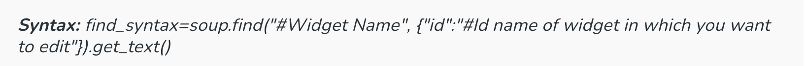
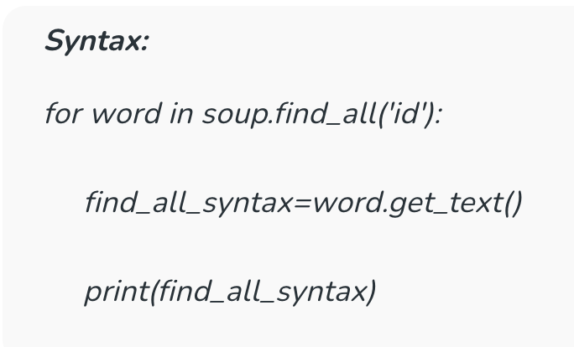
BEAUTIFULSOUP
25
find() and find_all()
find() - returns the first match, or None
find_all() - returns every match, as a list
25 / 36

Slide 27
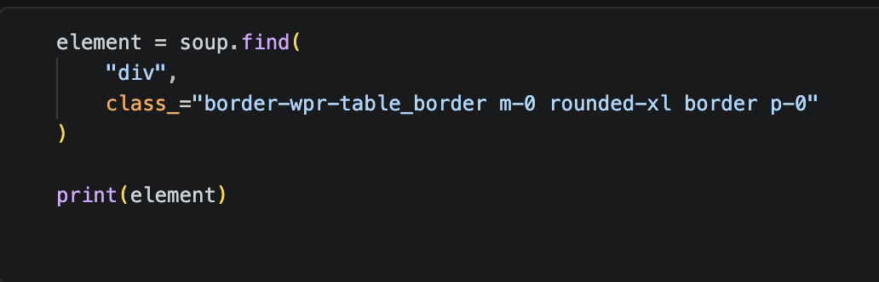
BEAUTIFULSOUP
26
Finding Elements by Class and ID
class_="..." - trailing underscore, since class is a reserved word in Python
id="..." - usually unique per page, so it's the most precise target
26 / 36

Slide 28
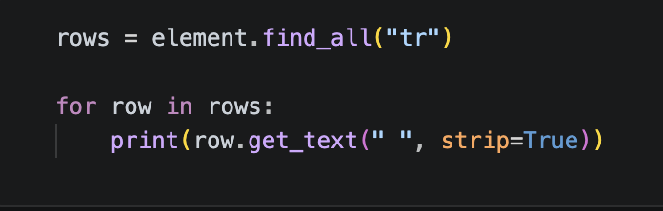
BEAUTIFULSOUP
27
Extracting Text
.get_text(strip=True) - clean text with whitespace trimmed
.stripped_strings - iterate clean text pieces out of a nested element
27 / 36

Slide 29
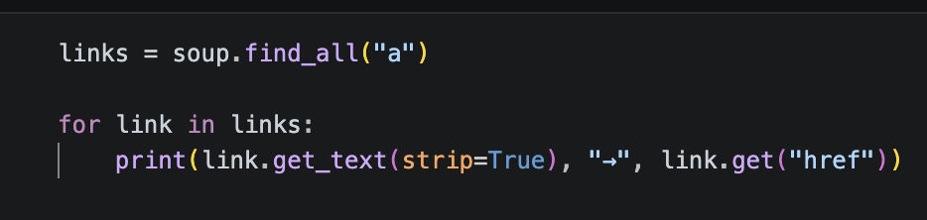
BEAUTIFULSOUP
28
Extracting Links
link.get("href") - the raw href attribute, often a relative path
urljoin(base_url, href) - converts a relative link into a full URL
28 / 36

Slide 30
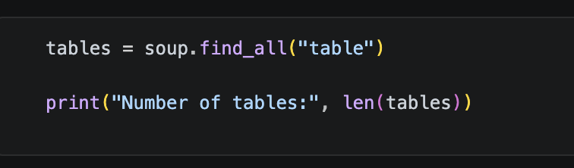
BEAUTIFULSOUP
29
Scraping HTML Tables
find_all("table") for the tables, find_all("tr") for rows, find_all(["th","td"]) for cells
Watch for cells that hold a link or an image instead of plain text
29 / 36

Slide 31
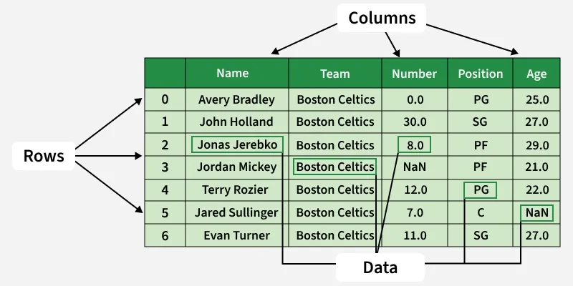
PANDAS & DATA
30
Using Pandas for Web Scraping
pandas turns scraped lists and dicts into a structured table
Makes filtering, sorting, and analyzing scraped data straightforward
30 / 36

Slide 32
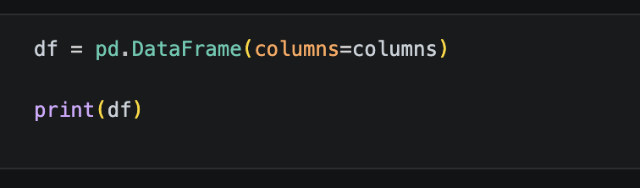
PANDAS & DATA
31
Creating DataFrames from Scraped Data
pd.DataFrame(data, columns=columns)
Column headers usually come straight from a table's <th> elements
31 / 36

Slide 33

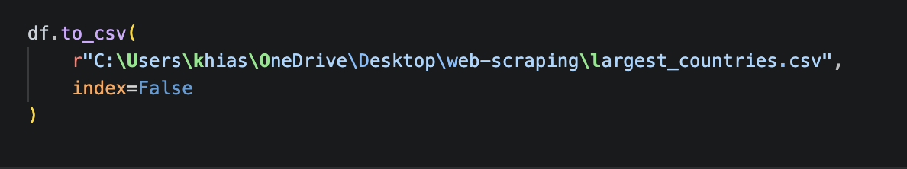
PANDAS & DATA
32
Exporting Data to CSV
df.to_csv("file.csv", index=False)
index=False stops pandas from writing its own row-number column
32 / 36

Slide 34

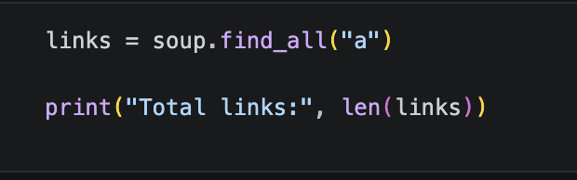
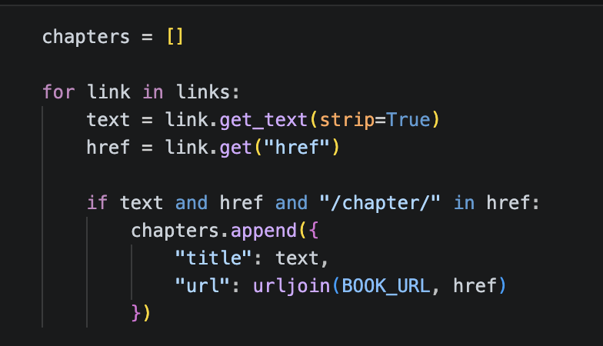
SCALING UP
33
Scraping Multiple Pages
Pagination patterns: page numbers in the URL, "next" links, infinite scroll
urljoin() + a loop + a clear stopping condition
Always rate-limit between requests with time.sleep()
33 / 36

Slide 35
SCALING UP
34
Common Web Scraping Challenges
JavaScript-rendered content - needs Playwright/Selenium, not just requests
Anti-bot measures: CAPTCHAs, IP blocking, aggressive rate limiting
Site structure changes that silently break your selectors
Missing or inconsistent data - always code defensively
34 / 36

Slide 36
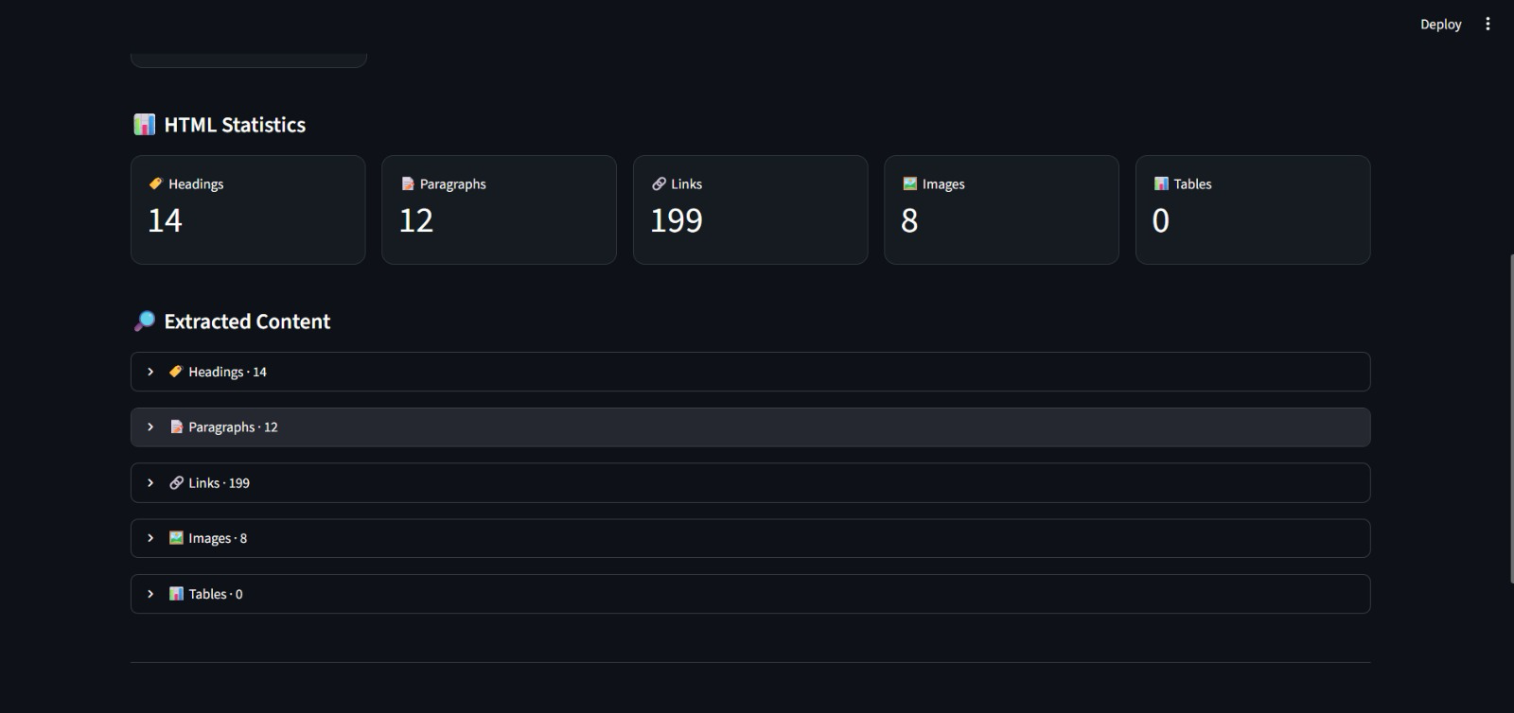
SCALING UP
35
Mini Project
35 / 36

Slide 37
SCALING UP
36
Homework
Read Homework.md file in https://github.com/Arshiyakhias/python_workshop
Entire code showed in session can also be found in the above repo
36 / 36

