Slide 1







The Impact of Prior Reward Experience on Current Reward Processing: Activation Patterns and Resting-State Correlates
Parinaz Vahdat Arshiya Sangchooli
Mentor:
Adeel Razi Project TA: TA: Aryan Roxana Namiranian
Andrew Bender Yazdanpanah
Neuromatch Academy 2021

Slide 2
Background
Reward-related neural activity can represent aspects of reward-processing, such as the processing of reward valence, reward expectations, and errors
An important part of reward processing is prediction of positive or negative rewards, and the influence of prior reward processing on present response to rewarding stimuli.
Unexpected outcomes, are critical for reporting surprising events so that learning can occur.
fMRI studies
Task-based fMRI (tfMRI) is often used to assess regional activities underlying reward processing
Resting-state fMRI (rsfMRI) can be used together with tfMRI to explore the networks which support these regional activations

Slide 3
Questions
Do preceding experiences of win or loss lead to distinct regional activations involved in subsequent reward-processing?
Does the strength of valence-transition-related activity in these regions correlate with their resting-state functional connectivity to brain regions involved in the processing of memory, reward and affect ?
So : The sequences of trials in the HCP gambling task were categorized as :
win-Win --- Congruent Win loss-Loss --- Congruent Loss
loss-Win --- Incongruent Win win-Loss --- Incongruent Loss
Neuromatch Academy 2021

Slide 4
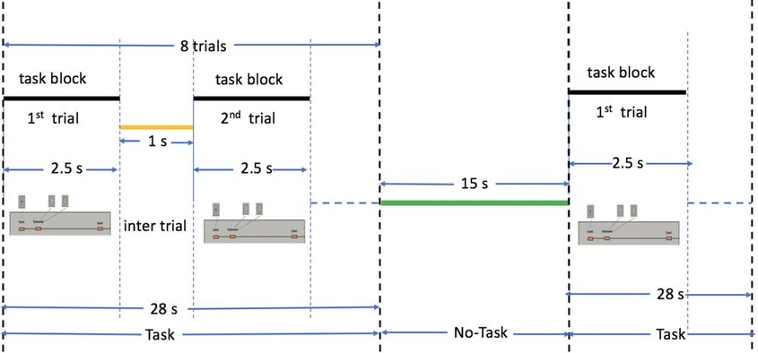
HCP gambling task
First Run
L: L L W L W L L L
W: W N W W W W N W
L: L L W L W L L L
W: W W L W L W W W
Second Run
W: W W L W W W N W
L: W L L L N L L L
L: L L L N L N L L
W: W W L W L W W W
Neuromatch Academy 2021

Slide 5
Methods Dataset: HCP gambling tfMRI and rsfMRI data, N = 339. Time-series z-standardized and concatenated across two runs.
GLM
CONTRAST
Incongruent win>congruent win
CCA
Parcels < Bonferroni-corrected p & Cohen’s d > 1 selected
Incongruent loss>congruent loss
Incongruent win+loss>congruent win+loss
EVs defined
Coefficients from first-level analysis
Group-level summary statistics
Resting-state functional connectivity to all other parcels
Neuromatch Academy 2021

Slide 6
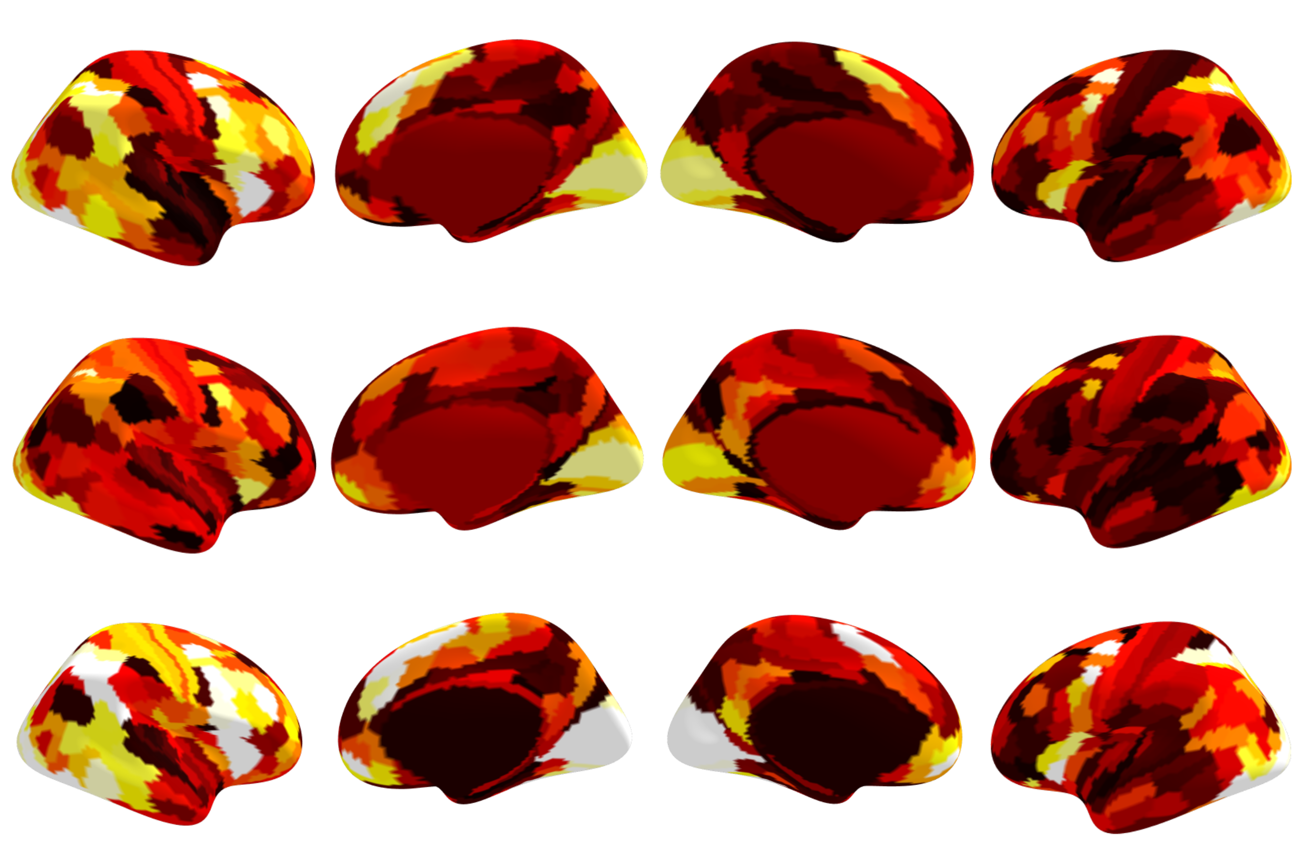
Task-related activations
win-Loss > loss-Loss
loss-Win > win-Win
Incongruent > Congruent
(win-Loss+ (loss-Loss+
loss-Win) win-Win)
20
10
0
Right Left
>

Slide 7
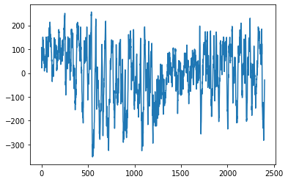
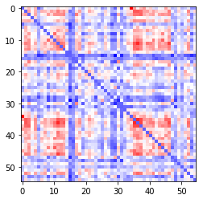
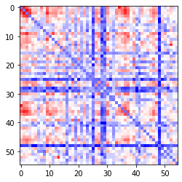
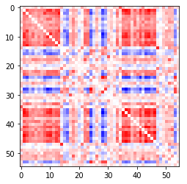
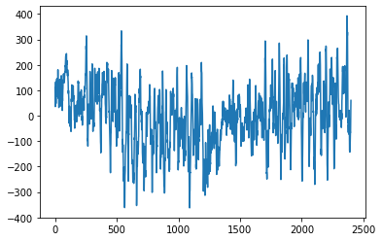
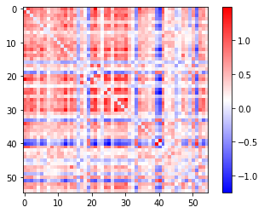
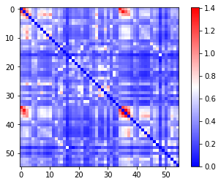
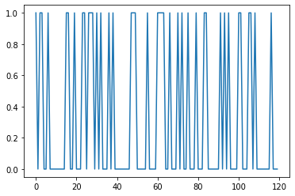
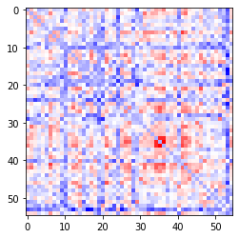
Dynamic Functional connectivity
Resting-state connectivity
…
…
State 0
…
…
…
Functional connectivity
…
…
…
State 1
P(stay in s1)
State 1
P(stay in s2)
P(transition s1 -> s2)
State 0
P(transition s2 -> s1)
ROIs
Window

