Slide 1

Restaurant Survival Analysis
A Data-Driven Consulting Report
Spring 2026 Data Challenge | UW–Madison Statistics Club
56K
5.3M
0.98
Restaurants
Reviews
ROC-AUC

Slide 2
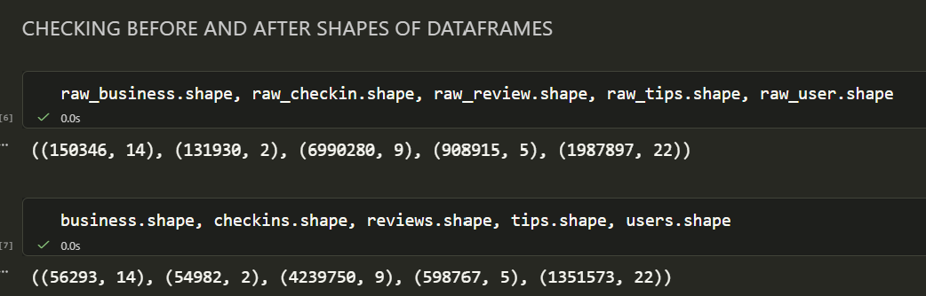
Problem Framing & Dataset
Two Core Questions
The Dataset
Which restaurant attributes are most associated with survival?
01
56,293
5.3M
Part 1a - Attribute Selection
Part 1b - Dashboard
Food Businesses
Reviews
Can we predict whether a restaurant is currently open or closed?
02
748K
68K
Part 2 — Predictive Model
Tips
Check-in Records

Slide 3
Methodology
1
2
3
4
5
Feature Engineering
Leakage Detection
Model Training
SHAP Interpretation
Validation
Merged 5 files into one table per restaurant. Engineered recency, velocity, quality, and attribute features — 55 total features.
Partial correlation test removed avg_reviewer_experience (residual r = 0.037 after controlling for time).
XGBoost classifier (300 trees, lr=0.05, depth=6) on 80/20 stratified split. Preserves 80/20 class imbalance.
Game-theoretic feature attribution. Each feature's contribution quantified across all predictions.
5-fold cross-validation confirms robustness. Attribute analysis uses class-stratified prevalence rates.

Slide 4
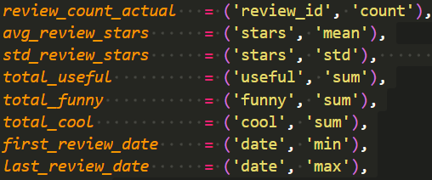
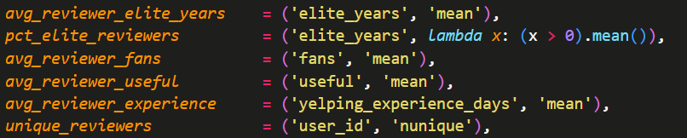
Feature Engineering
1
2
3

Slide 5
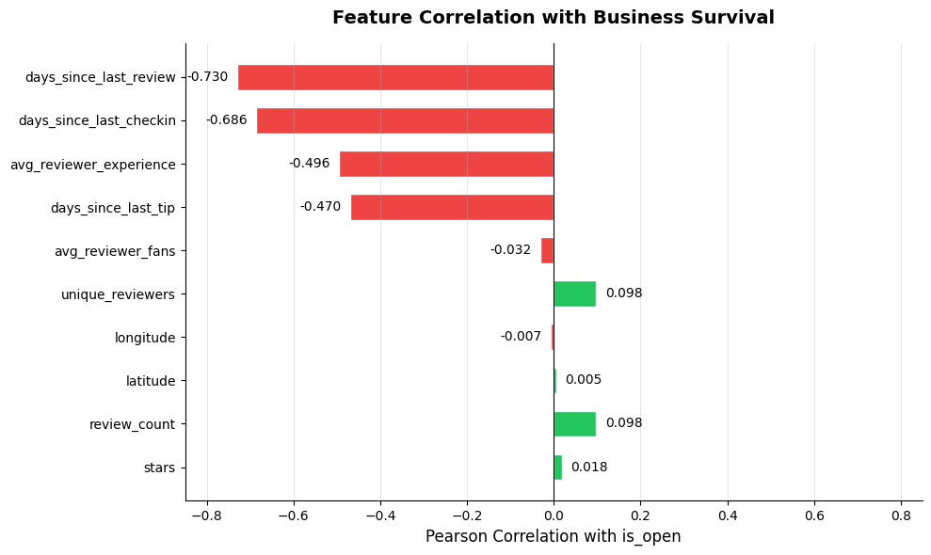
Data Analysis

Slide 6
Key Finding: Activity Recency Drives Survival
A restaurant that people stopped reviewing and visiting is almost certainly closed — regardless of its star rating.
Why This Makes Sense
−0.730
−0.730
Open business → people keep reviewing → low days_since_last_review Closed business → reviews stop → high days_since_last_review Star ratings are a lagging indicator. Activity recency is the leading signal.
This gives us the idea that the features may not linearly relate with our target. This motivates the use of a non linear training model further on, since there is a chance that several features provide a strong signal only when considered together
−0.686
−0.686
−0.470
−0.470
+0.128
+0.128
+0.017
+0.017

Slide 7
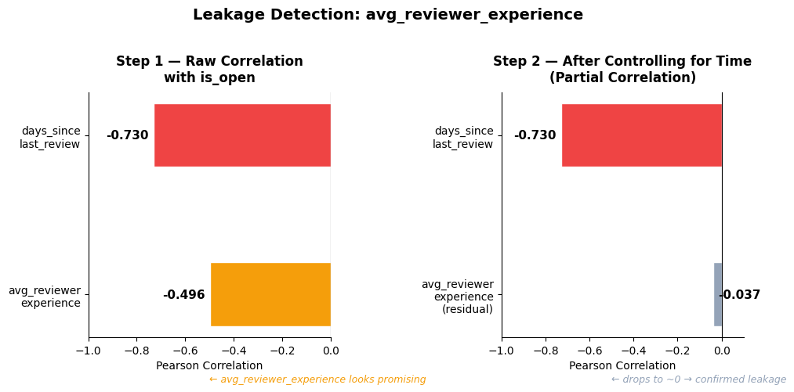
Leakage Detection
avg_reviewer_experience appeared to have -0.496 correlation — promising on the surface
We ran a partial correlation test, residualizing it against days_since_last_review
Residual correlation dropped to 0.037, which confirmed leakage. Closed businesses stopped getting reviews earlier, so their reviewers have been on Yelp longer by definition. The feature was encoding when a business closed, not anything meaningful about reviewer quality. Excluded from the model.

Slide 8
Model Performance & Robustness
0.9809
0.9820
±0.0005
94%
ROC-AUC
(Test Set)
Mean AUC
(5-Fold CV)
Std Dev
(Cross-Validation)
Overall
Accuracy
Classification Report
Why ROC-AUC?
Class | Precision | Recall | F1
Closed (0) | 0.91 | 0.88 | 0.89
Open (1) | 0.95 | 0.96 | 0.96
80% of businesses are open.
A model predicting 'open' for everything achieves 80% accuracy while being completely useless. ROC-AUC measures the probability of correctly ranking a random open business above a random closed one, immune to class imbalance.
5-fold CV scores: [0.98145, 0.98192, 0.98180, 0.98188, 0.98300] — consistent across all splits

Slide 9
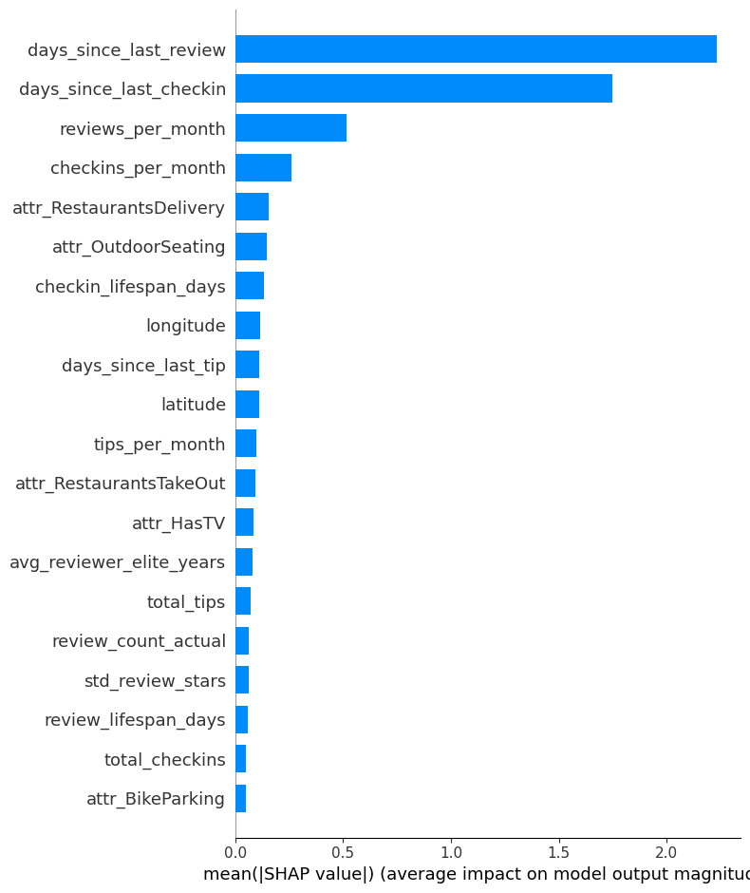
Model Performance & Robustness
5-fold CV scores: [0.98145, 0.98192, 0.98180, 0.98188, 0.98300] — consistent across all splits

Slide 10
Attribute Recommendations (Part 1a)
Invest In
Avoid
Restaurants Delivery
+35.8%
Happy Hour
−18.1%
Open: 72.9% | Closed: 37.0%
Open: 60.7% | Closed: 78.8%
Drive Thru
+41.1%
Reservations
−11.4%
Open: 67.3% | Closed: 26.2%
Open: 29.1% | Closed: 40.4%
Has TV
+17.6%
Alcohol (Full Bar)
−8.7%
Open: 82.0% | Closed: 64.4%
Open: 19.6% | Closed: 28.3%
Good For Kids
+5.6%
Key Insight: Formal sit-down dining models (bars, reservations, happy hour) carry measurably higher closure risk than accessible, convenience-oriented formats.
Open: 86.1% | Closed: 80.4%
Rates computed within each class separately to control for 80/20 class imbalance

Slide 11
Attribute Recommendations (Part 1a)
For binary attributes, Pearson correlation doesn't apply cleanly — both variables are 0/1. So we developed a more direct approach
Computed attribute prevalence separately within open and closed restaurants
This gives P(attribute | open) vs P(attribute | closed) — directly answering the business question
We controlled for the 80/20 class imbalance by computing rates within each class, not raw counts
This doesn't contradict the non-linearity argument — correlation measures linear relationships between continuous variables. This is a descriptive conditional probability — no linearity assumption involved.

Slide 12
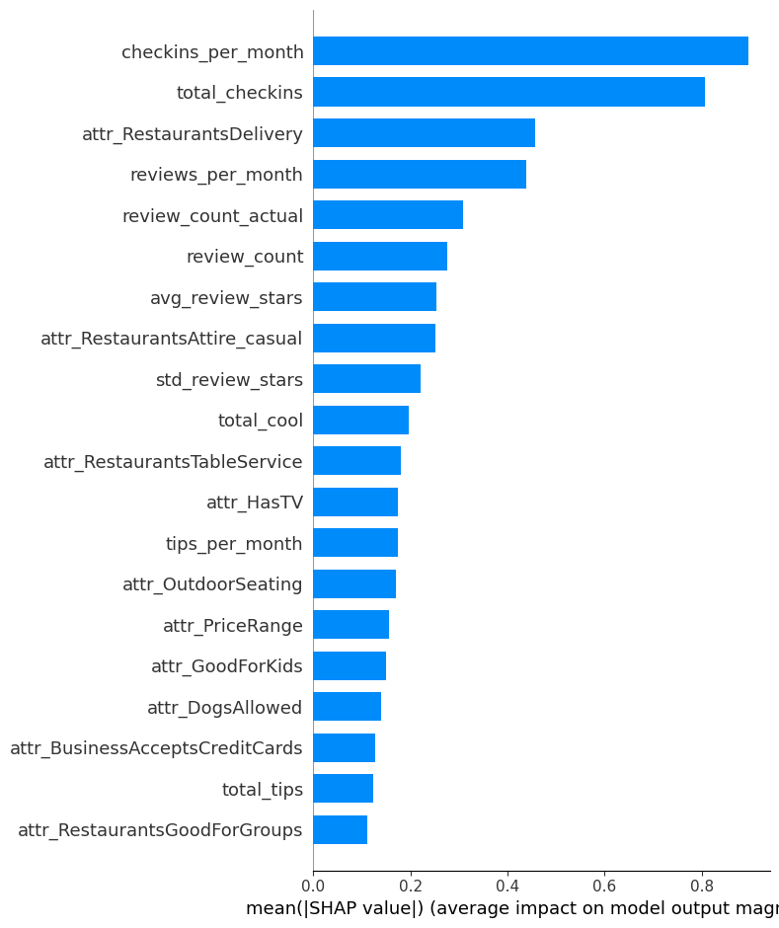



Robustness: Two-Model Validation
Full Model
Activity-Stripped Model
0.9809
0.9100
All 55 features
Static features only
ROC-AUC
ROC-AUC
Removes all time-based recency proxies. Validates that attributes have standalone predictive power.
Includes recency features (days since last review, check-in, tip). Used for competition submission.

Slide 13
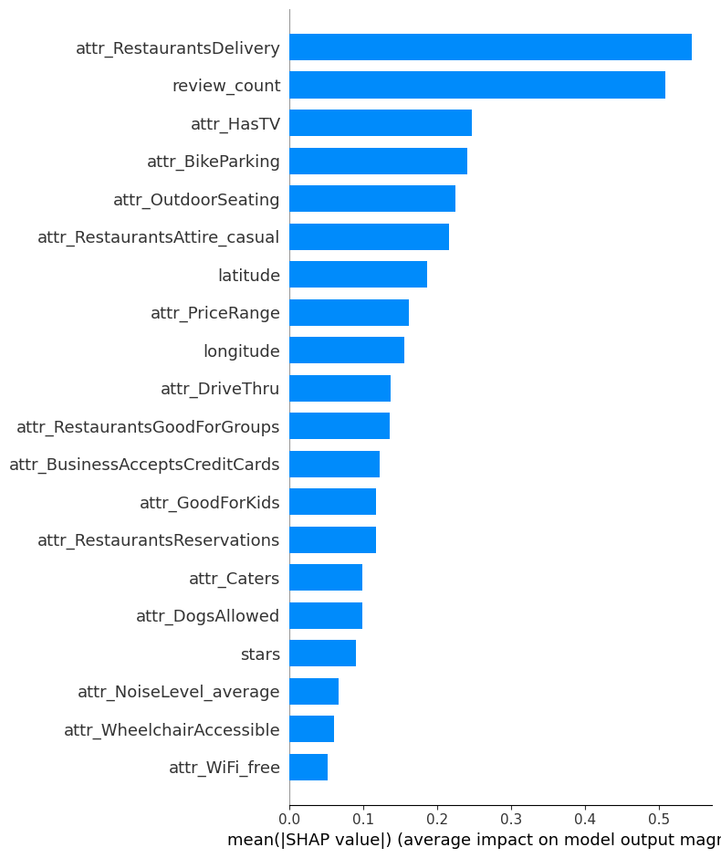
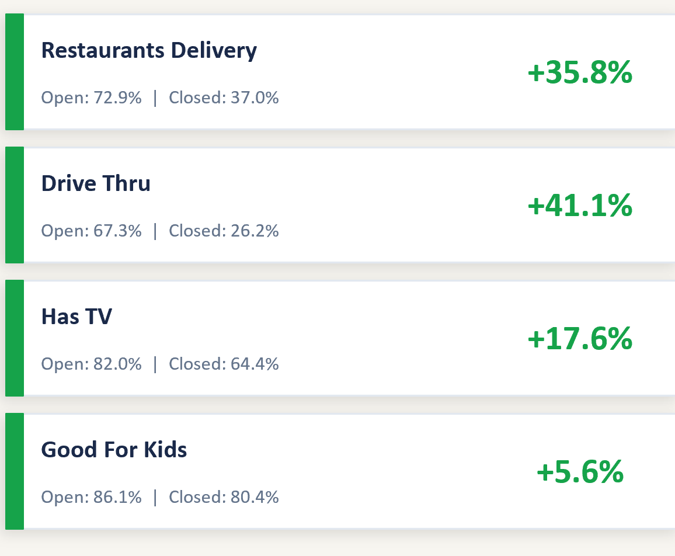




Robustness: Attributes only model
Activity-Stripped Model
0.8353
ROC-AUC
ROC-AUC
Removes all time-based recency proxies. Validates that attributes have standalone predictive power.

Slide 14
Conclusions & Limitations
Key Takeaways
Limitations
1
Invest in delivery, drive-thru, and family-friendly features — not formal dining infrastructure
Recency Tautology
Closed businesses stop getting reviews by definition , recency is partly a proxy, not purely predictive.
2
Monitor survival via review & check-in recency — stronger early warning than star ratings
Model achieves 0.98 AUC with strong cross-validation consistency (±0.0005)
New Restaurant Gap
3
For restaurants with no activity history, attribute-based features carry greater practical weight.
4
Delivery confirmed as top attribute by both ratio analysis AND stripped-model SHAP
Geographic Scope
Results reflect specific metro areas — may not generalize to all regions.
Thank you

Slide 15
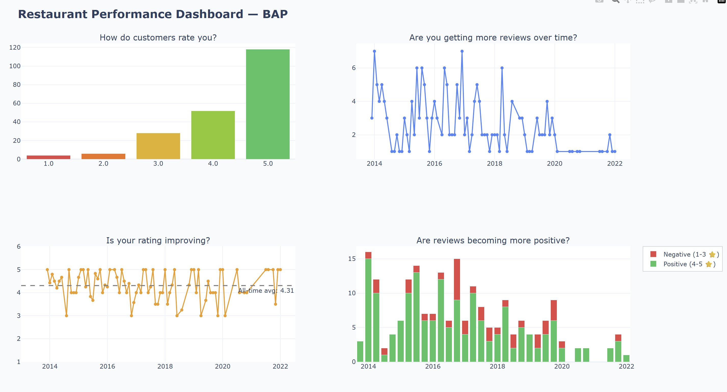

Slide 16
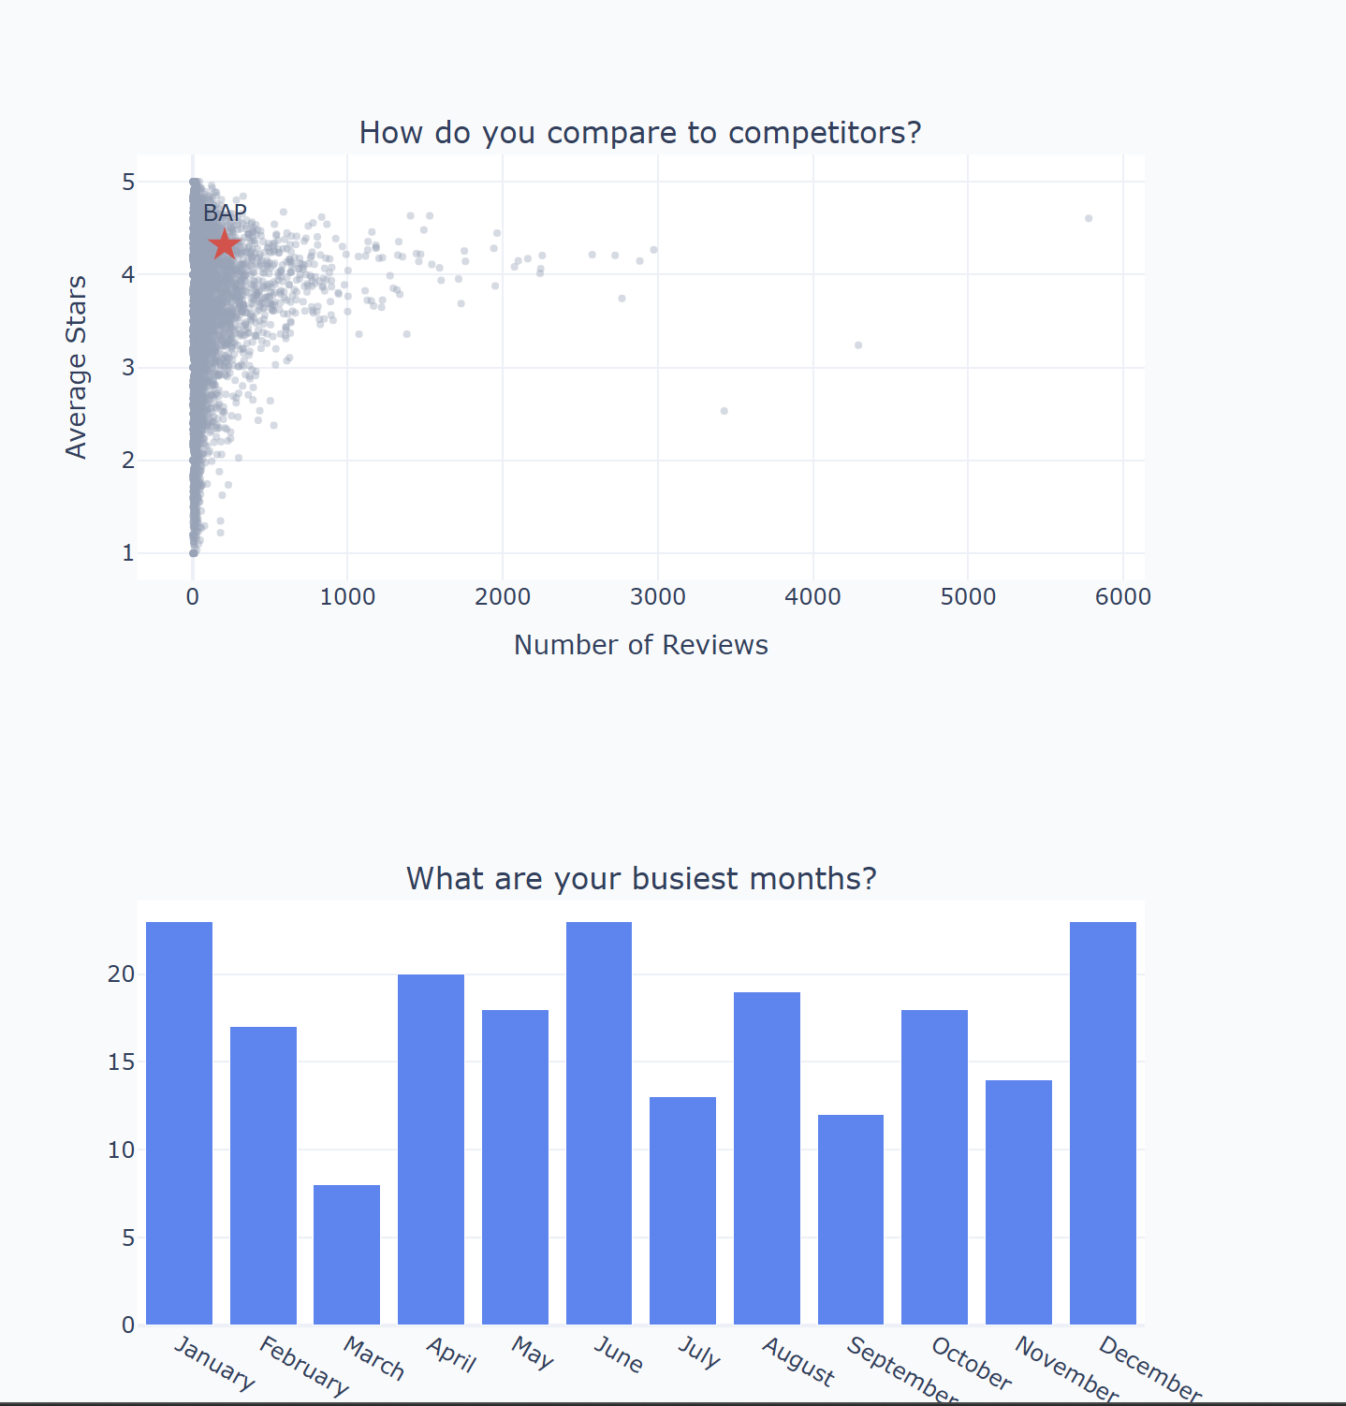

Slide 18
Next Steps
Key Takeaways
1
Parse the hours column Operating hours were never used as features. Features like "open on weekends", "open past 10pm", or "total weekly hours" likely carry meaningful survival signal
2
NLP on review text We used review metadata (stars, votes, dates) but never the actual text. 5.3 million reviews contain rich signal — sentiment trends, keywords like "under new management" or "going downhill", and topic shifts over time
3
Review velocity as a time series We engineered a static reviews_per_month average. A more powerful signal would be modeling the trend — is velocity accelerating or decelerating? A restaurant dropping from 20 reviews/month to 2 reviews/month over 6 months tells a very different story than one consistently at 2 reviews/month
Thank you

