Slide 1
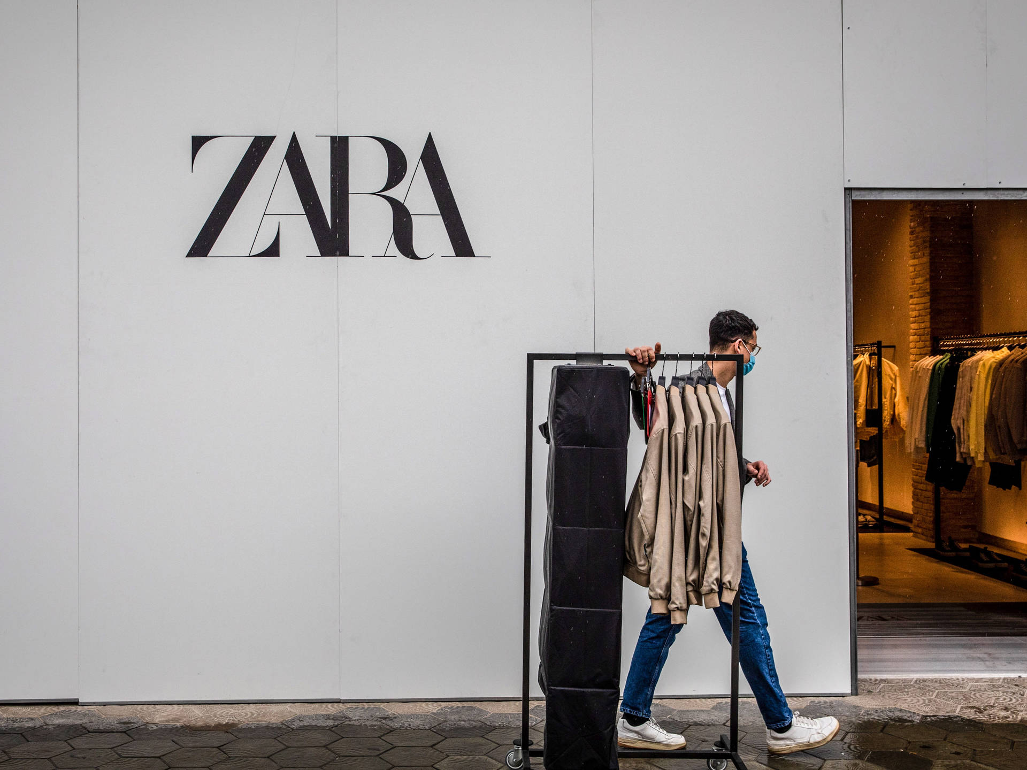

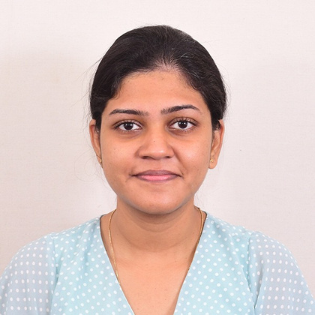
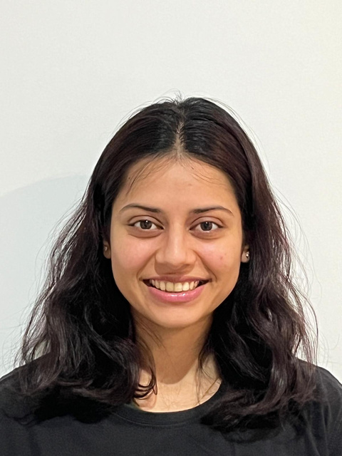

Social Media Analytics Dashboard For ZARA; Enhancing Engagement And Brand Loyalty With Power BI
Nadeera Ratnayake
IT Manager
21967657
Anushika Geekiyanage
Business Analyst
21831739
Arshita Sharma
Finance Manager
22048467
Farhana Morshada
Project Manager
21758178

Slide 2


About ZARA

Slide 3
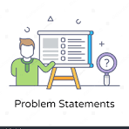
Problem Statement

Slide 4
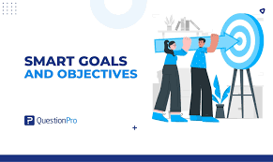
Project Objective

Slide 5
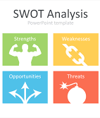
SWOT Analysis

Slide 6
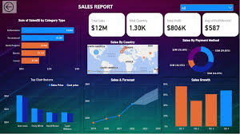
Proposed Solution

Slide 7
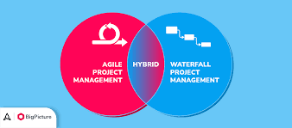
Project Approach

Slide 8

Project Assumptions

Slide 9

Project Limitations

Slide 10
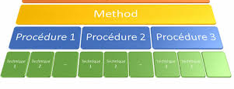
Methods and Procedures

Slide 11
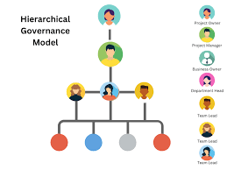
Governance Structure

Slide 12

Stakeholder Management

Slide 13
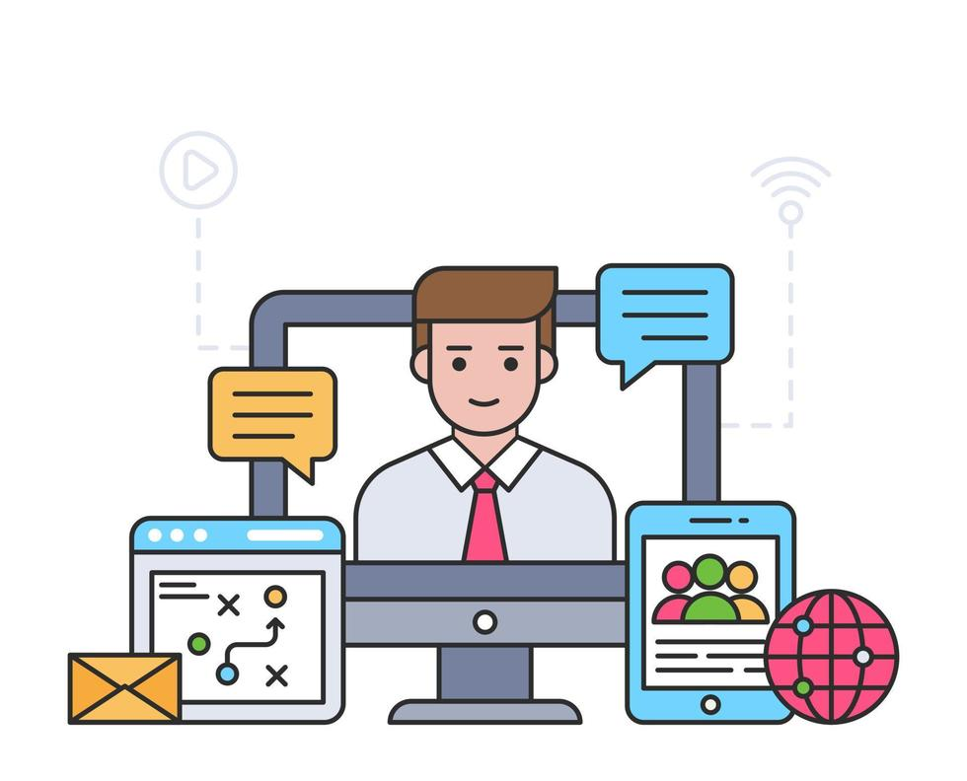
Communication Plan

Slide 14
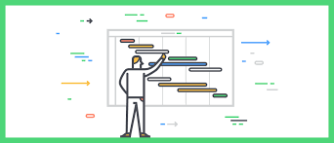
Project Schedule & Dependencies Management

Slide 15

Financial Management

Slide 16
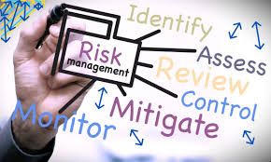
Risk Management

Slide 17
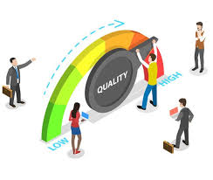
Quality Management

Slide 18

Lessons Learned

Slide 19
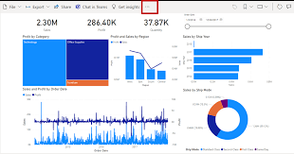
Project Output

Slide 20

Thank you

Slide 21
Social Media Analytics Dashboard For ZARA; Enhancing Engagement And Brand Loyalty With Power BI (Detailed Slide Deck)
Nadeera Ratnayake
IT Manager
21967657
Anushika Geekiyanage
Business Analyst
21831739
Arshita Sharma
Finance Manager
22048467
Farhana Morshada
Project Manager
21758178

Slide 22

About ZARA
One of the largest international fashion companies.
Social media plays a crucial role in customer engagement and brand loyalty efforts.
LARANA COMPANY

Slide 23
Problem Statement
Difficulty in managing and leveraging social media data across various platforms.
Necessity of a centralized solution that allows for real-time analysis of social media performance, influencer impact, and customer engagement.
LARANA COMPANY

Slide 24
Project Goals
Increase Customer Engagement by 20% in 3 Months.
Increase Influencer Collaboration Engagement by 50% in 3 Months.
Reduce Social Media Reporting Time by 50% within 1 Month.
LARANA COMPANY

Slide 25
SWOT Analysis
Strengths: Comprehensive insights, real-time updates, and data-driven decision-making capabilities.
Weaknesses: The complexity of integrating multiple platforms and ensuring data quality.
Opportunities: Expanding the dashboard’s use across different departments.
Threats: Data privacy concerns, Rapidly changing social media landscape.
LARANA COMPANY

Slide 26
Proposed Solution
A centralized, customizable Power BI dashboard to integrate social media data and provide real-time insights into key metrics .
Added features like automated reporting, influencer performance tracking, and trend identification.
LARANA COMPANY

Slide 27
Project Approach
Agile-Waterfall Hybrid model.
Planning and design phases- Waterfall Approach
Development and testing- Agile Sprints
LARANA COMPANY

Slide 28
Project Assumptions
Resource and Data Availability: It is assumed that all necessary hardware, Power BI software, and data from social media platforms (Facebook, Instagram, TikTok) will be consistently available without significant disruptions. The dashboard will refresh automatically every morning.
Stakeholder and Financial Support: Project stakeholders, including ZARA's marketing, social media, and IT teams, are expected to provide full cooperation. The project will aim to stay within the set budget, with a change management process in place if needed.
Risk and Mitigation: Assumptions are based on identified risks, such as data security breaches, with strategies in place to mitigate these risks as outlined in the risk management plan.
LARANA COMPANY

Slide 29
Project Limitations
Data and Integration Challenges: The accuracy and quality of data from various sources are critical. Integrating data from multiple platforms and systems may present technical challenges, impacting the overall effectiveness of the dashboard.
User Adoption and Technical Limitations: Teams will need training to effectively use the dashboard. Additionally, while Power BI is powerful, handling real-time data and custom visualizations can be complex and potentially costly.
Security and Time Constraints: Ensuring data privacy and security is crucial for maintaining customer trust. Additionally, the project’s tight deadlines for increasing engagement and reducing reporting time place pressure on timely deployment and training.
LARANA COMPANY

Slide 30
Methods & Procedures
Stakeholder Engagement and Development: Regular requirement-gathering sessions and technical briefings with stakeholders ensure the project aligns with both business and technical objectives. Agile sprints are used for iterative feature development, allowing quick incorporation of feedback.
Testing and Post-Implementation Support: Comprehensive testing (usability, performance, user acceptance) ensures the dashboard works effectively. Post-launch, continuous improvements and updates will be made based on user feedback and testing results.
Documentation and Training: Comprehensive user training materials (manuals, guides, videos) and post-implementation documentation ensure smooth user adoption and easy future system maintenance and upgrades.
LARANA COMPANY

Slide 31
Governance & Structure
Clear Roles and Responsibilities: Key team members like the Project Manager, IT Manager, Finance Manager, and others have specific responsibilities. This ensures that project objectives, data integration, design, and budget are managed effectively and aligned with ZARA's goals.
Strong Stakeholder Engagement: Regular feedback loops are established between the project team, governance entities (Project Sponsor), and end users (Marketing Team). This ensures the project remains aligned with both strategic goals and user needs.
Structured Oversight: The governance structure, including a RACI matrix and Work Breakdown Structure (WBS), ensures tasks are properly assigned and tracked, guaranteeing timely delivery of the dashboard while maintaining quality and functionality.
LARANA COMPANY

Slide 32
Stakeholder Management
Effective Stakeholder Engagement and Communication: Stakeholders are identified and prioritized based on their influence and interest. A clear communication plan ensures regular updates, feedback, and involvement in decision-making, addressing concerns promptly.
Ongoing Monitoring and Feedback: Stakeholder involvement is continuously tracked through regular check-ins, feedback sessions, and surveys. The success of stakeholder management is evaluated at the project's conclusion to ensure alignment with expectations and project outcomes.
LARANA COMPANY

Slide 33
Communication Plan
Regular meetings, email updates, and progress reports tailored according to stakeholder’s needs.
Feedback from stakeholders was continuously incorporated into the project.
LARANA COMPANY

Slide 34
Project Schedule & Dependencies Management
A Gantt chart, with key tasks and milestones for clear schedule.
Data integration before testing visualizations, were managed to ensure smooth project execution.
LARANA COMPANY

Slide 35
Financial Management
Total project budget is AUD 27,080- Covering labor, licenses, cloud hosting, and API integration costs.
A contingency fund of AUD 1,010- For unforeseen expenses.
Financial tracking tool (Smartsheet) was used to ensure adherence to the budget.
LARANA COMPANY

Slide 36
Risk Management
Key risks- API integration failures, data privacy concerns, and potential delays in cloud hosting setup.
Each risk has been assessed for likelihood and impact, with mitigation strategies in place.
Regular risk reviews were conducted to ensure timely responses.
LARANA COMPANY

Slide 37
Quality Management
Functionality and Performance: The dashboard will integrate data from various social media platforms and offer a user-friendly interface. Performance testing will ensure it handles large datasets efficiently, with fast loading times and responsiveness.
Accuracy and Security: Data validation and real-time synchronization will ensure accurate insights. Role-Based Access Control (RBAC) will secure sensitive data, limiting access to authorized users only.
Flexibility and Compatibility: The dashboard will be compatible across devices and browsers, and designed with flexibility to easily accommodate new features, data sources, and visualizations without redevelopment.
LARANA COMPANY

Slide 38
Lessons Learnt
Importance of stakeholder engagement, effective communication, and iterative development.
Risk management in addressing challenges like data privacy and integration issues.
Lastly, the value of continuous improvement and user feedback in delivering a successful product.
LARANA COMPANY

Slide 39
Project Output
A robust, user-friendly dashboard that integrates real-time social media data and provides actionable insights.
Assists ZARA’s marketing team to improve customer engagement, optimize influencer collaborations, and reduce manual reporting efforts by 50%.
LARANA COMPANY

