Slide 1
Mapreduce Program and Full Inverted Index
By Arsiema Yohannes

Slide 2
Acknowledgment
I would like to express my gratitude to Dr. Chang, Henry for his guidance and support throughout the development of this project.

Slide 3
Table of Content
Introduction
Design
Implementation
Test
Enhancement Ideas
Conclusion
Reference

Slide 4
Introduction
Objective: Implement a Full Inverted Index using MapReduce.
Motivation: Modern applications require efficient text indexing for information retrieval. MapReduce offers a scalable solution for large datasets.

Slide 5
Design
MapReduce Framework:
Utilizes MapReduce's distributed processing capabilities for efficient indexing.
Key-Value Pairs:
Mapper emits: (word, (doc_ID, position)) for each word in a document.
Reducer emits: (word, [(doc_ID, position)]) - final inverted index entry.

Slide 6
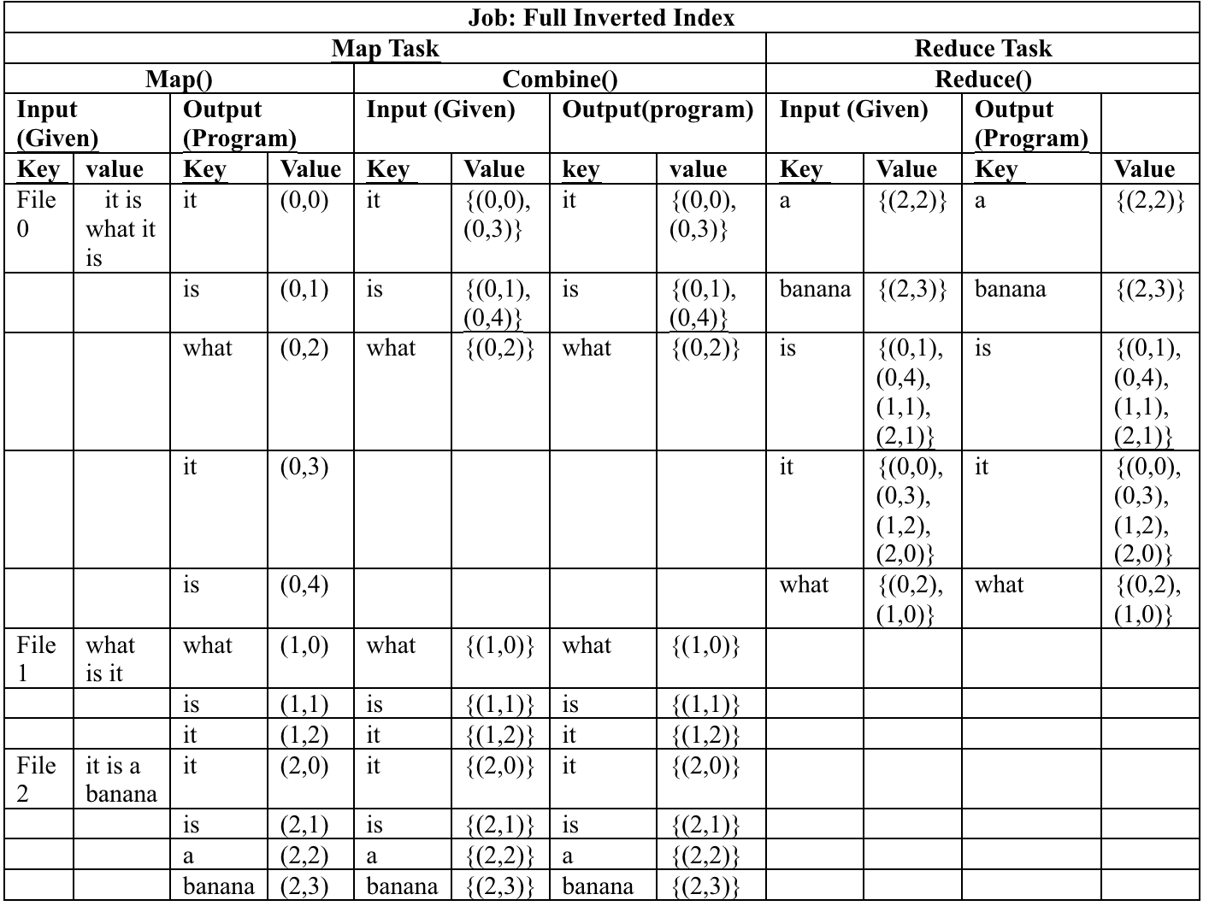
Design

Slide 7
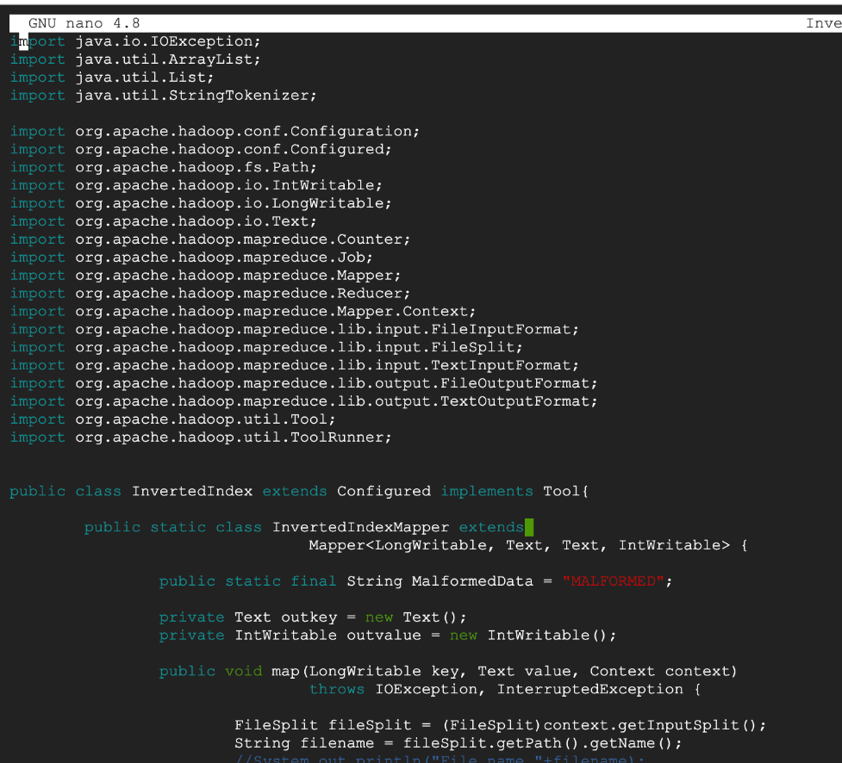
Implementation
Step 1. Create file InvertedIndex.java file in Hadoop-3.4.0 directory.

Slide 8
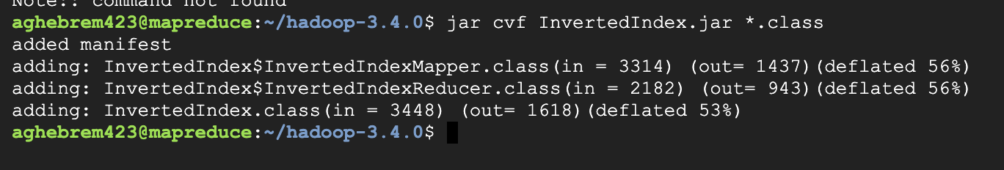
Implementation
Step 2. Java program (InvertedIndex.java) is being compiled with Hadoop libraries.
The command jar cf InvertedIndex.jar *.class packages all compiled Java class files in the current directory into a JAR file named InvertedIndex.jar.

Slide 9
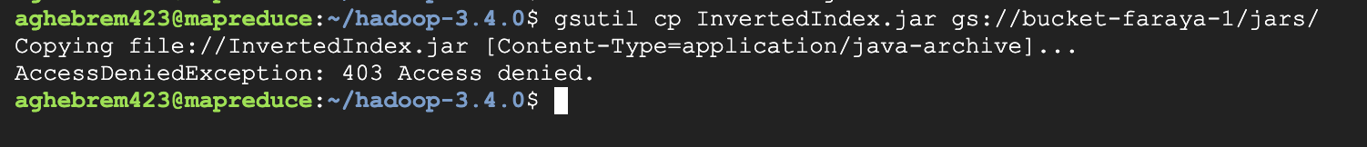
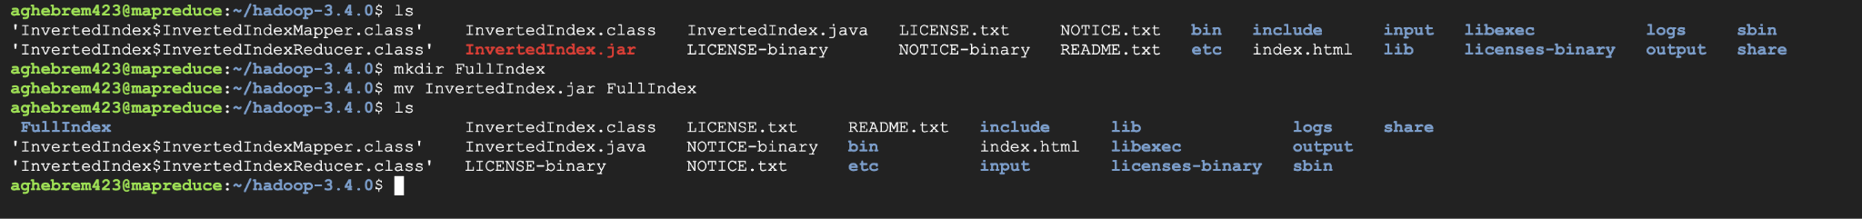
Implementation
Step 3. Create another folder called FullIndex in the current directory and move the IndexIndex.jar to that folder.

Slide 10
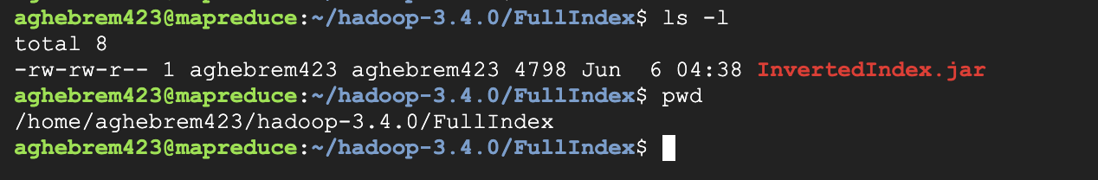
Implementation
Step 4. Go to the bin directory

Slide 11
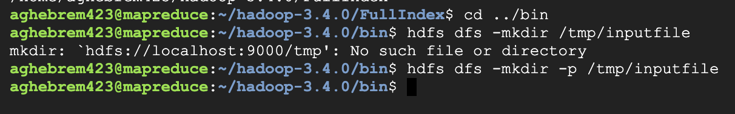
Implementation
Step 5. The command hdfs dfs -mkdir /tmp/inputfile creates a new directory named inputfile within the /tmp directory on the Hadoop Distributed File System (HDFS).

Slide 12
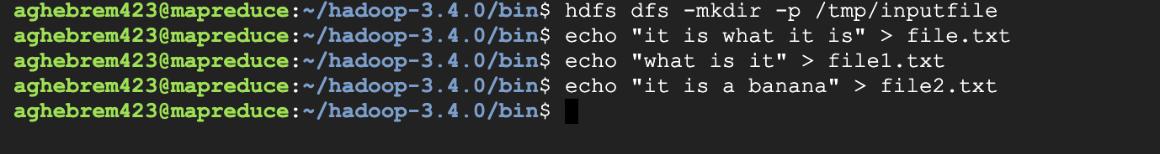
Implementation
Step 6. Create the three files.

Slide 13
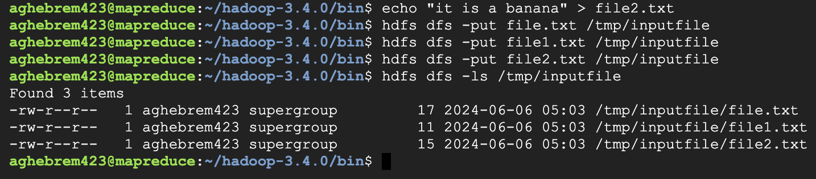
Implementation
Step 7. Uploads the local files to the /tmp/inputfile/ directory on the Hadoop Distributed File System (HDFS).

Slide 14
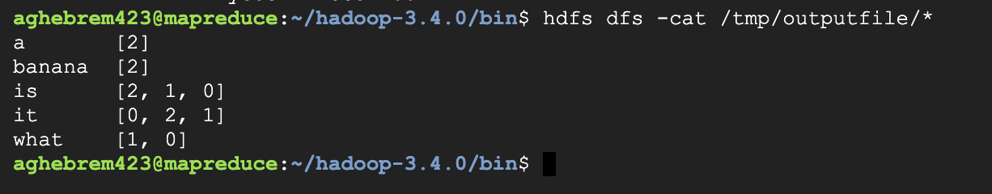
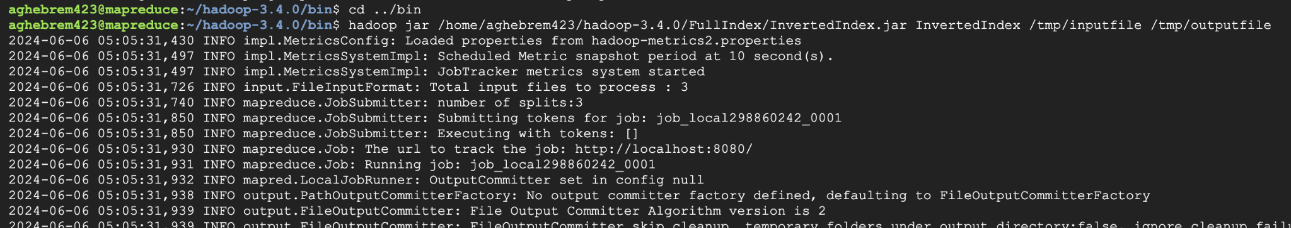
Implementation
Step 8. The command runs a Hadoop job using the InvertedIndex.jar to process data from /tmp/inputfile and output results to /tmp/outputfile.

Slide 15
Test
Finally, here we can see the result of the Partial Inverted Index

Slide 16
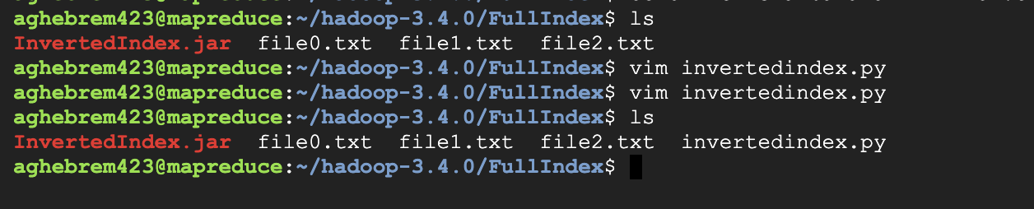
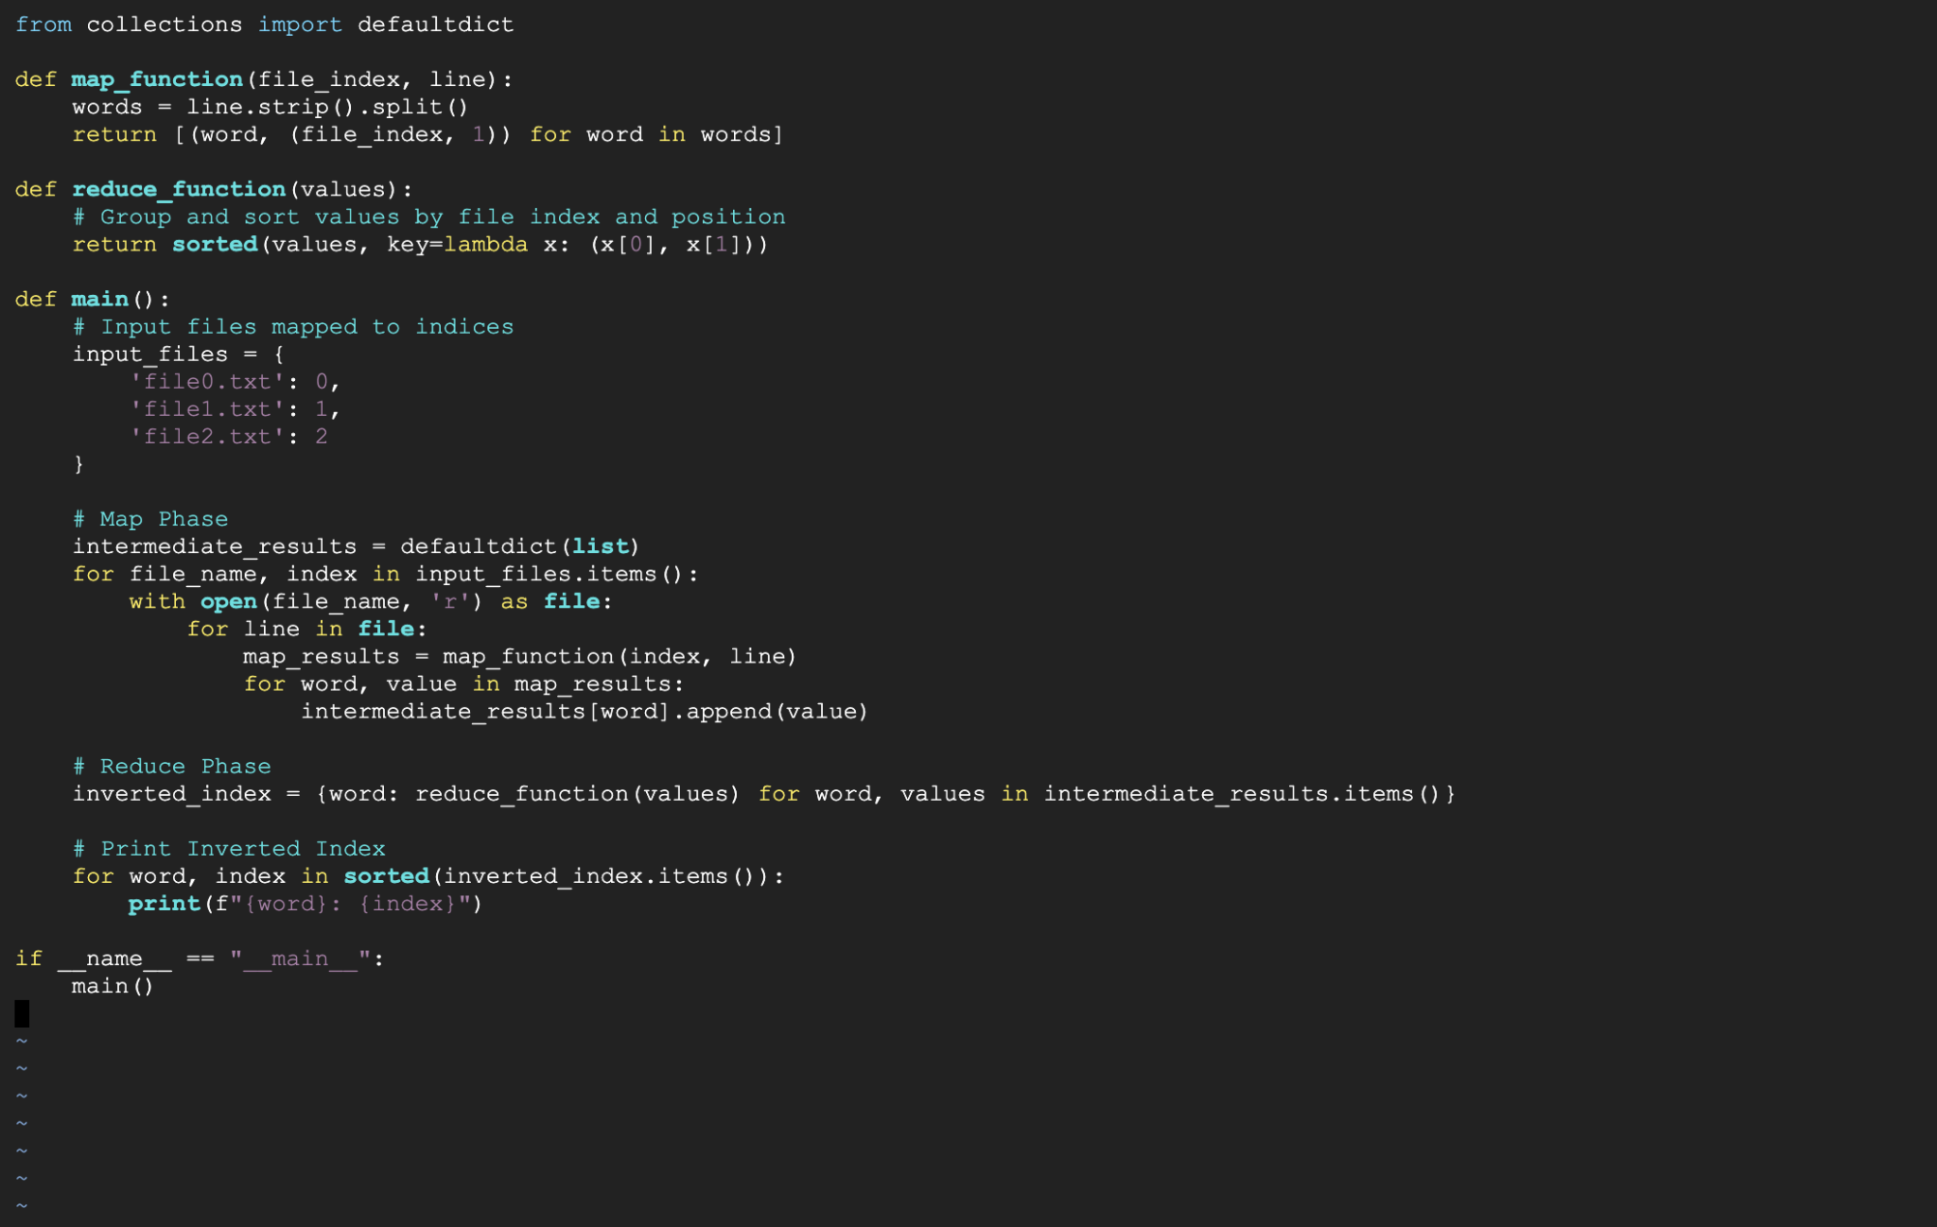
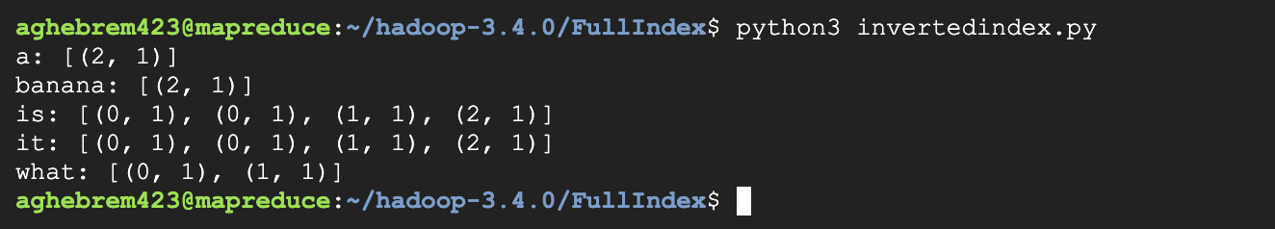
Test
And know we can see the full Inverted Index using python.

Slide 17
Enhancement Ideas
Port the Python code to Java: This emphasizes the process of adapting the existing logic to Java's syntax and libraries.
Reimplement the functionality in Java: This highlights the focus on recreating the same functionality using Java's capabilities.
Explore Java's alternatives for efficient text processing: This suggests potentially improving the code by utilizing Java's text processing libraries.

Slide 18
Conclusion
I have successfully built a Full Inverted Index using MapReduce, enabling efficient text indexing for large datasets. The program leverages parallel processing to overcome limitations of traditional methods. This scalable solution maps words to documents and their positions, facilitating faster information retrieval.

Slide 19
Reference
https://hadoop.apache.org/
https://hadoop.apache.org/docs/stable/hadoop-mapreduce-client/hadoop-mapreduce-client-core/MapReduceTutorial.html
https://cs.boisestate.edu/~amit/teaching/530/handouts/mapreduce-short-handout.pdf
https://hc.labnet.sfbu.edu/~henry/npu/classes/mapreduce/inverted_index/hw/q6/2022_fall/CS570_WEEK4_HW1_19599_Manickam_Ravisekar.pdf

Slide 20
Thank you

